Slide 1
Promoting Clean Environment with Smart Waste Identification
ICS 504 Term Project:
Ammar Alsafwani
Abdullah Alshammasi
Jafar Abu Qurayn

Slide 2
Outline
Introduction
Dataset
TACO: Trash Annotation in Context for Litter Detection Paper
  Objective
  Approach and Methodology
  Modeling
Challenges and Area of Improvements
Introduced Enhancements
Results
Conclusion

Slide 3
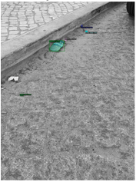
Introduction
The accumlation of trash in public areas is a concern
Trash affects the environment negatively
To keep environment clean, there is a need for monitoring systems
  Automated
  Accurate
Computer vision models
Notes:
Accumlation of trash in the public areas is a concern. It affects the environment including humans, marines, and wild life. To keep the environement clean, there is a need for monitoring systems that are automated and accurate. Accurate to the point of detecting even small objects similar to the trash in this picture

Slide 4
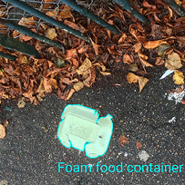
Deep Learning
Deep learning can help in detecting trash in the wild:
  Different backgrounds
  Various Context (beach, parks, etc)
  Deformed, fragmented, aged, occluded
With presence of solid model, monitoring will be enhanced
Notes:
From there, the authors of the TACO: Trash Annotation in Context Litter Detection had the idea that deep learning can help. Deep learning can be trained to detect trash in the wild, with different backgrounds, various context, objects that are deformed, fragmented, aged, or occluded. With the presence of solid model, monitoring trash will be enhanced

Slide 5
Original Model

Slide 6
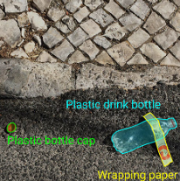
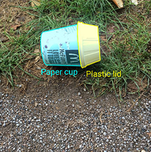
Dataset
TACO: Trash Annotation in Context for Litter Detection Paper
Real world images of litter taken in different countries and environments and annotated with detailed masks
High resolution 1500 images (4784 annotations)
60 classes (highly imbalanced)
Notes:
Accumlation of trash in the public areas is a concern. It affects the environment including humans, marines, and wild life. To keep the environement clean, there is a need for monitoring systems that are automated and accurate. Accurate to the point of detecting even small objects similar to the trash in this picture

Slide 7
TACO: Trash Annotation in Context for Litter Detection Paper
Two main Objectives
  TACO-1: Classify object as Trash or Not Trash
  TACO-10: Predict the category of the trash among 10 super categories

Slide 8

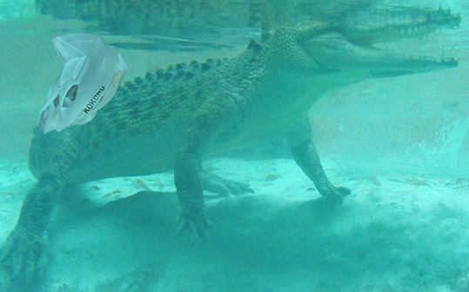
TACO: Trash Annotation in Context for Litter Detection Paper
Model: Trained with 4-fold cross validation, 1024 x 1024 input layer size
  Mask R-CNN
  Keras/TensorFlow Version
  ResNet-50 FPN Backbone
  COCO pretrained weights
Data Augmentation
  changed image exposure and contrast
  rotated images between [-45, 45]
  transplant

Slide 9
Results
TACO-1
AP: ~26%
TACO-10
AP: ~19%

Slide 10
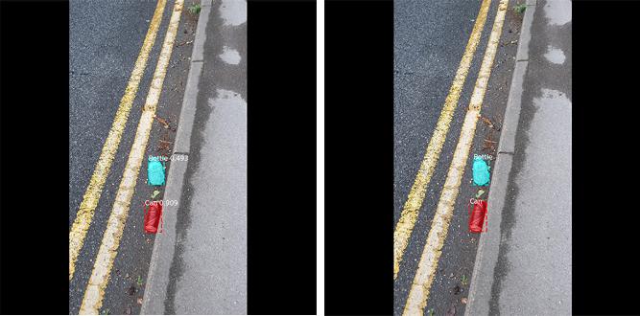
Predictions on TACO-10

Slide 11
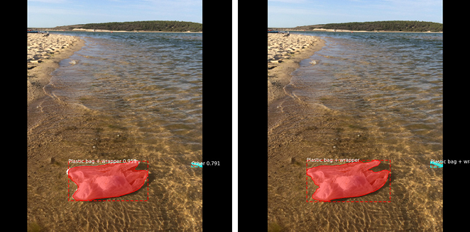
Predictions on TACO-10

Slide 12
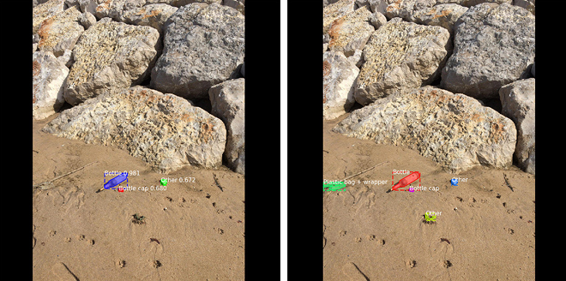
Predictions on TACO-10

Slide 13
Challenges and Area of Improvements
Limited dataset (1500 images)
Large number of classes (60 classes)
  Some classes had very limited instances
Imbalance dataset
Inaccuracy in detecting small objects such as cigaretes

Slide 14
Introduced Enhancements

Slide 15
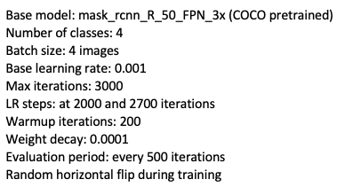
Introduced Enhancements
Reduced 60 categories to 18 by removing categories with limited instances
Grouped the 18 categories into 4 main categories
  Bottle, can, plastic bag and other
Stratified split (train/validation/test) 60/20/20
Used Detectron2 by PyTorch
  Paper had old version of TensorFlow

Slide 16
Results
TACO-4
AP: 35%
TACO-10
AP: 19%

Slide 17
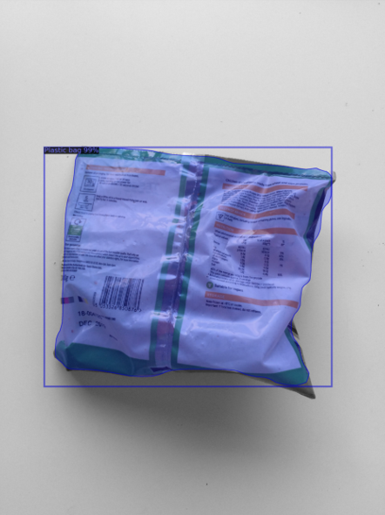
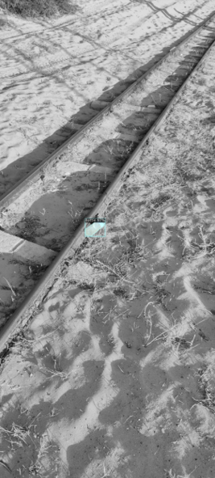
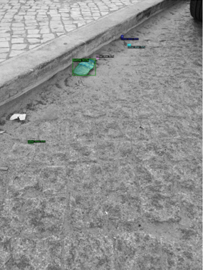
Predictions (On TACO Dataset)

Slide 18
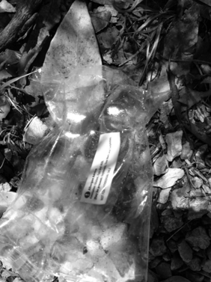
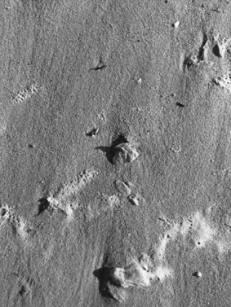
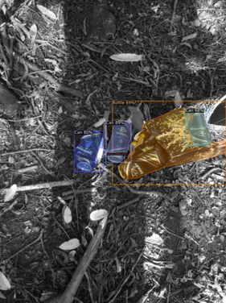
Predictions (On TACO Dataset)

Slide 19
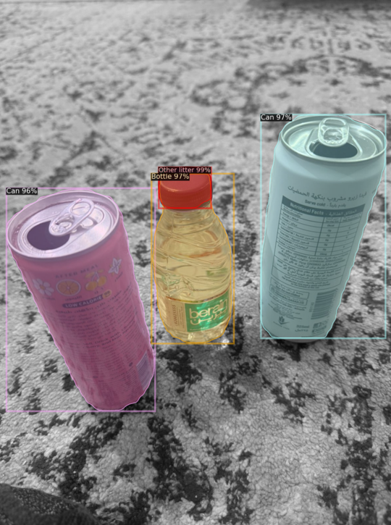
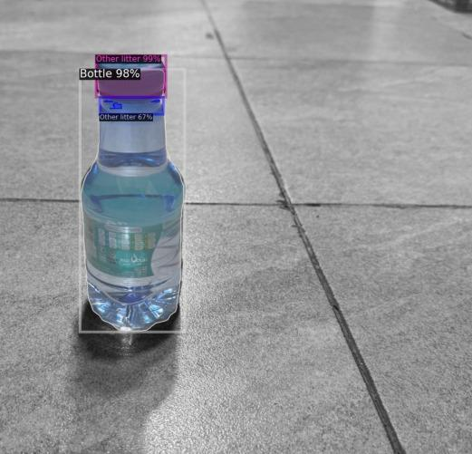
Predictions (Taken by us)

Slide 20
Conclusion
Detecting trash in the outdoor environements is challenging
  Huge variation of trash in the wild
Bigger dataset is needed for accurate classification
A higher accuracy was seen in categories with good number of instances
TACO dataset needs to be expanded

Slide 21

questions

