Slide 1
Geometry-Aware Patch Attacks: ShapeAware and PatchCross
Presented by : Ahmed Abdelkader Ahmed
Under the supervision of : Dr. Muzammil Behzad

Slide 2
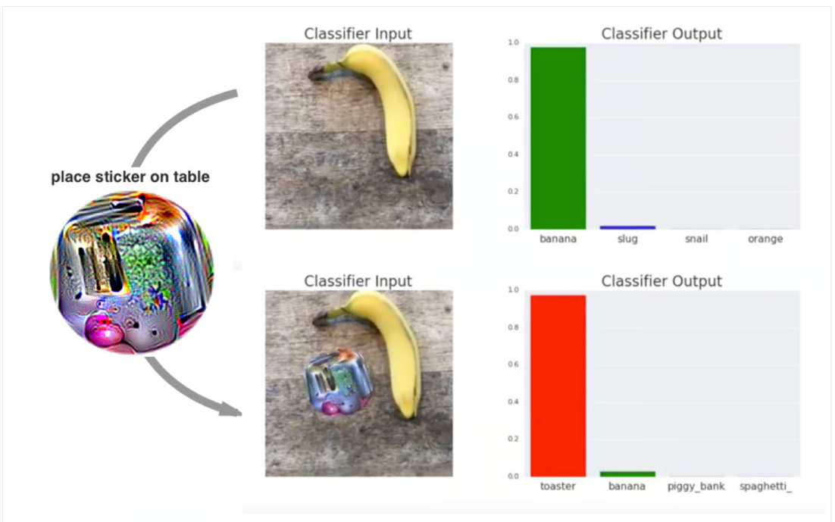
Patch-based attacks
Figure 1: An adversarial patch-based attack in action. (Source: T. B. Brown et al.)

Slide 3
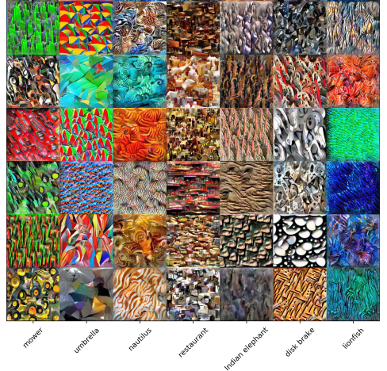
PatchAttack: Texture-based Patch Attack (TPA)(Chenglin-Yang)
Synthesize texture images from ImageNet ILSVRC 2012.
There are 30 texture for each of the 1000 ImageNet classes.
Figure 2: Examples in our designed texture dictionary. (Chenglin-Yang (Cropped))

Slide 4
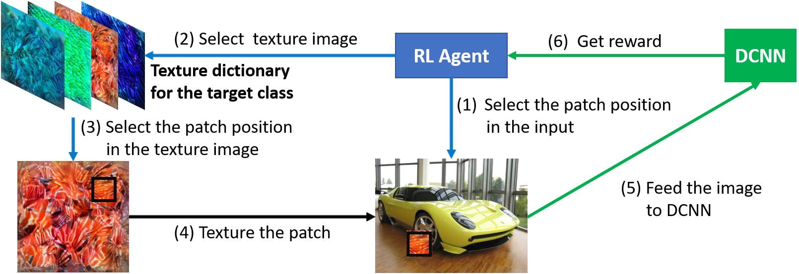
PatchAttack TPA loop
Figure 3: black-box texture-based patch attack via reinforcement learning. (Source: Chenglin-Yang)

Slide 5
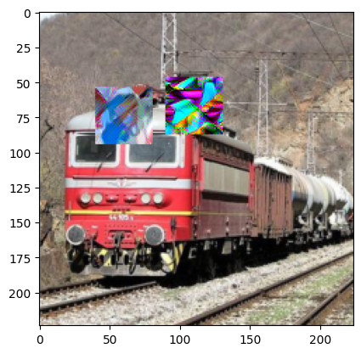
TPA Limitations:
Fixed geometry.
Weak reward function.
Limited camouflage ability.
Figure 4. Adversarial generated image by PatchAttack classified as Pinwheel by ResNet-50.

Slide 6
Methodology Overview :
Built on PatchAttack (TPA): RL-based, texture dictionary, early stopping.
ShapeAware: adds shape head and area-aware reward.
PatchCross: specializes to 1-pixel X mask, same reward as PatchAttack. (The X shape inspired from CSPA)
Unified RL framework under identical budgets.

Slide 7
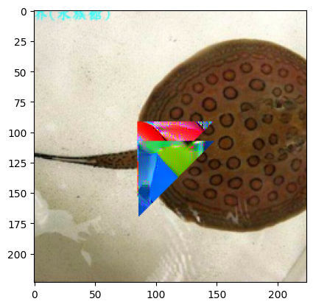
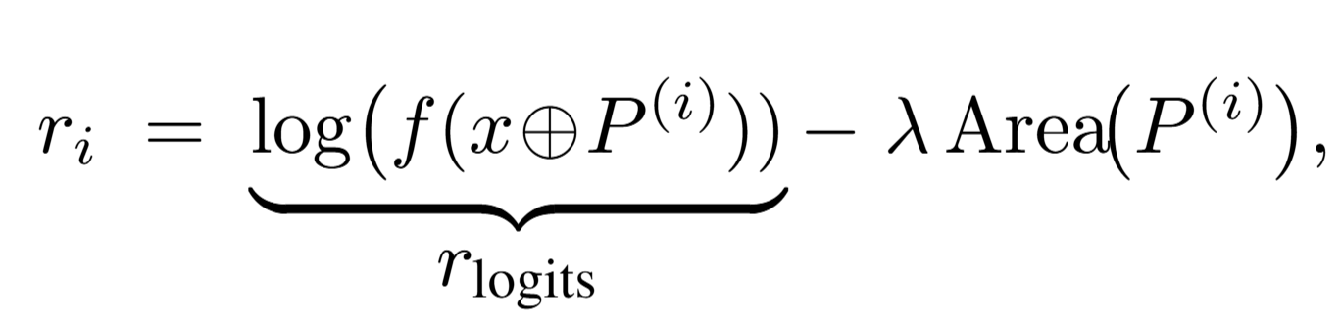
ShapeAware:
Shape head (circle, triangle, square) expands the action space.
Area-aware reward: encourages compact and overlapping patches,
Area penalty is calculated based on multi-agent cumulative union mask.
Figure 5. Adversarial generated image by ShapeAware classified as Pinwheel by ResNet-50.

Slide 8
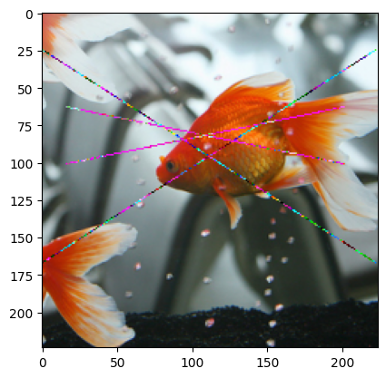
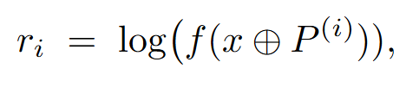
PatchCross:
Geometry specialized to an X-shaped mask (two diagonals).
Reward:
Thin strokes for strong camouflage; Extremely small area yet high ASR and query efficiency.
Figure 6. Adversarial generated image by PatchCross classified as Pinwheel by ResNet-50.

Slide 9
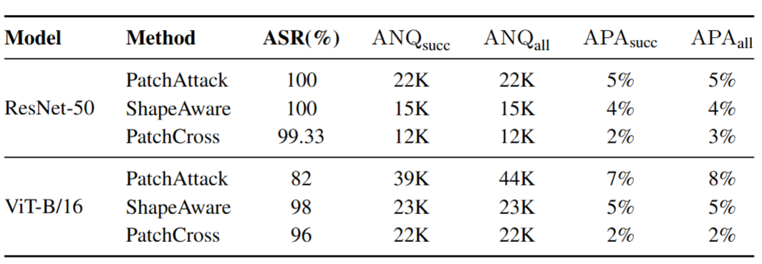
Experimental Results:
As shown in table 1; ResNet-50: ASR = 100%; ShapeAware ↓ANQ ↓APA; PatchCross ≈ ½ queries, minimal area.
ViT-B/16: PatchAttack degraded (82% ASR); ShapeAware 98%; PatchCross 96% with 2% APA.
TABLE I — COMPARATIVE RESULTS. BUDGETS: N=6 WITH AREA_OCCLU=2% FOR PATCHATTACK AND SHAPEAWARE; N=10 FOR PATCHCROSS; QUERY LIMITS: Q=12,250 PER AGENT.

Slide 10
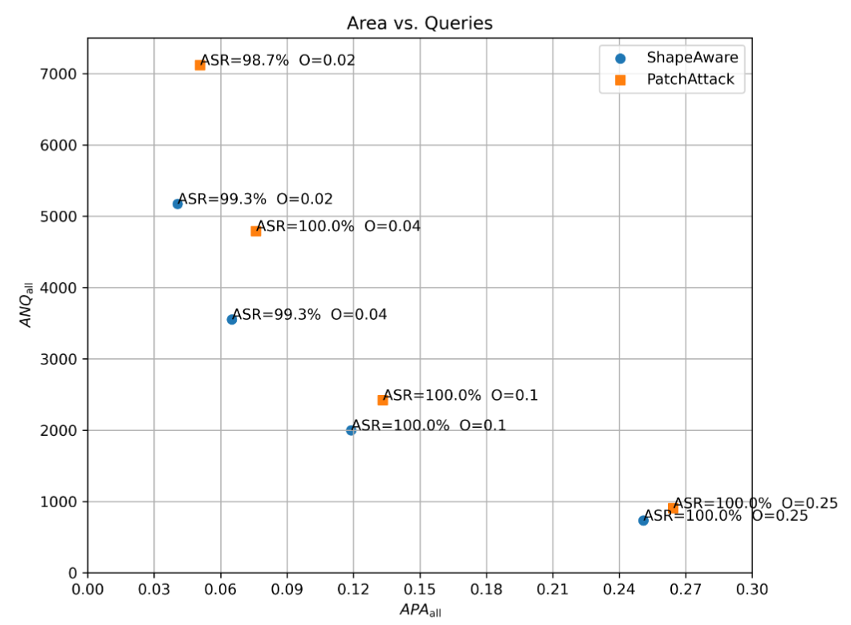
This Figure Says It All
Figure 7 shows the trade-off between area and queries, with area_occlu: O ∈ {0.02, 0.04, 0.10, 0.25}.
Larger O lowers query counts; ASR saturates at 100% for O ≥ 0.04.
ShapeAware points always below (fewer queries) and left (smaller area).
Figure 7 Area–queries trade-off on ResNet-50 under varying area_occlu O

Slide 11
Key Takeaways:
Geometry matters: shape decisions lower ANQ under same occlusion.
ShapeAware → compact, efficient.
The area penalty in ShapeAware achieves faster convergence even when only a single patch is added; that is, it acts as a regularizer that improves the exploration–exploitation balance.
PatchCross → minimal area, high camouflage.

Slide 12
Future Work:
Extend geometry to curved/spline primitives.
Test in physical-world and decision-based settings.
Evaluate attacks against adversarial defenses.

Slide 13

Any Questions?

