Slide 1
Enhancing Robustness to Prompt Variations in
Vision Language Models: A Comprehensive
Evaluation of CLIP, SigLIP, and CoOp under Noisy
Prompts with Ensembling Strategies
Presented by:
Aishah Altamimi

Slide 2
Outlines
Introduction
Literature Review
Problem Statement
Baseline Models & Challenges
Proposed Enhancements
Algorithm
Loss Functions
Datasets & Preprocessing
Performance Metrix
Experiment Setup
Results

Slide 3
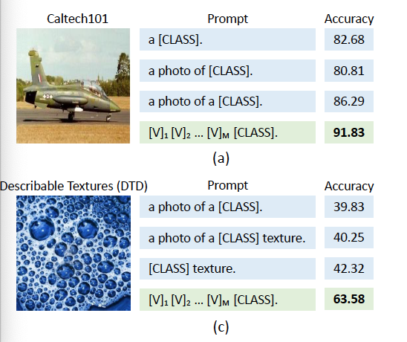
Introduction
VLMs are models learn to match images with text prompts rather than class names into a shared space, then compare their similarity.
Because they depend on text templates like ‘a photo of a {class}’, the wording of the prompt strongly affects predictions.
This motivates the need to study how prompt variations influence accuracy.

Slide 4
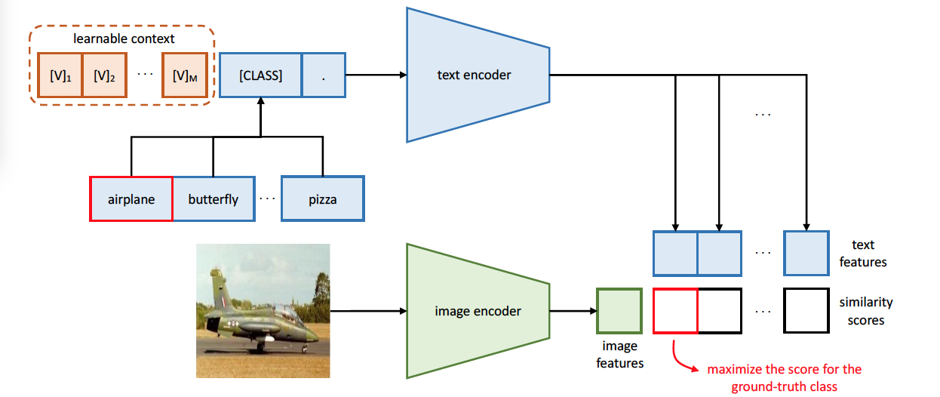
Baseline Models (Literature Review)
CLIP
uses manually written prompts
Softmax-based contrastive loss.
SigLIP
Replaces the softmax with a sigmoid pairwise loss.
CoOp
CoOp built on CLIP by learning continuous prompt vectors rather than relying on human-written prompts.
This make it stronger to wording changes.

Slide 5
Literature Review
[4Test-Time Ensembling (TTE)
The approach works by creating multiple versions of the same input → running the model on each version --> combining the predictions during test time.

Slide 6
Problem Statement
In real applications like image search or educational tools, users write prompts with typos, informal phrasing, or emojis.
Models must handle these variations, but current VLMs often fail under such noise.
Goal is to Systematically evaluate the robustness of CLIP, SigLIP, and CoOp under different types of noisy prompts
Explore techniques such as prompt Test time ensembling and noise-aware adapter training to improve their reliability in real-world user scenarios.

Slide 7
Datasets
Dataset | Domain | Classes | Images | Resolution | Description
Oxford-IIIT Pets | Animals | 37 | 7,349 | 300×300+ | Cat & dog breeds
Caltech-101 | Objects | 101 | 9,144 | 300×200+ | Object categories
Food-101 | Food | 101 | 101,000 | 512×512 | Food recognition
DTD | Textures | 47 | 5,640 | 300×300 | Texture attributes
EuroSAT | Satellite | 10 | 27,000 | 64×64 | Land-cover classification
Oxford Pets, Caltech-101, and Food-101 match typical web images, while DTD and
EuroSAT represent domain-shifted data that differ significantly from natural web images
(Key Findings in this research ).

Slide 8
Loss Functions
CLIP — Softmax Contrastive Loss
Uses a global softmax over all image–text pairs in the batch.
Encourages each image to match its correct text more than all other texts.
SigLIP — Sigmoid Pairwise Contrastive Loss
Replaces softmax with independent sigmoid pairwise comparisons.
Each image–text pair is evaluated separately.

Slide 9

Loss Functions
Noise-Aware Adapter Training
we use cross-entropy plus a consistency loss to force clean and noisy prompts to produce similar predictions.
Adapter is trained using clean + noisy prompts with K=5 ensembling.
Optimization objective:
As we show CLIP an image + a clean prompt and an image + a noisy prompt
Cross-entropy makes each one predict the correct class.
Consistency loss adds an extra rule: “The prediction for the clean prompt and the prediction for the noisy prompt must be similar.”

Slide 10
Experimental Framework
Phase 1: Baseline Benchmarking (Clean Prompts)
Phase 2: Noise Robustness Evaluation.
Phase 3: Noise-Aware Fine-Tuning

Slide 11
Phase 1: Baseline Benchmarking (Clean Prompts)
Evaluate CLIP, SigLIP, and CoOp using clean prompts.
Five datasets: Oxford Pets, Caltech101, Food101, DTD, EuroSAT.
Train/Val/Test split: 50% / 20% / 30%.
Metrics: Accuracy, Error Rate, Macro-F1.
Purpose: Establish a clean-performance baseline before adding noise

Slide 12
Phase 1: Baseline Benchmarking (Clean Prompts)
CoOp performs best on most datasets
SigLIP Better than CLIP in domain shift datasets (their data that differ significantly from natural web images) However the CLIP is better than SigLIP on other datasets. (First Key Finding in this research)
These baselines allow us to measure how much accuracy drops once noise is added.
Dataset | CLIP | CoOp | Gain over CLIP | SigLIP
Oxford Pets | 86.2% | 91.1% | +4.9% | 78.64%
Caltech101 | 92.0% | 93.4% | +1.4% | 74.05%
Food101 | 78.2% | 80.0% | +1.8% | —
DTD | 38.0% | 58.5% | +20.5% | 49.93%
EuroSAT | 22.0% | 50.2% | +28.2% | 40.99%

Slide 13
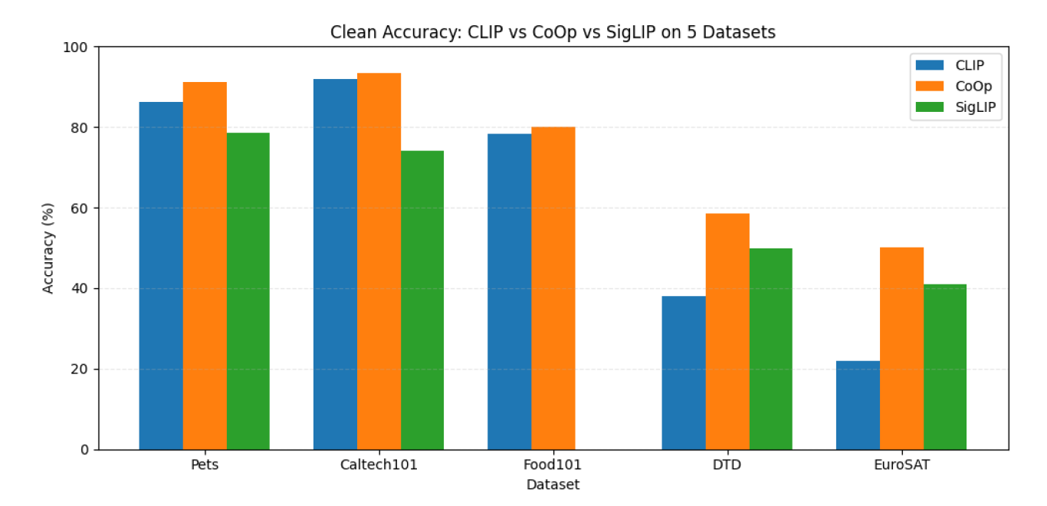
Phase 1: Baseline Benchmarking (Clean Prompts)

Slide 14
Phase 2: Noise Robustness Evaluation:
Purpuse: Measure how accuracy drops across noise levels and whether ensembling helps recover performance.
Evaluate CLIP, SigLIP, and CoOp under corrupted prompts.
Build a Noise Prompt Bank using four noise types:
  Typos , Letter-case changes, Extra spaces, Emoji insertions
Noise severity levels: 0 (clean) → 3 (heavy corruption)
Three test-time strategies:
  K = 1: single noisy prompt
  K = 5 + Clean: 5 noisy prompts + 1 clean prompt
  K = 5 No-Clean: 5 noisy prompts only

Slide 15
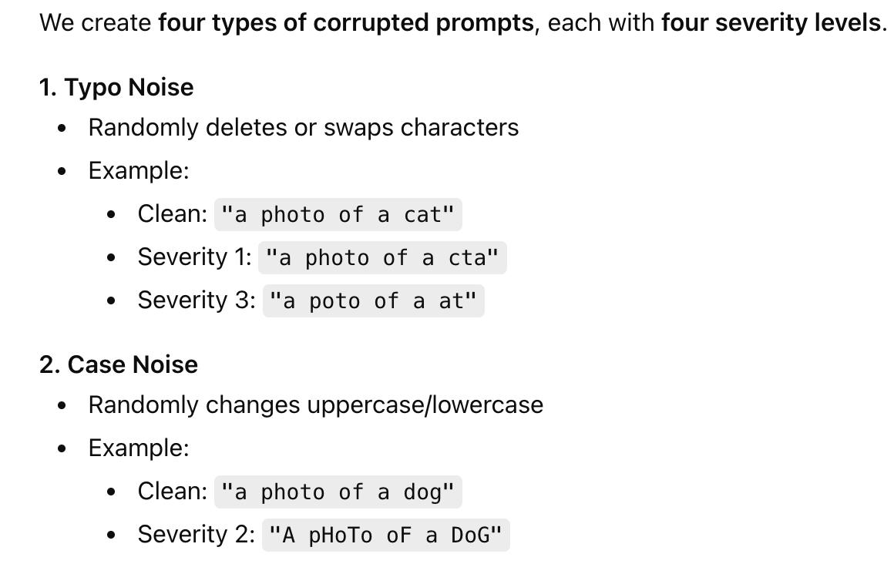
Noise Bank Creation

Slide 16
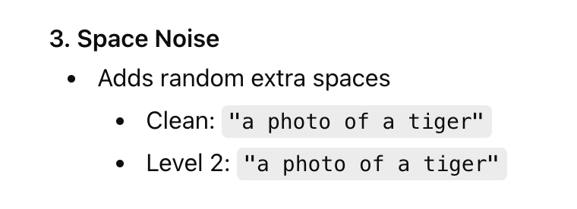
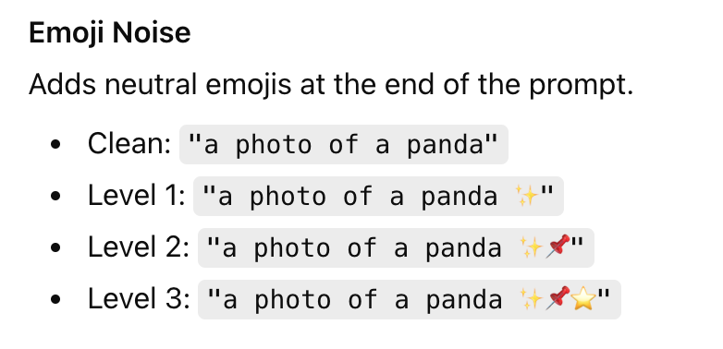
Noise Bank Creation

Slide 17
Noise Bank Creation
Prompt template: Each class is inserted into a fixed template, e.g.
“a photo of a {class}” → “a photo of a siamese cat”.
Noise injection: We then corrupt the class name using one or more noise operators (typo, case, space, emoji).

Slide 18
Noise Bank Creation
Severity levels (0–3):
  0: clean prompt → a photo of a siamese cat
  1: Apply one noise operator → “a photo of a siamse cat” (one typo)
  2: Two different noise operators → “A photo of a siamse cat✨”
  (typo + emoji)
  3: Apply three or more noise operators (strong distortions to the text) →“A poto of a siamse cat✨📌”

Slide 19
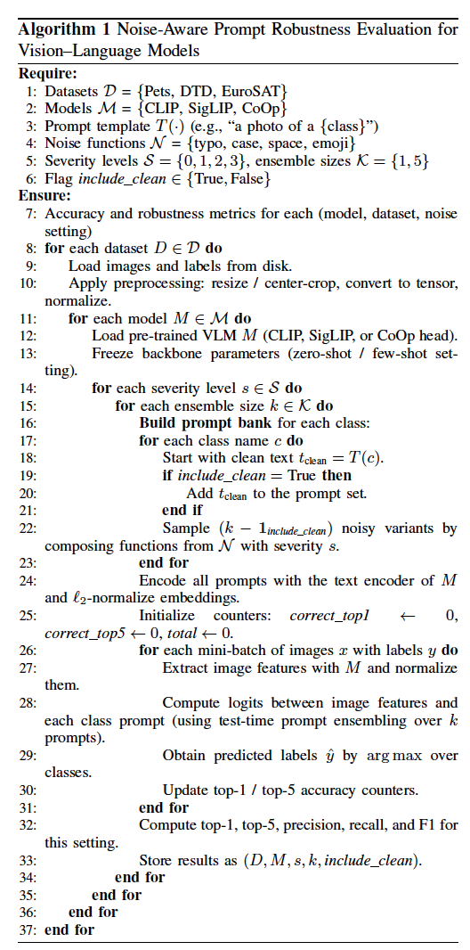
Phase 2: Algorithm:
We evaluate each model across all noise types, all severity levels, all ensemble strategies, and all datasets. This gives a complete robustness profile.

Slide 20
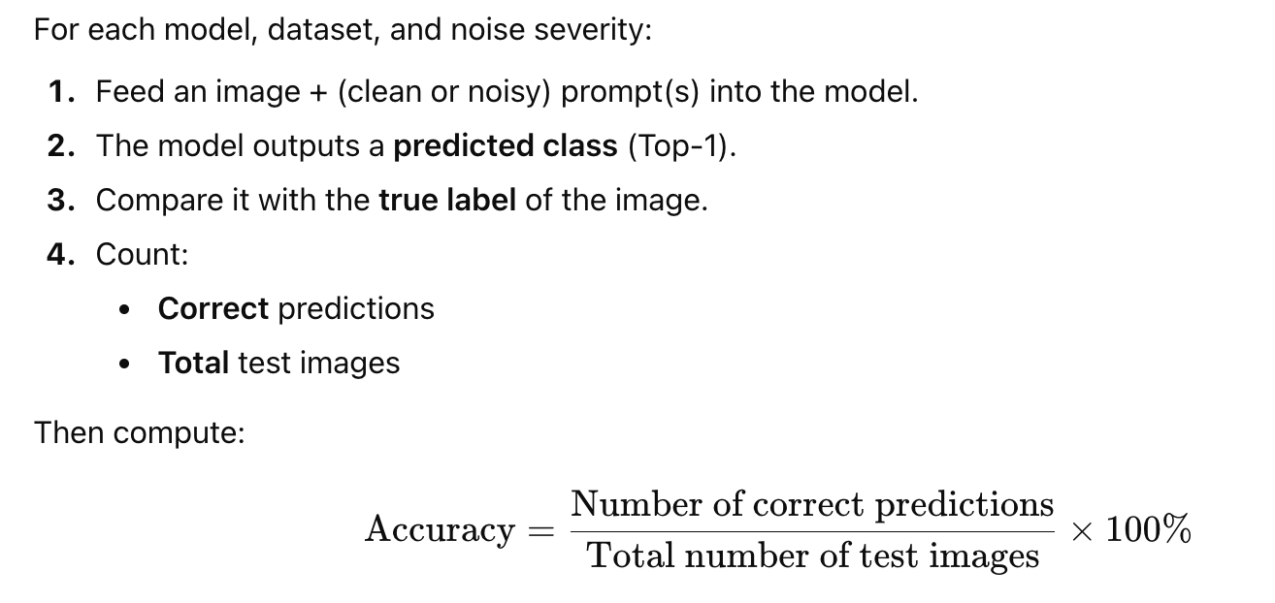
Phase 2: Performance Metrics - Accuracy
Repeated for Each severity level (0, 1, 2, 3)
Each ensemble setting (K=1, K=5, K=5+Clean, K=5 No Clean)
Each model (CLIP, SigLIP, CoOp)
Each dataset

Slide 21
Phase 2: Evaluation Metrics – Other Metrics
Absolute Accuracy Drop (Δ):
Measures how much accuracy decreases due to noise:
Δ = Acc_clean − Acc_noisy
Relative Robustness (RR):
How much of the clean accuracy is retained under noise:
RR = (Acc_noisy / Acc_clean) × 100
Relative Accuracy Drop (RAD):
Noise-induced degradation relative to clean accuracy:
RAD = ((Acc_clean − Acc_noisy) / Acc_clean) × 100
(RR and RAD are complementary: RR = 100 − RAD)
Ensemble Gain (Δₑₙₛ):
Improvement from prompt ensembling:
Δₑₙₛ = Acc_ensemble − Acc_single-prompt

Slide 22
CLIP Robustness Results (All Datasets)
Strong degradation as noise severity increases.
Prompt ensembling (K=5 + Clean) consistently boosts accuracy. (Second Finding in this research)
Strategy | Sev 0 | Sev 1 | Sev 2 | Sev 3
K=1 | 87.4% | 62.9% | 27.6% | 25.2%
K=5+Clean | 87.4% | 84.9% | 74.5% | 68.8%
K=5 No Clean | 87.4% | 75.2% | 57.8% | 34.6%

Slide 23
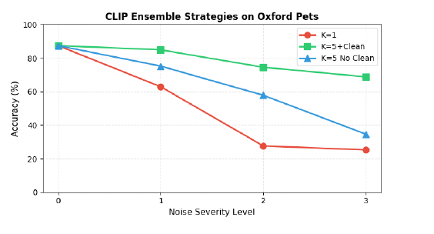
CLIP Ensemble Strategy on Oxford Dataset

Slide 24
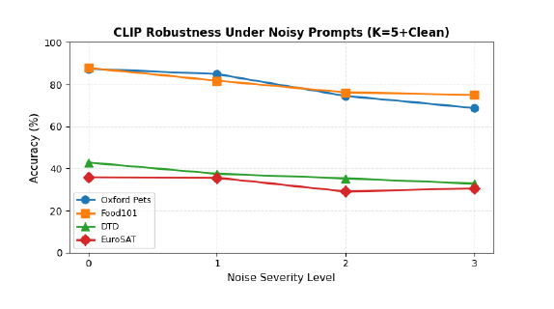
CLIP Robustness across All Datasets
Datasets with domain shift (DTD, EuroSAT) show significant drops.

Slide 25
SigLIP Robustness Results
Accuracy sometimes improves when using noisy prompts (regularization effect).
Strategy | Sev 0 | Sev 1 | Sev 2 | Sev 3
K=1 | 55.4% | 47.1% | 38.5% | 32.8%
K=5+Clean | 55.4% | 60.3% | 68.9% | 74.0%
K=5 No Clean | 55.4% | 65.7% | 80.1% | 74.0%

Slide 26
CoOp Robustness Results (Oxford Pets Only)
CoOp remains stable at all severity levels because it uses learned prompts.
Model | Sev 0 | Sev 1 | Sev 2 | Sev 3
CoOp | 91.11% | 91.11% | 91.11% | 91.11%

Slide 27
Phase 3: Regularized Noise-Aware Fine-Tuning
In Phase 3, we fine-tune CLIP using both clean and noisy prompts with a consistency regularization loss.
The goal is to teach the model that clean and noisy prompts should produce similar outputs.
Train on Oxford Pets using:
  Cross-entropy loss
  KL-divergence consistency loss (forces clean + noisy prompts to match)

Slide 28
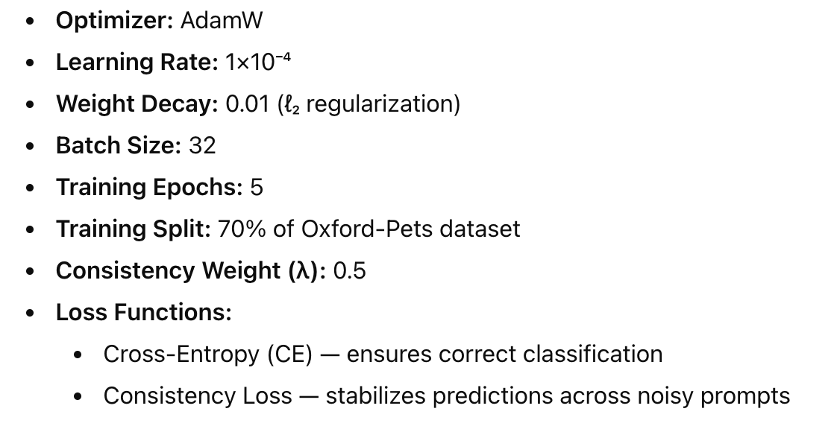
Phase 3: Regularized Noise-Aware Fine-Tuning

Slide 29
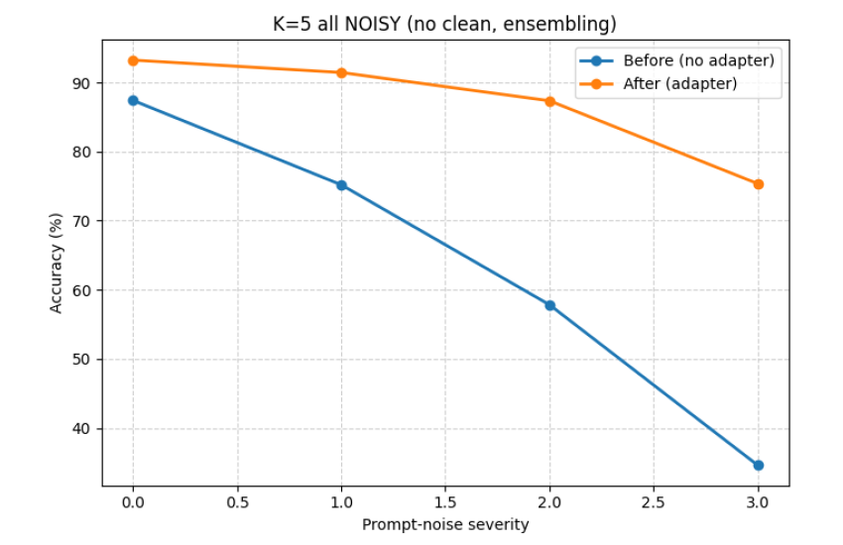
Regularized Noise-Aware Fine-Tuning
Setting | Severity | Before | After | Δ (Improvement)
K = 1 | 0 | 87.35 | 93.24 | +5.89
 | 1 | 29.54 | 68.11 | +38.57
 | 2 | 15.94 | 45.84 | +29.90
 | 3 | 7.00 | 23.79 | +16.79

Slide 30
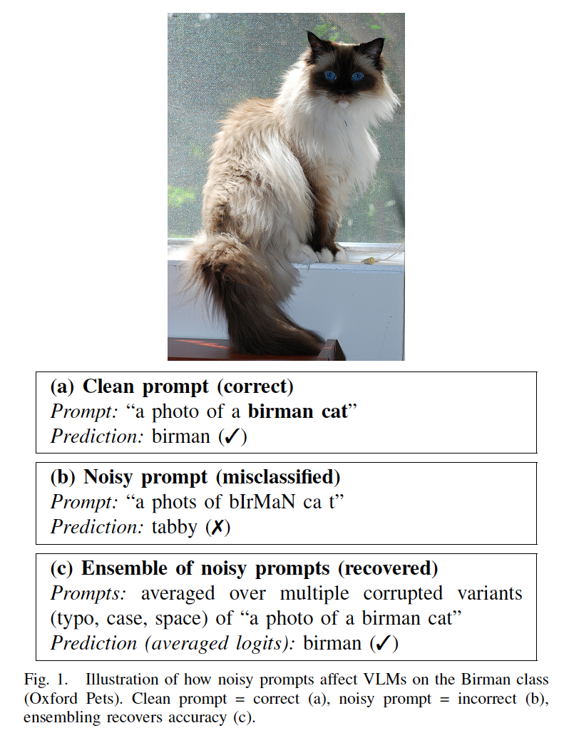
Ensemble Strategy

Slide 31
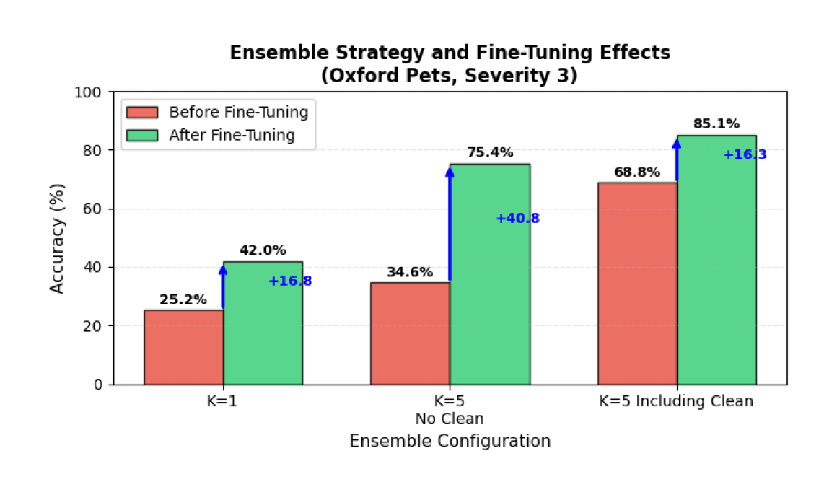
ABLATION STUDY
Our ablation shows that both
Ensemble Strategy
Noise-aware training significantly boosts performance under noisy prompts.

Slide 32
Conclusion
VLMs are highly sensitive to prompt variations, especially CLIP.
Prompt ensembling is a simple and effective Strategy that enhance model robudtness to noisy prompts.
CoOp remains stable across noise levels, and SigLIP performs better than CLIP under domain shift.
Training objectives (Loss Functions) strongly affect robustness, and noise-aware fine-tuning significuntly improves CLIP’s stability.

Slide 33
Future Work
Testing additional VLM architectures like BLIP and LLaVA would reveal whether our findings generalize to other models.
Exploring more noise types such as grammatical errors would build a more comprehensive robustness benchmark.

Slide 34
Thank you for listening
Any Question?

