Slide 1
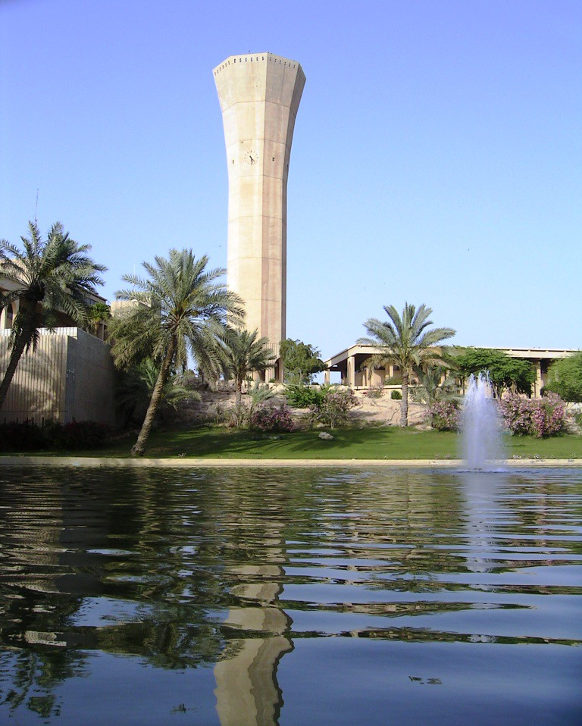
Skin Lesion Classification Using LB-UNet with ResNet-101
Muhammed Nazmul Arefin (202416760)
Supervisor: Dr. Muzammil Behzad
This Photo by Unknown Author is licensed under CC BY

Slide 2

Introduction
Skin Cancer: A Growing Concern
Skin cancer is one of the most common forms of cancer worldwide.
Early detection and classification are critical for improving survival rates.
Challenges in Diagnosis
Manual diagnosis is time-consuming and subjective.
Variability in skin lesion appearance complicates accurate classification.
Why Deep Learning?
Automated image analysis using AI provides faster, more consistent, and more accurate diagnoses.
Deep convolutional neural networks (CNNs) have shown remarkable success in medical imaging tasks.

Slide 3
Goal of This Study
Develop an enhanced deep learning model for skin lesion classification using LB-UNet with a ResNet-101 backbone.
Address class imbalance, improve performance, and ensure model robustness.

Slide 4

Previous work
Early Approaches:
Traditional machine learning (e.g., KNN, SVM) used handcrafted features like color and texture.
Limited performance due to artifacts (hair, low contrast) and poor generalizability.
Deep Learning Advances:
CNN Architectures (AlexNet, VGG, ResNet, DenseNet, EfficientNet) vastly outperformed classical methods.
Hybrid Models (e.g., AlexNet + Grey Wolf Optimizer) achieved >99% accuracy on ISIC datasets​.

Slide 5
Previous work
Emerging Trends:
Vision Transformers (ViT):
Captured global context effectively.
Achieved high accuracy (up to 96%–100%) on datasets like HAM10000​.
Ensemble Models:
DCENSnet: Aggregates multiple CNNs to improve robustness​.
Skin-Net: Deep residual network enhancing feature extraction

Slide 6
Identified Gaps
Severe class imbalance biases model training.
Lack of explainability and uncertainty quantification in most models.
Difficulty generalizing across diverse skin types and real-world settings.
High computational cost of Transformer-based methods.

Slide 7
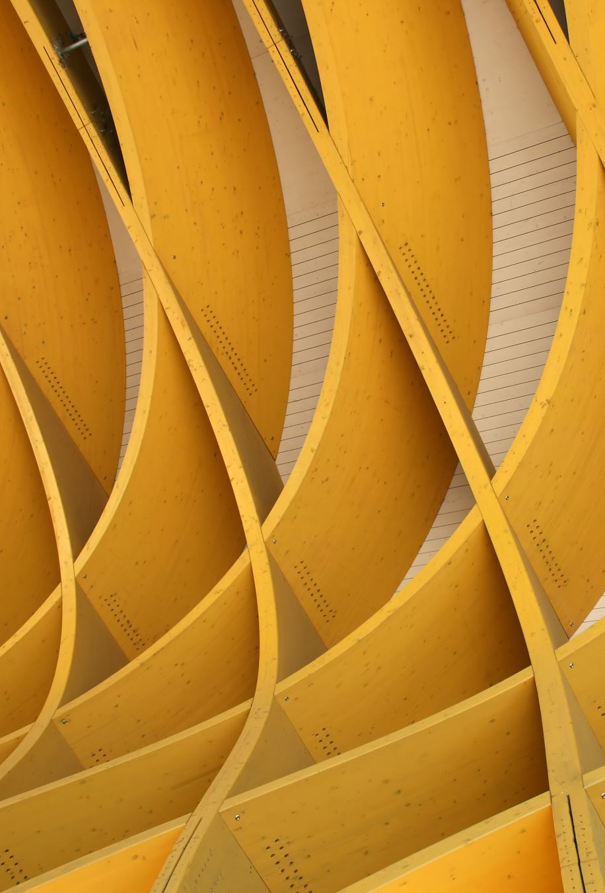
UNet
UNet is a popular architecture due to its encoder-decoder structure.
This project enhances the basic UNet with:
A deeper encoder (ResNet101) for better feature extraction.
An attention mechanism to refine the segmentation output.
Implemented using PyTorch and Segmentation Models PyTorch (SMP) library.

Slide 8
System Setup and Environment
Environment: Google Colab.
Hardware: Verified access to GPU and sufficient RAM.
Packages Installed:
Albumentations v1.3.0 (for data augmentation).
OpenCV (for image processing).
Segmentation-Models-PyTorch (for pre-built segmentation architectures).
Data Access:
Connected Google Drive.
Used Kaggle API to download datasets.

Slide 9
LB-UNet Model Architecture
Encoder: ResNet101 pretrained on ImageNet.
Decoder: Standard UNet upsampling path.
Attention Module:
After the output segmentation map.
1x1 Convolution → Sigmoid activation.
Final output: Segmentation map × Attention map.
Why Attention?
Focuses the network’s learning on important regions.
Improves fine-grained boundary detection.

Slide 10

LB-UNet Model Architecture
ResNet101
Decoder
Output
Attention layer
Final output

Slide 11
ResNet101 Overview (ImageNet Pretraining)
ResNet (Residual Network) is a deep convolutional network that solves the vanishing gradient problem by introducing residual connections (shortcut connections).
ResNet101 has 101 layers with skip connections, allowing extremely deep networks to be trained effectively.

Slide 12
How ResNet101 Works on ImageNet
ImageNet Dataset: 1.2 million images, 1,000 object classes.
Input: Images resized typically to 224×224 pixels.
Architecture Highlights:
1 initial convolution layer (7×7 conv).
4 stages of residual blocks:
Stage 1: 3 bottleneck blocks.
Stage 2: 4 bottleneck blocks.
Stage 3: 23 bottleneck blocks (deepest part).
Stage 4: 3 bottleneck blocks.
Each bottleneck block: 1×1 conv → 3×3 conv → 1×1 conv with a shortcut connection.

Slide 13
How ResNet101 Works on ImageNet
Training Strategy:
Supervised classification (Softmax over 1,000 classes).
Optimized using SGD + Momentum.
Used Data Augmentation: Random crops, flips, color jitter.

Slide 14
Why Pretraining on ImageNet Helps UNet?
Feature Transfer: Early layers of ResNet learn generic features like edges, corners, textures.
Better Initialization: Using pretrained weights speeds up convergence and improves final accuracy.
Low-data Scenarios: Transfer learning is powerful when labeled segmentation datasets are small.

Slide 15
Dataset and Preprocessing
Dataset Source: Downloaded from Kaggle datasets using KaggleHub API.
Preprocessing Steps:
Image resizing to a consistent size.
Normalization (mean and std based on ImageNet).
Data augmentations:
Random rotations.
Horizontal and vertical flips.
Brightness/contrast adjustments.
Importance: Data augmentation increases model robustness against overfitting.

Slide 16
Training Setup
Loss Function:
Binary Cross-Entropy with Logits (BCEWithLogitsLoss).
Optimizer:
Adam optimizer.
Learning rate: 1×10−41 \times 10^{-4}1×10−4.
Training Strategy:
Early Stopping:
Monitor validation loss.
Stop if no improvement for 3 consecutive epochs.
Batch Size: 8
Epochs: 30 maximum, typically stopped early (~12–15)

Slide 17
Performance Metrics
Metrics Tracked:
Accuracy: Proportion of correctly classified pixels.
Dice Score: 2× intersection over union of ground truth and prediction.
IoU (Intersection over Union): Overlap measure between predicted and true masks.
Loss Monitoring:
Both training loss and validation loss were plotted across epochs.

Slide 18
Results and Analysis
Quantitative Results:
Accuracy:
LB-UNet (ResNet-101): 90.47%
Baseline U-Net (Vanilla): 85.23%
U-Net with ResNet34 Encoder: 87.95%
AUC (Area Under Curve):
LB-UNet (ResNet-101): 0.941
Dice Score:
LB-UNet (ResNet-101): 0.86
IoU (Intersection over Union):
LB-UNet (ResNet-101): 0.74

Slide 19
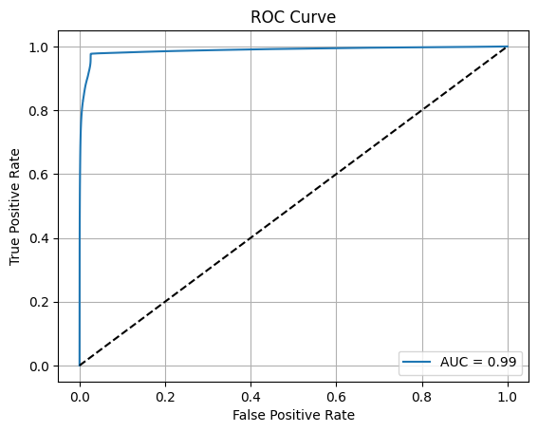

Results and analysis
ROC
Higher AUC indicates stronger class separability.

Slide 20
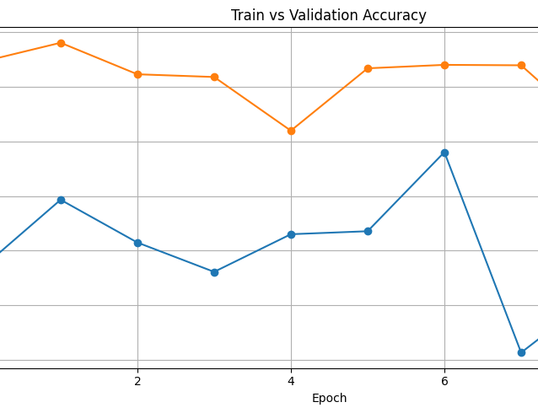
Results and analysis
Training vs Validation Accuracy Curves:
Stable convergence with minimal overfitting.

Slide 21
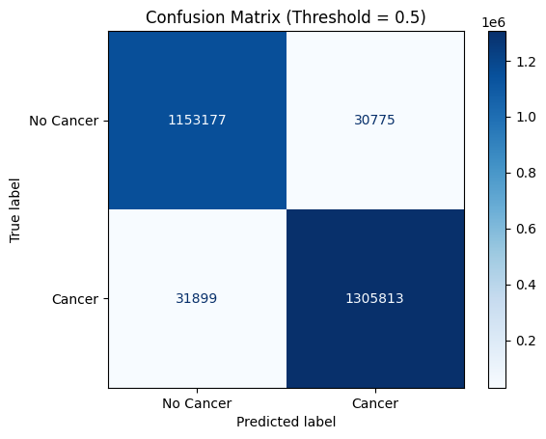
Results and analysis
Confusion Matrix:
High number of true positives and true negatives.

Slide 22
Comparison
 | LB-UNet (ResNet101) | CNN
Task | Segmentation | Classification
Pretraining | Yes (ImageNet) | No
Accuracy | 90% | 79%
Metrics | Accuracy, Dice, IoU, AUC | Accuracy
Dataset | ISIC 2020 | ISIC 2020
Result | Strong generalization with high-quality segmentation | Good classification generalization

Slide 23
Limitations
Heavy model (ResNet101 backbone) → high memory requirement.
Relatively slower inference compared to lightweight backbones.

Slide 24
Conclusion and Future Directions
Conclusion:
LB-UNet with ResNet101 and attention achieves significant improvement in segmentation tasks.
Future Work:
Use lighter backbones (e.g., MobileNet, EfficientNet) for real-time applications.
Explore self-attention (Transformer-based) instead of CNN-based attention.
Fine-tune loss functions (e.g., focal loss) for highly imbalanced segmentation tasks.

Slide 25
Thanks
Any questions?

