Slide 1

RESEARCH PRESENTATION
Smarter Maintenance Machine Learning for Reliable Air Compressor Health Monitoring
Presented By: Khalid Alyahya & Abdullah Alsagoor
Supervisor: Dr. Muzammil Behzad
King Fahd University of Petroleum and Minerals

Slide 2








Agenda
Objective
Data at Hand
Existing Approach
Proposed Model
Results

Slide 3






Main Issues of Compressor Malfunctions
Unpredicted Downtime
Expensive Maintenance
Safety Incidents
Immediate operational halts and efficiency losses.
Reactive repairs exceed planned costs; premium pricing for emergency labor.
High-pressure failures threaten on-site personnel and infrastructure.

Slide 4

Objective
To enable reliable, automated health monitoring by a robust deep learning model, ensuring timely fault detection and minimizing unplanned downtime

Slide 5
Objective
Current Practice
REACTIVE APPROACH
"Run-to-Failure"
Proposal
PROACTIVE APPROACH
"Predict & Prevent"

Slide 6
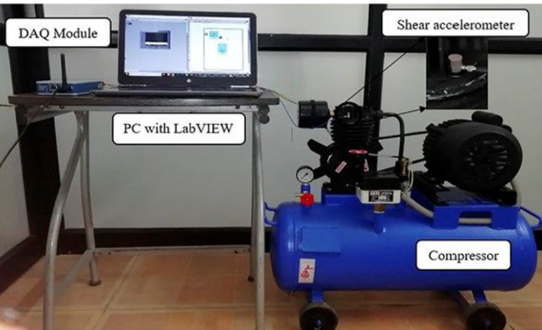
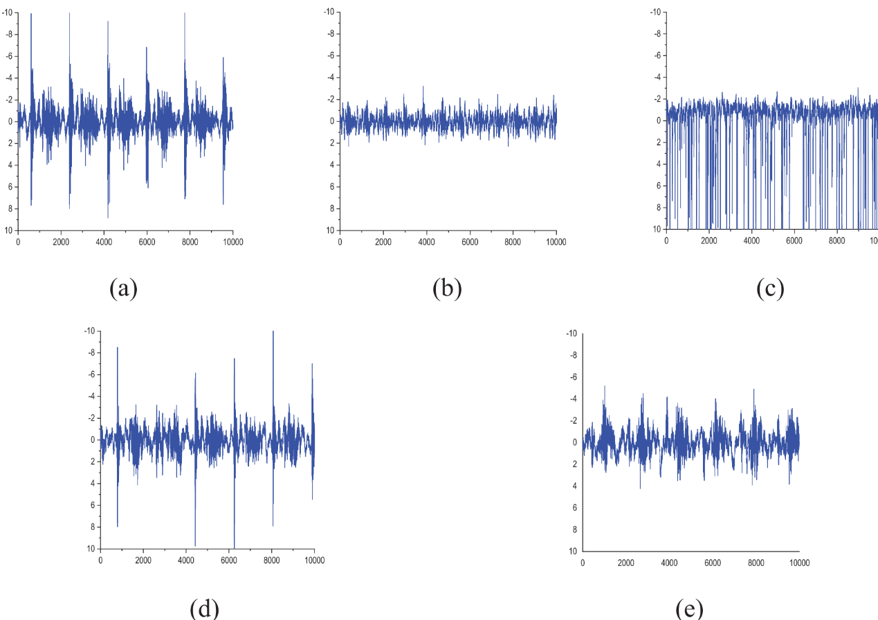
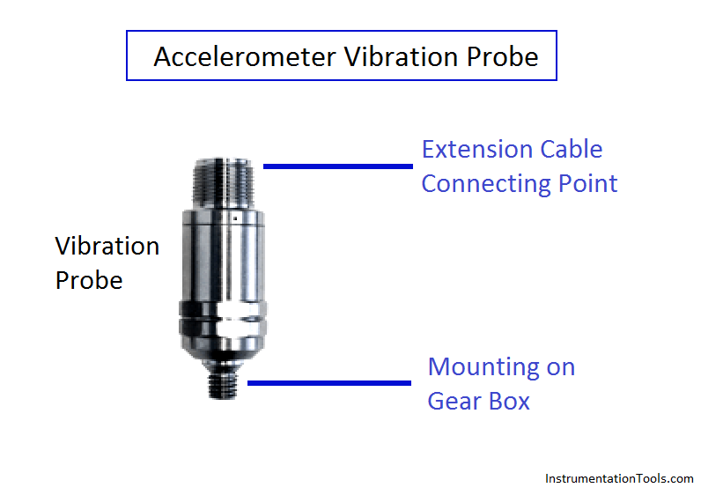
Data at Hand: 5 Categories

Slide 7
Data at Hand: 5 Categories
# | Time | Acceleration | Status
1 | 15.625 | -0.77155 | CVF
2 | 15.62504 | -0.80461 | CVF
10001 | 16.40625 | 0.49576 | IOVF
10002 | 16.40629 | 0.453774 | IOVF
20001 | 16.40625 | 1.531134 | GOOD
20002 | 16.40629 | 0.428262 | GOOD
20003 | 16.40633 | 2.629368 | GOOD
30001 | 31.25 | -1.15222 | IVF
30003 | 31.25016 | -0.77506 | IVF
40019 | 32.81391 | 0.785439 | OVF
40020 | 32.81398 | 0.671792 | OVF
Inlet Valve Fault
Improper seating due to rust or bending.
Outlet Valve Fault
Fluttering caused by bent outlet plate.
Inlet/Outlet Fault
Combined fluttering in both valves.
Control Valve Fault
Loss of stiffness in internal spring.
Healthy Condition
Normal operation, no degradation.

Slide 8


Existing Approach & Limitations
Existing Approach
Critical Limitations
Methods: Recent papers (Nambiar et al. 2024, Bhattacharyya et al. 2025) report near-perfect accuracy (98-100%).
Scalability: Handcrafted pipelines are hard to scale to different machines or operating conditions.
Technique: Heavily rely on handcrafted features (Statistical, Histogram, ARMA, radar 2D images) and classifiers like kNN or WiSARD.
Validation Leakage: Use of simple random splits allows models to "memorize" temporal patterns, inflating accuracy.
Preprocessing: Requires significant manual tuning and expert domain knowledge to extract features.
No Blind Test: Lack of strict, time-separated blind testing masks the model's true generalization ability on unseen data.

Slide 9



















Model Architectures
Model 1
Baseline BiGRU
Model 2
Conv1D + GRU
Model 3
Proposed (Reg.)
Model 4
Proposed (No Reg)
★ Best Performance

Slide 10
Proposed Methodology: Hybrid Sequence Learning
End-to-End Architecture
Problem Understanding
A hybrid deep learning model that learns directly from raw signals.
Problem Understanding
Problem Understanding
Input: Raw vibration windows (150 samples, Stride 10).
Core Layers: Conv1D (Feature Extraction) + BiGRU (Temporal Dependencies).
Hyperparameters:
Problem Understanding
Problem Understanding
Batch Size: 128
Optimizer: Adam
Loss: Categorical Cross-Entropy
Problem Understanding
Validation: 5-Fold Stratified CV

Slide 11
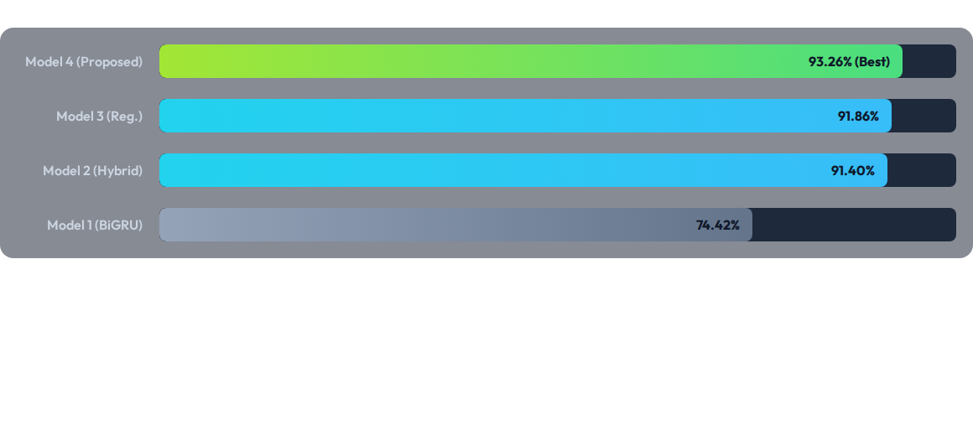
Results & Findings
Key Findings: The non-regularized Conv1D-BiGRU (Model 4) achieved the highest blind-test accuracy.
PyTorch Stability: Unlike TensorFlow, PyTorch showed high consistency between CV scores (>98%) and blind test results (>91%), proving the model learns true physical features, not just noise.

Slide 12
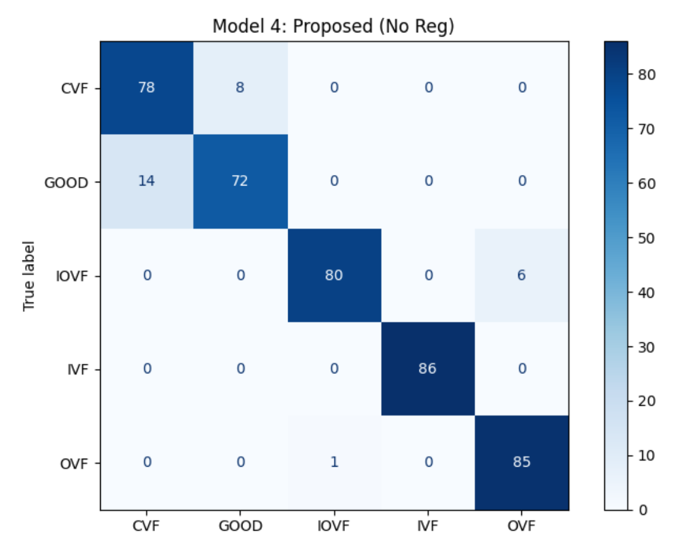
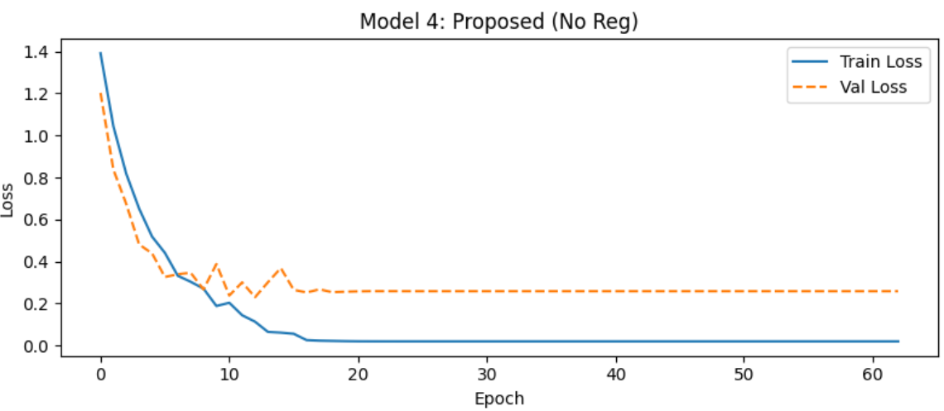
Results & Findings

