Slide 1

WAVELIFT: FAST FREQUENCY-GUIDED UNDERWATER RESTORATION
Abdulaziz Alfaraj, Hassan Al Nasser, Mohammed Al Naser

Slide 2

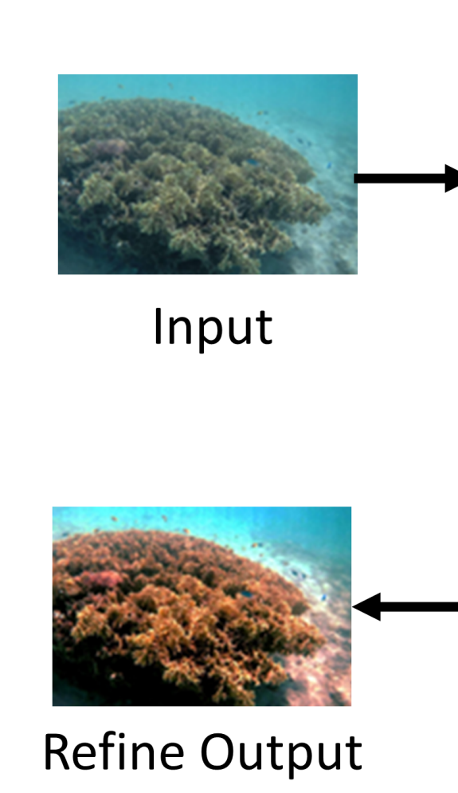
Application Domain: Underwater Image Enhancement
Underwater images often look too blue/green, low-contrast
This matters for underwater robots, marine inspection, real-time object detection, etc.
The goal is to restore realistic colors and sharp details from degraded underwater photos.
Adapted from Zhao et al. (CVPR 2024)

Slide 3
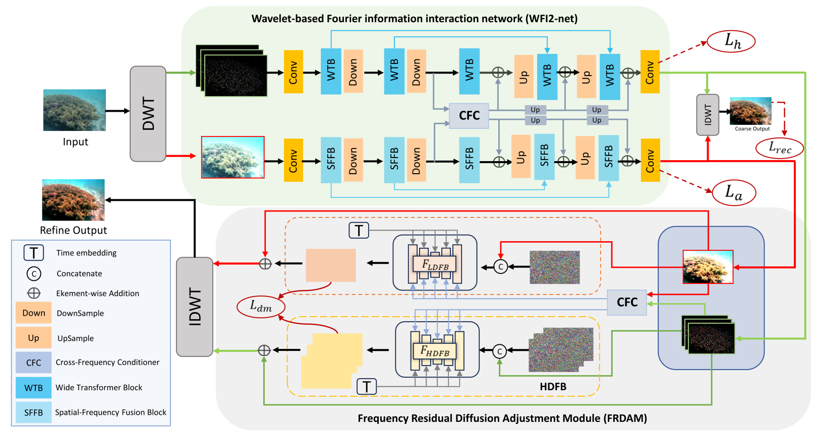
Base Model and Datasets
WFI-2-net
Reference Model: WF-Diff with 2 stages/modules
WFI2-net that does the main improvement
FRDAM has 2 branches deals with high frequency (details/edges) and low-frequency (color/illumination) separately.
UIEB Dataset: 890 paired images (raw underwater + a “reference” improved image) and 90 non-paired images.
UIEB Dataset: 5004 paired images, much more diverse in underwater environments
FRDAM

Slide 4
Current Problems with WF-Diff
WF-Diff can look great on the training dataset, but performance drops on new environments/pictures.
Sensitive to water type and/or camera changes
FRDAM uses 2 different diffusion branches, which affects inference speed massively
Goal: make enhancement stable across different underwater styles and to lower the inference time.

Slide 5
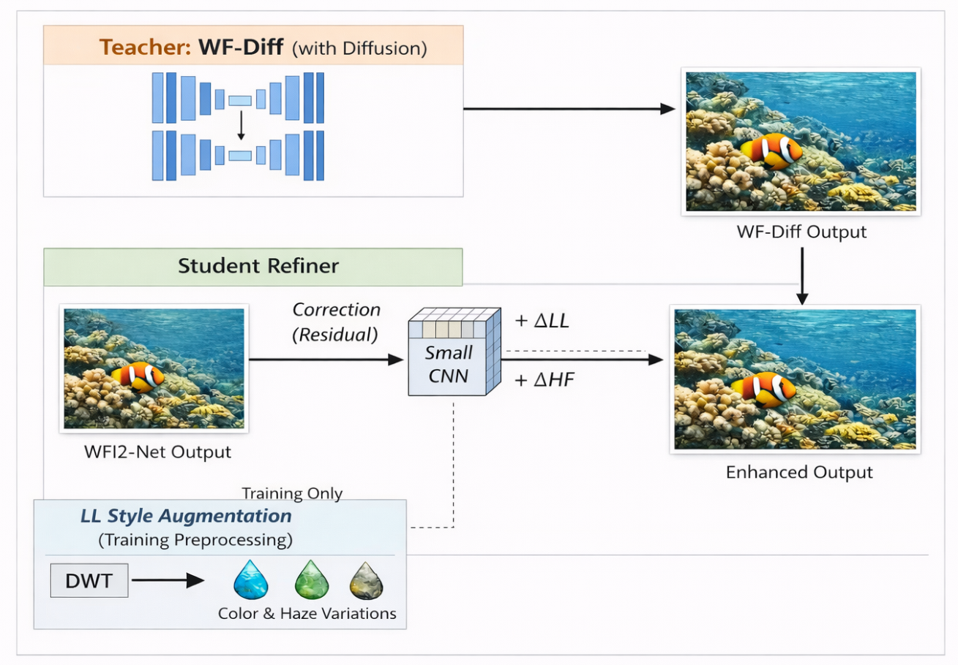
Proposed Improvements
Use full WF-Diff (with diffusion) as the teacher to generate high-quality outputs, then train a small student refiner (2 CNNs) to mimic the teacher’s refinement.
The CNNs predict a small correction (residual) that is added to WFI2-net’s output to match teacher quality.
Apply pre-process low-frequency style randomization (simulate different watercolors, haze, and lighting).
Rough Sketch for the Improvement Architecture

