Slide 1
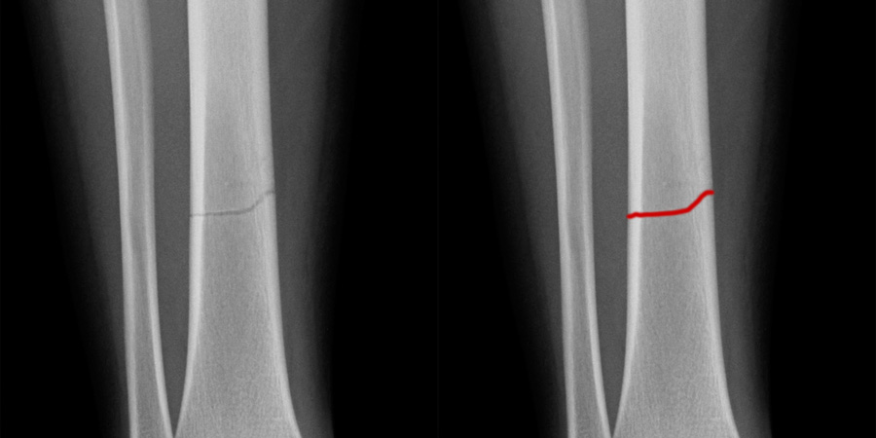
X-fracture : AI fracture detection
Student: Ahmed Sami Baabdullah
Supervisor: Dr. Muzammil Behzad

Slide 2
Introduction
Bone fractures: Common, require accurate and early diagnosis.
Traditional diagnosis: X-ray reading by radiologists, prone to errors.
AI Role: offers automated, accurate solutions.

Slide 3
Problem Statement
Misdiagnosis of fractures is still frequent.
Manual examination analysis is slow, subjective, and prone to errors.
Goal: Enhance fracture detection

Slide 4
Terminologies
LGBM : Light Gradient Boosting Machine
- ML
MobLG-Net:
- Combines MobileNet (lightweight CNN) with LGBM

Slide 5
Literature Review
Guan et al. (2020): Achieved 62.04% precision with basic CNN models.
Kim and MacKinnon (2018): Used Inception V3 with transfer learning, achieving 95% accuracy on wrist X-ray images.
Tanzi et al. (2020): Used VGG16, reaching 96% accuracy.
Lee et al. (2020): Evaluated different CNNs; showed strong performance on small datasets.
What’s the problem?

Slide 6
Dataset Details
Total X-ray images: 9,463
Balanced Dataset:
- Fracture (0): 4,841 images
- Not Fracture (1): 4,624 images
Preprocessing:
- Resized to 224x224
- Grayscale normalization
- Data augmentation (rotation, flipping, contrast)

Slide 7
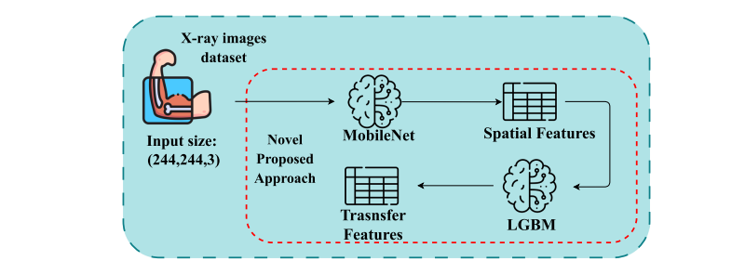
Paper model
Published Paper: MobLG-Net(features) + ML classifier ( RF,LR,LGBM,knn)

Slide 8
My Proposed Model
ResNet Backbone: Stronger feature propagation and reuse.
Custom Head: Hidden & Dense layers for binary classification.
Loss Function: Binary Cross-Entropy
Optimizer: Adam Evaluation Metrics : Accruacy , Precision , Recall,F1

Slide 9
Experimental Setup
Image Size: 224x224 pixels
Batch Size: 32
Epochs: 10
Data Split: 80% training, 20% testing
Data Augmentation: Rotation, flipping, shifting.
Dropout:40%

Slide 10
Testing Result:
Performance Comparison:
MobLG-Net + ML classifiers: between 96 and 99%
ResNet : 99.60%

Slide 11
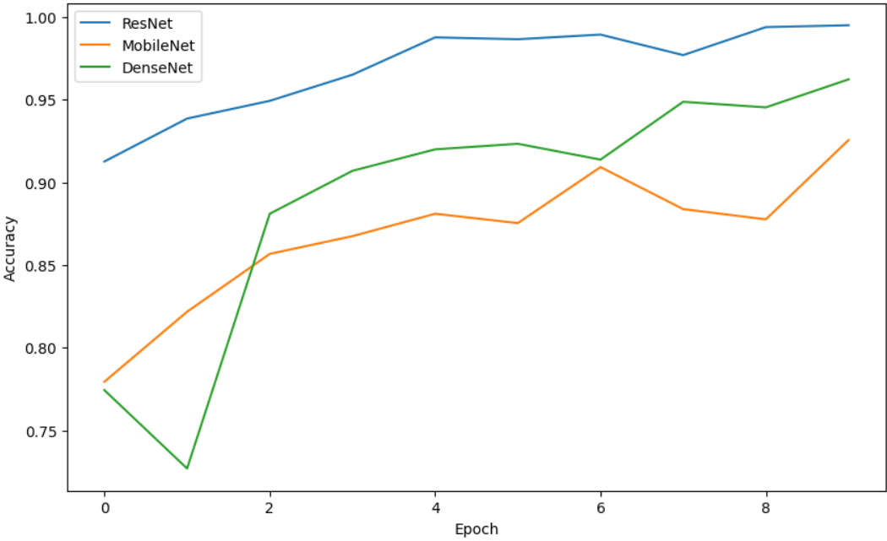
Accuracy Progression
- ResNet: Fastest and best convergence
- MobileNet: Steady improvement
- DenseNet: Caught up to ResNet

Slide 12
Key Metrics (ResNet)
Accuracy: 99.60%
Precision: 99.33%
Recall: 99.89%
F1 Score: 99.61%

Slide 13
Conclusion
DenseNet and mobilenet are strong for fracture detection
Outperformed MobLG-Net results
Future Work:
- Multi-class classification
- Add Explainable AI (XAI)

