Slide 1
Who am I ?
Name :- Jyotirmoy bandyopadhayaya
Registration no :- 12015646
Section :- kocnp
Group :- 1
Course code :- pes-318

Slide 2
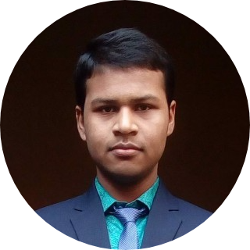
About me ..
My name is Jyotirmoy Bandyopadhayaya, 17, from Kolkata, West Bengal. I refer to my self as a Developer, Innovator and Gamer. I can handle multiple task on daily basis, use creative approach to solve problems and complete the tasks given to me with complete honesty and dedication. I also a very friendly person and believe in teamwork. And like to work in Open-Source Projects in my leisure time.
Get to know more about me at https://bravo68web.me

Slide 3
Skill tree
Technical Skills
Non-Technical Skills
Highly Skilled at Web Development
Verified Discord Bot Developer
Always try to Learn more about Programing
Well know to 20 + Programing Languages
Love to create and innovate new Projects
Reading Detective and Mystery novels and books
Vocab Builder
Love to work in Team and Group
Creative Writing

Slide 4
achievements
Cleared Hacktobestfest for last 3 year including this years
Won 1st Prize in Pune Cantonment Computer Aptitude test.
Won 2nd Prize in Cyber Olympiad 2018 (City Level).
Won CodeCheff’s Cookoffs thrice.

Slide 5
Thank You !!!!!

