Slide 1


QGIS GML application schema toolbox guided tour – use case on French Groundwater Information Network (GIN)
S.Grellet – BRGM / H.Mercier – Oslandia

Slide 2
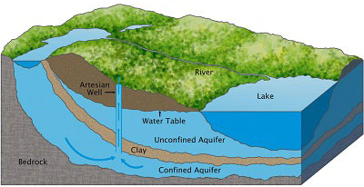

French GIN – linked data use case
Objectives
To provide stable and resolvable links to resources
To allow reference / data citation
Independant from underlying technologies used to provide data
I am #Piezometre/00634X0147/PZ1.2
attached to #Borehole/00634X0147/PZ1.2
I have a lot of #GroundWater Levels observations regarding #EntiteHydroGeol/107AK01
I am #Piezometre/00634X0147/PZ1.2
attached to #Borehole/00634X0147/PZ1.2
I am #EntiteHydroGeol/107AK01
I am monitored by #Piezometre/00634X0147/PZ1.2
I am #EntiteHydroGeol/107AK01
#GroundWater Levels obs. from #Piezometre/00634X0147/PZ1.2
Notes:
2
2

Slide 3



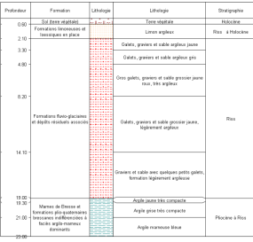

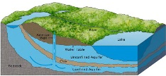
French GIN – linked data use case
Flows based on OGC and INSPIRE defined featureTypes
Env. Monitoring Facility
environmentalMonitoringFacility
hasObservation
GroundWater
raw levels
Borehole
attachedTo
relatedMonitoringFeature
GroundWater validated levels
featureOfInterest
relatedObservation
featureOfInterest
Observations/ Geological logs
Geology / HydroGeology
xx
Legend:
Feature(s)
Observation(s)
Notes:
2
2

Slide 4
French GIN – linked data use case
Object instances are associated by their URI
Env. Monitoring Facility
URI
URI
GroundWater
raw levels
Borehole
URI
URI
GroundWater validated levels
URI
URI
URI
Observations/ Geological logs
Geology / HydroGeology
URI
Legend:
Feature(s)
Observation(s)
Notes:
2
2

Slide 5
French GIN – linked data use case
URI allowing to dereference content exposed by OGC services
Env. Monitoring Facility
URI
WFS
URI
GroundWater
raw levels
Borehole
URI
WFS
URI
SOS
GroundWater validated levels
URI
URI
URI
SOS
Observations/ Geological logs
Geology / HydroGeology
URI
WFS
SOS
Legend:
Feature(s)
Observation(s)
Notes:
2
2

Slide 6
GML application schema toolbox - overview
Initial idea
Reuse information available in XML compliant to xsd(s) to handle this content with no hardcoded configuration -> XML aware and database generation on the fly.
Retrieve objects of interest described according to an interoperable standard
= semantic and geographical representation
interacts with the content (XML and Database). Database -> plug other tools
Resolve XLinks to add more content
vocabulary registry definitions (multilinguism is handled)
linked domain features / observation
Notes:
2
2

Slide 7
GML application schema toolbox - overview
Trigger custom widgets based on interoperability standards
working: Waterml 2 timeseries, Inspire PointTimeSeries
drafty: GW_GeologyLogCoverage
on-going EU AirqualityDirective timeseries
Writes content (file not WFS-T)
Standalone OGR/GDAL driver -> reuse
Notes:
2
2

Slide 8
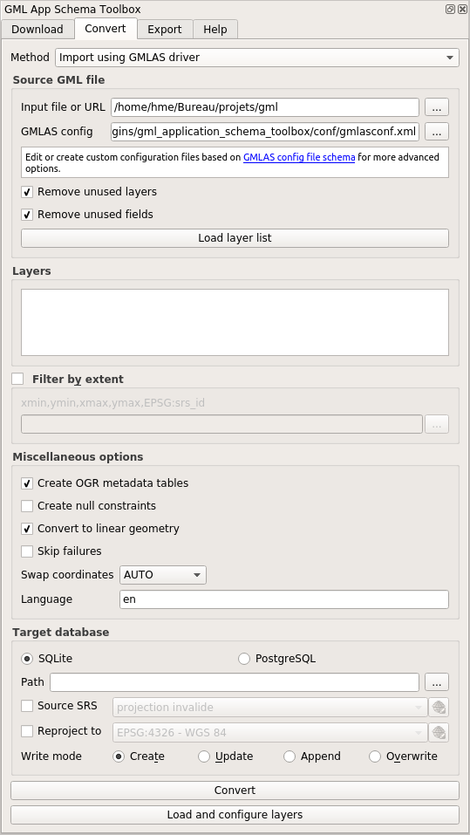
GML application schema toolbox use – QGIS 3
Notes:
2
2

Slide 9
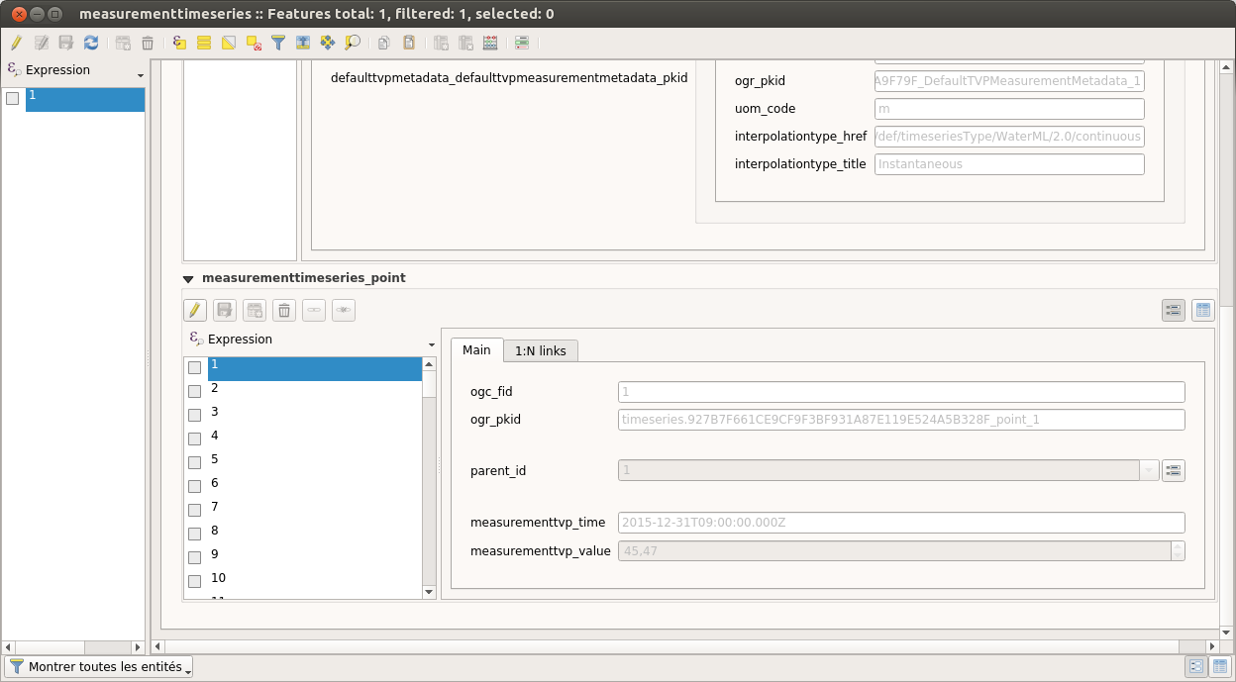
GML application schema toolbox - overview
Two modes
XML mode
“relational” mode, thanks to GMLAS GDAL driver
QGIS project automatic configuration (layers / relations / editor widgets)
navigation in the model through standard QGIS forms
Notes:
2
2

Slide 10
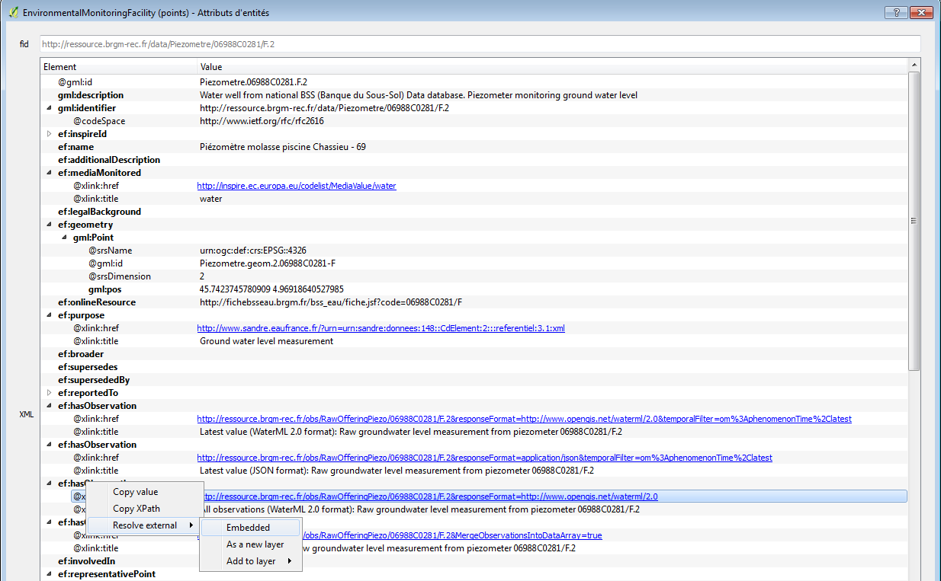
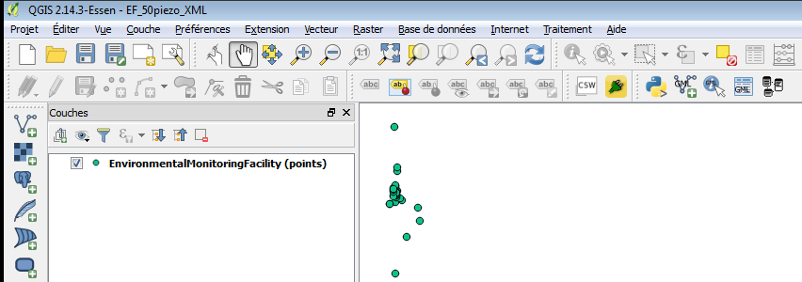
GML application schema toolbox use – XML
Env. Monitoring Facility
GroundWater
raw levels
URI
URI
1
2
Notes:
2
2

Slide 11
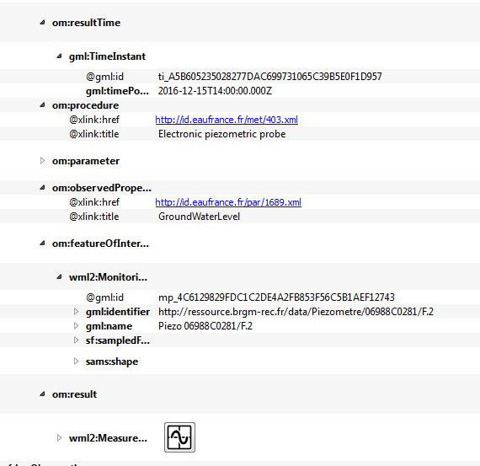
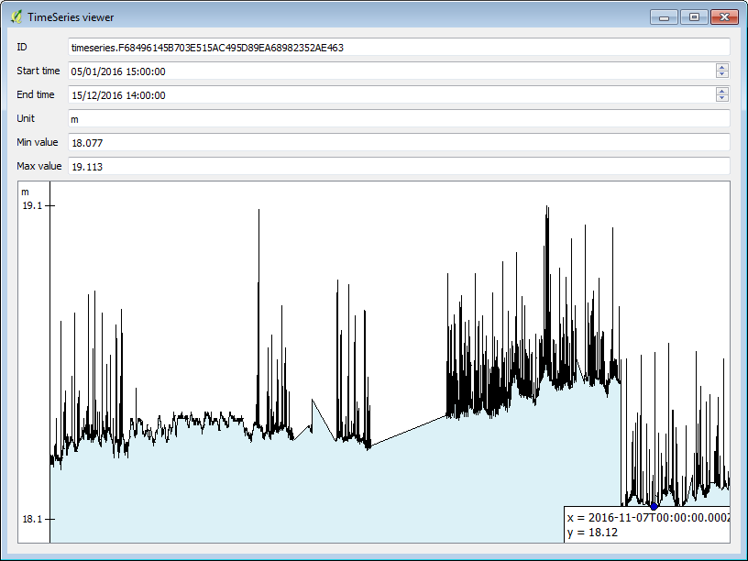
GML application schema toolbox use – XML
Env. Monitoring Facility
GroundWater
raw levels
URI
URI
3
Notes:
2
2

Slide 12
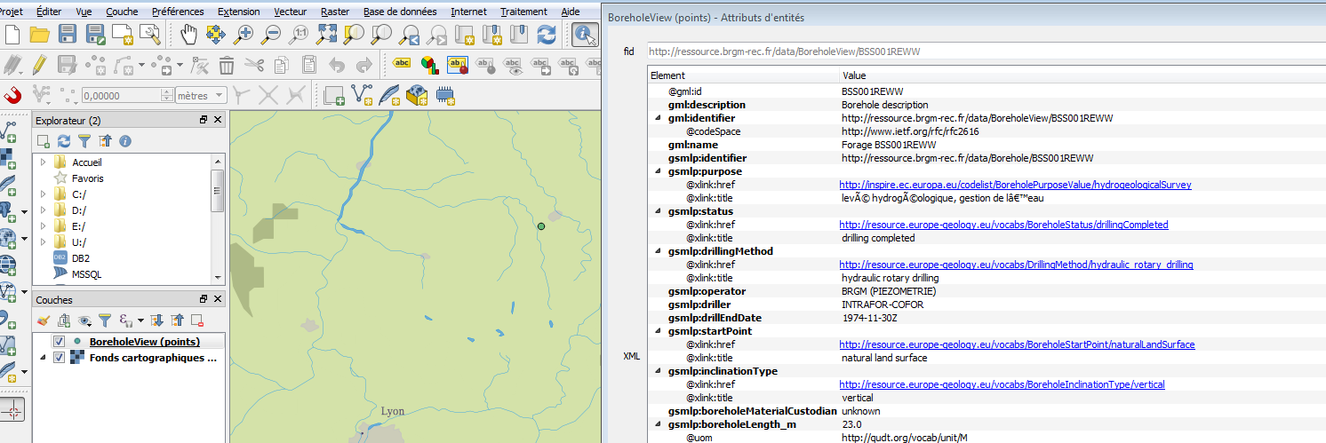
GML application schema toolbox use – XML
Borehole
A
Notes:
2
2

Slide 13
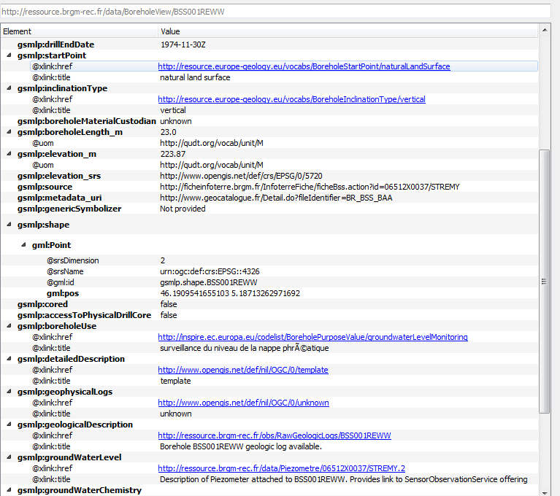
GML application schema toolbox use – XML
Borehole
Notes:
2
2

Slide 14
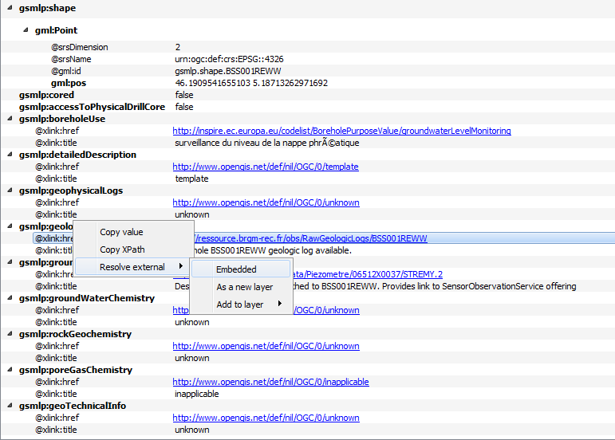
GML application schema toolbox use – XML
Borehole
URI
URI
Observations/ Geological logs
B
Notes:
2
2

Slide 15
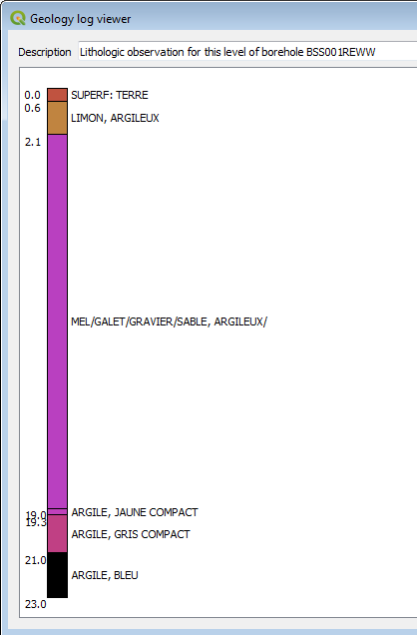
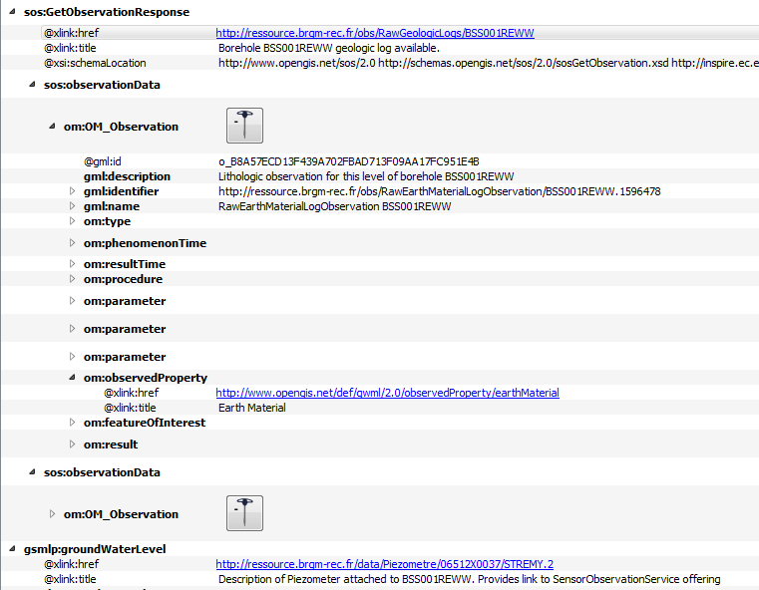
GML application schema toolbox use – XML
Borehole
C
URI
URI
Observations/ Geological logs
Notes:
2
2

Slide 16
GML application schema toolbox use – XML
Borehole
URI
URI
Env. Monitoring Facility
-> back to slides 9, 10
Notes:
2
2

Slide 17
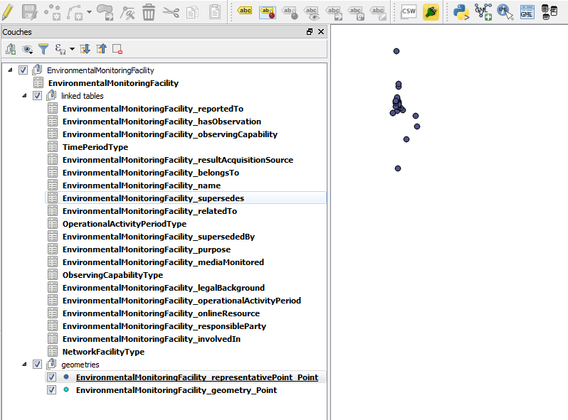
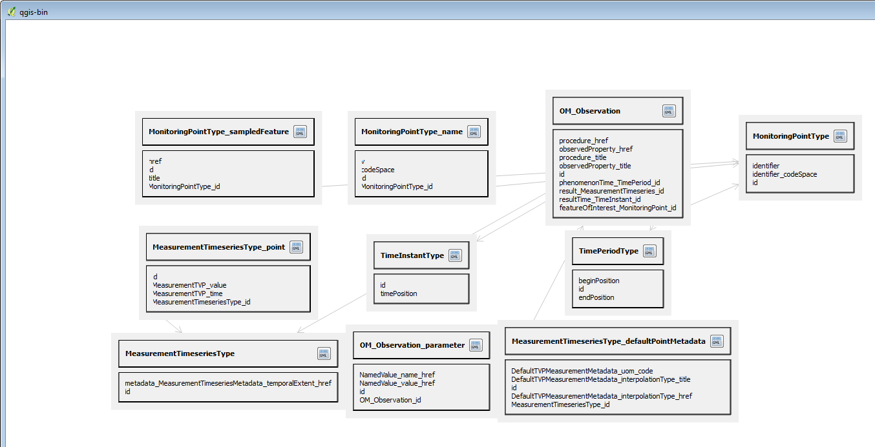
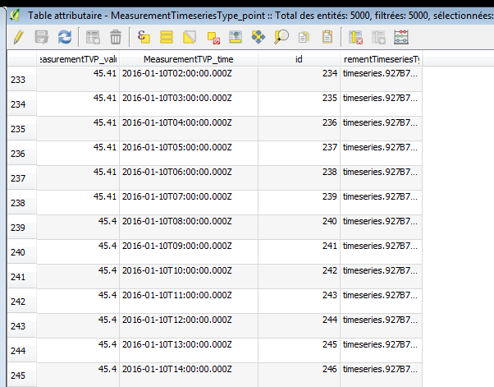
GML application schema toolbox use – Database
WaterML2 flow (see slide 10, Timeseries viewer) but client in database mode
Tables created dynamically
by GDAL GMLAS
Notes:
2
2

Slide 18
GML application schema toolbox - Custom viewers API
Custom viewer?
a piece of code able to present some data in a visually appealing way
e.g. : timeseries as plot rather than list of (x,y) values
Main ideas
a simple and common way to express access to data: XPath on the xsd
a common graphical API: PyQT
a simple way to add new viewers for specific application schemas (targeted to Python dev audience for now)
Just create a new .py file in a given directory
With a common base Python class
Notes:
2
2

Slide 19
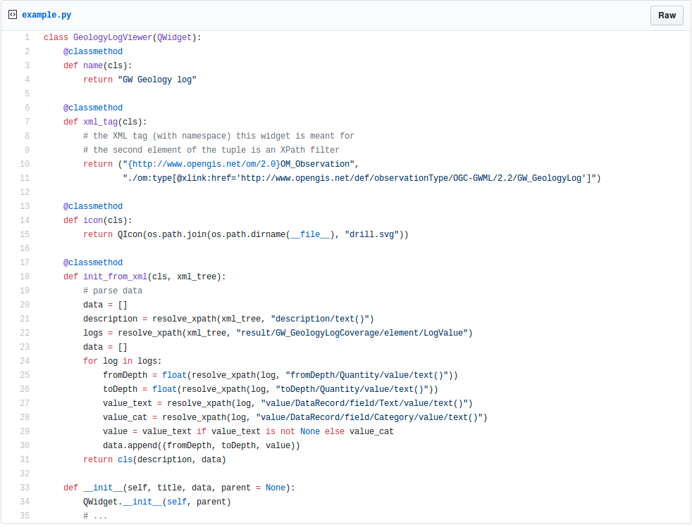
GML application schema toolbox - Custom viewers API
Notes:
2
2

Slide 20
Useful links
https://plugins.qgis.org/plugins/gml_application_schema_toolbox/
https://github.com/BRGM/gml_application_schema_toolbox
Documentation, GUI presentation
Multilinguism handling
INSPIRE registry: same flow asking for English then Greek definitions
https://www.youtube.com/watch?v=EeAyyUOykVE
How to test under QGIS3 until its official release
OSGeo4W
Use OSGeo4W installer
Advanced install \ Desktop -> add qgis-dev
Then install the plugin from QGIS repository
Virtualbox : http://hekla.oslandia.net/qgis_gmlas_box/
Notes:
2
2

Slide 21
Conclusion
Generic work successfully tested on
OGC : GroundWaterML2, GeoSciML4, WaterML2
INSPIRE : EnvironmentalMonitoringFacilities, BioGeographicalRegions, LandCover, ProtectedSites, MineralResources, PointTimeSeriesObservation
Our domain colleagues can now finally make use of standardized content ☺
Next steps
Address (some) SWE specificities
Have more domain widgets
Handle other content type (JSON-LD ?)
Workshop at Foss4G-E : github ticket to gather content to play with
Feel free to use, test, enhance it, propose evolutions
Notes:
2
2

Slide 22


Conclusion - whishlist
Input
data
reading
Data
format
Data
use
Output
data
writing
Input
connector
GUI-Widget WaterML2
WFS 2 client
<XML>
GUI-Widget GWML2 BoreholeLog
File
GMLAS
GUI-Widget EU AQD
TimeSeries
GMLAS
PostreGre/GIS
Spatialite
SOS 2 client
More data structures
More data structures
More domain
GUI-widgets
Data processing libs
GML Application schema toobox
Existing
Evolution idea
Notes:
2
2

Slide 23
Thank you
s.grellet@brgm.fr
m.beaufils@brgm.fr
hugo.mercier@oslandia.com
Notes:
2
2

