Slide 1
Security Controls in Shared Source Code Repositories
Best Practices for Implementing Security Controls
Brandon Hackett
Module 11.2 – 07/14/2024

Slide 2
Overview
Importance of Security: Ensuring the security of shared source code repositories is crucial to prevent unauthorized access, data breaches, and potential malicious code injections.
Risks: Insecure repositories can lead to intellectual property theft, code tampering, and the introduction of vulnerabilities.

Slide 3



Access Controls
Role-Based Access Control
Least Privilege Principle
Regular Reviews
Assign specific roles and permissions to users based on their responsibilities.
Grant users the minimum level of access necessary to perform their tasks.
Periodically review and update access permissions to ensure they are still appropriate.

Slide 4
Authentication Mechanisms
Strong Authentication: Implement multi-factor authentication (MFA) to add an extra layer of security.
SSH Keys: Enforce the use of SSH keys for accessing repositories, providing more secure access than passwords.
Token Rotation: Periodically rotate authentication tokens to minimize the risk of compromised credentials.

Slide 5
Encryption
Data Encryption: Encrypt data both in transit (using protocols like HTTPS) and at rest to protect sensitive information.
HTTPS: Ensure all interactions with repositories use HTTPS to secure data transmission.
Sensitive Files: Encrypt sensitive files and secrets stored within the repository.

Slide 6


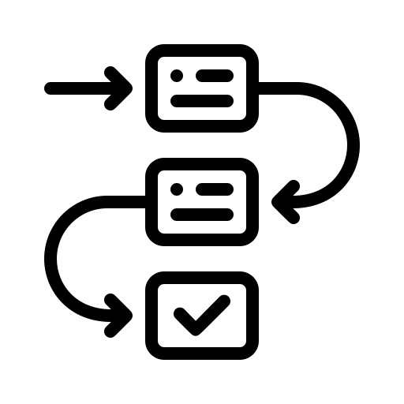
Code Review and Approval Processes
Mandatory Code Reviews
Automated Tools
Approval Workflow
Require code reviews for all changes to ensure code quality and security.
Utilize automated code review tools to identify potential security issues.
Establish a clear process for code approval to maintain consistency and accountability.

Slide 7
Monitoring and Logging
Activity Monitoring: Continuously monitor repository activities to detect any suspicious behavior.
Comprehensive Logging: Implement detailed logging to create audit trails of all repository interactions.
Log Review: Regularly review logs to identify and respond to security incidents.

Slide 8
Vulnerability Management
Automated Scanning: Use tools to automatically scan the repository for vulnerabilities.
Dependency Updates: Regularly update dependencies and libraries to patch known vulnerabilities.
Prompt Response: Quickly address identified vulnerabilities to minimize security risks.

Slide 9
Incident Response
Incident Response Plan: Develop and document a plan for responding to security incidents.
Regular Drills: Conduct regular drills to ensure readiness in case of an actual incident.
Containment and Mitigation: Focus on quickly containing and mitigating breaches to limit damage.

Slide 10
Conclusion
Recap: Review of best practices including access control, authentication, encryption, code reviews, monitoring, vulnerability management, and incident response.
Ongoing Efforts: Emphasize the need for continuous improvement and staying updated with security trends.

Slide 11
Sources
A01:2021 – Broken Access Control. A01 Broken Access Control - OWASP Top 10:2021. (n.d.). https://owasp.org/Top10/A01_2021-Broken_Access_Control/
Authentication documentation. GitHub Docs. (n.d.). https://docs.github.com/en/authentication
Barker, E. (n.d.). Recommendation for key management: Part 1 - general. Recommendation for Key Management. https://nvlpubs.nist.gov/nistpubs/specialpublications/nist.sp.800-57pt1r5.pdf
Enterprise vulnerability management: Processes and Tools. Snyk. (n.d.). https://snyk.io/series/enterprise-security/enterprise-vulnerability-management/
Rboucher. (n.d.). Azure Monitor Overview - Azure Monitor. Azure Monitor | Microsoft Learn. https://learn.microsoft.com/en-us/azure/azure-monitor/overview

