Slide 1
Implementing a Just Culture in DevOps: Understanding the Learning Curve
Brandon Hackett
Module 9.2

Slide 2
Introduction
Definition of Just Culture: A just culture in DevOps emphasizes balancing accountability with learning from mistakes. It focuses on system design and behavioral choices to enhance safety and outcomes.

Slide 3
Importance of Just Culture in DevOps
Safety Improvement: Encourages reporting and transparency.
Accountability: Differentiates between human error, at-risk behavior, and reckless behavior.
Learning Environment: Promotes continuous improvement rather than punishment.

Slide 4
Steps to Implement Just Culture in DevOps
Leadership Commitment: Essential for cultural change.
Education and Training: Comprehensive programs to educate staff on just culture principles.
Policy Development: Clear policies that define expectations and responses to errors.
Stakeholder Collaboration: Involving all relevant parties to ensure comprehensive understanding and implementation.

Slide 5
Learning Curve Challenges in DevOps
Initial Resistance: Staff may be wary of change.
Consistency: Ensuring uniform application of just culture principles across the organization.
Tool Mastery: Learning to use a variety of tools necessary for implementing DevOps effectively​ (Grant Fritchey)​​(DASA)​.

Slide 6
Benefits of a Just Culture in DevOps
Enhanced Reporting: Increased error reporting due to reduced fear of punishment.
Improved Safety: Systemic issues are identified and addressed, leading to safer environments.
Staff Morale: Creates a supportive environment, improving job satisfaction and morale.
Faster Deployment: More efficient processes and reduced downtime​ (Built In)​​ (DEV Community)​.

Slide 7
Case Studies in DevOps
Healthcare Sector: Hospitals implementing just culture have seen reductions in disciplinary actions and improvements in safety metrics.
Tech Industry: Companies like Paige and MayStreet have integrated just culture principles into their DevOps practices, enhancing collaboration and performance​ (PSNet)​​ (Built In)​.

Slide 8
Key Takeaways
Commitment and Training: Essential elements for successful implementation.
System Focus: Prioritize system improvements over individual blame.
Continuous Learning: Regularly update policies and training to adapt to new challenges.

Slide 9
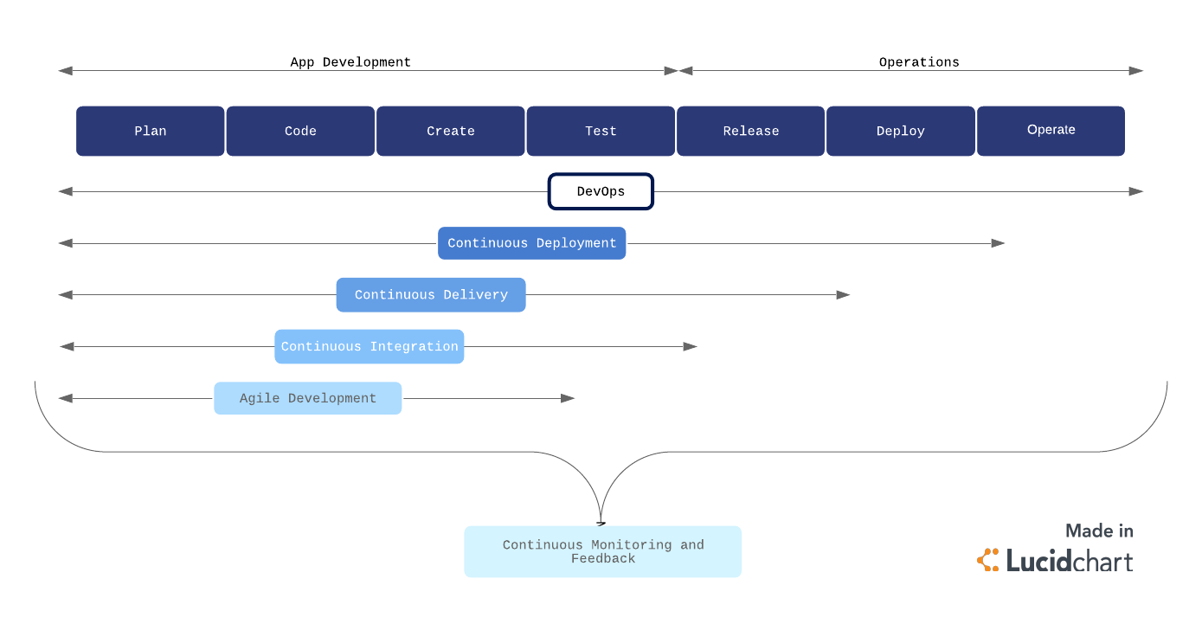
Flowchart of Just Culture Implementation in DevOps

Slide 10
Conclusion
Importance of Just Culture:
Promotes safety, accountability, and continuous learning.
Enhances system reliability and team collaboration.
Implementation Steps:
Leadership commitment, education and training, policy development, and stakeholder collaboration are essential.
Mastering tools, monitoring implementation, and fostering continuous improvement complete the process.
Benefits:
Increased reporting and transparency, improved safety, and higher staff morale.
More efficient processes and faster deployment, leading to better overall performance.
Challenges:
Initial resistance, ensuring consistency, and mastering a variety of tools.
Continuous education and adaptation to new challenges are crucial.
Implementing a just culture within DevOps is a journey that requires dedication, continuous learning, and collaboration.
The benefits of a just culture are profound, leading to a more resilient, innovative, and motivated team capable of achieving rapid and reliable deployments.

Slide 11
Refrences
How to build a devops culture and methodology that works. Built In. (n.d.). https://builtin.com/articles/devops-culture
Kim, G., Humble, J., Debois, P., Willis, J., Forsgren, N., & Allspaw, J. (2021). The devops handbook: How to create world-class agility, reliability, & Security in Technology Organizations. IT Revolution Press.
Making just culture a reality: One organization’s approach. Patient Safety Network. (n.d.). https://psnet.ahrq.gov/perspective/making-just-culture-reality-one-organizations-approach
Oehrlich, E., Ashley, M., Solomon, N., Sawyerr, S., Junčytė, K., & Washington, B. (2021, April 20). How the devops skill journey fosters a learning culture. DevOps.com. https://devops.com/how-the-devops-skill-journey-fosters-a-learning-culture/
Vankuilenburg, J. (2024, June 25). Developing a learning culture to enhance devops success. DASA. https://www.dasa.org/blog/developing-a-learning-culture-to-enhance-devops-success/

