Slide 1
The Technology Value Stream
Optimizing Lead Time for Agile Deployment
Brandon Hackett
1.2 Assignment: The Technology Value Stream
5/29/2024

Slide 2
Introduction to Technology Value Stream
Definition of Technology Value Stream: The Technology Value Stream represents the end-to-end work required to deliver a software product or service, encompassing all stages from idea to production.
Importance in DevOps practices: Understanding and optimizing the Technology Value Stream is crucial for achieving DevOps goals, such as increased agility, faster time to market, and improved quality.
“Efficiency is doing things right; effectiveness is doing the right things." - Peter Drucker

Slide 3
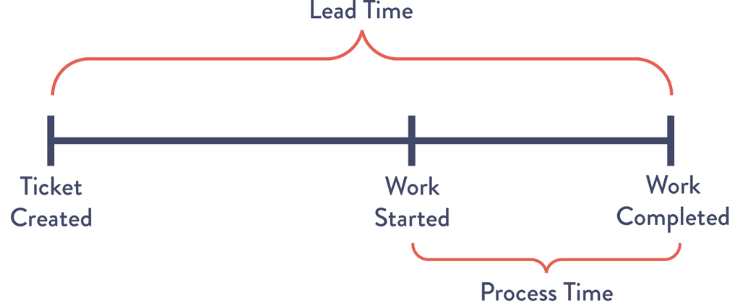
Defining Lead Time vs. Processing Time
Lead Time: The total time taken from the initiation of a process to its completion, including both processing time and any wait time between stages.
Processing Time: The time spent on performing the tasks or activities required to complete a process, excluding any wait time.

Slide 4
Common Scenario: Deployment Lead Times Requiring Months
Description of traditional deployment processes:
Manual and error-prone deployment procedures
Siloed teams with handoffs and delays between development, QA, and operations
Challenges and inefficiencies leading to long lead times:
Lack of automation
Complex release processes
Manual testing and deployment
Impact on productivity and competitiveness: Slow deployment cycles hinder innovation, delay time to market, and increase the risk of defects and outages.

Slide 5



Our DevOps Ideal: Deployment Lead Times of Minutes
Introduction to the DevOps ideal of rapid deployment:
Continuous Integration and Continuous Deployment (CI/CD)
Infrastructure as Code (IaC)
Automated testing and deployment pipelines
Benefits of reducing lead times to minutes:
Faster feedback loops
Rapid delivery of features and bug fixes
Increased agility and responsiveness to customer needs
Examples of companies achieving this ideal:

Slide 6
Strategies for Achieving Rapid Deployment
Automation of build, test, and deployment processes:
Use of CI/CD tools (e.g., Jenkins, GitLab CI)
Scripting and automation frameworks (e.g., Ansible, Chef, Puppet)
Continuous Integration and Continuous Deployment (CI/CD):
Automate the entire software delivery process, from code commit to production deployment.
Implement automated testing at every stage to ensure quality and reliability.
Infrastructure as Code (IaC):
Define and manage infrastructure using code, enabling version control, consistency, and repeatability.
DevOps culture and collaboration:
Break down silos between development, QA, and operations teams.
Foster a culture of collaboration, experimentation, and continuous improvement.

Slide 7
Strategies for Achieving Rapid Deployment
Key Strategies:
Automation: Implement automation across the deployment pipeline to reduce manual interventions and ensure consistency.
CI/CD: Adopt Continuous Integration and Continuous Deployment practices for automated builds, tests, and deployments.
Infrastructure as Code (IaC): Manage and provision infrastructure using code to enable versioning, repeatability, and scalability.
Streamlined Processes: Eliminate bottlenecks and manual handoffs, foster team collaboration, and encourage cross-functional collaboration.
Continuous Improvement: Foster a continuous improvement and experimentation culture to optimize deployment processes iteratively.

Slide 8
Reference
Kim, G. et al. (2021) The devops handbook: How to create world-class agility, reliability, & Security in Technology Organizations. Portland, OR: IT Revolution Press, LLC.
Prakash, S. (no date) What is a Value Stream, Value Stream Mapping, and Value Stream Management?, Devopsinstitute.com. Available at: https://www.devopsinstitute.com/value-stream-management-explained-in-plain-english/ (Accessed: 29 May 2024).

