Slide 1

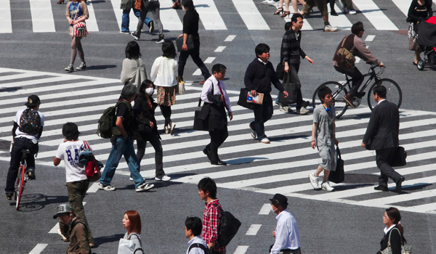
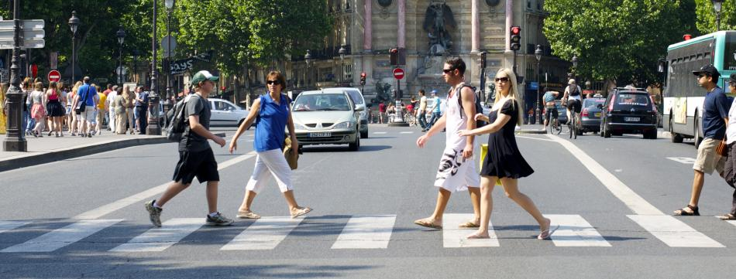
A Fog-based Architecture for Safeguarding Vulnerable Road Users
Institute of Automotive and Transport (ISAT)

Slide 2


World Health Organization
global status report on road safety 2014

Slide 3
World Health Organization 2014 :
Category | 2000 | 2010
Pedestrian | 10.4 % | 12.1 %
Cyclists | 3.3 % | 3.7 %
Moped | 5.6 % | 6.2 %
Motorcyclists | 11.6 % | 17.6 %
1.2 million
injuries each year.
Distribution of fatal road accidents according to the different categories of users
Notes:
No Slide Master

Slide 4
World Health Organization 2014 :
Category | 2000 | 2010
Pedestrian | 10.4 % | 12.1 %
Cyclists | 3.3 % | 3.7 %
Moped | 5.6 % | 6.2 %
Motorcyclists | 11.6 % | 17.6 %
1.2 million
injuries each year.
Distribution of fatal road accidents according to the different categories of users
Notes:
No Slide Master

Slide 5
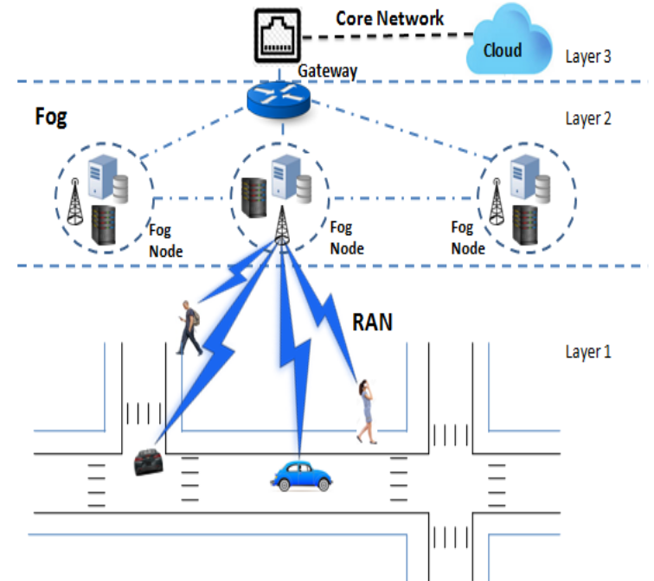
Infrastructure-less fog-based architecture

Slide 6
Infrastructure-less fog-based architecture

Slide 7
Infrastructure-less fog-based architecture

Slide 8
Infrastructure-less fog-based architecture

Slide 9
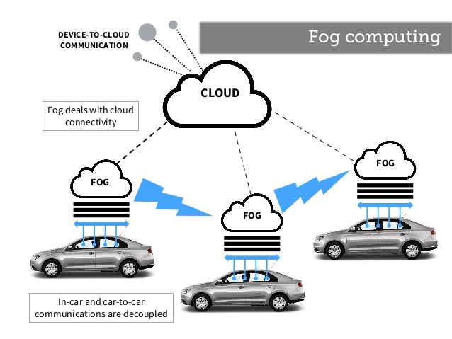
Infrastructure-less fog-based architecture
Characteristics:
- Low latency
- Location awareness
- Wide spread geographical distribution
- Mobility support

