Slide 1
ClinGen Allele Registry
Protein Variants
Piotr Pawliczek
April 2017

Slide 2
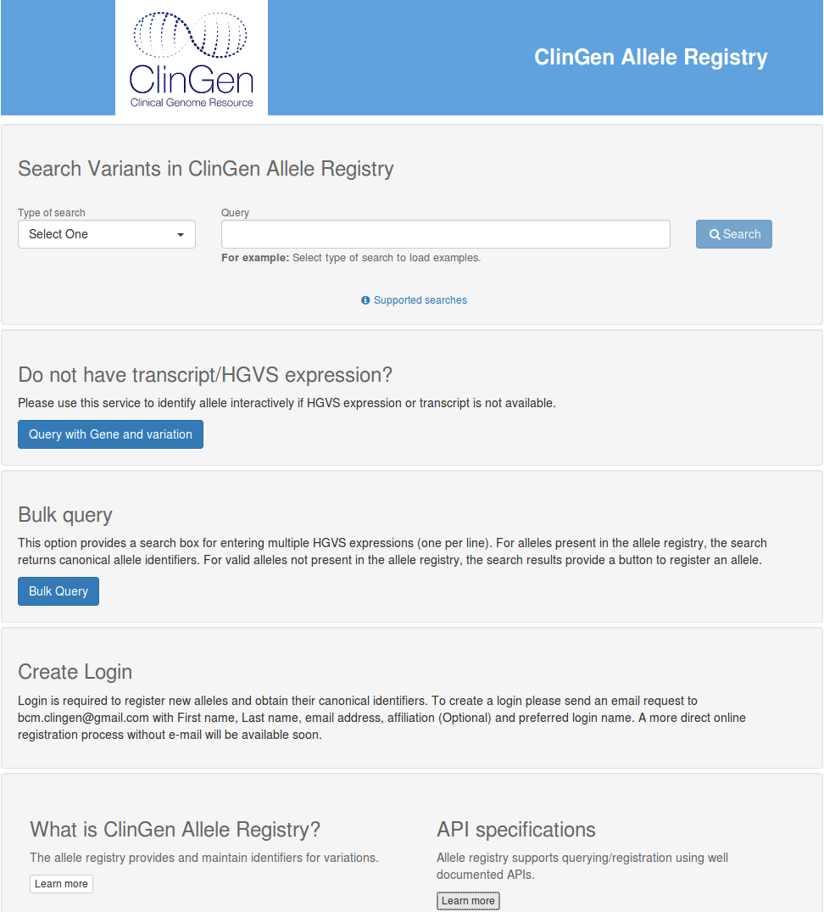
Current version
Last CAR release (0.10.04) is installed on the Rackspace servers.
New User Interface (beta version)
Production server: http://reg.genome.network http://reg.clinicalgenome.org
Test server: http://reg.test.genome.network
REST API with JSON-LD responses
Documentation for API with examples in Python and Ruby

Slide 3
Next version - in development
Next CAR release (0.11.x) will appear in ~3-4 weeks on the test server (http://reg.test.genome.network).
~250 millions of Canonical Alleles (vs. ~15 millions in 0.10.x)
Identifiers and links to dbSNP, gnomAD, myVariant.info
Larger & faster bulk queries & registrations
API – new parameters to control format of output documents
Better support for protein variants (to discuss)

Slide 4
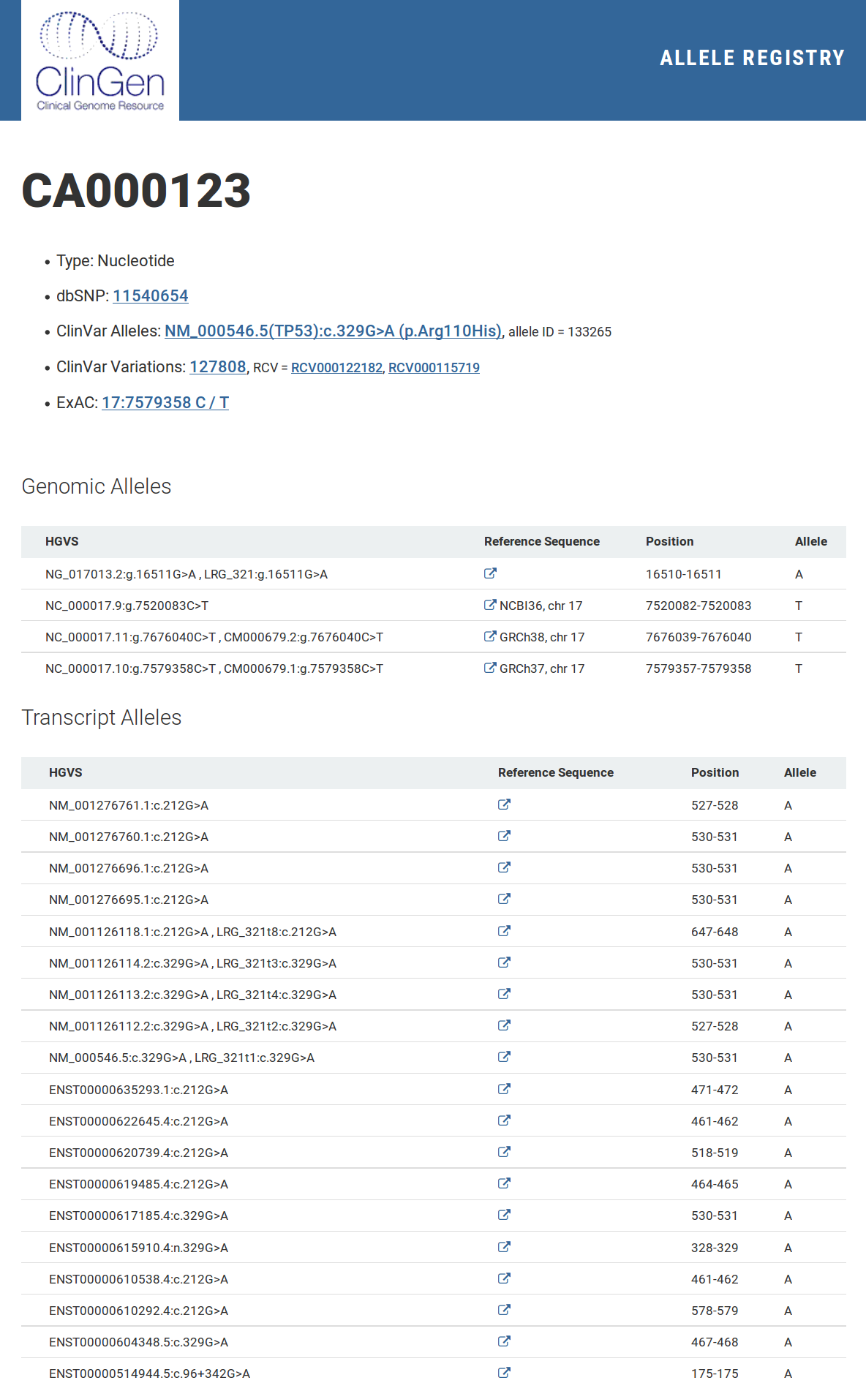
Genomic alleles
Single returned page in UI (or document in API) corresponds to one Canonical Allele. It contains list of corresponding Contextual Alleles and known external identifiers (and links).

Slide 5
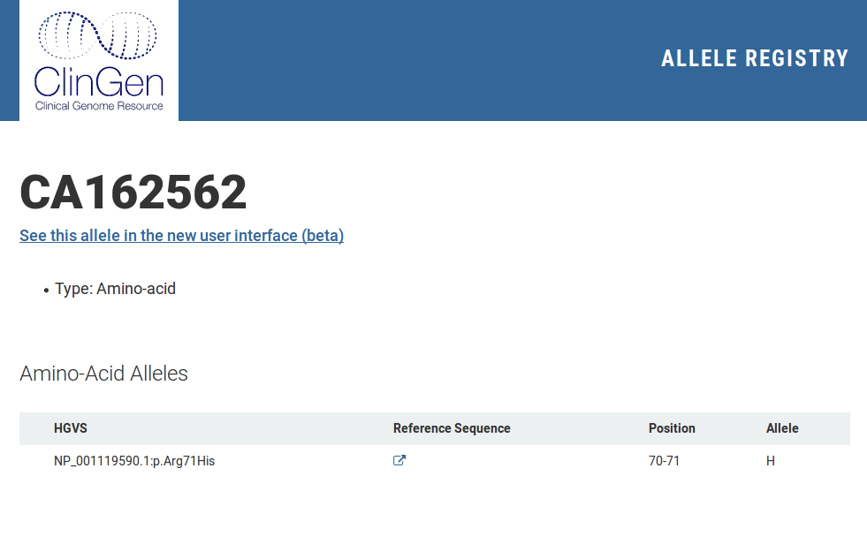
Protein alleles
Canonical Alleles with protein variants contain always one protein mutation (Contextual Allele). There is no link between genomic & protein alleles.

Slide 6
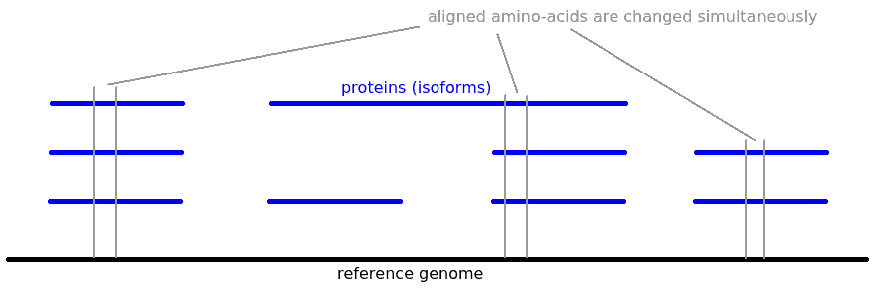
Grouping together protein alleles
For each protein's amino-acid we can find corresponding codon on the reference genome
For this codon we can find all proteins, that contain amino-acid produced from this codon (no frameshift is allowed)

Slide 7
Grouping together protein alleles
Using this approach we can calculate alignment between proteins (isoforms).
For given protein variant, a list of corresponding protein variants can be calculated.
For given protein variant CAR can return page (document) with corresponding variants on different proteins, that always co-occur together (Canonical Protein Allele).
Two Contextual Protein Allele belong to the same Canonical Protein Allele => they occur simultaneously (it does not work in the opposite direction).

Slide 8
Protein variant (modification) definition
Protein variant (modification) definition:
  Sequence modification (minimal, right aligned)
    Range of replaced amino-acids (may be empty)
    New amino-acids (may be empty)
  Frameshift
    0 – no frameshift
    1 – skip 1bp
    2 – skip 2bp
Complex Alleles can be aligned between proteins
Several different protein variants with frameshifts can be translated to the same HGVS

Slide 9
Links between genomic & protein alleles
Contextual Genomic Allele may have link to single Contextual Protein Allele (exception: two “active” start codons)
Canonical Genomic Allele may have link to single Canonical Protein Allele
Contextual Protein Allele may have links to several Contextual Genomic Allele
Canonical Protein Allele may have links to several Canonical Genomic Allele

Slide 10
Others
Change prefix of identifiers of Protein Alleles
What should have unique ID?
  Canonical Protein Allele
  Contextual Protein Allele (this is probably needed)
  both
Where to bind external identifiers?
  Canonical Protein Allele
  Contextual Protein Allele
  Both
Can Contextual Protein Allele belong to two Canonical Protein Alleles?

