Slide 1
ClinGen Allele Registry
Protein Variants
Piotr Pawliczek
May 2017

Slide 2
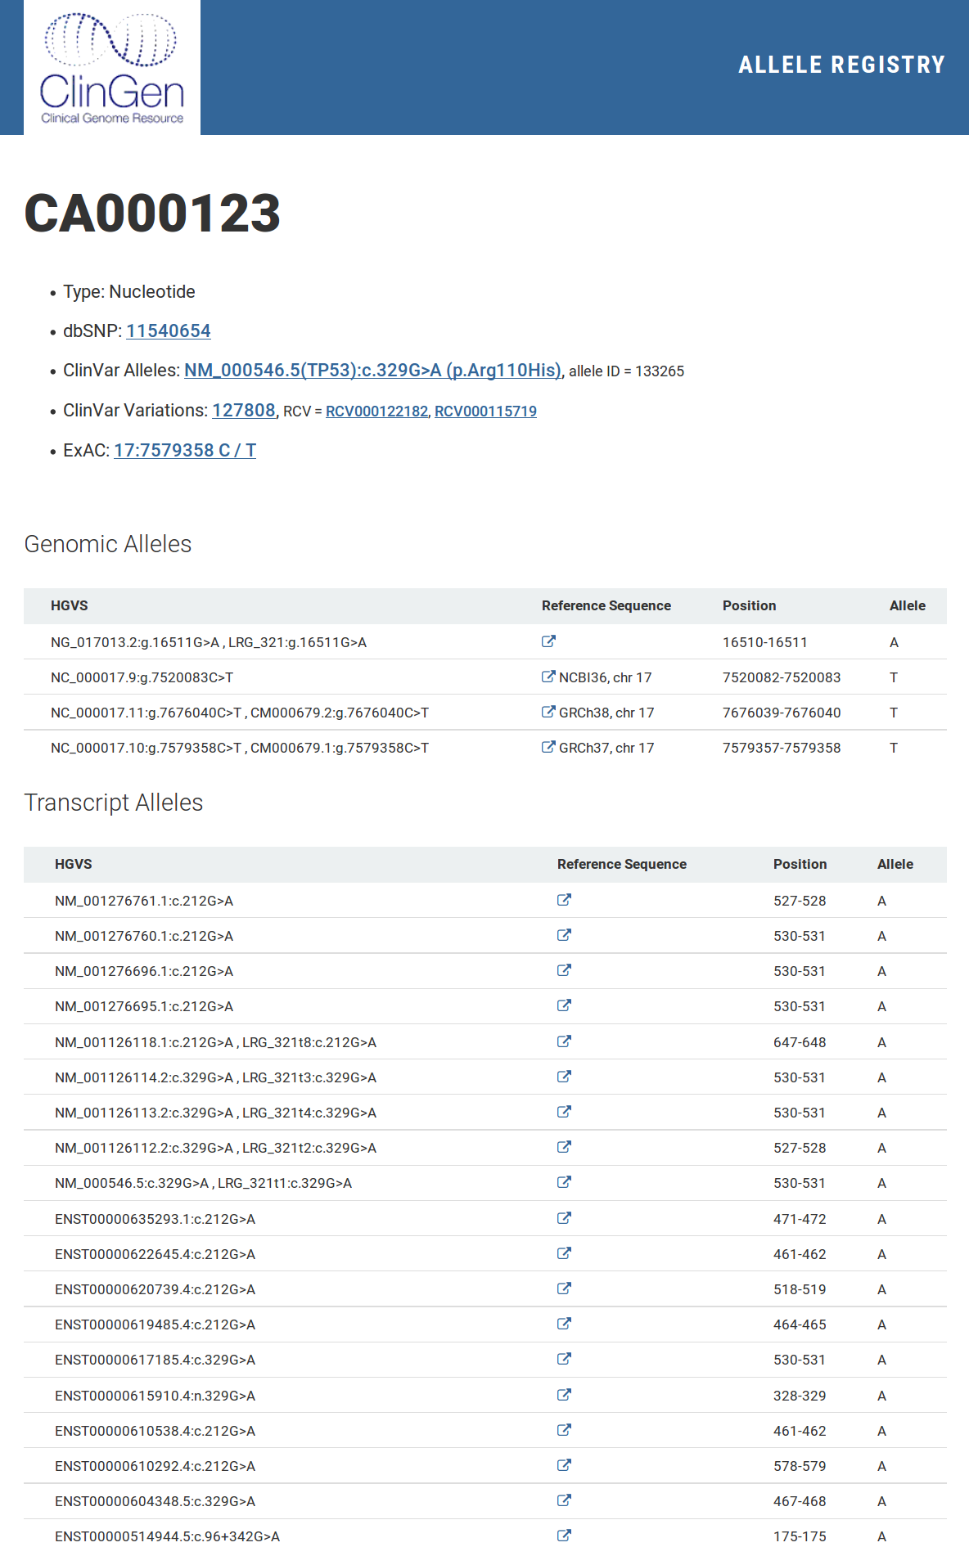
Current version - Genomic alleles
Single returned page in UI (or document in API) corresponds to one Canonical Allele. It contains list of corresponding Contextual Alleles and known external identifiers (and links).

Slide 3
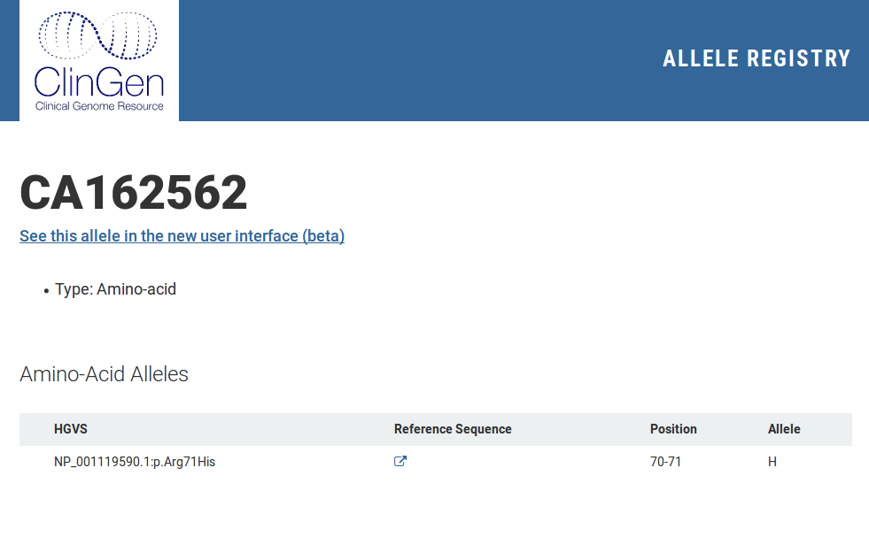
Current version - Protein alleles
Canonical Alleles with protein variants contain always one protein mutation (Contextual Allele). There is no link between genomic & protein alleles.

Slide 4
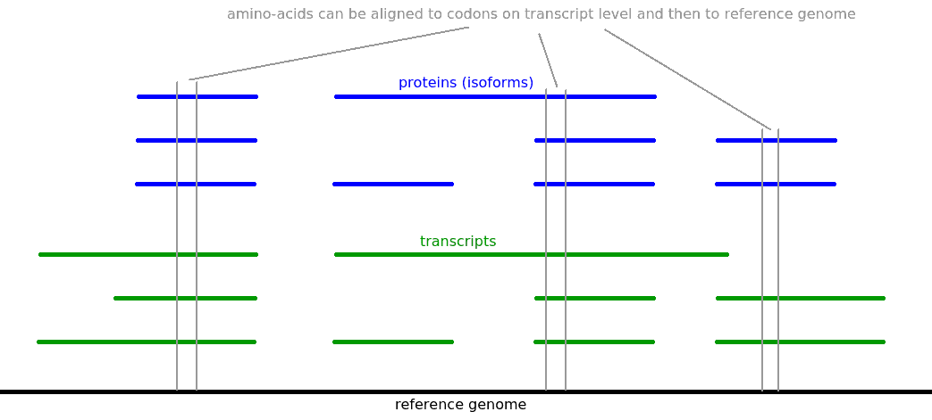
Protein alleles vs. Canonical Alleles

Slide 5
Amino-acid variants vs. nucleotide variants
For every alteration on amino-acid level, we can generate many matching alterations on nucleotide level.
On the nucleotide level, SNVs and insertions/deletions with length divisible by 3 can be mapped directly to amino-acid level (if don't cross exon-intron boundary).
Insertions/deletions with length indivisible by 3 cause frameshift, what seriously affects the rest of the protein.
In some cases, effect of frameshift appears couple of amino-acids downstream from alteration on nucleotide level.

Slide 6
Example
The changes on amino-acid level can origin from upstream changes on transcript level.
In the example below the amino-acid alteration p.Gly17Arg is caused by small insertions located 10 base-pairs upstream from the corresponding codon.
NM_001178030.1:c.[38_39insT;51del]
NP_001171501.1:p.G17R = NP_001171501.1:p.Gly17Arg
M A T G A N A T P L G K L G P P G L P P
ATGGCGACCGGAGCGAACGCCACGCCGTTGGGTAAGCT_GGGCCCCCCCGGGCTGCCCCCG
ATGGCGACCGGAGCGAACGCCACGCCGTTGGGTAAGCTTGGGCCCCCCCGG_CTGCCCCCG
M A T G A N A T P L G K L G P P R L P P
The same effect on protein level may be caused by simple SNP: NM_001178030.1:c.49G>C.

Slide 7
Protein Allele
Definition of protein variant
  Protein ID
  Alteration of protein sequence
Two alteration of protein sequence are the same <=> they produce the same output sequence
Protein Allele registered in the system will have unique ID with prefix PA (e.g. PA001234). Requests to the “old” protein alleles registered with prefix CA will be redirected to the new ones

Slide 8
Links between genomic & protein alleles
Contextual Allele (transcript level) may have link to single Protein Allele (exception: two “active” start codons)
Protein Allele may have links to several Contextual Alleles (transcript level)
Protein Allele may have links to several Canonical Alleles

Slide 9
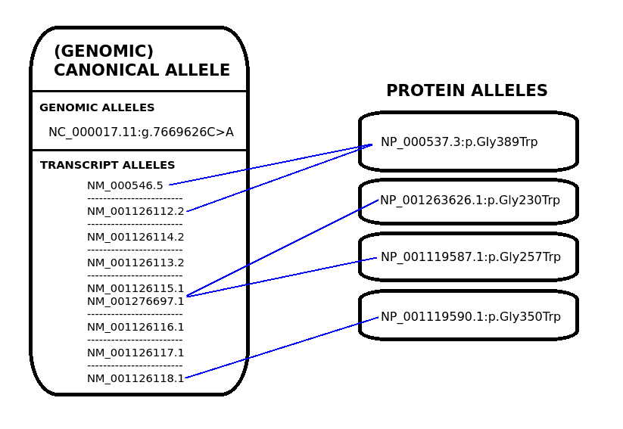
Relations between Canonical & Protein Alleles

Slide 10
What is well-defined protein variant?
We cannot defined alteration of protein variant based on alteration of underlying transcripts – the same/different variants for different transcript's versions can produce different/the same protein variants (many-to-many relation)
We have to base on resultant alteration of protein sequence (frameshift definitions like “Gly17Argfs” cannot be used for identity resolution)
We allow to register and browse protein variants alterating no more than 7 amino-acids

Slide 11
Protein variants implementation on 0.11.x
Change prefix of identifiers of Protein Alleles
No protein variants with frameshift (large alterations) are registered - only well-defined protein variants
For every transcript variant, corresponding protein variant is calculated automatically (with link to document with Protein Allele, if well-defined)
For every well-defined Protein Allele, links to all corresponding, already registered Canonical Allele are provided.
Full normalization for well-defined protein variants

