Slide 1
97 Nissan Pickup
Model Release
March 2024

Slide 2
Original Data Collection & Modeling
Collected 4425 Scanned Data Points using X-station System, sketches, and hand measurements.
Imported collected points into Rhino (V4.0 4b)
Built much of the target description in Rhino using reference points, sketches, and hand measurements.
Additional modeling in BRL-CAD to replace lines and pipes with pipe entities and subtractions to eliminate overlaps.

Slide 3
Conversion to BRL-CAD
Used BRL-CAD Version 7.16.7
Used BRL-CAD’s 3dm-g utility to convert between Rhino and BRL-CAD.
3DM conversion was 372 primitives, 278 regions, and 114 groups
BRL-CAD model was originally 240 primitives, 337 regions, and 367 groups.
Final hybrid BRL-CAD model is 364 primitives, 362 regions, and 376 groups

Slide 4
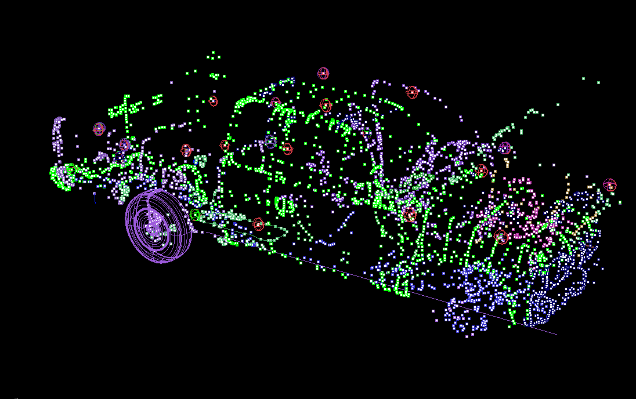
Reference Points Collected

Slide 5
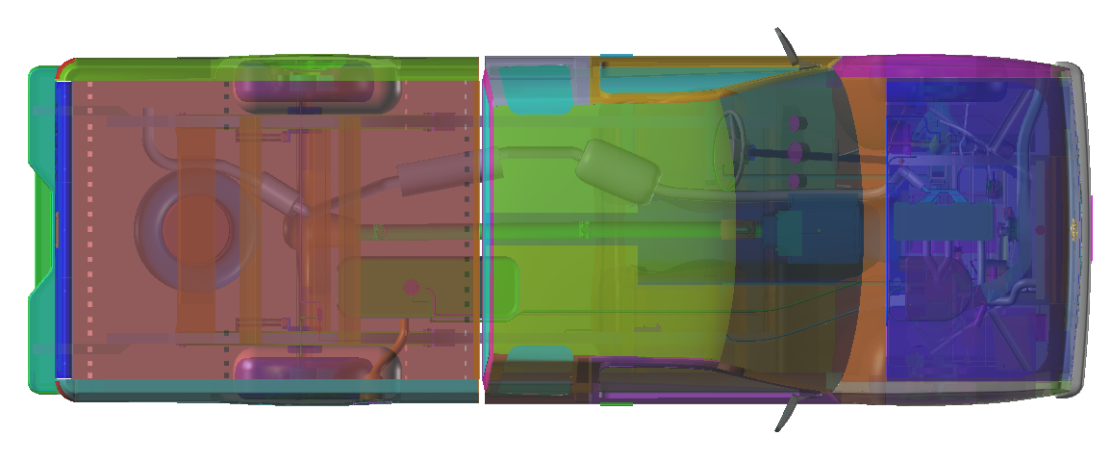
Top View

Slide 6
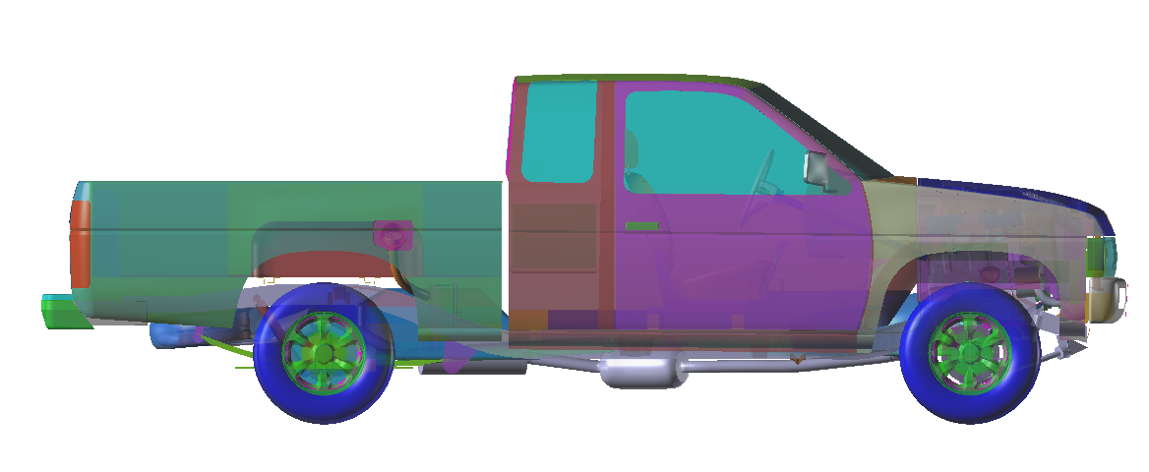
Right View

Slide 7
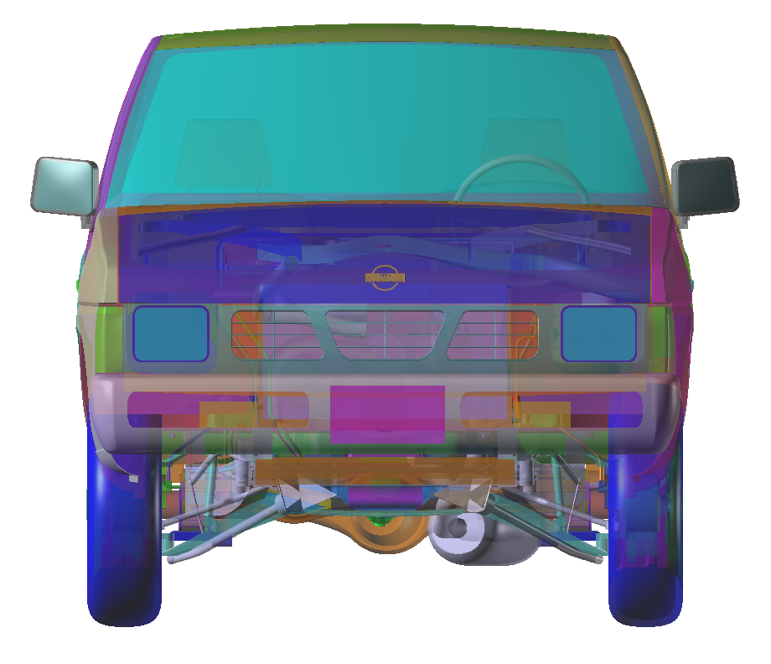
Front View

Slide 8
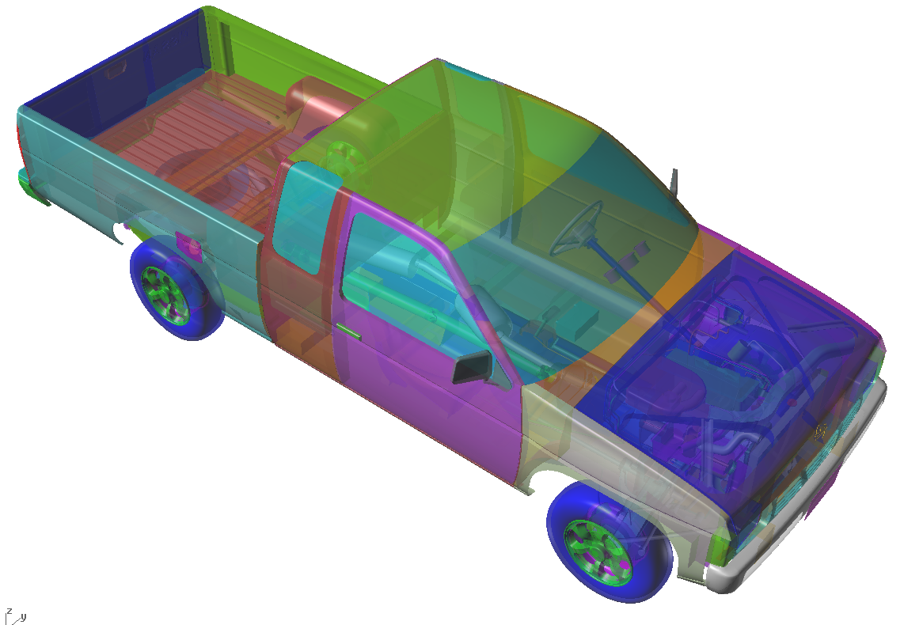
Perspective View

Slide 9
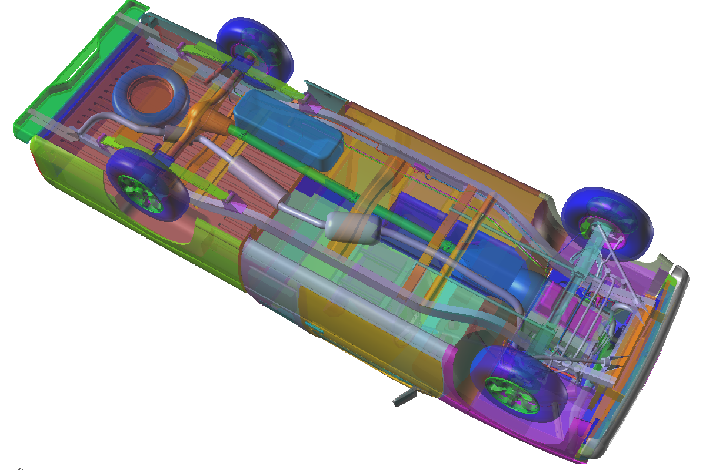
Bottom View

Slide 10
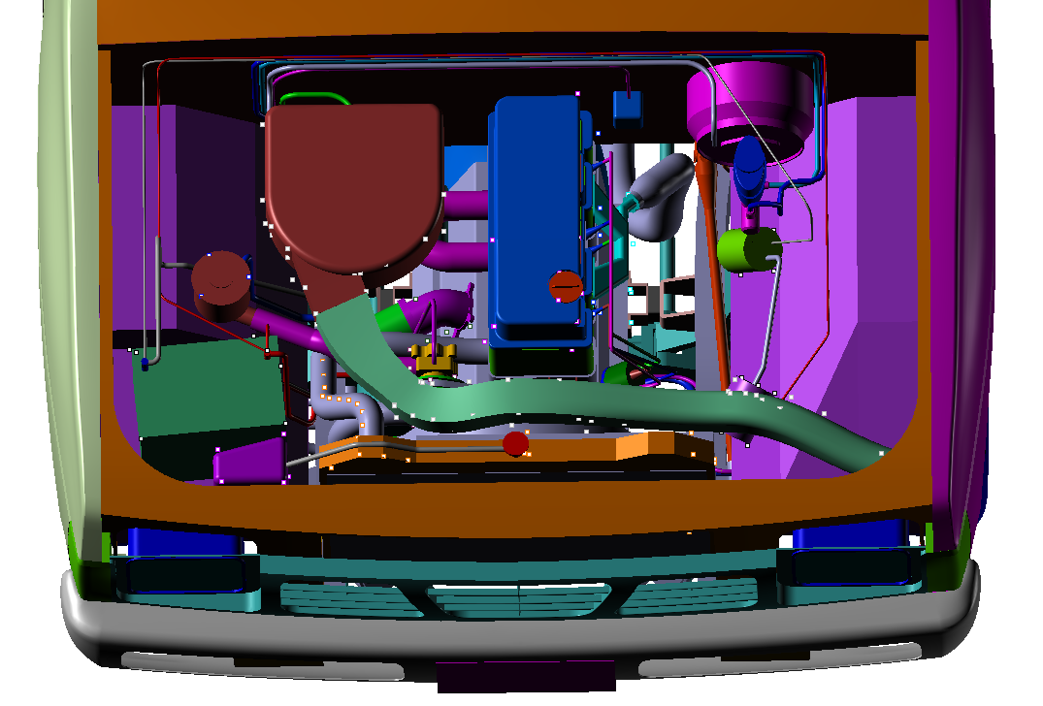

Slide 11
