Slide 1
Code Project spam detection
Detect spam questions on a coding QnA platform and classify them
Debmalya Sen(MT2021036) and Bhargav Mehta(MT2021029)

Slide 2
MULTI CLASS TEXT CLASSIFICATION PROBLEM
DATASET: TRAIN DATA - 1685264 rows × 12 columns
TEST DATA - 1685264 rows × 11 columns
As we can see ,number of data points in our training and test data set are approx 1.6 million each ,it is a problem where we have to deal with big data too.
We have faced many problems due to large size of dataset we will discuss those later in the slides.

Slide 3
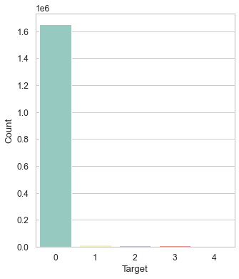
DATASET SCHEMA
DATASET CONSIST OF TOTAL 11 COLUMNS
Qid(id of the question asked)
Post date time and when account was made(Related to time)
Karma(similar to credibility)
NumAnswers(number of questions answered)
Heading of query
Main text of the query
Primary ,secondary ,tertiary and other Subject (of the query)
Target Column(5 class)
CLASS NO OF DATA POINTS ACTUAL OUTPUT
Class 0 1650195 valid questions
Class 1 15394 “kehna kya chahte ho”questions
Class 2 8765 irrelevant questions
Class 3 7830 low quality questions
Class 4 3079 not reproducible questions
Dataset is highly imbalanced

Slide 4
TAKEAWAYS FROM THE DATASET
DATA IS HIGHLY IMBALANCED
QID IS OF NO USE CAN BE DROPPED
DAY AND TIME OF A POST AND ACCOUNT CREATION DATE CAN BE USED TO GET A ESTIMATE OF HOW OLD AN ACCOUNT IS
NUM OF ANSWERS AND KARMA MAY BE HELPFUL(WE WILL SEE LATER)
THERE ARE MANY SUBJECTS THEY CAN BE CONCATENATED TO ONE SUBJECT
SUBJECT ,HEADING AND MAIN TEXT NEED TO BE PREPROCESSED

Slide 5
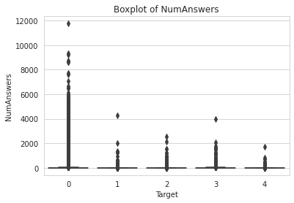
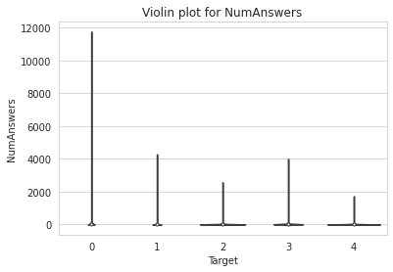
Exploratory data analysis
Analysis of NumAnswers
Observation: If NumAnswers are >3000(approx) then there is high probability that it is valid question.

Slide 6
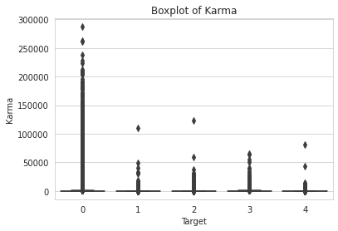
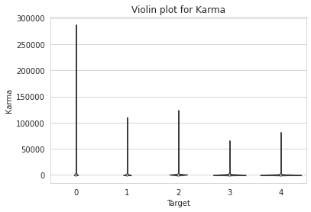
Exploratory data analysis
Analysis of Karma
Observation: If Karma is >60000(approx) then there is high probability that it is valid question.

Slide 7
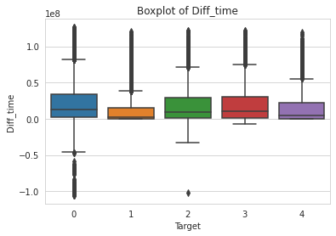
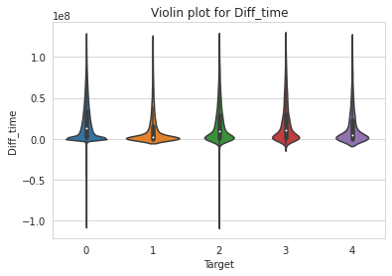
Exploratory data analysis
Analysis of (PostDateTime – WhenAccountMade)
Observation: for class 1 and 4 difference of PostDateTime and WhenAccountMade is less as compared to class 0 , 2 and 3.

Slide 8
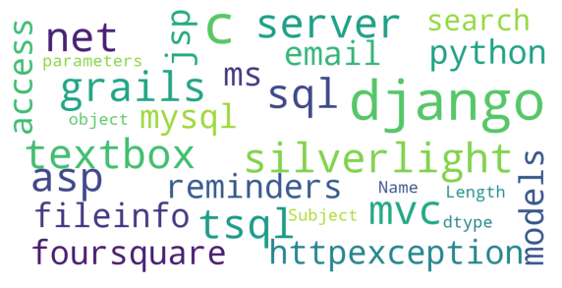
Word cloud for valid questions
considering Subject column

Slide 9
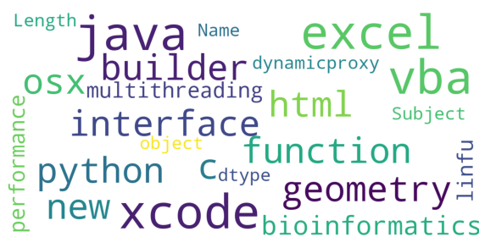
Word cloud for “kehna kya chahte ho”questions considering Subject column

Slide 10
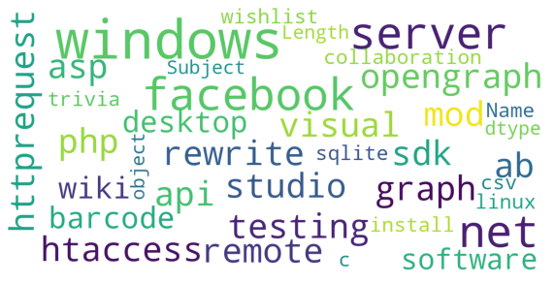
Word cloud for irrelevant questions
considering Subject column

Slide 11
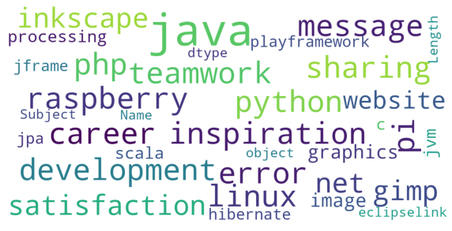
Word cloud for low quality questions
considering Subject column

Slide 12
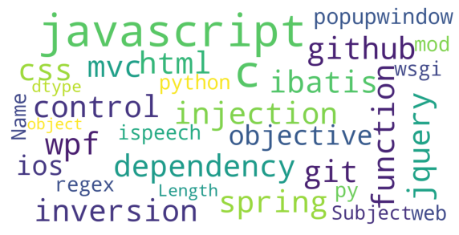
Word cloud for not reproducible questions
considering Subject column

Slide 13
Text preprocessing steps
Removal of Contractions:
Expansion of contracted words such as “you’ve”➔"you have"
Removal of Non-alphanumeric & non printable characters
Removal of Email address
Removal of Numeric characters
Removal of URLs
Converts all characters to lowercase
Removing stop words
Removal of Multiple whitespaces to one

Slide 14
Text preprocessing steps(continued)
Lemmatization
Lemmatization is a process of grouping together words with the same root or lemma but with different meaning so they can be analyzed as one item.
Example:
‘Caring’ -> Lemmatization -> ‘Care’
‘Caring’ -> Stemming -> ‘Car’

Slide 15
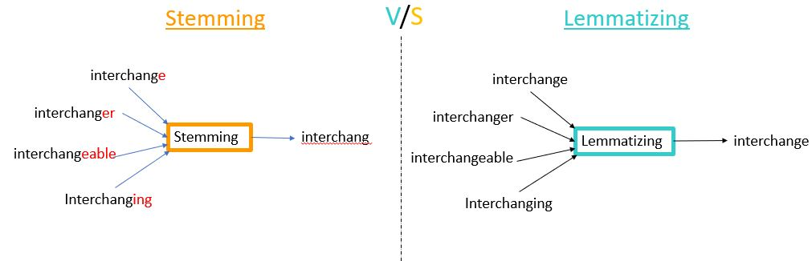
Text preprocessing steps(continued)
We preferred lemmatization over stemming due to below reasons,
In contrast to stemming, lemmatization looks beyond word reduction and considers a language’s full vocabulary to apply a morphological analysis to words. The lemma of ‘was’ is ‘be’ and the lemma of ‘mice’ is ‘mouse’.

Slide 16
Word Embeddings
Word embedding we used are,
Hashing vectorizer:
  it can be used in a streaming (partial fit)
  it is very low memory scalable to large datasets as there is no need to store a vocabulary dictionary in memory.
2) BOW
    BoW model creates a vocabulary extracting the unique words from the documents and keeps the vector with the term frequency of the particular word in the corresponding document
    In BOW Term ordering is not considered
    In BOW Rareness of a term is not considered
    Due to above reasons we are using TFIDF.

Slide 17
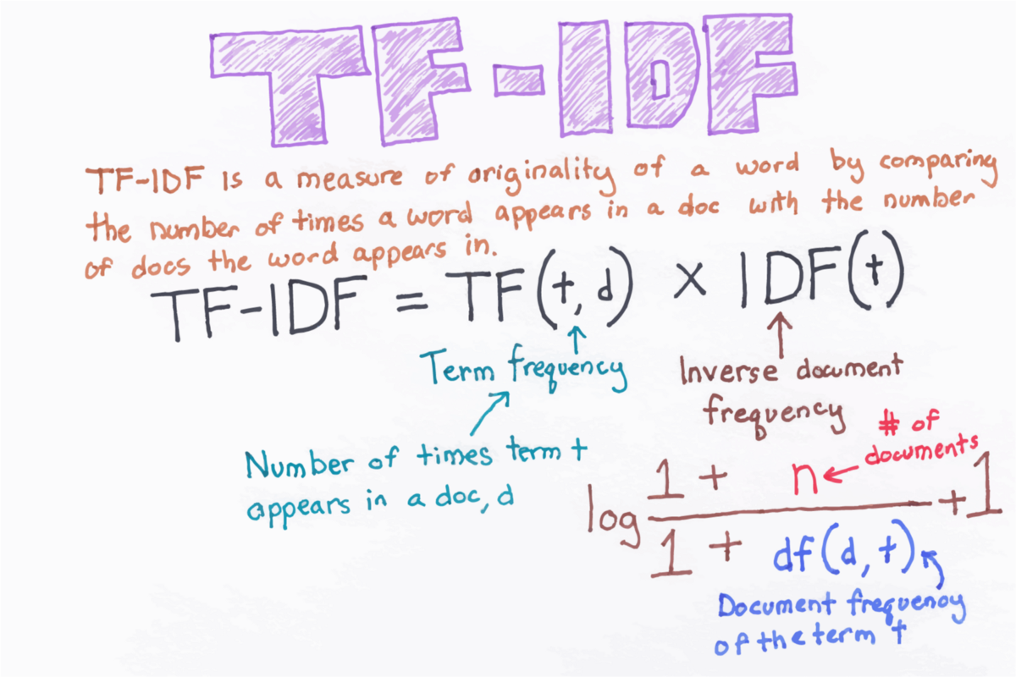
3) Tfidf
Here Rareness of a term is considered and Term ordering is also considered.

Slide 18
4)Word2vec
The word2vec algorithm uses a neural network model to learn word associations from a large corpus of text,considers the context .
Once trained, such a model can detect synonymous words or suggest additional words for a partial sentence
As the name implies, word2vec represents each distinct word with a particular list of numbers called a vector
We have tried 2 varations,
1. Average word 2 vec
  In this method after finding vector representation for each word we take average of all vector representations present in the cell.
2. Tfidf word 2 vec
  In this method after multiplying each word vector with it’s corresponding tfidf value we add them to get final vector representation of cell.

Slide 19
Data set preparation
Normalization of NumAnswers, Karma and Difference of PostDateTime and WhenAccountMade columns
Output of TFIDF and BOW is sparse matrix so we have concatenated above mentioned columns with sparse matrix to get final train and test data.

Slide 20
Models
We experimented with Naive Bayes as it performs well for Big data as the computations involved are very less, in the meantime we came across Complement Naive Bayes which outperforms Naive Bayes when the data is unbalanced .
When Complement Naive Bayes was tried with BOW it gave us a macro F1 score around 0.2556, and gave a score of around 0.197 when tried with TFIDF.
When multinomial naïve bayes was tried with tfidf it gave us a macro F1 score around 0.1979.

Slide 21
Hyper parameter tuning
BOW(n gram range=(1,1)) with complement_NB gave us max f1 score of 0.2556.
BOW(n gram range=(1,2)) with complement_NB gave us max f1 score of 0.18721.
We tried combination BOW(n gram range=(1,3)) with complement_NB but we got RAM limit exceeded runtime error.

Slide 22
Models(continued)
When random forest(with balanced class weights) was tried with word2vec it gave us a macro F1 score around 0.09529.
When bagging was tried with word2vec it gave us a macro F1 score around 0.12025.
When boosting was tried with word2vec it gave us a macro F1 score around 0.10398.
When easy classifier was tried with word2vec it gave us a macro F1 score around 0.10301.
When complementary NB was tried with word2vec it gave us a macro F1 score around 0.15989.

Slide 23
Models(continued)
When complement NB was tried with hashing vectorizer it gave us a macro F1 score around 0.19878.
When multinomial_NB was tried with tfidf it gave us a macro F1 score around 0.1979.
When logistic_regression was tried with tfidf it gave us a macro F1 score around 0.1979.

Slide 24
Models(continued)
Poor performance of word2vec owes to the fact that word embeddings works best with neural networks, as Sequence of data is to be considered.
We tried Word2Vec only on heading column as in other cases we were getting RAM error,we think that we would have get better results if we would have tried word2vec over the maintext and subject column too.
TFIDF models works better than wordtovec when classical models are considered .

Slide 25
With the Word2vec model we tried Random forest too and got an macro F1 score Around 0.9529.
We came across imblearn library and applied many inbuilt algorithms such as easy classifier ,bagging and boosting , all these algorithms are suitable for unbalanced data.
We have specified the macro F1 score we got later in an excel file.
Models(continued)

Slide 26
Problem faced
Dataset is immensely huge so train and test data is taking more time for preprocessing.
How to find semantic of the sentence.
After reducing number dimensions still it is difficult to preprocess data.

Slide 27
Whats’s next
We will experiment with word2vec embeddings on neural network(LSTM,BERT) models later .

