Slide 1
S
Schedulr.
Version-controlled specification schedules for architecture and interiors practices
Software Engineering Bootcamp · Capstone Project · 2026
Presented by Hannah Williams

Slide 2
Outdated localized software for Architecture/ Interior Design Scheduling ...
The Problem!
Nothing is remembered
1
That perfect product you specified in 2023. Or was it 2024? Six hours of folder-diving later… Ouch it was 2022.
Everything is retyped (or worse copied and pasted)
2
The same 30 products, typed again and again every project but with different typos.
And the schedule you just sent the client still cites the 2016 building code; the year of the project you copied it from.
Nothing is shared
3
You find the perfect tile six months too late, because it was living in someone else's spreadsheet.
I work in an architecture and interiors practice; believe me I have seen the problem! many times, with my own eyes.

Slide 3
Spreadsheet ease, organisation accessible library, full version control
The Solution!
1
2
3
Edit like a spreadsheet
Never lose a version
Reuse across projects
Double-click a row, type, click away. No forms, no create pages, no page loads.
Every save writes a new immutable version. Nothing is ever overwritten.
A shared organisation library. Specs flow into schedules and refined ones flow back.
From experience: designers don't love change, so the solution! had to feel like Excel, their old friend

Slide 4
S
Live Demo

Slide 5
VERSIONING
An edit adds a version — it never overwrites one
Spec
SpecOption
SpecVersion
the thing being specified
e.g. Acoustic Wall Panel
a product choice
holds a pointer to current
immutable snapshot
of the text
What happens when someone edits a spec
1
The old version is left exactly as it is
2
A new SpecVersion is written, numbered 2
3
SpecOption.currentVersionID moves to point at it
4
Any read follows the pointer, so it lands on the new version

Slide 6
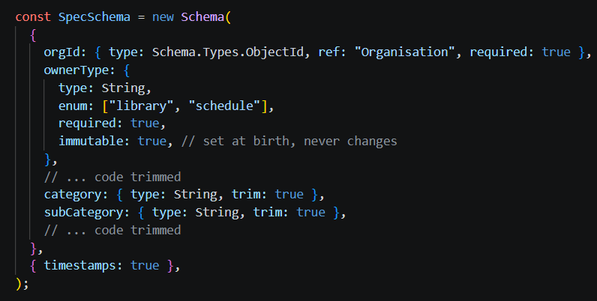
VERSIONING
An edit adds a version — it never overwrites one
Spec
the thing being specified
e.g. Acoustic Wall Panel
backend/src/models/specModel.js

Slide 7
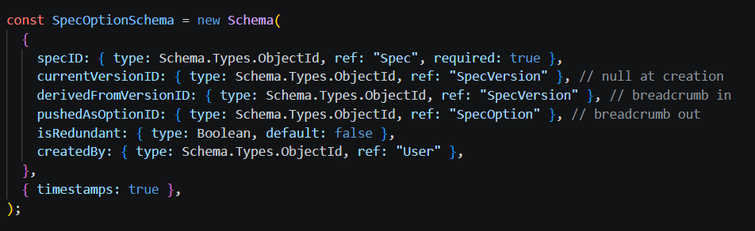
VERSIONING
An edit adds a version — it never overwrites one
SpecOption
a product choice
holds a pointer to current
backend/src/models/specOptModel.js

Slide 8
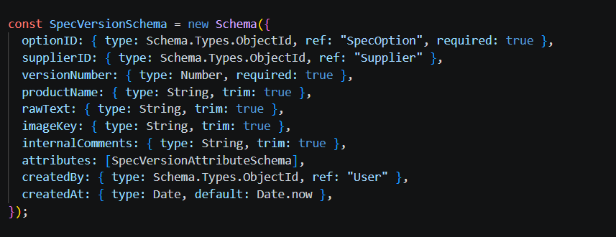
VERSIONING
An edit adds a version — it never overwrites one
SpecVersion
immutable snapshot
of the text
backend/src/models/specVerModel.js

Slide 9
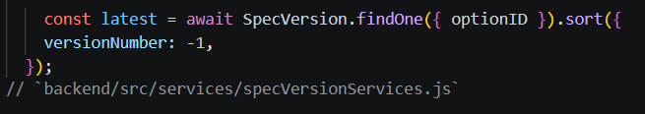
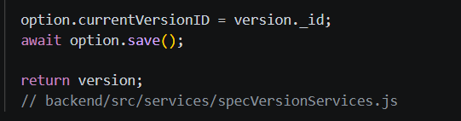
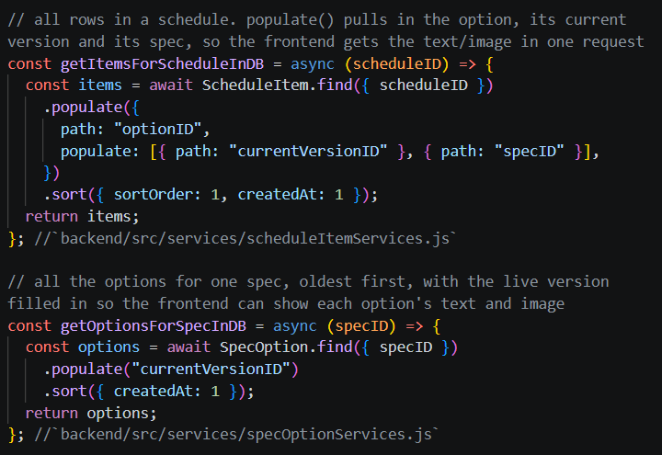
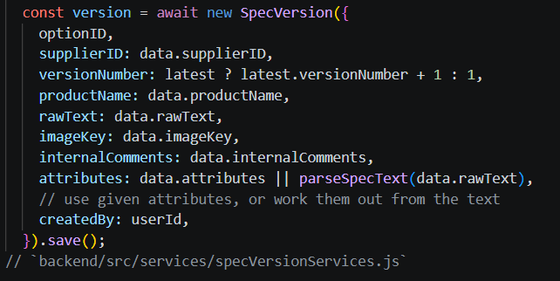
VERSIONING
What happens when someone edits a spec
1
The old version is left exactly as it is
3
SpecOption.currentVersionID moves to point at it
The existing version is only ever read, to find out what number to use next.
4
Any read follows the pointer, so it lands on the new version
2
A new SpecVersion is written, numbered 2

Slide 10
FRONTEND
Making a web grid behave like a spreadsheet
1
Multi-line editing inside a cell
2
Images rendered in the row
3
Filtering without the round trip

Slide 11
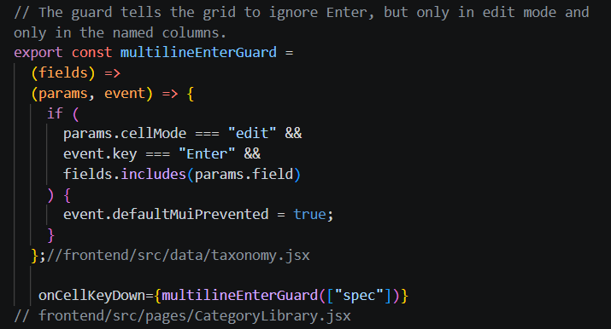
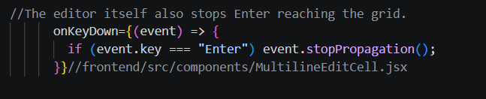
FRONTEND
Making a web grid behave like a spreadsheet
Multi-line editing inside a cell
1
A DataGrid commits the row when you press Enter. A spec needs Enter to mean a new line. A key guard intercepts it inside the Specification cell, so the text box behaves the way a designer expects and clicking away is what saves.

Slide 12
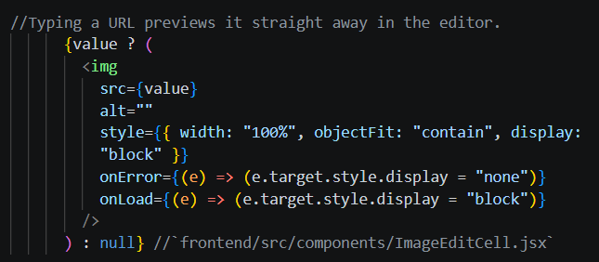
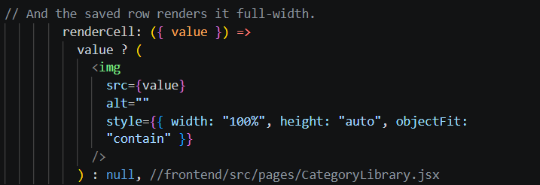
FRONTEND
Making a web grid behave like a spreadsheet
Images rendered in the row
1
2
Paste an image URL and it previews live in the edit cell, then renders full-width in the grid — so a finishes schedule can be read visually, the way a sample board is.

Slide 13
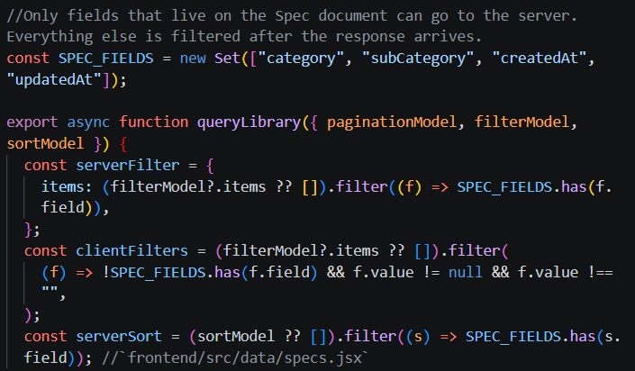
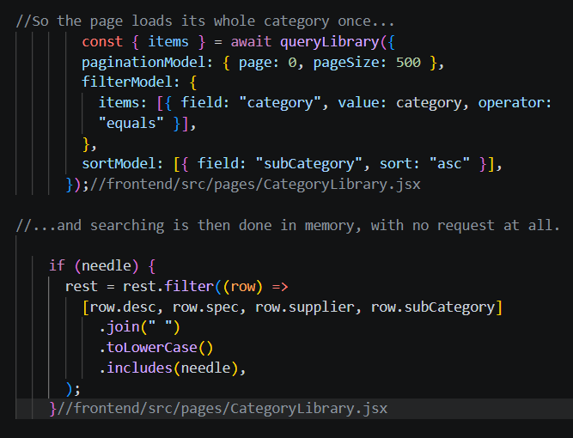
FRONTEND
Making a web grid behave like a spreadsheet
Filtering without the round trip
3
The product text lives on the version, not the spec, so the server cannot filter on it. Each library page loads its category once and filters in memory, which makes searching and sorting instant.

Slide 14
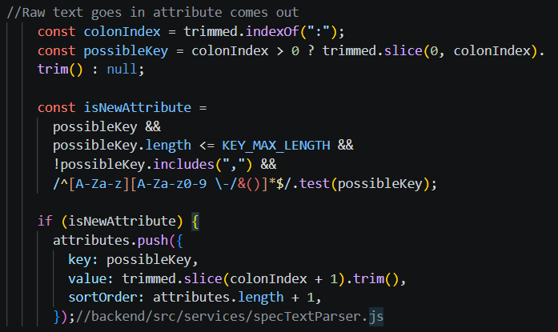
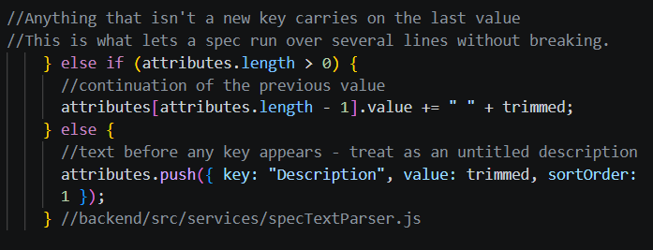
THE TEXT PARSER
One text box in, structured data out
What the designer types
What the database stores
Product: Echopanel 24mm
Colour: Onyx 550
Size: W1200 x L2800
NRC: Direct fix 0.65
Supplier: Woven Image
rawText the text, kept verbatim
attributes[]
{ key: "Colour", value: "Onyx 550" }
{ key: "Size", value: "W1200 x L2800" }
… sortOrder preserved
parse
Typing stays as fast as a spreadsheet cell, but the data comes out structured - ready for filtering, comparison and export later, no forms

Slide 15
Schedulr.
S
with Spreadsheet ease.
but Nothing forgotten.
and Everything shared.
Thank you — happy to take questions.
For more information, please refer to the README and Project Documentation.

