Slide 1

Internet Programming
PHP
Presented by
Ahmed M

Slide 2
Contents
No
1 | Introduction to web development with PHP
2 | How to create and use arrays, strings
3 | How to code control statements, loops
4 | How to create and use functions
5 | How to test and debug a PHP application
6 | How to work with form data
7 | How to work with files, uploads, and images
8 | How to design a database
9 | Introduction to databases and MySQL

Slide 3
No. | Learn Content
 | How to use PHP with a MySQL database
 | Professional PHP for working with MySQL
 | How to work with sessions
 | A database-driven web based application
 | How to create secure websites

Slide 4
Course Description
Students apply PHP and MySQL to create dynamic web sites.
Employing the principles of usability engineering and information architecture.
Topics include:
creation of PHP web page features,
FTP
Accessibility and usability,
information design, and the graphic design of web pages.
A new framework
The course also includes introduction to MySQL for accessing a back-end database.

Slide 5
Cont…
Student BSC web site files can be accessed using public domain software.
The Windows software used includes a text editor (such as Notepad or NotePad++ ), and an HTML 5 compliant browser (IE 9, Chrome, or FireFox etc.).
Students do not need to purchase software because all software can be downloaded either from the Internet.

Slide 6
Objectives
Upon successful completion of this course, students:
will have a basic understanding of PHP and MySQL programming concepts and back-end databases to create and maintain interactive web pages.
Knowledge of web based application.

Slide 7
Grading system
Grade | Range |  |  | Grading | Grade | Range
A | 95 | - | 100 |  | C+ | 77 | - | 79
A- | 90 | - | 94 |  | C | 74 | - | 76
B+ | 87 | - | 89 |  | C- | 70 | - | 73
B | 84 | - | 86 |  | D | 60 | - | 69
B- | 80 | - | 83 |  | F | 0 | - | 59
No. | Learn Content
 | A database-driven website
 | How to create secure websites

Slide 8
URLs and web servers
A set of servers that map written names to IP address
Example’’
Your browser connects to that IP address and requests the given file
The web server software (e.g. Apache) grabs that file from the server's local file system.
The server sends back its contents to you
http://servername/path/file.html
http://ddu.edu.et/schools/chairs/CS.php
www.ddu.edu.et
10.235.10.11

Slide 9


Server-Side web programming
Server-side pages are programs written using one of many web programming languages/frameworks
Examples: PHP, Java/JSP, Ruby on Rails, ASP.NET, Python, Perl
Also called server side scripting

Slide 10
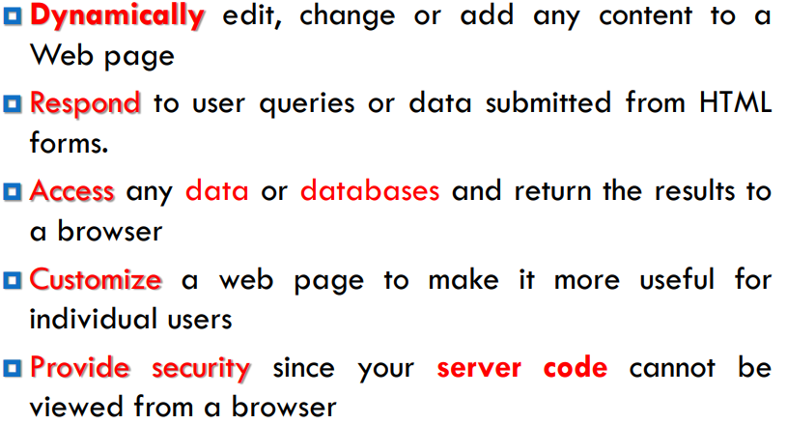
Cont…

Slide 11
Prerequisites for PHP
You can work on local machine
Set up development server
Some of them are:
WAMP – Windows Apache MySQL and PHP
XAMP is best for Windows flavor
MAMP – Mac Apache MySQL and PHP
LAMP – Linux Apache MySQL and PHP
They come in the form of package
Install and configure them – default is already done

Slide 12
Cont…
Once XAMP is installed, open xampp control panel and start services
Write your PHP code and store it in C:/xampp/htdocs folder
Open a browser and type localhost/foldername/file.php to see result on browser.

Slide 13
Cont…
Working Remotely
Web server already configured with PHP and MySQL is needed
High speed connection is needed
Use Telnet or SSH to create databases and set permissions from command line
Need to have software like PuTTY for Telnet/SSH access on windows PC , Mac has already SSH

Slide 14
Cont…
Program Editors
Plain-text editors
Notepad
For Highlighted code
Notepad ++
Editra

Slide 15
What is PHP?
PHP stands for "PHP: Hypertext Preprocessor"
PHP is a server-side scripting language, like ASP
PHP scripts are executed on the server
Used to make web pages dynamic:
provide different content depending on context
interface with other services: database, e-mail, etc.
authenticate users
process form information

Slide 16
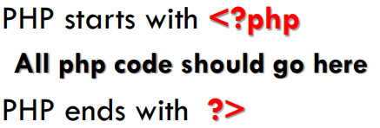
Language used to generate dynamic content from the server every time client sends request
PHP code can be embedded in XHTML code
PHP documents end with extension .php
Browser sends PHP codes to PHP processor
Some webservers force HTML and CSS codes to be parsed by the PHP processor to hide that they are using php

Slide 17
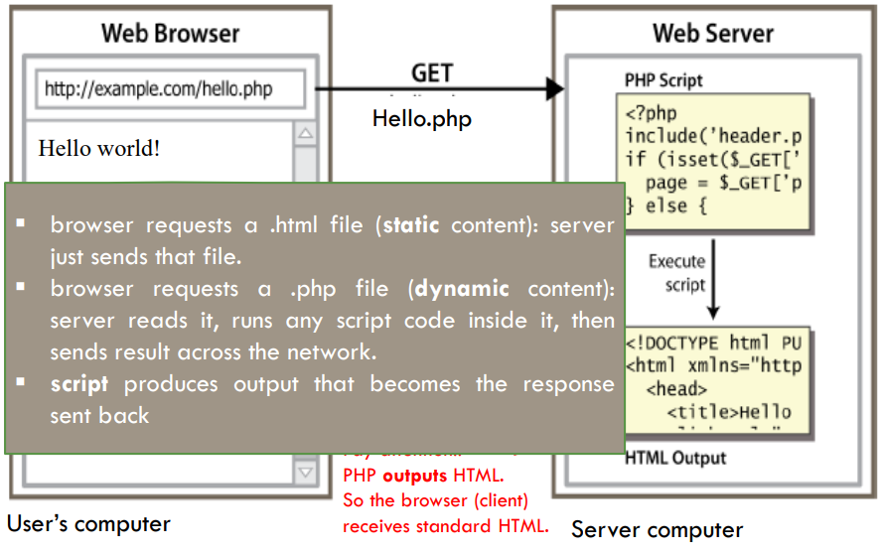
Lifecycle of a PHP web request

Slide 18
Why PHP?
free and open source: anyone can run a PHP-enabled server free of charge
compatible: supported by most popular web servers
It’s easy to learn and use: lots of built-in functionality; familiar syntax
It’s versatile: platform independent
It is well connected with databases
It’s fast and secure
It is tried and tested
It enjoys strong community support

Slide 19
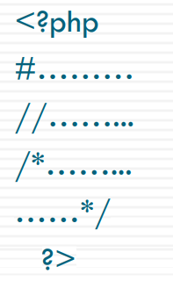
Structure of PH

Slide 20
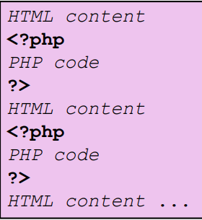
PHP syntax template

Slide 21
Cont…
Contents of a .php
file between are executed as PHP code.
All other contents are output as pure HTML.
We can switch back and forth between HTML and PHP “modes”

Slide 22
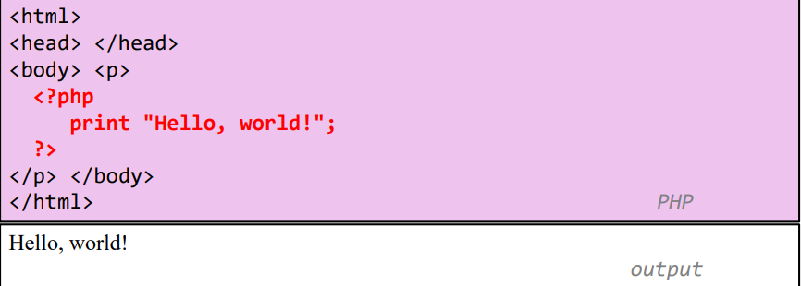
‘Hello, world!’ PHP program

Slide 23
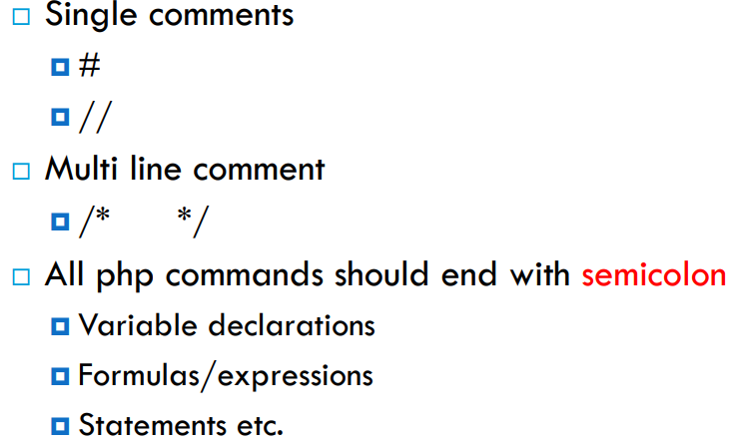
Comments , Semicolons

Slide 24
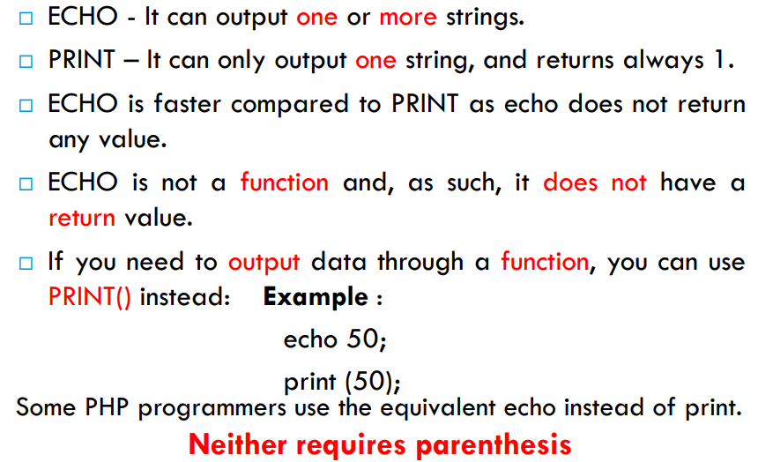
ECHO and PRINT statements in PHP

Slide 25
Variables and data type
Always starts with $ and letter or underscore. Can be composed of numbers, underscores, and letters.
$my_var = 10;
$a_2nd_var = "bison";
Data types: integers, doubles (numbers with a decimal point), boolean (true or false), NULL, strings, arrays, objects, and resources (like database connections).

Slide 26
Data type
Virtually all programming languages categorize data into types
PHP is known as a “loosely typed” language. That means it decides the data type dynamically. This means variables storing data can change types.
Strongly type languages (e.g. C, C++, Java) require the programmer to declare variable types that remain the same

Slide 27
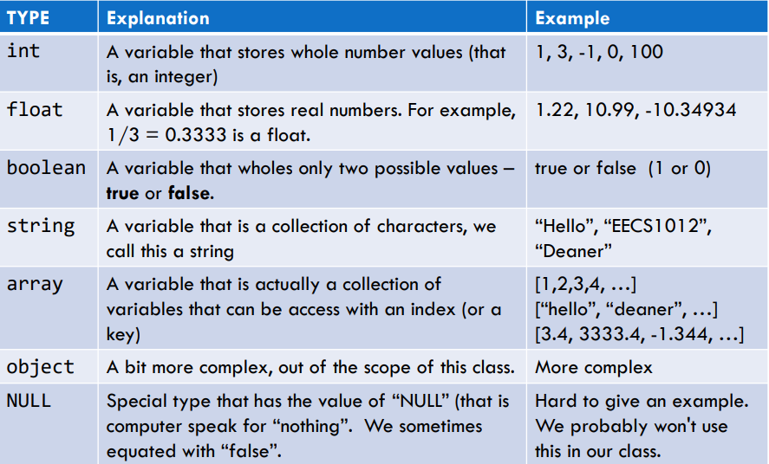
Data Type

Slide 28
Variables
PHP variables must begin with a “$” sign
Case-sensitive ($Foo != $foo != $fOo)
Global and locally-scoped variables
Global variables can be used anywhere
Local variables restricted to a function or class
Certain variable names reserved by PHP
Form variables ($_POST, $_GET)
Server variables ($_SERVER)

Slide 29
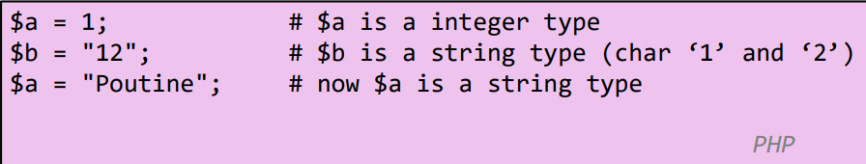
Cont…
PHP automatically assigns the type for a variable
PHP will also change the type dynamically

Slide 30
Cont…
<?php
$foo = 25; // Numerical variable
$bar = “Hello”; // String variable
$foo = ($foo * 7); // Multiplies foo by 7
$bar = ($bar * 7); // Invalid expression
?>
Variables have a default value (0, empty string, false, or empty array) if they aren’t initialized before trying to use them

Slide 31
<?php
$foo = 25; // Numerical variable
$bar = “Hello”; // String variable
echo $bar; // Outputs Hello
echo $foo,$bar; // Outputs 25Hello
echo “5x5=”,$foo; // Outputs 5x5=25
echo “5x5=$foo”; // Outputs 5x5=25
echo ‘5x5=$foo’; // Outputs 5x5=$foo
?>
Notice how echo ‘5x5=$foo’ outputs $foo rather than replacing it with 25
Strings in single quotes (‘ ’) are not interpreted or evaluated by PHP  This is true for both variables and character escape-sequences (such as “\n” or “\\”)

Slide 32
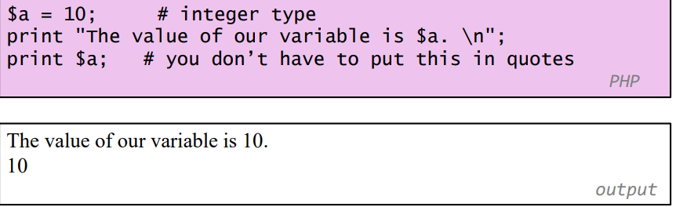
Printing variables
You can use print (or echo) to output the value of the variable.
This will be used very frequently in PHP.

Slide 33
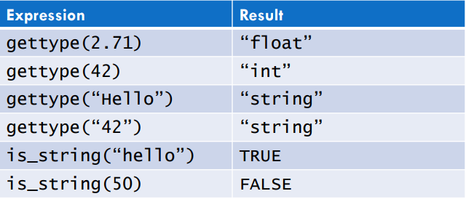
Checking type
This is “jumping ahead” a bit, but there are functions in PHP to help you determine the variable’s type.
We often use these functions to help debug our code.

Slide 34
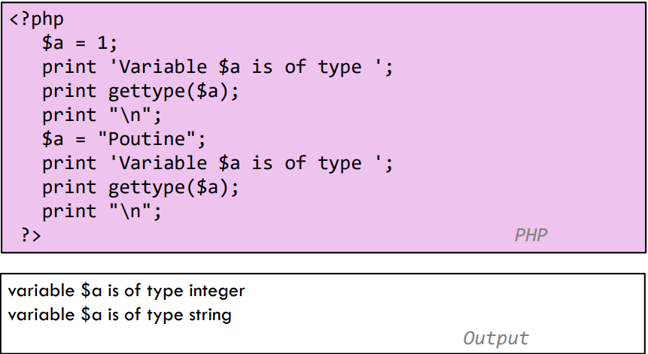
Example

Slide 35
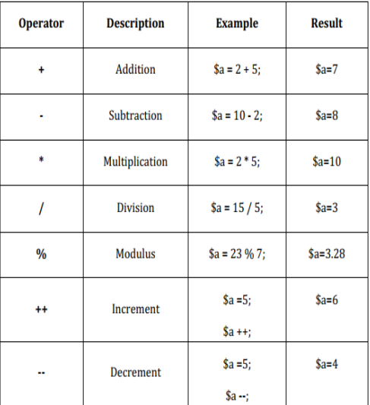
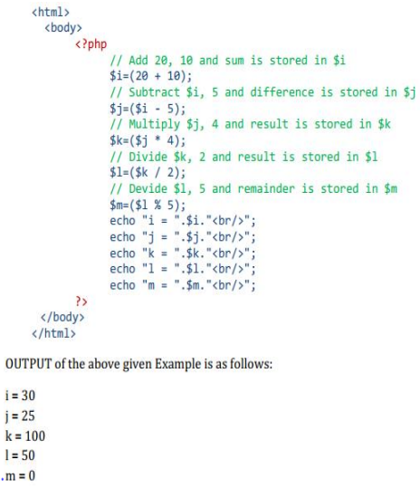
Arithmetic Operators

Slide 36
Arithmetic Operations
Assignment :(=, +=, -=, /=, *=, %=, ++, -- ). .= - string concatenation operator (see strings section).
Arithmetic : ( +, -, *, /, % )- like most programming languages.
Comparison:
1. == != < > <= >= like most programming languages. Also <> is the same as !=.
2. === true if arguments are equal and the same data type.
3. !== true if arguments are not equal or they are not of the same data type.

Slide 37
Cont…
Logical:
1. && || ! like most programming languages (&& and || short-circuit)
2. and or like && and || but have lower precedence than && and ||.
3. xor true if either (but not both) of its arguments are true.

Slide 38
Arithmetic Operations
<?php
$a=15;
$b=30;
$total=$a+$b;
Print $total;
Print “<p><h1>$total</h1>”;
// total is 45
?>

Slide 39
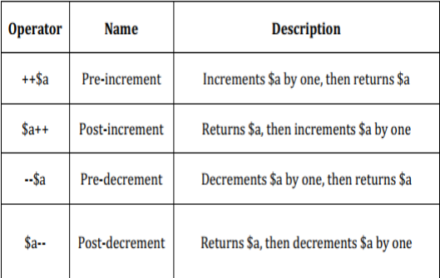
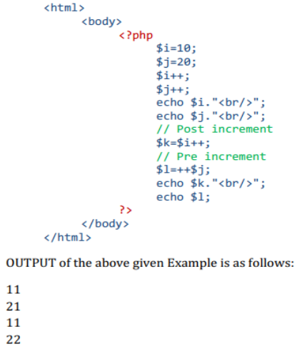
Increment and Decrement Operators

Slide 40
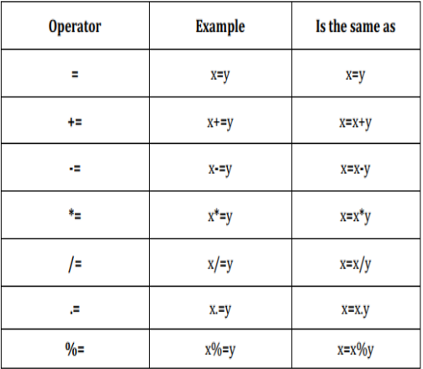
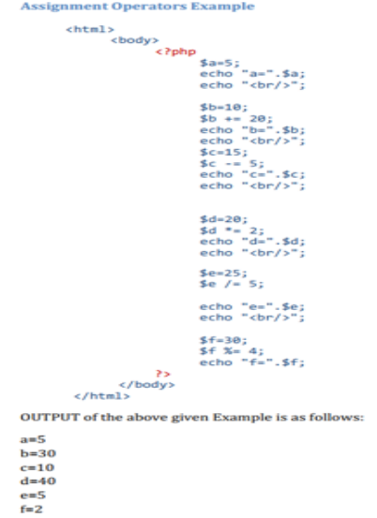
Assignment Operators in PHP

Slide 41
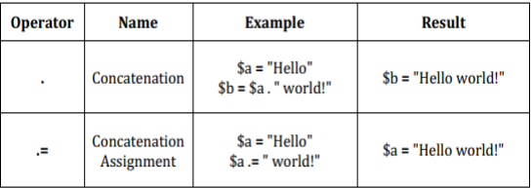
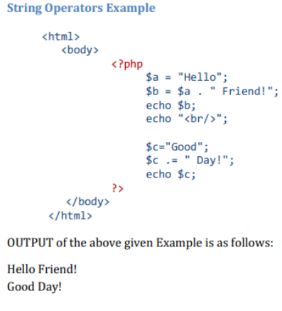
String Operators in PHP

Slide 42
Concatenation
Use a period to join strings into one.
<?php
$string1=“Hello”;
$string2=“PHP”;
$string3=$string1 . “ ” .
$string2;
Print $string3;
?>
Hello PHP

Slide 43
PHP Control Structures
Control Structures: Are the structures within a language that allow us to control the flow of execution through a program or script.
Grouped into conditional (branching) structures (e.g. if/else) and repetition structures (e.g. while loops).
Example if/else if/else statement:

Slide 44
Choice structures
1. if ($x > 0)
$y = 5;
2. if ($a) { // tests if $a is true or non-zero or a non-empty string
print($b);
$b++;
}
else print($c);
<?php
If($user==“John”)
{
Print “Hello John.”;
}
Else
{
Print “You are not John.”;
}
?>

Slide 45
Cont…
if ($a > $b)
print "a is bigger than b";
elseif ($a == $b) // use "elseif" or "else if"
print "a is equal to b";
else
print "a is smaller than b";

Slide 46
Cont…
switch ($vehicle_type) { // works for integers, floats, or strings
case "car": $car++; break;
case "truck": $truck++; break;
case "suv": $suv++; break;
default: $other++;
}

Slide 47
B. Looping structures
while ($n < 10) {
print("$n ");
$n++;}
<?php
$count=0;
While($count<3){
Print “hello PHP. ”;
$count += 1;
// $count = $count + 1;
// or
// $count++;
?>
hello PHP. hello PHP. hello PHP.
do {
print("$n ");
$n++;
} while ($n < 10);

Slide 48
Cont…
for ($n = 1; $n < 10; $n++)
print("$n ");
foreach ($myarray as $item)
print("$item ");

Slide 49
if ($foo == 0) {
echo ‘The variable foo is equal to 0’;
}
else if (($foo > 0) && ($foo <= 5)) {
echo ‘The variable foo is between 1 and 5’;
}else {
echo ‘The variable foo is equal to ‘.$foo;
}

Slide 50
Date Display
$datedisplay=date(“yyyy/m/d”);
Print $datedisplay;
# If the date is April 1st, 2009
# It would display as 2009/4/1
$datedisplay=date(“l, F m, Y”);
Print $datedisplay;
# If the date is April 1st, 2009
# Wednesday, April 1, 2009

Slide 51
PHP Arrays
An array is a data structure that stores one or more similar type of values in a single value.
There are three different kind of arrays and each array value is accessed using an ID c which is called array index.

Slide 52
Numeric array − An array with a numeric index. Values are stored and accessed in linear fashion.
Associative array − An array with strings as index. This stores element values in association with key values rather than in a strict linear index order.
Multidimensional array − An array containing one or more arrays and values are accessed using multiple indices.
NOTE − Built-in array functions is given in function reference PHP Array Function

Slide 53
These arrays can store numbers, strings and any object but their index will be represented by numbers. By default array index starts from zero.
Example
Following is the example showing how to create and access numeric arrays.
Here we have used array() function to create array. This function is explained in function reference.

Slide 54
<html>
<body>
<?php
/* First method to create array. */
$numbers = array( 1, 2, 3, 4, 5);
foreach( $numbers as $value ) {
echo "Value is $value <br />";
} /* Second method to create array. */
$numbers[0] = "one";
$numbers[1] = "two";
$numbers[2] = "three";
$numbers[3] = "four";
$numbers[4] = "five";
foreach( $numbers as $value ) {
echo "Value is $value <br />";
}
?>
</body>
</html>

Slide 55
Associative Arrays
The associative arrays are very similar to numeric arrays in term of functionality but they are different in terms of their index.
Associative array will have their index as string so that you can establish a strong association between key and values.
To store the salaries of employees in an array, a numerically indexed array would not be the best choice. Instead, we could use the employees names as the keys in our associative array, and the value would be their respective salary.

Slide 56
<html>
<body>
<?php
/* First method to associate create array. */
$salaries = rray("mohammad" => 2000, "qadir" => 1000, "zara" => 500);
echo "Salary of mohammad is ". $salaries['mohammad'] . "<br />";
echo "Salary of qadir is ". $salaries['qadir']. "<br />";
echo "Salary of zara is ". $salaries['zara']. "<br />";
/* Second method to create array. */
$salaries['mohammad'] = "high"; $salaries['qadir'] = "medium";
$salaries['zara'] = "low";
echo "Salary of mohammad is ". $salaries['mohammad'] . "<br />";
echo "Salary of qadir is ". $salaries['qadir']. "<br />";
echo "Salary of zara is ". $salaries['zara']. "<br />";
?>
</body>
</html>

Slide 57
Output
Salary of mohammad is 2000
Salary of qadir is 1000
Salary of zara is 500
Salary of mohammad is high
Salary of qadir is medium
Salary of zara is low

Slide 58
Multidimensional Arrays
A multi-dimensional array each element in the main array can also be an array.
And each element in the sub-array can be an array, and so on. Values in the multi-dimensional array are accessed using multiple index.

Slide 59
<html>
<body>
<?php
$marks = array(
"mohammad" => array (
"physics" => 35,
"maths" => 30,
"chemistry" => 39
),
"qadir" => array (
"physics" => 30,
"maths" => 32,
"chemistry" => 29
),
"zara" => array (
"physics" => 31,
"maths" => 22,
"chemistry" => 39
) );
/* Accessing multi-dimensional array values */
echo "Marks for mohammad in physics : " ;
echo $marks['mohammad']['physics'] . "<br />";
echo "Marks for qadir in maths : ";
echo $marks['qadir']['maths'] . "<br />";
echo "Marks for zara in chemistry : " ;
echo $marks['zara']['chemistry'] . "<br />";
?>
</body>
</html>

Slide 60
Output
Marks for mohammad in physics : 35
Marks for qadir in maths : 32
Marks for zara in chemistry : 39

Slide 61
Functions
1. PHP is...
A. A scripting language processed on the client side
B. A scripting language processed on the server side
C. A scripting language processed on both the client and server side

Slide 62
Which of the following scripts are NOT correct?
A. Echo "Hello I am Tom";
B. Echo Hello I am Tom;
C. Echo 'Hello I am Tom';
D. Echo "Hello I'am Tom";

Slide 63
PHP server scripts are surrounded by delimiters:
A. <php and >
B. </php and />
C. <?php and ?>
D. <$php and $>

Slide 64
How do you write "Hello world " in PHP?
Alert (Hello world);
Show (Hello world);
Cout <<Hello world;
Echo "Hello world";
All variables in PHP start with:
#
&
$
Letters

