Slide 1

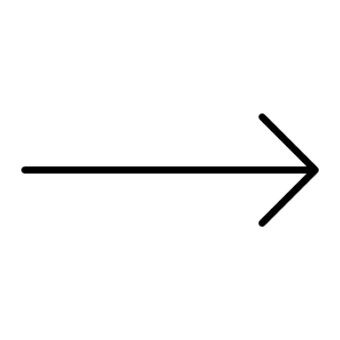

Block 2: From Theory to Practice

Slide 2

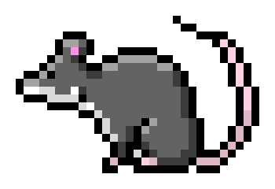
What it’s all about?
Conceptually
Find mice and tigers in your model
“Technically”
Load the model -> Design experiments -> Analyse results ->
Interpretation
stop starring at me… they’re going to find us
what’s up boi?

Slide 3
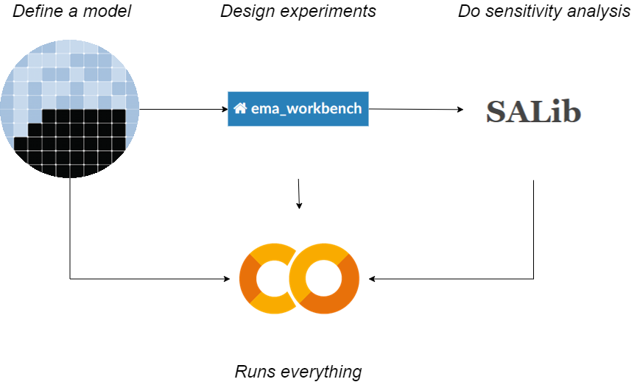
What are the tools?

Slide 4
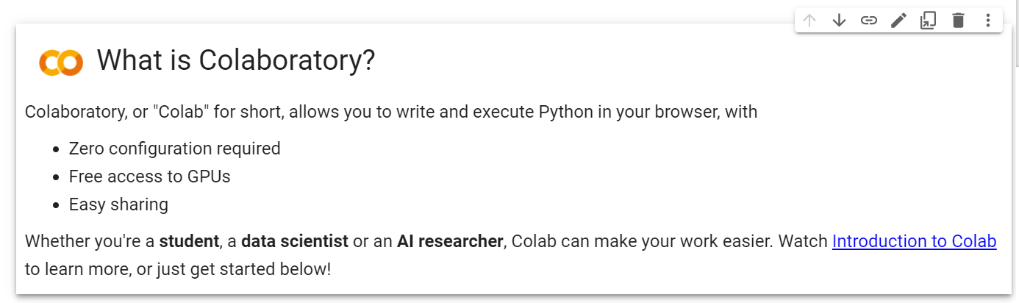
Google Colab

Slide 5
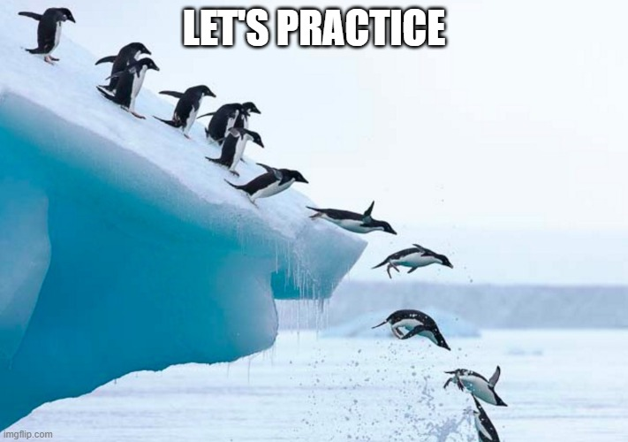

Slide 6
EMA Workbench: conceptual blocks
Connectors
Exploratory modelling framework
Analysis
To connect NetLogo, Vensim, Excel models to Python
Define model parameters,
outcomes, sampling, run experiments
To run Patient Rule Induction method, Classification Tree, …

Slide 7
EMA Workbench: software blocks
Exploratory modelling framework
model
parameters
outcomes
samplers
evaluators
Specify your
model
Define its parameters
Define the outcomes
Sample the parameters
Perform experiments

Slide 8

TIME TO PRACTICE?

Slide 9




EMA Workbench: which models?

Slide 10
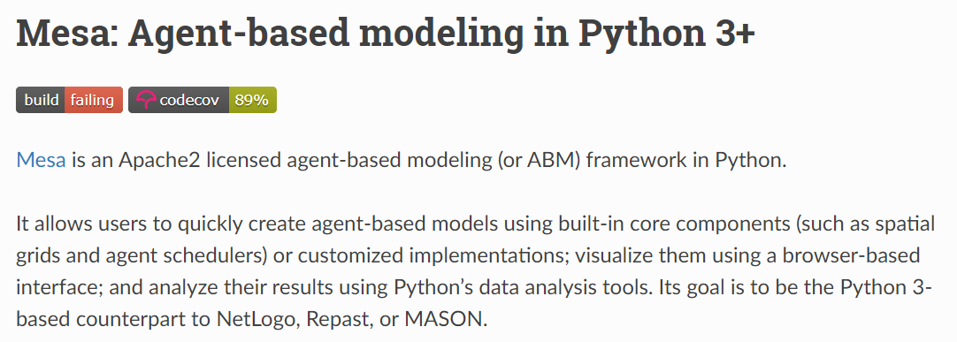
Mesa Agent-based modeling

Slide 11
Mesa: software blocks
Mesa
Agent
Model
Time
Space
Visualization
Specify your
agents
Connect them into a model
Scheduling of agent actions
Distribute agents over a grid
Sliders, grids, graphs…

Slide 12
Mesa: Virus on a Network

Slide 13







Alternatives.to
Rodium

Slide 14


What are we doing?
Conceptually
Find mice and tigers in your model
“Technically”
Load the model
Design and run experiments
not again…
Perform Sobol SA

Slide 15
Setup I
kutt.it/sa-easy

Slide 16
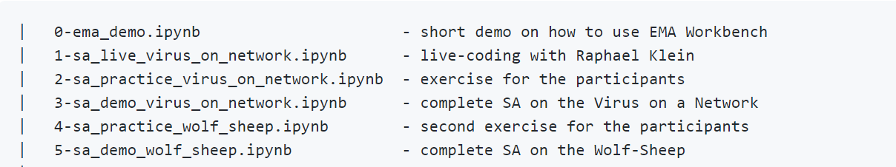
Setup II
15-20 min
20-30 min
Bonus…

Slide 17


Slide 18
