Slide 2
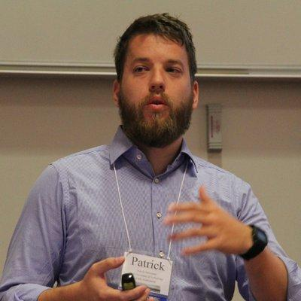




Team
@steipatr
@mikhailsirenko
@raphaelkl1
patrick.steinmann@wur.nl
m.sirenko@tudelft.nl
r.klein-1@tudelft.nl

Slide 4

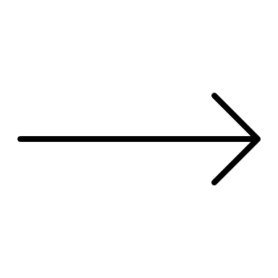

Block 2: From Theory to Practice

Slide 5
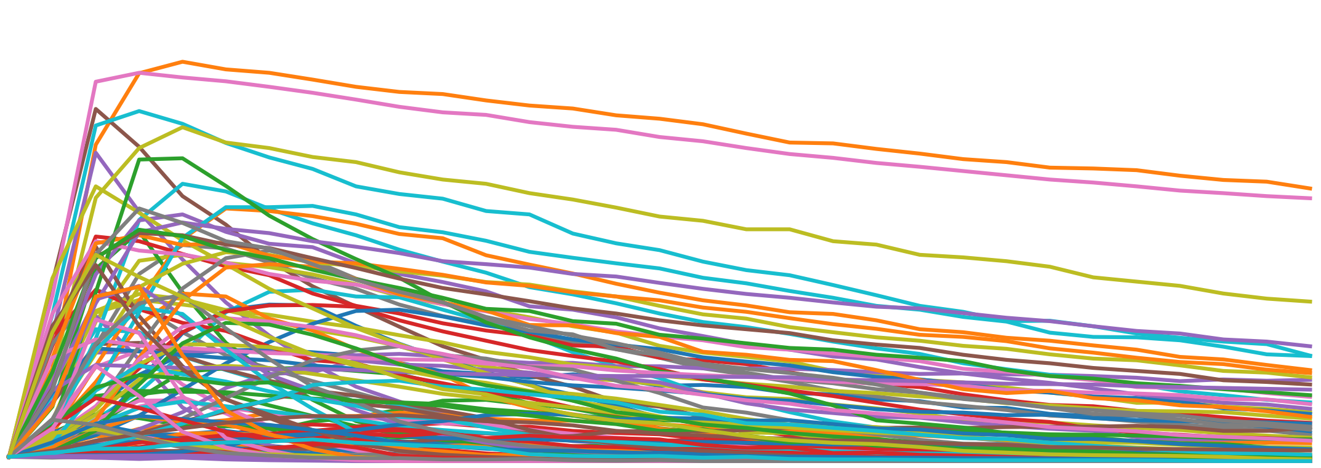


Mesa
EMA Workbench
Design and analyse experiments
ABM in Python
Google Colab
Run Jupyter Notebooks in the cloud

Slide 6
EMA Workbench: three big questions
Why?
What?
How?

Slide 7
EMA Workbench: main building blocks

Slide 8
Mesa - ABM in Python 3+
Python framework for agent-based modelling, includes:
Modelling module with agents, a scheduler and space
Analysis module to collect data
Visualisation, uses Javascript interface on a web server
Entirely open source and on GitHub with new features on a fairly regular basis
Contains a number of model example such as the ones present in the NetLogo library

Slide 9
Mesa - ABM in Python 3+
Demonstration with model of virus on a network.

Slide 10
Google Colab: Google Docs for code

Slide 11
Alternatives.to

Slide 12
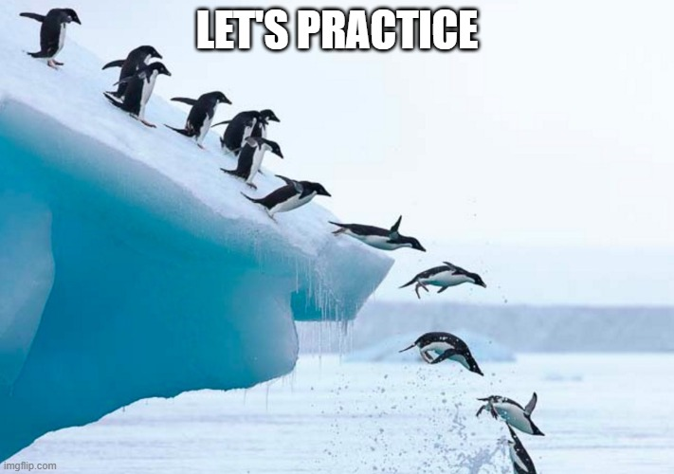

Slide 13
Instructions URL

