Slide 1
Infraestrutura na AWS
Iniciando a jornada
Amanda Quinto
Março 2020

Slide 2
Principais serviços

Slide 3


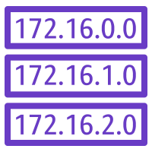













Amazon EC2 Auto Scaling
Route table
NAT gateway
Elastic Load Balancing
Internet gateway
Amazon EC2
AMI
Amazon VPC
Amazon RDS
Subnets
Amazon Elastic Block Store
Elastic IP address

Slide 4
Route table
NAT gateway
Internet gateway
Amazon VPC
Subnets
Elastic IP address

Slide 5
Amazon RDS

Slide 6




Arquitetura
AWS Cloud
Availability Zone 1
Availability Zone 2
VPC
Internet gateway
Internet gateway
Elastic Load Balancing
Auto Scaling group
Instance
Instance
Auto Scaling group
Instance
Instance

Slide 7



Organizations
ROOT
Dev
Prod
MKT
Data
Account
Product
Product
Sandbox
AWS Organizations
Product
Stage
Organizational unit
Raw
Product

Slide 8
Q&A
Amanda Quinto

Slide 9
Obrigada!
amandaqt@amazon.com

