Slide 1
This is your presentation title

Slide 2

Hello!
INSERT
IMAGE
HERE
I am Bryce Moore
I am here because I love to give presentations.

Slide 3
Mobile App Title with Logo
Knowledge is Power

Slide 4
Why tell what not to do when you can tell why not to do.

Slide 5
How Hacking works

Slide 6
Mobile App Purpose
I plan to tackle the issue of people not understanding the logistics and logic of coding which can lead to scams being very successful against people unaware. I am doing this because every day I see tons of accounts that have been hijacked by hackers and phishing attempts, so I would like to reduce that amount.

Slide 7
Mobile App Goal
I want to spread the knowledge of how and why these hackers do this, and how to spot that it is a fraud. I also want to tackle a little bit how to minimize the damage caused by successful attempts, such as setting up a keyphrase or signifier so that friends can easily tell if you’re not controlling the account. Also I would like to tackle delayers such as 2 factor authentication and VPNs and how they can help a lot with instant protection, but also not something to entirely rely on.

Slide 8

Target Audience My target demographic is users that are less familiar with coding and how exactly scams work. This includes older people, kids, or simply just those that don’t understand the internet much.

Slide 9
Mobile App Features
Will explain how social engineering and hacking is done and what to do to minimize the chances.
Will explain how to handle reporting and stopping the spread of scams and how to fix getting hacked with minimal damages.
Quizzes users on these topics and more.

Slide 10
Competition Mapping
We plan to serve as a more streamlined approach to teaching.

Slide 11
Risks/Weaknesses
I don’t feel that competition will interfere too much with my app, as it is targeting a more casual audience than most. I will however run into issues in getting people to try the app in the first place. However, one risk is it allowing exploits using the code feature in the app, so that I will have to be careful to avoid.

Slide 12
Development process
concept
(1-3 days)
second
last

Slide 13
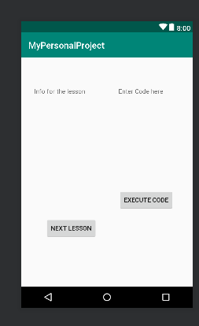
Android project
The Textbox on the left will be used to show the current lesson, with the button underneath progressing to the next lesson. On the right the entry box can be used to enter basic code so that users can test out the lessons taught right on the same screen. The button underneath will execute the code.

Slide 14
Android project
The Textbox on the left will be used to show the current lesson, with the button underneath progressing to the next lesson. On the right the entry box can be used to enter basic code so that users can test out the lessons taught right on the same screen. The button underneath will execute the code.

Slide 15
Thanks!
Any questions?
You can find me at
@.edu

Slide 16
Icons are editable shapes.
This means that you can:
You can use any of the icons on the left (just copy and paste)
Resize them without losing quality.
Change line color, width and style.
Isn’t that nice? :)
Examples:

