Slide 1
Current data transfer services in CMS
Schedule data transfers on dataset level
Treat destination sites only as consumers
Lack of global network resource allocation among transfers
Consequences:
Low concurrency
Low link utilization
Long transfer delay

Slide 2

ExaO: Software Defined Exascale Data Transfer Orchestrator
ExaO
Rest Interface
ExaO
Rest Interface
ExaO
Rest Interface
ExaO
Rest Interface
ExaO
Rest Interface
Scheduler
Phedex
ExaO
Rest Interface
DB
ExaO
Rest Interface
FDTDaemon
ASO
Transfer Execution Nodes
ALTO
MLSensor
Kibana Monitoring
Kibana Monitoring
Kibana Monitoring
Batch
Monalisa
FDTDaemon
FDTDaemon
MLSensor
MLSensor

Slide 3
ExaO: Software Defined Exascale Data Transfer Orchestrator
PhEDEx
ExaO
Dataset level scheduling
Decide sources for files all at once
Low flexibility
File level scheduling
No rush in deciding sources all at once
Leave room for better source selection
Destination sites are only consumers
Low concurrency
Allow destination sites to be suppliers after receiving files
High concurrency
No network resource allocation scheme
Low link utilization
Collect real-time network information
Dynamic rate allocation among transfers
End host rate limiting to enforce allocation

Slide 4
Software Defined Data Transfer
S

Slide 5
ExaO: EXAscale Data Transfer Orchestrator
End-to-end orchestration of data flows involving multiple host groups at different domains,
RESTFul-API: allow users submit and manage transfer request through different interface
ALTO: collect minimal, real-time network information from different domains
ExaO Scheduler: centralized, efficient file-level source and rate co-scheduling
FDT: efficient data transfer tools on end hosts
Monalisa: Distributed monitoring infrastructure for real time monitoring each flow, transfer
Minimally invasive change on end host groups
Real-time, dynamic resource allocation under the existence of other network traffic
Not CMS or HEP specific, hence support any data intensive sciences.
Dataset distribution to N destination sites with M candidate source sites:
Maximal link utilization in the testbed
N/M times faster than dataset level scheduling

Slide 6
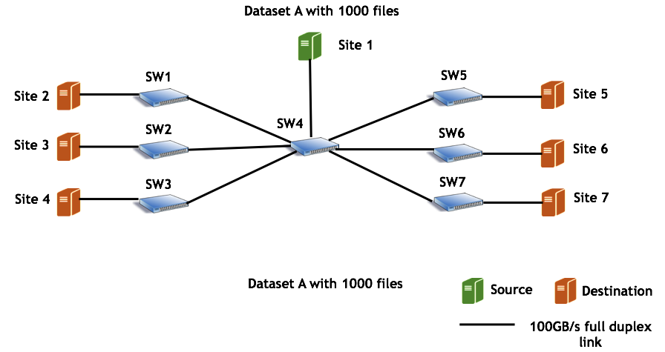
Case Study: Dataset Distribution

Slide 7
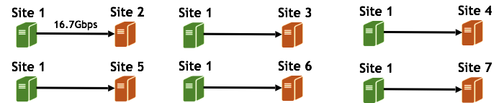
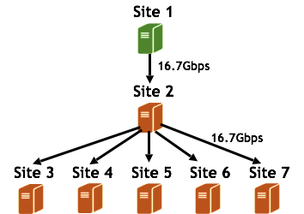

Dataset-Level Scheduling (PhEDEx):
Link Utilization: 1/7 = 14.29%
File-Level Scheduling (ExaO):
Link Utilization: 6/7 = 85.71%
...

Slide 8
Demo:
User submits a request:
{
“DatasetName”: “A”,
“Destination”: {“Site 2”, “Site 3”, “Site 4”, “Site 5”, “Site 6”, “Site 7”}
}
ExaO receives this requests and makes online file-level scheduling decisions to maximize network utilization
Audience visualize the status of file transfers through Monalisa and high link utilization through testbed UI

