Slide 1
Data transfer services in CMS
Dataset level source selection
Decide sources for all files at once
Destination sites are treated only as consumers
Built on top of traditional multi-domain networks
Lack of real-time, global network view
No network resource allocation scheme
Performance
Low concurrency, low link utilization, long transfer delay

Slide 2

Case Study: Distribution Dataset X to All the Sites
Dataset X (3000 50GB files)
Site 1
SW1
SW5
Site 2
Site 5
SW2
SW4
SW6
Site 3
Site 6
SW3
SW7
Site 4
Site 7
Source
Destination
100GB/s full duplex link

Slide 3
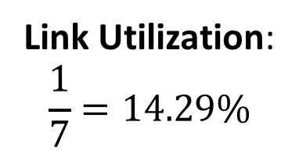
Dataset-Level Scheduling in PhEDEx
Only Site 1 is the source
Site 1 sends all 3000 files to each destination site
Scheduling decision: (File K, site 1, site X) where K=1, 2, …, 3000 and X=2, 3, … 7
Leaves the bandwidth allocation to TCP
Fair share of each site-to-site flow converges at 100/6=16.7GB/s
Site 1
Site 2
Site 1
Site 3
Site 1
Site 4
3000 files
3000 files
3000 files
16.7GB/s
16.7GB/s
16.7GB/s
Link Utilization:
$$\frac{1}{7}=14.29\%$$
Site 1
Site 5
Site 1
Site 6
Site 1
Site 7
3000 files
3000 files
3000 files
16.7GB/s
16.7GB/s
16.7GB/s

Slide 4
ExaO: Software Defined Data Transfer Orchestrator
On-demand, dynamic, minimal network state abstraction to provide global, real-time, inter-domain network view
Centralized, file-level transfer scheduling to achieve high transfer concurrency
Dynamic network resource allocation among flows to achieve high network utilization and low transfer delay

Slide 5

ExaO: Software Defined Data Transfer Orchestrator
Query new requests
ExaO
Rest Interface
ExaO
Rest Interface
ExaO
Rest Interface
ExaO
Rest Interface
Scheduler
PhEDEx
ExaO
RESTful Interface
Dynamic Scheduling
Dynamic Scheduling
Query abstract network state
Users submit dataset transfer requests
Requests written to database
ExaO
Rest Interface
ExaO
Rest Interface
FDTDaemon
ASO
DB
Transfer Execution Nodes
ALTO
MLSensor
Compute abstract network state
Kibana Monitoring
Kibana Monitoring
Kibana Monitoring
Batch
Collect complete network state
Monalisa
FDTDaemon
FDTDaemon
MLSensor
MLSensor

Slide 6
ExaO: EXAscale Data Transfer Orchestrator
End-to-end orchestration of data flows involving multiple host groups at different domains,
RESTFul-API: allow users submit and manage transfer request through different interface
ALTO: collect minimal, real-time network information from different domains
ExaO Scheduler: centralized, efficient file-level source and rate co-scheduling
FDT: efficient data transfer tools on end hosts
Monalisa: Distributed monitoring infrastructure for real time monitoring each flow, transfer
Minimally invasive change on end host groups
Real-time, dynamic resource allocation under the existence of other network traffic
Not CMS or HEP specific, hence support any data intensive sciences.
Dataset distribution to N destination:
Maximal link utilization in the testbed
N times faster than dataset level scheduling

Slide 7
Case Study: Distribution Dataset X to All the Sites
Dataset X (3000 50GB files)
Site 1
SW1
SW5
Site 2
Site 5
SW2
SW4
SW6
Site 3
Site 6
SW3
SW7
Site 4
Site 7
Source
Destination
100GB/s full duplex link

Slide 8
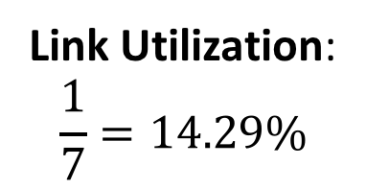
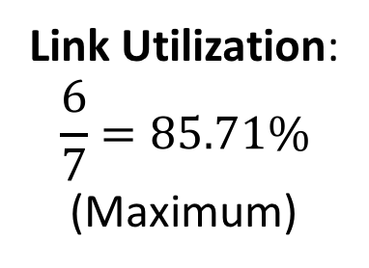
Dataset-Level Scheduling (PhEDEx):
Site 1
Site 2
Site 1
Site 3
Site 1
Site 4
3000 files
3000 files
3000 files
16.7GB/s
16.7GB/s
16.7GB/s
Link Utilization:
$$\frac{1}{7}=14.29\%$$
Site 1
Site 5
Site 1
Site 6
Site 1
Site 7
3000 files
3000 files
3000 files
16.7GB/s
16.7GB/s
16.7GB/s
File-Level Scheduling (ExaO):
Site 1
Site 1
File 1-500
16.7GB/s
File 2501-3000
16.7GB/s
Link Utilization:
$$\frac{6}{7}=85.71\%$$
(Maximum)
Site 2
Site 7
File 1-500
16.7GB/s
File 2501-3000
16.7GB/s
Site 3
Site 4
Site 5
Site 6
Site 7
Site 2
Site 3
Site 4
Site 5
Site 6

Slide 9
Demo:
User submits a request:
{
“DatasetName”: “A”,
“Destination”: {“Site 2”, “Site 3”, “Site 4”, “Site 5”, “Site 6”, “Site 7”}
}
ExaO receives this requests and makes online file-level scheduling decisions to maximize network utilization
Audience visualize the status of file transfers through Monalisa and high link utilization through testbed UI

Slide 10
ExaO: Software Defined Data Transfer Orchestrator
PhEDEx
ExaO
Dataset level scheduling
Decide sources for files all at once
Low flexibility
File level scheduling
No rush in deciding sources all at once
Leave room for better source selection
Destination sites are only consumers
Low concurrency
Allow destination sites to be suppliers after receiving files
High concurrency
No network resource allocation scheme
Low link utilization
TODO: path, routing state abstraction, etc.
Collect real-time network information
Dynamic rate allocation among transfers
End host rate limiting to enforce allocation

Slide 11
Problem
Super computing can benefit from super efficient and super flexible infrastructures
Traditional networks are not flexible, leading to inefficient network resources usage
Emergence of SDN promises super efficient and flexible networks but current SDN control programming systems are low level, limited (machine code age…)
Key feature | Issue
SDN programmer manually generates OpenFlow rules | OpenFlow is a low level, complex computation model: it does not even support logic negation, and hence needs priority to simulate logic negation, it supports only layer 2 to layer 4, but many decisions may depend on higher layers
SDN programmer uses incremental programming | Complex manual tracking of execution dependency Manual cleanup, re-execute
[TODO: Add more]…

