Slide 1

ExaO: Software Defined Data Transfer Orchestrator
Yale University SNLab

Slide 2
Implement Flexible Data Delivery Application Based on SDN
Yale University SNLab

Slide 3
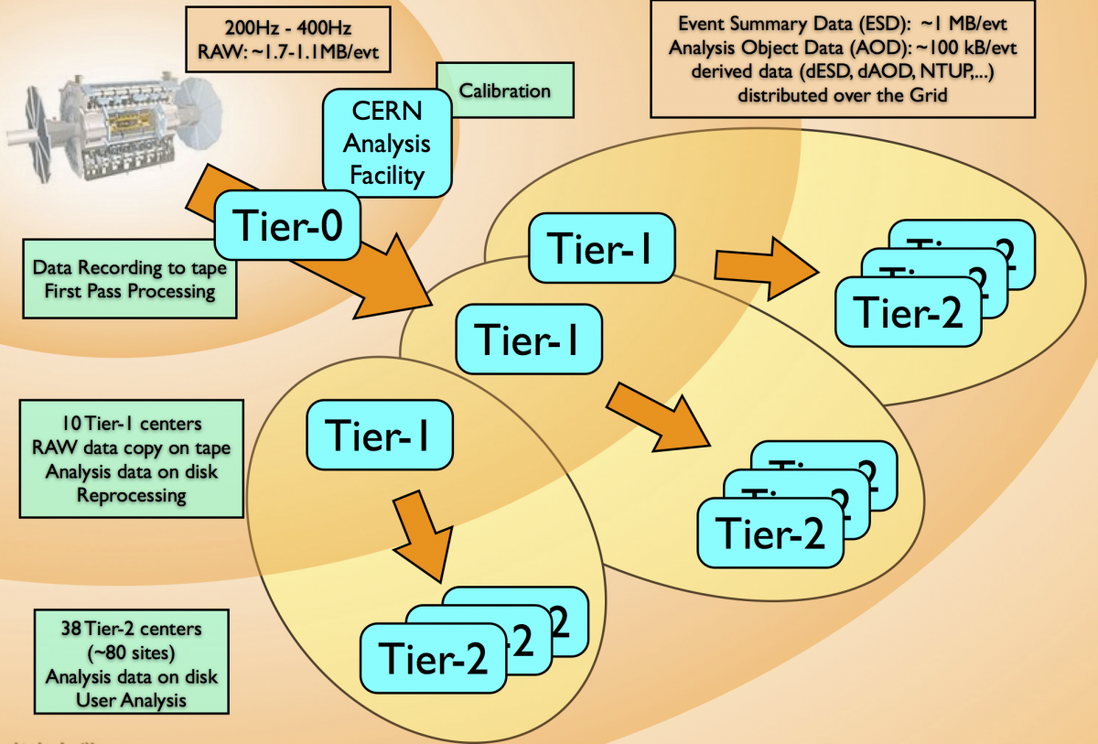
Background
Large raw datasets are collected from LHC at the Tier-0 site.
RECO and AOD datasets are distributed to Tier-1 sites for secure storage.
RECO, AOD and simulation datasets are transferred among Tier-1, Tier-2 and Tier-3 sites for analysis.

Slide 4
Scheduling Policy of CMS’s PhEDEx
Dataset level source selection
Decide sources for all files at once
Destination sites are treated only as consumers
Built on top of traditional multi-domain networks
Lack of real-time, global network view
No network resource allocation scheme
Performance
Low concurrency, low link utilization, long transfer delay

Slide 5
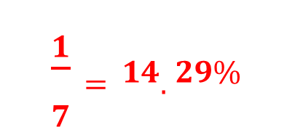
Data Transfer Case of CMS’s PhEDEx
Only Site 1 can be the source
Site 1 sends all 3000 files to each destination site
Scheduling decision: (File K, site 1, site X) where K=1, 2, …, 3000 and X=2, 3, … 7
Leaves the bandwidth allocation to TCP
Fair share of each site-to-site flow converges at 100/6=16.7Gbps
Inflexible and static scheduling decision causes low link utilization :
$$\frac{1}{7}=14.29\%$$
Notes:
Inflexible and static scheduling decision cause low link utility

Slide 6
ExaO: Software Defined Data Transfer Orchestrator
Leverage the emerging SDN technique to realize end-to-end orchestration of data flows involving multiple host groups at different domains
Key Features
On-demand, dynamic, minimal network state abstraction to provide global, real-time, inter-domain network view
Centralized, file-level transfer scheduling to achieve high transfer concurrency
Global, dynamic network resource allocation among flows to achieve high network utilization and low transfer delay

Slide 7
ExaO: Software Defined Data Transfer Orchestrator
PhEDEx
ExaO
No real-time, global network view
Application-Layer Traffic Optimization (ALTO)
Collect real-time routing information at different domains (ALTO-SPCE)
Compute minimal, equivalent abstract routing state (ATLO-RSA)
Dataset level scheduling
Destination sites cannot become candidate sources until receiving the whole dataset
Low concurrency
Scheduler
Centralized file level scheduling
Destination sites become candidate sources after receiving files
High concurrency
No network resource allocation scheme
Low utilization
Scheduler and Transfer Execution Nodes (TEN)
Global, dynamic rate allocation among transfers (Scheduler)
End host rate limiting to enforce allocation (TEN)
Notes:
Minimally invasive change on end host groups
Real-time, dynamic resource allocation under the existence of other network traffic
Not CMS or HEP specific, hence support any data intensive sciences.
Dataset distribution to N destination:
Maximal link utilization in the testbed
N times faster than dataset level scheduling

Slide 8
Components of ExaO
RESTful-API
allow users submit and manage transfer request through different interface
ALTO
collect on-demand, real-time, minimal abstract routing information from different domains
ExaO Scheduler
centralized, efficient file-level scheduling and network resource allocation
FDT
efficient data transfer tools on end hosts
Monalisa
Distributed monitoring infrastructure for real time monitoring of each flow, transfer

Slide 9

ExaO Workflow
Users submit, track and manage dataset transfer requests
Scheduler queries NEW requests via ExaO RESTful interface
Scheduler queries ALTO controllers for routing state
ALTO controller collects complete network state
ALTO controller computes on-demand, minimal, abstract routing state in response to query
Scheduler makes centralized, dynamic, file-level scheduling and global network resource allocation decisions
Transfer Execution Nodes (TEN) query updated scheduling and allocation decisions
TEN instruct efficient data transfer tools on end hosts (e.g., FDT) to enforce scheduling and allocation decisions
MonALISA sensors monitor data transfer status and send update back
PhEDEx
ASO
Batch
ExaO
RESTful Interface
Database
Scheduler
Transfer Execution Nodes
Kibana
Monitoring
MonALISA
ALTO Controller
ALTO Controller
ALTO Controller
FDTDaemon
FDTDaemon
FDTDaemon
MLSensor
MLSensor
MLSensor

Slide 10
ExaO Workflow
Users submit, track and manage dataset transfer requests
User Request

Slide 11
ExaO Workflow
Users submit, track and manage dataset transfer requests
Scheduler queries NEW requests via ExaO RESTful interface
Scheduler queries ALTO controllers for routing state
User Request
Routing Query
Routing Query
Routing Query

Slide 12
ExaO Workflow
Users submit, track and manage dataset transfer requests
Scheduler queries NEW requests via ExaO RESTful interface
Scheduler queries ALTO controllers for routing state
ALTO controller collects complete network state and computes on-demand, minimal, abstract routing state in response to query
Routing ACK
Routing ACK
Routing ACK

Slide 13
ExaO Workflow
Users submit, track and manage dataset transfer requests
Scheduler queries NEW requests via ExaO RESTful interface
Scheduler queries ALTO controllers for routing state
ALTO controller collects complete network state and computes on-demand, minimal, abstract routing state in response to query
Scheduler makes centralized, dynamic, file-level scheduling and global network resource allocation decisions
Schedule Result
Schedule Request
Schedule Request
Schedule Request

Slide 14
ExaO Workflow
Users submit, track and manage dataset transfer requests
Scheduler queries NEW requests via ExaO RESTful interface
Scheduler queries ALTO controllers for routing state
ALTO controller collects complete network state and computes on-demand, minimal, abstract routing state in response to query
Scheduler makes centralized, dynamic, file-level scheduling and global network resource allocation decisions
Transfer Execution Nodes (TEN) query updated scheduling and allocation decisions
TEN instruct efficient data transfer tools on end hosts (e.g., FDT) to enforce scheduling and allocation decisions
TEN Decision
TEN Query
TEN instruct
TEN instruct
TEN instruct

Slide 15
ExaO Workflow
Users submit, track and manage dataset transfer requests
Scheduler queries NEW requests via ExaO RESTful interface
Scheduler queries ALTO controllers for routing state
ALTO controller collects complete network state and computes on-demand, minimal, abstract routing state in response to query
Scheduler makes centralized, dynamic, file-level scheduling and global network resource allocation decisions
Transfer Execution Nodes (TEN) query updated scheduling and allocation decisions
TEN instruct efficient data transfer tools on end hosts (e.g., FDT) to enforce scheduling and allocation decisions
MonALISA sensors monitor data transfer status and send update back
Status
Status
Status

Slide 16
Practical Concerns
Minimally invasive change on end host groups
Real-time, dynamic resource allocation under the existence of other network traffic
Not CMS or HEP specific, hence support any data intensive sciences.
Dataset distribution to N destination:
Maximal link utilization in the testbed
N times faster than dataset level scheduling

Slide 17
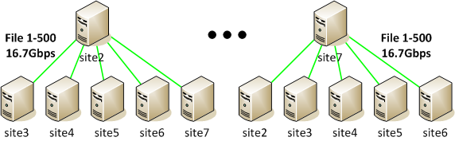
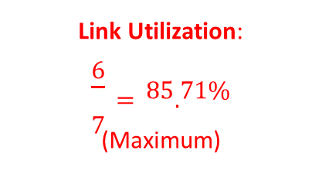
Data Transfer Solution of CMS’s ExaO
Site 1 is the only source at the beginning
Each site can become a source once receiving certain files
Site 1 sends 3000/6=500 unique files to each destination site
Fair share of each (site 1, site X) flow is 100/6=16.7GB/s
Remaining uplink bandwidth of site 1 is 0GB/s
After receiving a unique file from site 1, site X becomes a source to other destination sites
Site X sends the received file to other destination sites at (100-16.7)/5=16.7GB/s
Link Utilization:
$$\frac{6}{7}=85.71\%$$
(Maximum)

Slide 18
Demo:
A user submits a request:
{
“DatasetName”: “A”,
“Destination”: {“Site 2”, “Site 3”, “Site 4”, “Site 5”, “Site 6”, “Site 7”}
}
ExaO receives this request and makes online file-level scheduling to maximize network utilization
Audience observe the scheduling decision made by ExaO and the high link utilization from testbed UI, and observe the status of file transfers through Monalisa

