Slide 1
Problem
Super computing can benefit from super efficient and super flexible infrastructures
Traditional networks are not flexible, leading to inefficient network resources usage
Emergence of SDN promises super efficient and flexible networks but current SDN control programming systems are low level, limited (machine code age…)
Key feature | Issue
SDN programmer manually generates OpenFlow rules | OpenFlow is a low level, complex computation model: it does not even support logic negation, and hence needs priority to simulate logic negation, it supports only layer 2 to layer 4, but many decisions may depend on higher layers
SDN programmer uses incremental programming | Complex manual tracking of execution dependency Manual cleanup, re-execute
[TODO: Add more]…

Slide 2

Toward Super SDN Programming: New SDN Programming Tools
Powerful state of the art, generic tools to substantially simplify SDN programming
Before (manual programming)
Complex, manual maven programming
Web IDE
Web-based automatic generation of projects
Programmer focuses only on key aspect
Before (low level, limited programming model)
Low-level, complex, limited (L2-L4) OpenFlow rule programming
Programmer can define only at flow level
Specific access control allowing only hosts partition
Maple programming (high-level, all-layer programming)
High-level, completely south-bound agnostic, cross-layer (L2-L7) programming
Programmer sees (logically) each and every packet
Integrated access control supporting per-user or role based programming
Before (raw data store)
Complex, manual tracking of execution dependency
Manual cleanup, re-execute
Designed directly on raw data store
FAST (automation function store)
Automatic execution dependency tracking
Automatic cleanup, re-execution (intent ++)
Host generic network functions
Data Store
Before
Ad hoc flow rule installation
FAST Schedule
Consistent, optimized flow-mod scheduling

Slide 3

The Super Simple SDN Programming Model
Consider each pkt as a request
- Network as a single virtual server
- Network functions expressed in general purpose language
- Network functions (logically) invoked on each new pkt, returning how net handles that request
- Network decision can depend on L2 to L7
- Network decision is lambda decision, not incremental decision
- Realization of return is opaque, by system

Slide 4
1. private static final String[] H12_TAP = { H1, "openflow:1:2", "openflow:2:1" }​
2. private static final String[] H12_ONE = { H1, "openflow:1:2", "openflow:2:3", "openflow:4:1" }​
3. private static final String[] H12_TWO = { H1, "openflow:1:3", "openflow:3:2", "openflow:4:1" } ​
4.​
5. void f(Packet pkt) {​
6. int srcIP = pkt.srcIP; int dstIP = pkt.dstIP;​
7. String flowId = computeFlowId( srcIP, dstIP, pkt.srcPort, pkt.dstPort, pkt.protocol );​
8. if ( srcIP == H1 && dstIP == H2 ) {​
9. FlowMetadata fm = getFlowMetadata(flowId); ​
10. if ( fm == null ) { ​
11. pkt.addRoute( H12_TAP );​
12. pkt.addRoute( H12_ONE );​
13. } else if ( isVideo( getUri( fm ) ) ) {​
14. pkt.addRoute( H12_TWO );​
15. } else pkt.addRoute( H12_ONE );​
16. } else if ( srcIP == H2 && dstIP == H1 ) {​
17. …​
18. } else pkt.addRoute( Route.drop );​
19. }​
Per-packet
programming
model
Meta header to
control cross
layers
South-band
agnostic
Notes:
relatively low rate, unreliable, nodes are highly mobile

Slide 5
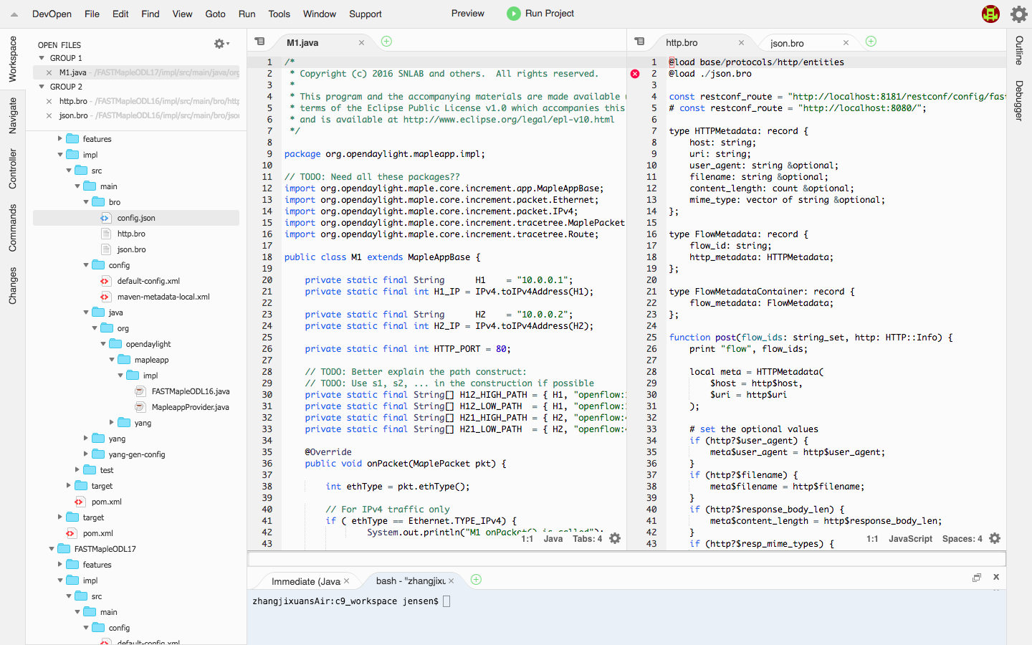
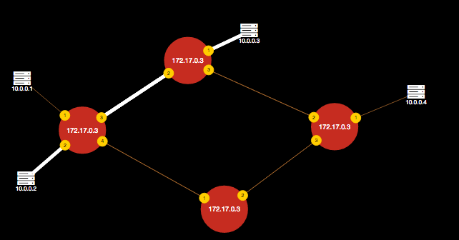
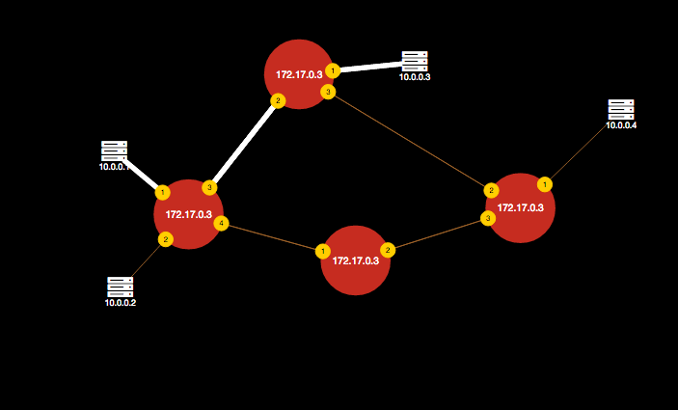
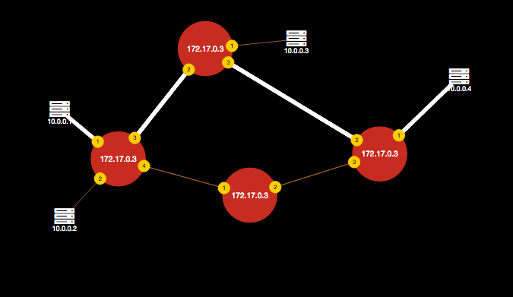
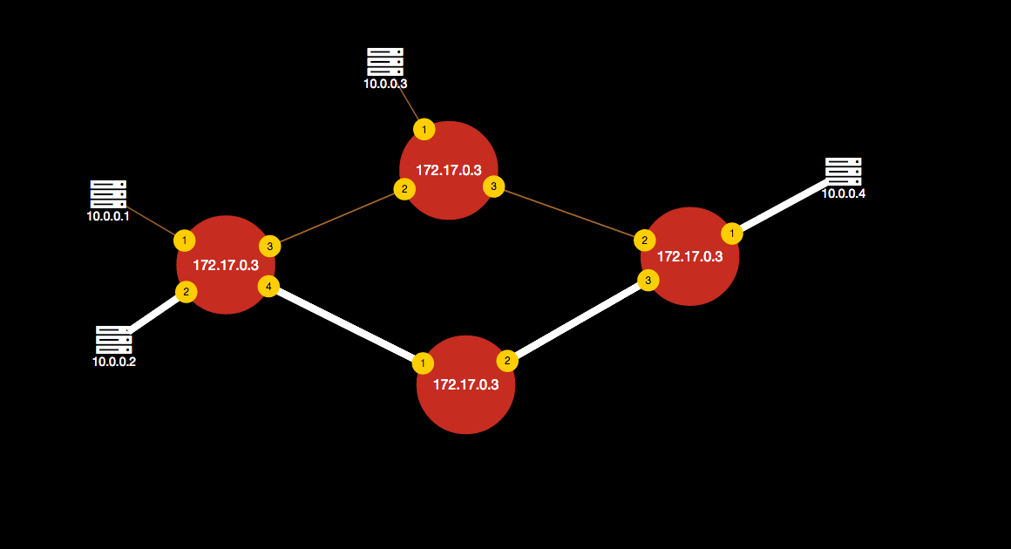
Demo: Realizing Super Simple SDN Programming using OpenFlow, Bro
Update data store, FAST re-executes the MapleApp.java
http.bro
MapleApp.java
Step one:
IDE writes MapleApp and Bro programs
Controller
Bro
Step two:
IDE deploys programs one click away
S2
Client1
S1
S4
Server
Step three:
Start an HTTP server at the Server
Client2
S3
Step four:
Client1 sends a request for a txt file at the Server
Step five:
Client2 sends a request for an mp4 file at the Server
Choose paths based on L7 information (file type)

Slide 6
Summary
Complex, manual programming
Web IDE simplifies SDN programming, automatically deploying the programs, integrating different views (programs, topology, routes)
Low level, limited programming model
Maple provides high-level, per-packet, south-bound agnostic, cross-layer (L2-L7) programming
Complex data consistency management
FAST automatically tracks execution dependencies, re-executing functions when dependencies change

Slide 7
Availability
Make it clear how others may try our system

Slide 8
Backup Slides

Slide 9
Demo: Realizing Super Simple SDN Programming using OpenFlow, Bro
TODO: Draw network, label what each component does; show the overall workflow, including
IDE writes program
Bro to go beyond OF L2-4, to support L7
RESTCONF/YANG Data Store to achieve shared data
…

Slide 10
High-level SDN Programming Abstraction: Function Store (Details; skip)
public void QoSRouting(Ipv4Address src, Ipv4Address dst, int requiredBw) {
srcNode, dstNode = mapToNode(src, dst);
topology = readTopology();
pq.add(srcNode);
while (!pq.isEmpty()) {
n = pq.pop();
if (bw_src(n) < requiredBw)
return failure
if (n == dstNode)
return writeRoute(src, dst, path);
for (e(n->m): n.neighbors) {
if (min(e.bw, bw_src(n)) > bw_src(m)) {
updateBw(m, min(e.bw, bw_src(n)));
...
}
}
}
return failure }
function instance
function instance
function instance
Allow generic functions
Automatically track data dependency
Automatic clean up, reschedule, and re-execute after dependent data changes (achieve intent)

Slide 11
New Tools in Action: Programmable Science DMZ
TO FINISH
function cloud
Data-driven function/transport control
Bro
Bro
Bro
RESTCONF /YANG Data Store
transport network

Slide 12
Problem
Super computing can benefit from super efficient and super flexible infrastructures
Traditional networks are not flexible and often cannot use network resources efficiently
Emergence of SDN promises super efficient and flexible networks but current SDN control programming systems are low level, limited in key capabilities
Service/ Policy
Program Logic
Datapath Model
Datapath Model
Network State

