Slide 1


IHC - ENERO - MAYO 2026
KITCHEN MAGIC
Aviles Castillo Jesús Alberto
Loria Pech Rubén Moises
Maldonado Medina Hansony de Jesús
Montero Uc José Francisco
Suárez Balam Brandon Emmanuel
https://youtu.be/hIEn2miydVw

Slide 2
SUMMARY OF PROGESS

Slide 3
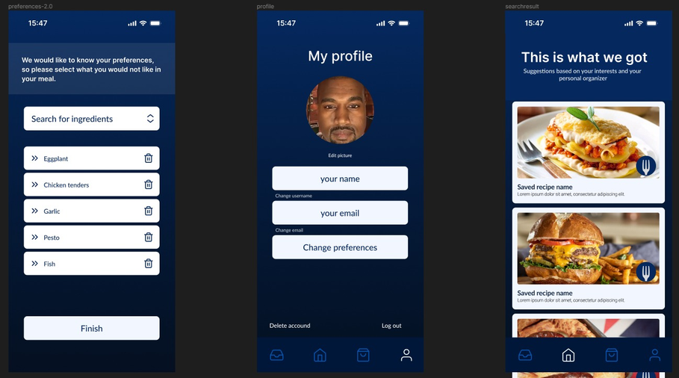
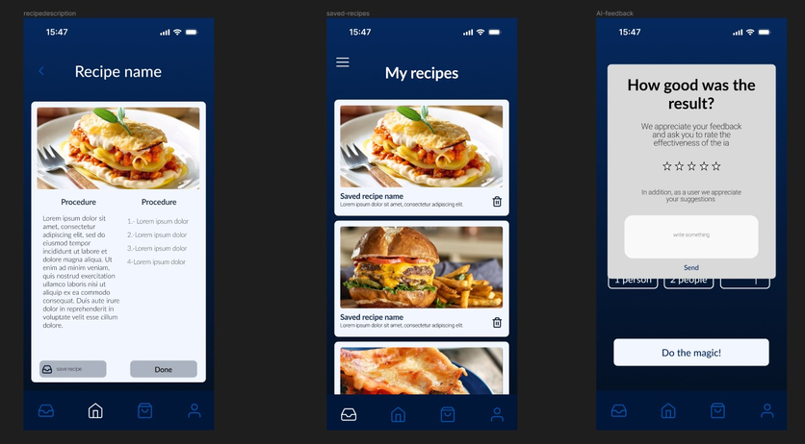
First Deliverable:
Foucused on defining what the project would be about.
We wrote the application's purpose, justified why it is useful , and detailed who would benefit from it.
assembled the initial list of core functions.
Second Deliverable:
New functions: We expand the list of what the app can do.
Visual Enhancements: We changed the typography to one that reads better from a distance or under kitchen lighting.
Testing Formats: We prepared all the formats, surveys, and checklists required to evaluate the application's.
Thrid Deliverable:
High-Fidelity Prototype: We completely designed the definitive interfaces in high fidelity.
Relevant Adjustments: After reviewing the finished screens, we made a couple of quick changes.
Usability Testing (Simulated): We conducted a simulation practice of the usability tests using the formats we already had prepared.

Slide 4
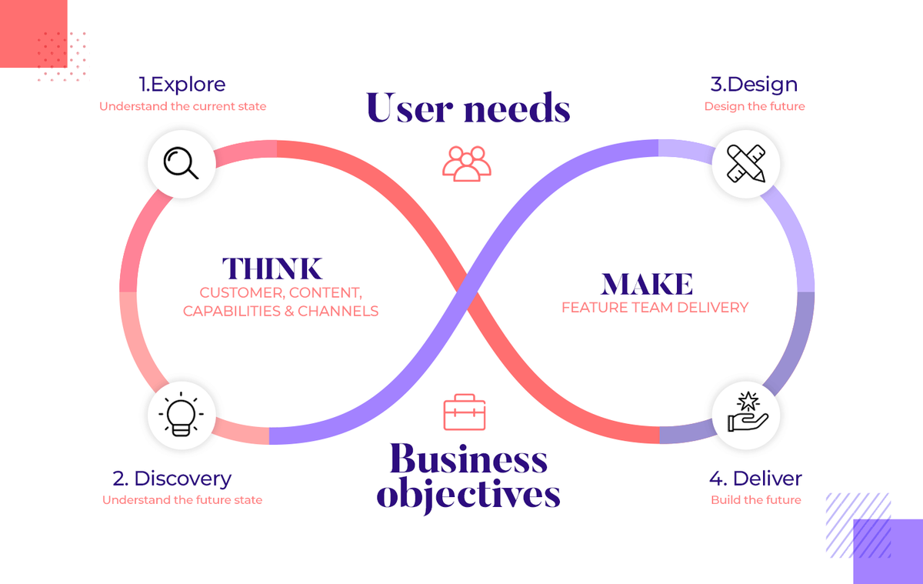

UCD METODOLOGY
The development of the 'Kitchen Magic' project adopts User-Centered Design (UCD) as its technical and methodological framework, ensuring that each functionality addresses the needs identified in its application environment. To guide the lifecycle in an organized manner, the project structure is divided into fundamental blocks ranging from establishing the project foundations to modeling interfaces based on real user interactions.

Slide 5
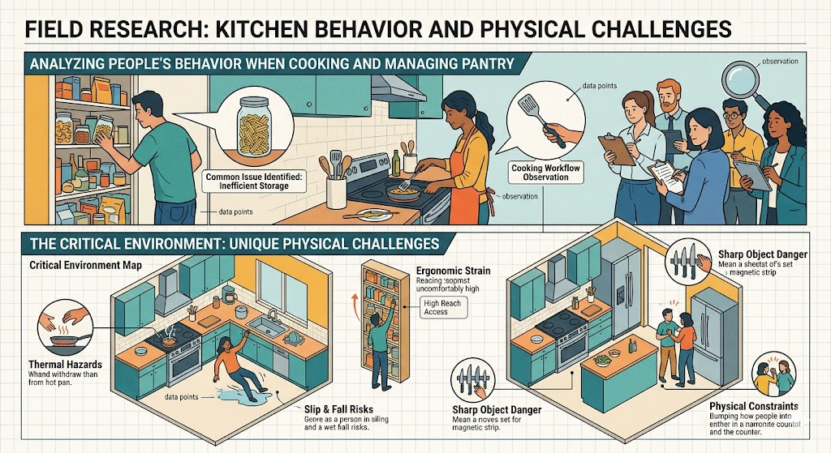
PHASE 1: UNDERSTANDING THE CONTEX OF USE AND DISCOVERY
Field Research: We analyzed people's behavior when cooking and managing their pantry. We identified a common issue
The Critical Environment: We determined that the context (the kitchen) presents unique physical challenges

Slide 6
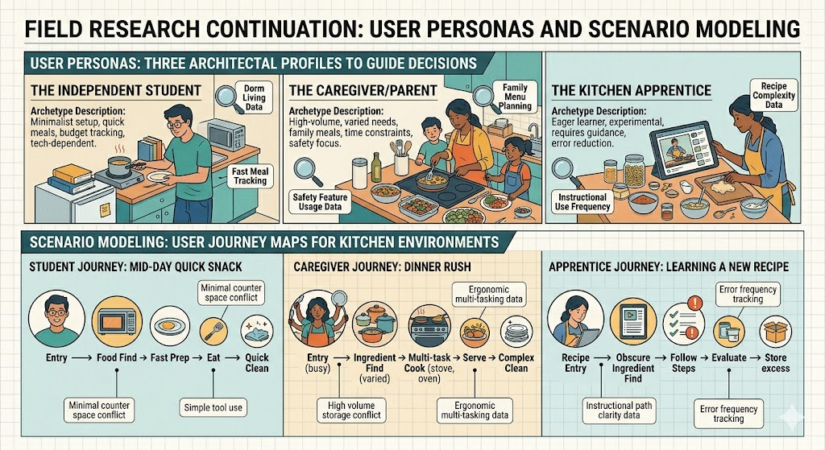
PHASE 2: SPECIFYING USER REQUIREMENTS
Definition of User Personas: We created three archetypal profiles to guide the team's decisions:
The Independent Student
The Caregiver//Parents
The Kitchen Apprentice
Scenario Modeling: We developed user journey maps based on daily situations for these profiles

Slide 7
PHASE 3: PRODUCE DESIGN SOLUTIONS
Initial Stage: First, a preliminary site map and structural information architecture were designed using a tactile approach.
Critical Adjustments: Based on these initial visual iterations, critical adjustments were implemented.
Typography: High-readability fonts were selected to counteract challenges like variable lighting.
Ergonomics & Layout: Titles and menus were relocated to lower action zones for single-handed operation.
Voice Assistant: The size and brightness of the voice assistant indicators were maximized.
Final Consolidation: Finally, the definitive interface was consolidated by integrating empirical testing, justifying the final design changes based on the evidence collected.

Slide 8
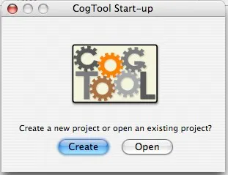
PHASE 4: DESING EVALUATIONS AND VALIDATION
Analytical Evaluation (KLM and CogTool): We selected the system's most critical task and broke down every click and user movement into KLM mathematical operators.
Simulated Usability Testing: We designed a complete experimental protocol with checklists and carried out a simulation practice by filling out standardized usability questionnaires.

Slide 9
IMPLEMENTATION PHASES

Slide 10
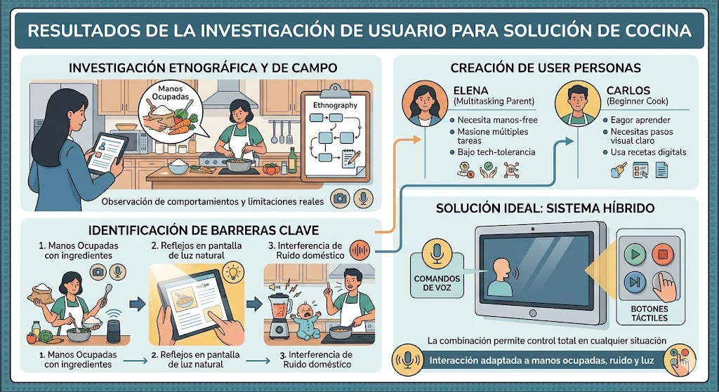
STAGES 1 & 2
Stages 1 and 2: Understanding the Context and User ModelingProcess: Field research and ethnographic analysis in real kitchens.
Deliverables: Creation of user personas and definition of system requirements.
Results: Identification of key problems (busy hands, poor visibility, noise) and selection of a multimodal solution (Voice + Touch).
Transition: The identified problems and user profiles served as the direct basis for beginning to sketch the first wireframes in the next stage.

Slide 11
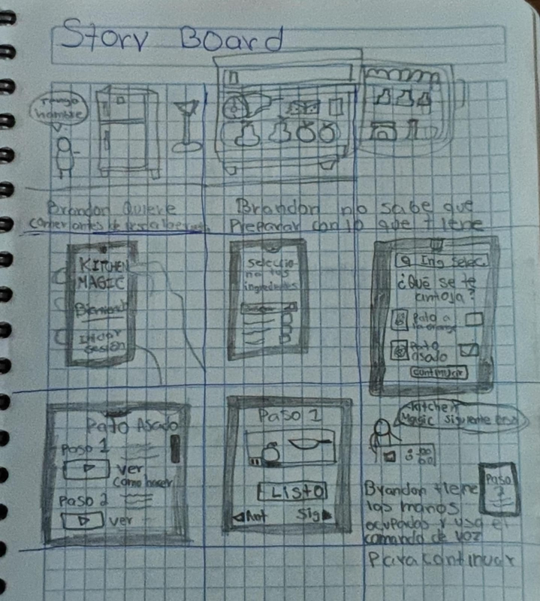
STAGE 3
Deliverables: A three-step information architecture (Ingredients, Pairing, Execution) and the creation of prototypes ranging from low-fidelity (Lo-Fi) to high-fidelity (Hi-Fi).
Results: Interface with centralized voice controls, large typography, and dynamic calorie calculation.
Transitions:
Between prototypes: We moved from a basic layout focused on thumb reach to an interactive (Hi-Fi) prototype with professional design and full multimodal functionality.
Toward evaluation: The completion of the interactive design made it ready for testing.

Slide 12
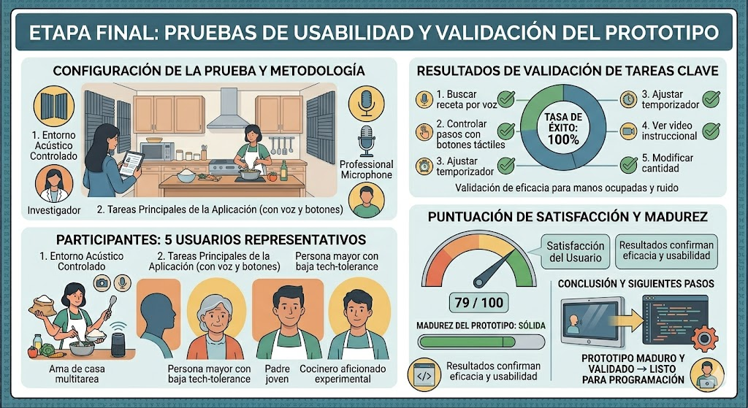
STAGE 4
Process: Predictive modeling (KLM/CogTool) and controlled real-world testing with 5 users using the Think-Aloud method and the SUS scale.
Deliverables: Collection of success metrics, execution times, and a usability error matrix.
Results: 100% success rate, completion times below the target (2.5 minutes on average), and a high satisfaction rating (79/100).
Transition (Post-evaluation): The minor errors detected (such as the lack of a visual indicator when using voice commands) led to the creation of a “Roadmap” to redesign details and schedule a second phase of testing in kitchens with real-world noise.

Slide 13
USABILITY TEST

Slide 14
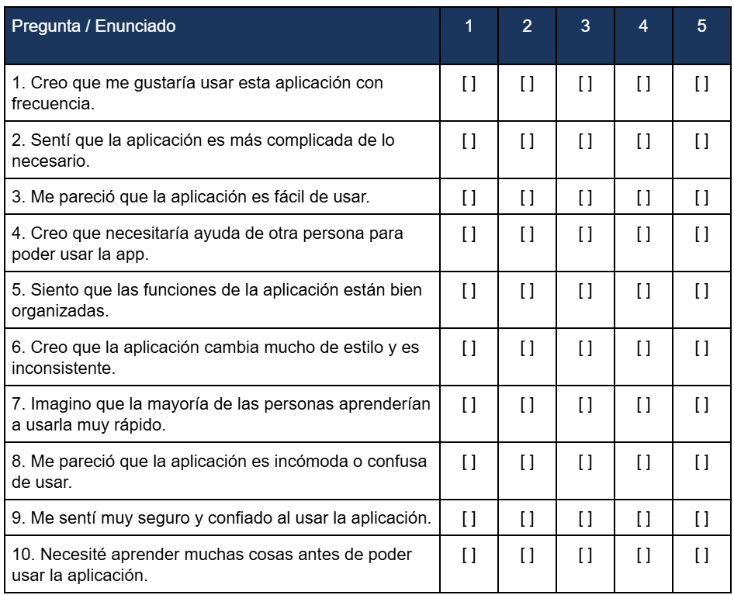
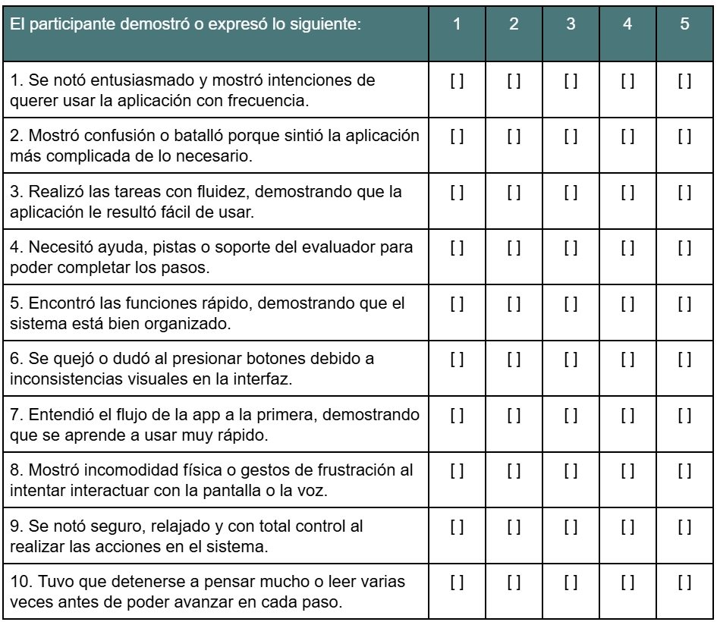
USABILITY TESTS
To conduct the tests in a controlled way, we used The standard SUS questionnaire (10 questions rated from 1 to 5) and an open-ended questions section.

Slide 15
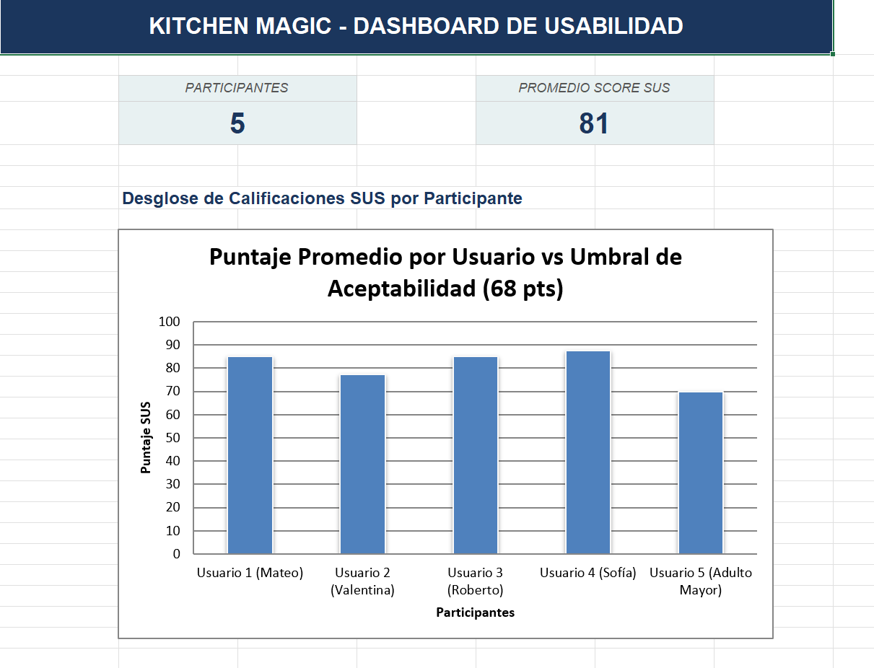
TESTS RESULTS

Slide 16
LESSONS LEARNED

Slide 17

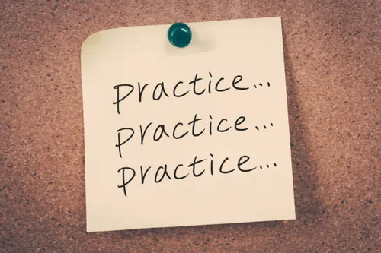
CONTRAST: THEORY VS PRACTICAL IMPLEMENTATION
In Theory: User-Centered Design seems like a linear process where defining User Personas and scenarios magically resolves the interface.
In Practice: We encountered the reality of the "context of use". Theory provided us with the tools, but practice forced us to iterate, switch to fonts that are more readable from a distance.

Slide 18

MISTAKES MADE ALONG THE PROCESS
Developer Bias (Assuming for the user): In the early deliverables, we designed flows assuming that the user would understand the iconography immediately.
Underestimating Analytical Modeling: Initially, we viewed the KLM model and the CogTool software simply as a mathematical requirement.

Slide 19
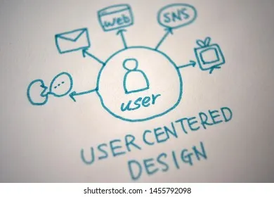
SIGNIFICANT LEARNINGS
The most valuable takeaway was the adoption of the UCD (User-Centered Design) approach. We learned that usability is not an "embellishment" added at the end of a project, but the very structure upon which it is programmed.
Understanding that software must adapt to humans (and not humans bending to understand the software) completely shifted our perspective as future developers.

Slide 20
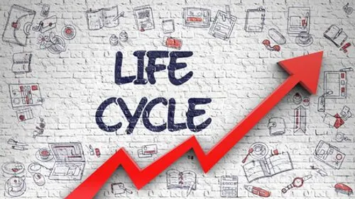
EVIDENCE OF ACHIEVING COURSE OBJECTIVES
We progressed from a basic, empirical software requirements specification (SRS) to a robust catalog focused on accessibility.
We successfully applied a complete design cycle: contextual research, low-fidelity sketching, ergonomic optimization, high-fidelity interactive prototyping, and the methodological simulation of usability testing in a formal results report.

Slide 21
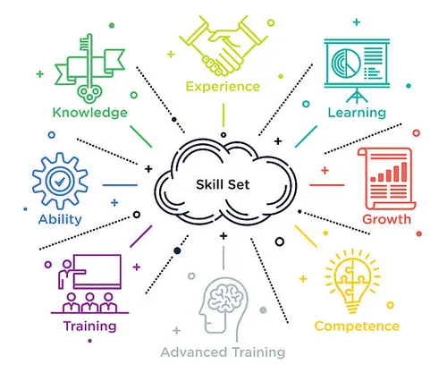
ACQUISITION OF ADDITIONAL SKILLS (SOFT AND TECHNICAL SKILLS)
Simulation and Technical Testing: We learned how to structure cross-referenced checklists and observation methodologies.
Student Project Management: Balancing responsibilities among the 5 members taught us to coordinate research, design, and documentation tasks in parallel under real-time constraints.
Visual Communication and Synthesis: Creating the final poster and design report forced us to transform complex technical data into clear visual arguments.

Slide 22

THANK
YOU

