Slide 1


Slide 2
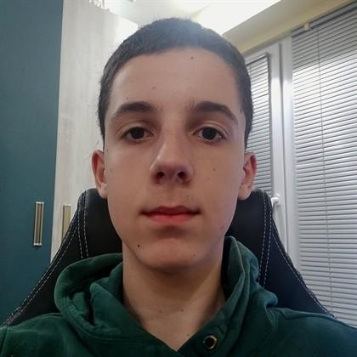
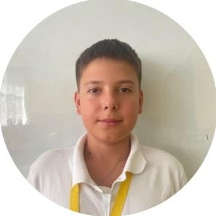
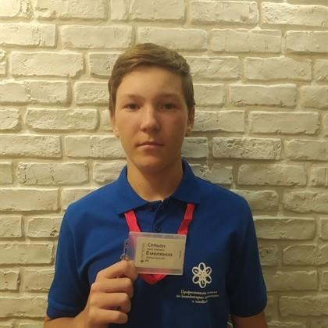
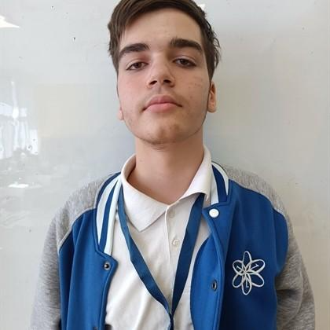
1.The Team
Borislav Andrikov - Project Manager
Ivan Kolozenko - Front-End Developer
Simeon Emelyanov - Developer
Mihail Mavrodiev - Documentation & Testing

Slide 3
2.Steps In our Project
Sprint 1 – Planning
Choose project idea
Create repository
Assign team roles
Sprint 2 – UI Development
Sprint 4 – Finalization
Fix bugs
Improve design
Final testing
Prepare presentation
Sprint 3 - Features
Add functionality
Connect events and buttons
Test interactions

Slide 4





4.Apps and technologies used

Slide 5
Thank you for your attention.

