Slide 1
نحوه ساخت شخصیت انسان در Unity , OpenGl
امیرحسین کارگران

Slide 2
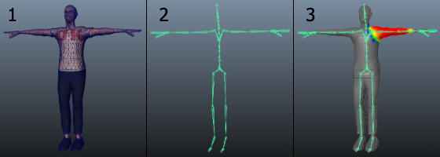
Modeling, Rigging, Skinning

Slide 3
FBX Format
FBX (Filmbox) is a proprietary file format (.fbx) developed by Kaydara and owned by Autodesk since 2006. It is used to provide interoperability between digital content creation applications. FBX is also part of Autodesk Gameware, a series of video gamemiddleware.

Slide 4
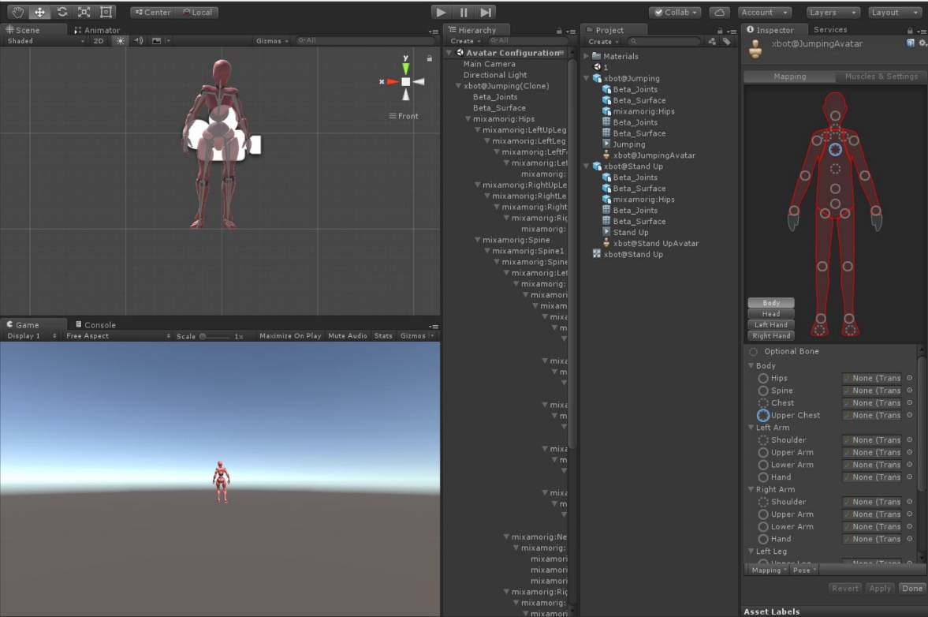
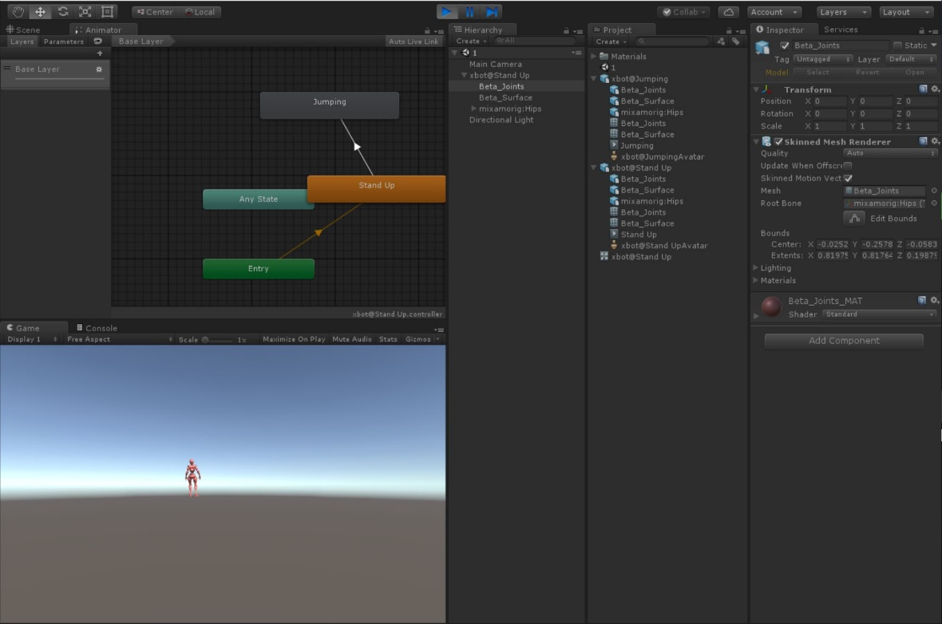
Unity

Slide 5
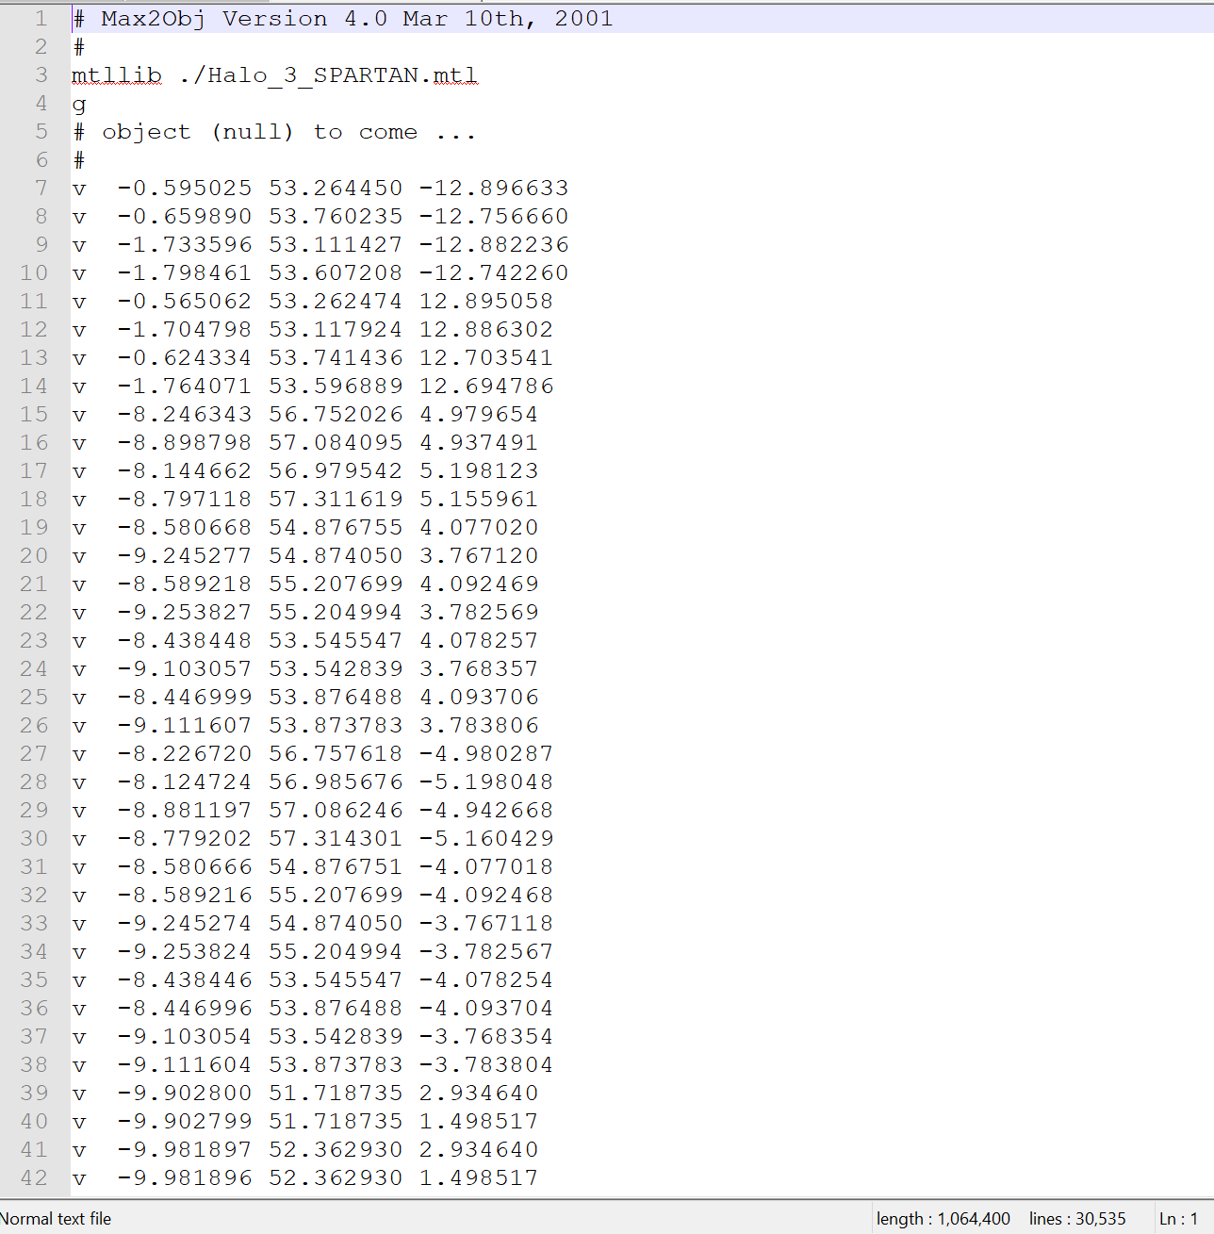
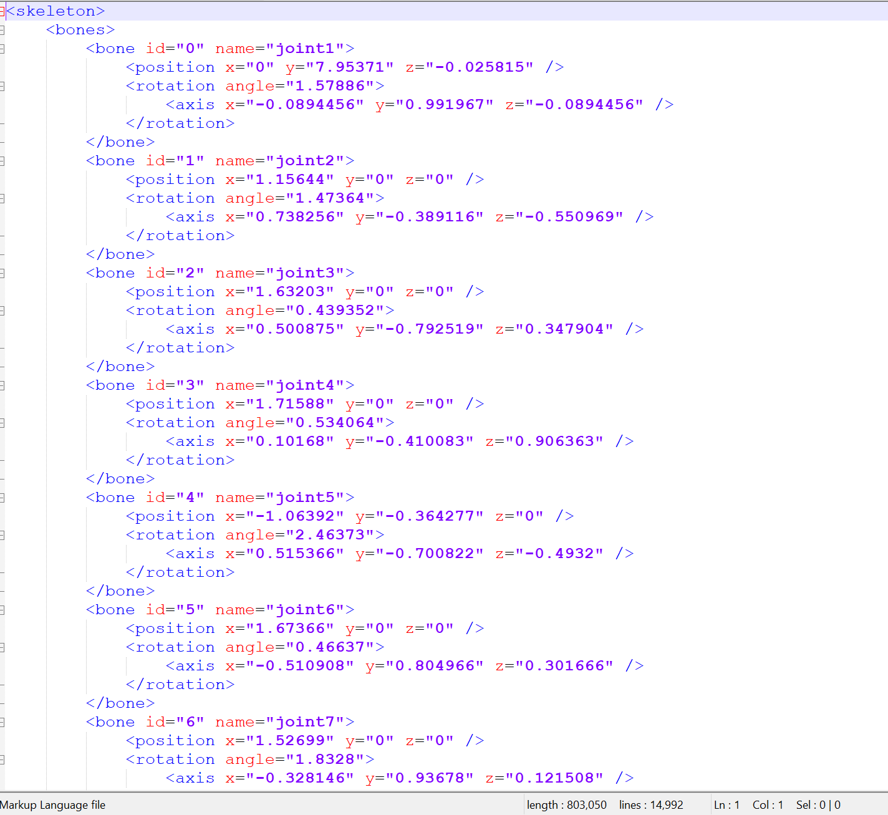
Obj and Xml

Slide 6
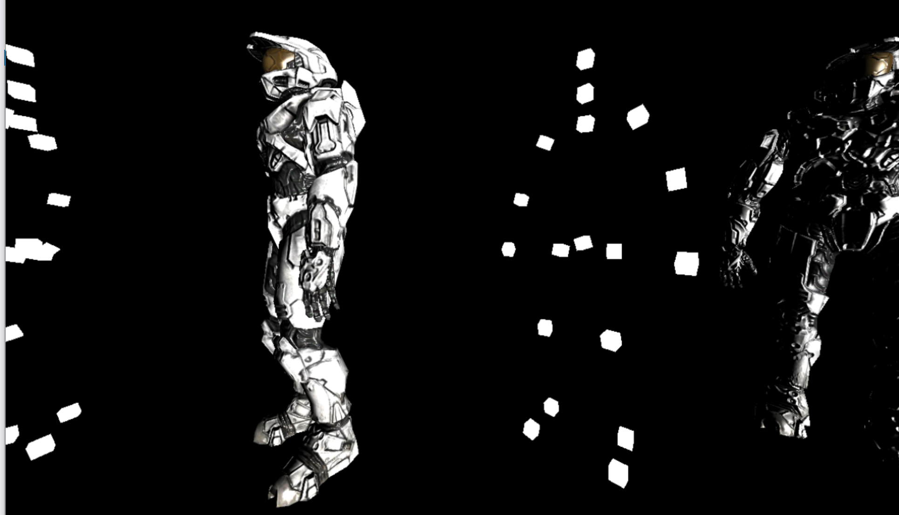
Open GL

