Slide 1

UNIVERSITY OF CENTRAL PUNJAB
Real-time Landmark Recognition for Tourism: Pilot Project for Lahore
By Muhammad Hammad, Ali Sehran and Waleed Kamran
Faculty of Information Technology(FOIT)
University of Central Punjab(UCP), Lahore

Slide 2
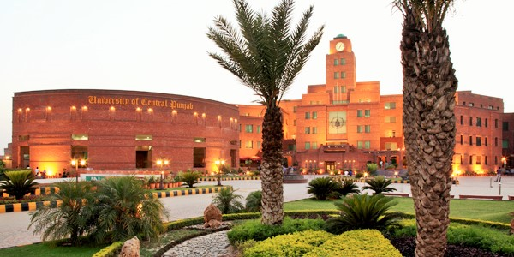
UNIVERSITY OF CENTRAL PUNJAB
Introduction
Department of Computer Sciences, Faculty of Information Technology (FOIT), University of Central Punjab, Lahore
Computer vision, image recognition, real-time, object detection, landmark recognition, and classification

Slide 3
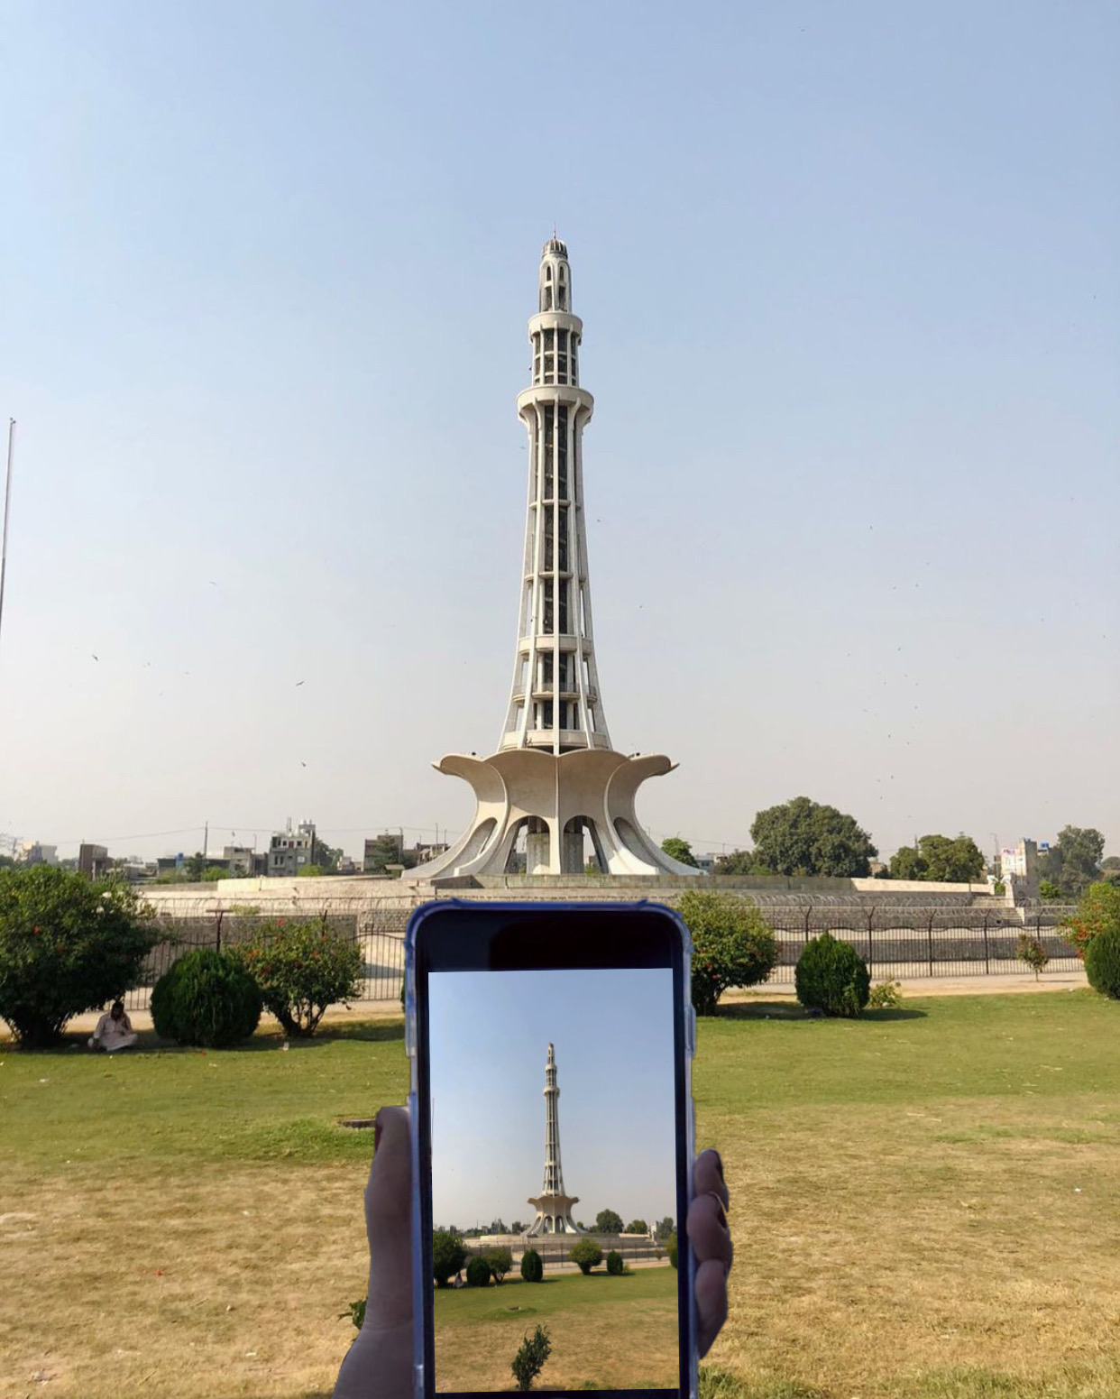
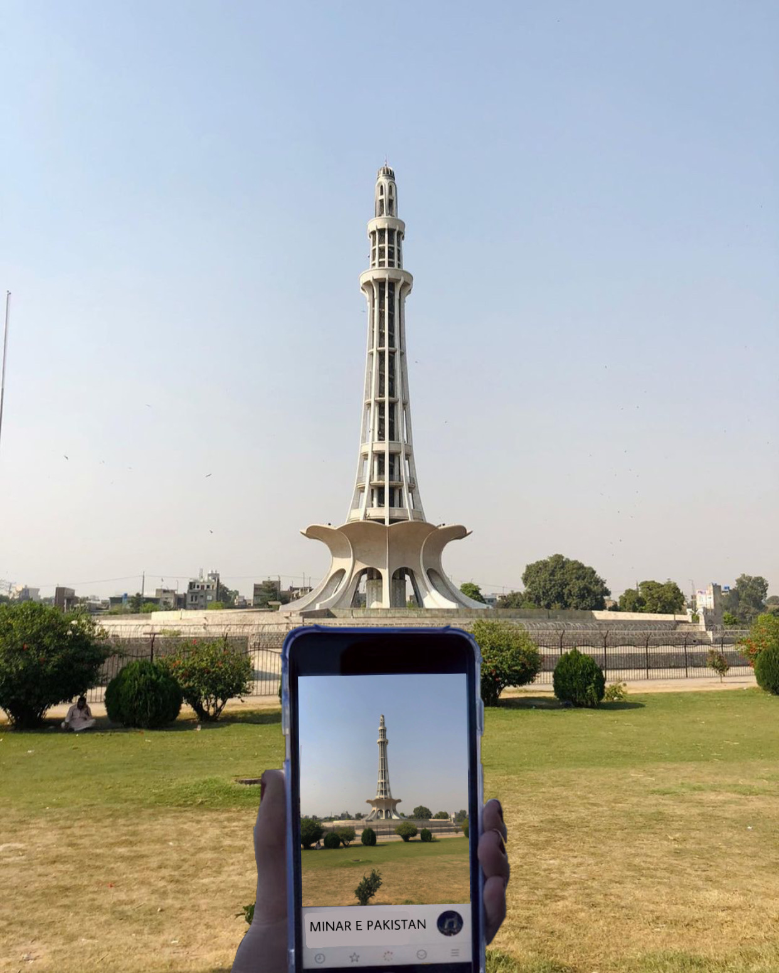
UNIVERSITY OF CENTRAL PUNJAB
Problem Statement
Real-time Camera Frames
Recognized Frame as Minar-e-Pakistan

Slide 4


UNIVERSITY OF CENTRAL PUNJAB
Industry Solutions
API
API

Slide 5
UNIVERSITY OF CENTRAL PUNJAB
Academia Solutions
Tour The World
Scene maps
Chinese Landmark Recognition
Indian Monument Recognition
Landmark Recognition at Cloud Mail.ru Group
Google Landmarks Recognition Challenge
A case study of Istanbul

Slide 6
UNIVERSITY OF CENTRAL PUNJAB
Results of Related Literature Work
 | Accuracy | Variance In Light | Variance in Angle/Size | Description | Geo-Info
Microsoft API | 11.8% | X | X | Cloud landmark recognition API | X
Google API | 35.7% | X | X | Cloud landmark recognition API | X
Tour The World | 46.3% | X | X | Image retrieval from a local landmark database | X
Scene Maps | 80.65% | X | X | Image retrieval from a local landmark database | X
Chinese Landmarks Recognition | 72.55% | X | X | iOS landmark recognition application | X
Indian Monument Recognition | 92.7% | X | ✓ | Framework for monument recognition | X
Cloud Mail.ru Group | 95% | X | ✓ | Landmark recognition framework deployed on Cloud-based application | ✓
Case Study of Istanbul | 96.3% | X | X | iOS landmark recognition application | X

Slide 7
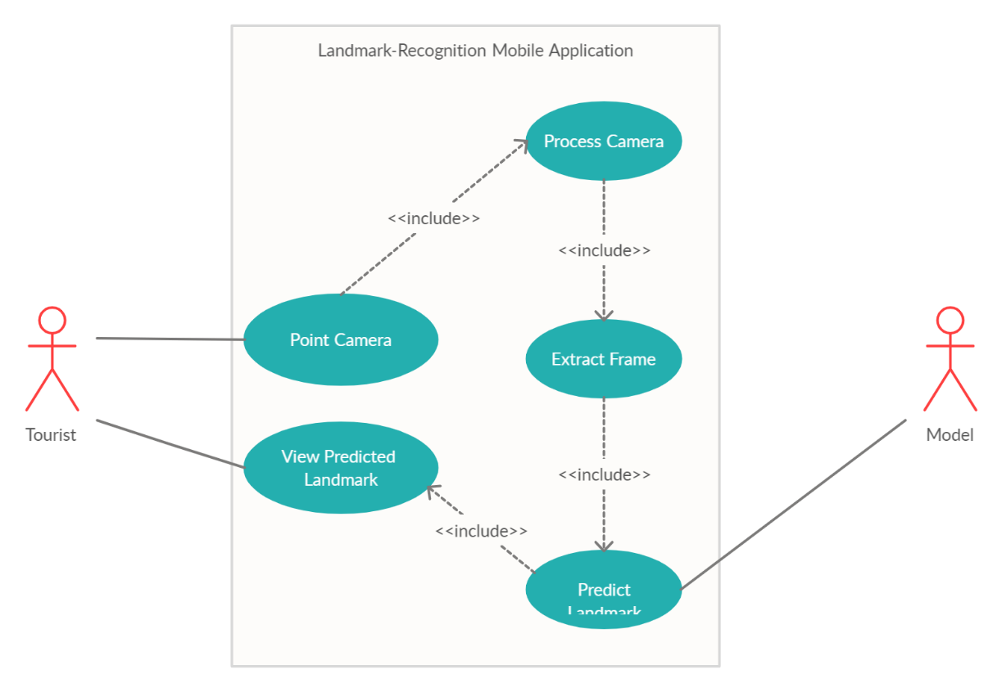
UNIVERSITY OF CENTRAL PUNJAB
System Boundary
System Boundary

Slide 8

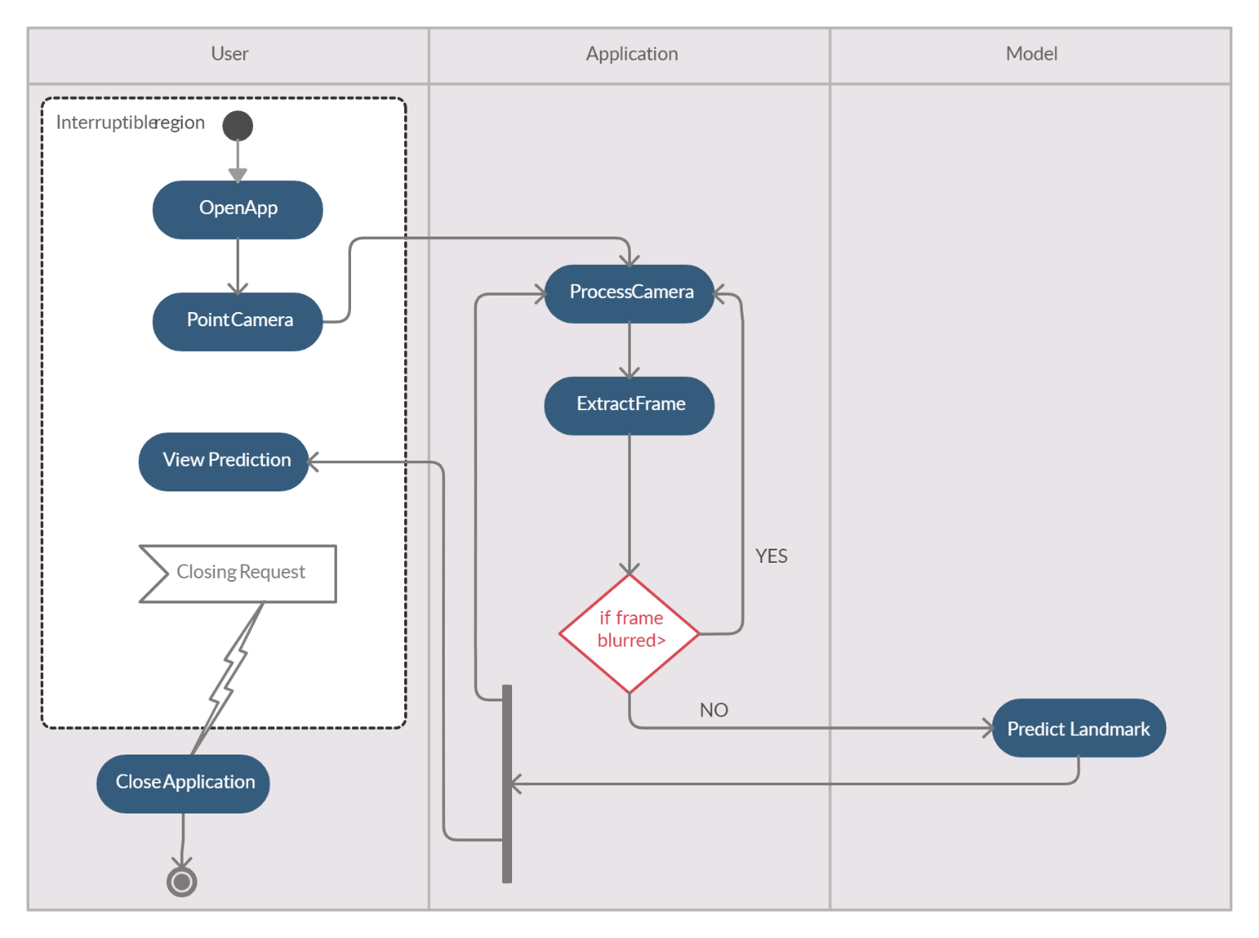
UNIVERSITY OF CENTRAL PUNJAB
System Interaction with External Entities
Tourist
System

Slide 9
UNIVERSITY OF CENTRAL PUNJAB
System Boundary
System
User

Slide 10
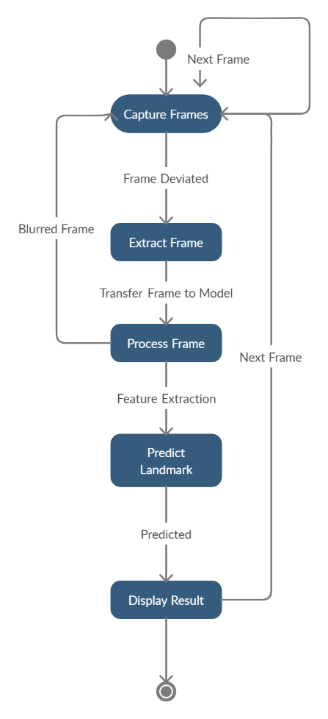
UNIVERSITY OF CENTRAL PUNJAB
System Interaction with External Entities
Tourist in Real-time Environment

Slide 11
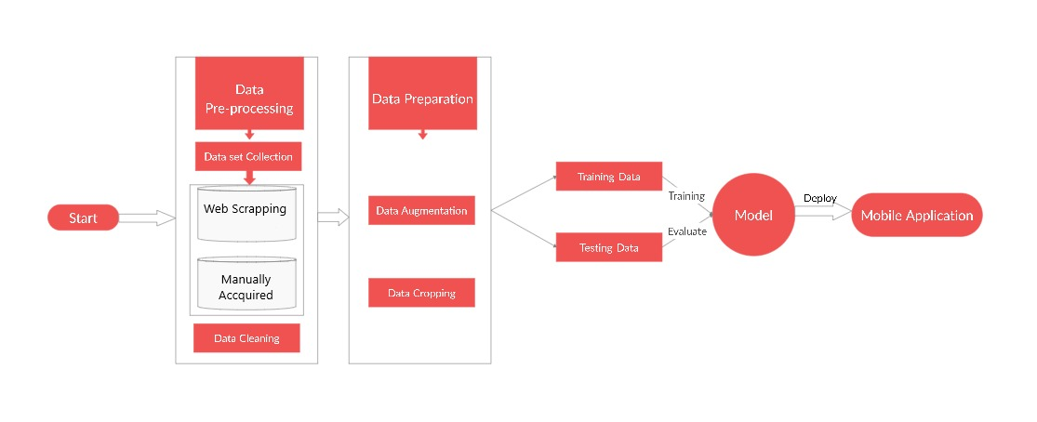
UNIVERSITY OF CENTRAL PUNJAB
Proposed System’s Workflow

Slide 12
UNIVERSITY OF CENTRAL PUNJAB
Project Understanding
Features
User scan landmark:
Process the device camera towards landmark
On behalf of deviation, system will extract a frame
System send extracted frame to model to predict the landmark
User is displayed the prediction at the bottom of the screen

Slide 13
UNIVERSITY OF CENTRAL PUNJAB
Project Understanding
Software Quality Attributes to be achieved:
Robustness
Usability
Reliability
Efficiency

Slide 14
UNIVERSITY OF CENTRAL PUNJAB
Project Understanding
Use Cases:
UC-1: Point Camera
UC-2: Process Camera
UC-3: Extract Frame
UC-4: Predict Landmark
UC-5: View Predicted Landmark

Slide 15
UNIVERSITY OF CENTRAL PUNJAB
Project Understanding
Scenarios
Some scenarios of the system are stated in the next slides

Slide 16
UNIVERSITY OF CENTRAL PUNJAB
Project Understanding
Scenarios:
S-1: Tourist points the camera towards a landmark in a real-time environment. The system processes the camera and extracts the frame to predict the landmark using the deep learning model.
Alternate S-1: Tourist is point camera towards a landmark in a real-time environment with no connectivity. The system will alert the user to connect to the internet via a dialog box.

Slide 17
UNIVERSITY OF CENTRAL PUNJAB
Project Understanding
Scenarios:
S-2: The model predicts the given frame by the tourist. The system presents the predicted landmark name, some description via text or speed assistant.
Alternate S-2: Model is not able to predict the given frame by the tourist because the prediction accuracy does not meet the threshold. The system does not show the prediction and continue checking with the incoming frames.

Slide 18
UNIVERSITY OF CENTRAL PUNJAB
Project Understanding
Activity Diagram:

Slide 19
UNIVERSITY OF CENTRAL PUNJAB
Initial Results
Dataset Collection for the landmarks of Lahore
Ways??

Slide 20
UNIVERSITY OF CENTRAL PUNJAB
Initial Results
Dataset Collection for the landmarks of Lahore
Ways??
Dataset Collection via Web Scraping?

Slide 21
UNIVERSITY OF CENTRAL PUNJAB
Initial Results
Dataset Collection for the landmarks of Lahore
Ways??
Dataset Collection via Web Scraping?
The dataset was collected for 11 landmarks of Lahore via web scraping using Image APIs from Google and Microsoft, and frames extraction through Youtube videos to test the web scraping collection approach

Slide 22
UNIVERSITY OF CENTRAL PUNJAB
Initial Results
Total images collected via web scraping was around 3000 and most of them contained filters

Slide 23
UNIVERSITY OF CENTRAL PUNJAB
Initial Results
Total images collected via web scraping was around 3000 and most of them contained filters
After cleaning, around 1000 images were left for 11 classes of the landmarks of Lahore

Slide 24
UNIVERSITY OF CENTRAL PUNJAB
Initial Results
Total images collected via web scraping was around 3000 and most of them contained filters
After cleaning, around 1000 images were left for 11 classes of the landmarks of Lahore
Initial results contained the experiments for the collected dataset using pretrained image classification models and models built from scratch

Slide 25
UNIVERSITY OF CENTRAL PUNJAB
Initial Results
Pretrained image classification models network architecture
Example VGG-16

Slide 26
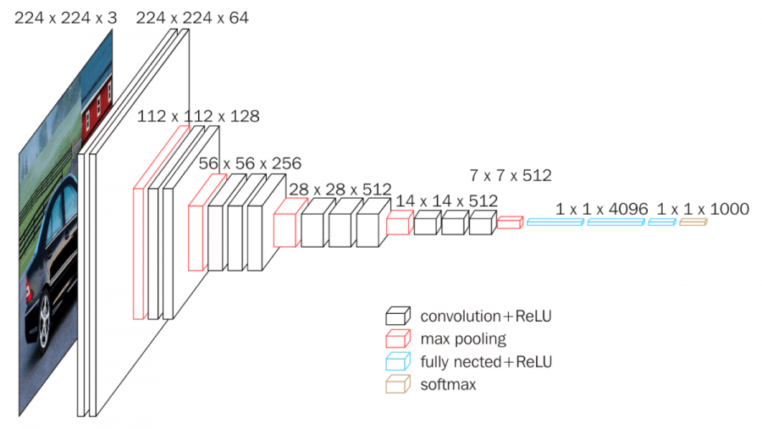
UNIVERSITY OF CENTRAL PUNJAB
Initial Results
VGG-16

Slide 27
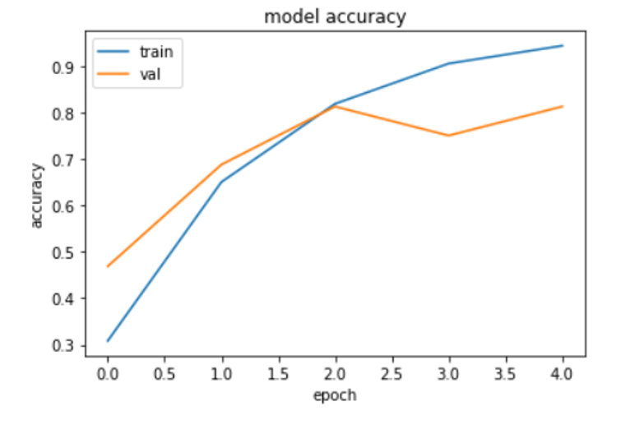
UNIVERSITY OF CENTRAL PUNJAB
Initial Experiments
Experiment 1
Method VGG-16

Slide 28
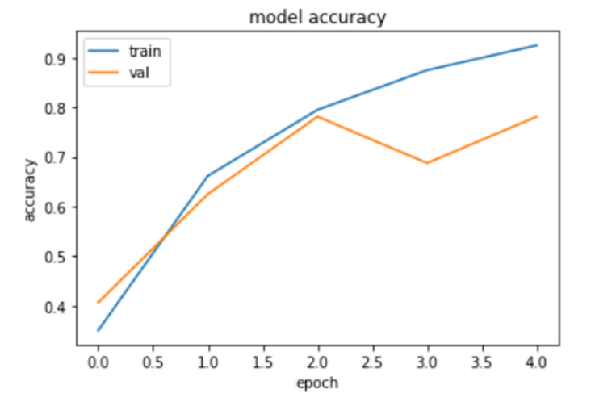
UNIVERSITY OF CENTRAL PUNJAB
Initial Experiments
Experiment 2
Method VGG-19

Slide 29
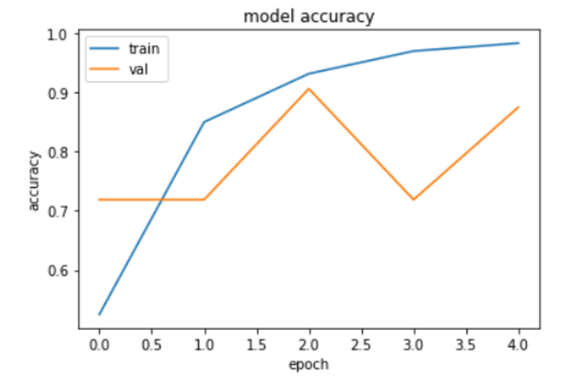
UNIVERSITY OF CENTRAL PUNJAB
Initial Experiments
Experiment 3
Method ResNet-50

Slide 30
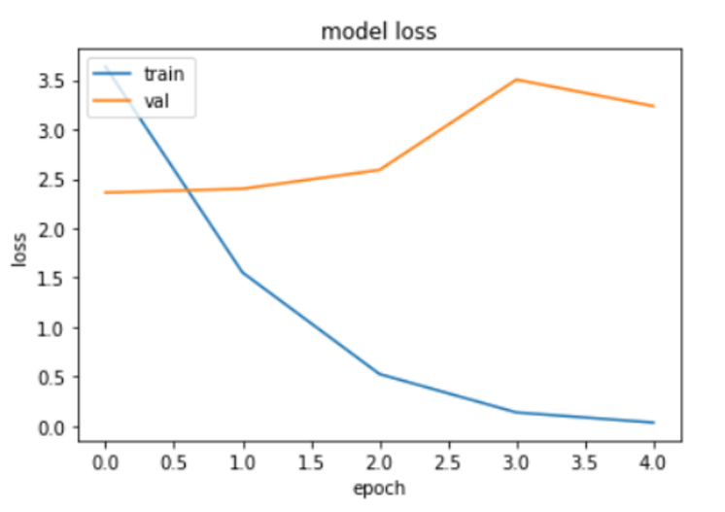
UNIVERSITY OF CENTRAL PUNJAB
Initial Experiments
Experiment 4
Method 3-layered CNN on Greyscale Images

Slide 31
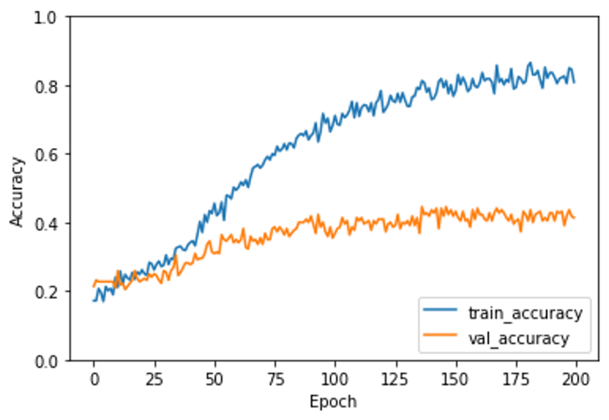
UNIVERSITY OF CENTRAL PUNJAB
Initial Experiments
Experiment 5
Method 7-layered CNN on RGB Images

Slide 32
UNIVERSITY OF CENTRAL PUNJAB
Initial Results Achieved
Methods | Accuracy
VGG-16 | 77.5%
VGG-19 | 70%
ResNet-50 | 87.5%
CNN (Greyscale) | 32%
CNN (RGB) | 41%

Slide 33
UNIVERSITY OF CENTRAL PUNJAB
Issues in Initial Results??

Slide 34
UNIVERSITY OF CENTRAL PUNJAB
Issues in Initial Results
Models on which the experiments were run are deep learning models
Because deep learning models are best for image classification/recognition problems

Slide 35
UNIVERSITY OF CENTRAL PUNJAB
Issues in Initial Results
Models on which the experiments were run are deep learning models
Because deep learning models are best for image classification/recognition problems
Deep learning is data hungry, its algorithms requires as much as labelled samples of a problem space

Slide 36
UNIVERSITY OF CENTRAL PUNJAB
Issues in Initial Results
Models on which the experiments were run are deep learning models
Because deep learning models are best for image classification/recognition problems
Deep learning is data hungry, its algorithms requires as much as labelled samples of a problem space
Very less amount of data

Slide 37
UNIVERSITY OF CENTRAL PUNJAB
Why It Doesn’t Work!
Deep learning currently lacks in mechanism for learning abstractions

Slide 38
UNIVERSITY OF CENTRAL PUNJAB
Why It Doesn’t Work!
Deep learning currently lacks in mechanism for learning abstractions
So, it is the overfitting case for the experiments run because of very less data

Slide 39
UNIVERSITY OF CENTRAL PUNJAB
What’s Next
There should be some other way for collecting the dataset for the famous landmarks of Lahore??

Slide 40
UNIVERSITY OF CENTRAL PUNJAB
What’s Next
There should be some other way for collecting the dataset for the famous landmarks of Lahore??
Yes

Slide 41
UNIVERSITY OF CENTRAL PUNJAB
What’s Next
There should be some other way for collecting the dataset for the famous landmarks of Lahore??
Yes
Another possible technique was proposed to collect the dataset of the famous landmarks of Lahore
“Manual Collection of Dataset”

Slide 42
UNIVERSITY OF CENTRAL PUNJAB
Collaboration for Manual Dataset Collection
Collaborated with “Walled City of Lahore Authority” to manually collect the dataset of the famous landmarks of Lahore

Slide 43
UNIVERSITY OF CENTRAL PUNJAB
Collaboration for Manual Dataset Collection
Collaborated with “Walled City of Lahore Authority” to manually collect the dataset of the famous landmarks of Lahore
Provided with a tourist guide to help us make that possible

Slide 44
UNIVERSITY OF CENTRAL PUNJAB
Collaboration for Manual Dataset Collection
Collaborated with “Walled City of Lahore Authority” to manually collect the dataset of the famous landmarks of Lahore
Provided with a tourist guide to help us make that possible
Collected more than 31 thousand images for the 25 famous landmarks of Walled City of Lahore

Slide 45
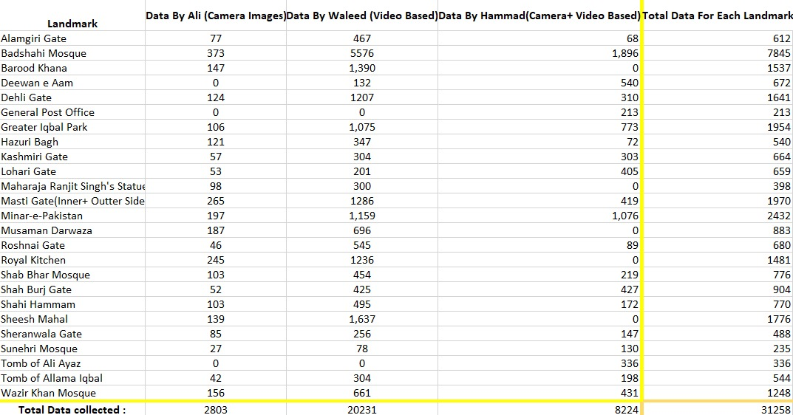
UNIVERSITY OF CENTRAL PUNJAB
Collected Dataset Analysis

Slide 46
UNIVERSITY OF CENTRAL PUNJAB
Collected Dataset Analysis
Strategies for dataset collection:
1. Camera Based Images(Ali Sehran)
To cover the desired and specific angles with attention
2. Video Based Images(Waleed Kamran)
To cover the angles and views missed unconsciously
3. Camera + Video Based(Muhammad Hammad)
To cover all desired and specific angles and views of the landmarks

Slide 47
UNIVERSITY OF CENTRAL PUNJAB
Target Final Results
 | Accuracy | Variance In Light | Variance in Angle/Size | Description | Geo-Info
Microsoft API | 11.8% | X | X | Cloud landmark recognition API | X
Google API | 35.7% | X | X | Cloud landmark recognition API | X
Tour The World | 46.3% | X | X | Image retrieval from a local landmark database | X
Scene Maps | 80.65% | X | X | Image retrieval from a local landmark database | X
Chinese Landmarks Recognition | 72.55% | X | X | iOS landmark recognition application | X
Indian Monument Recognition | 92.7% | X | ✓ | Framework for monument recognition | X
Cloud Mail.ru Group | 95% | X | ✓ | Landmark recognition framework deployed on Cloud-based application | ✓
Case Study of Istanbul | 96.3% | X | X | iOS landmark recognition application | X
Our Proposed Solution | 80%+ | ✓ | ✓ | Android/cross-platform landmark recognition application | Maybe

Slide 48
UNIVERSITY OF CENTRAL PUNJAB
Future Directions for Phase-2
Several data augmentation technique’s literature review is in process and will be applied for increasing the labelled samples of the problem space
Pre processing
Model training

Slide 49
UNIVERSITY OF CENTRAL PUNJAB
Thank you!!

