Slide 1
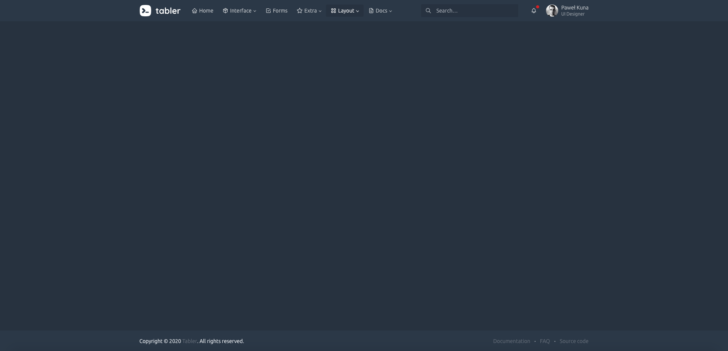
(1) Logo
(2) Navigation
(3) Extra elements
(4) Dropdowns

