Slide 1
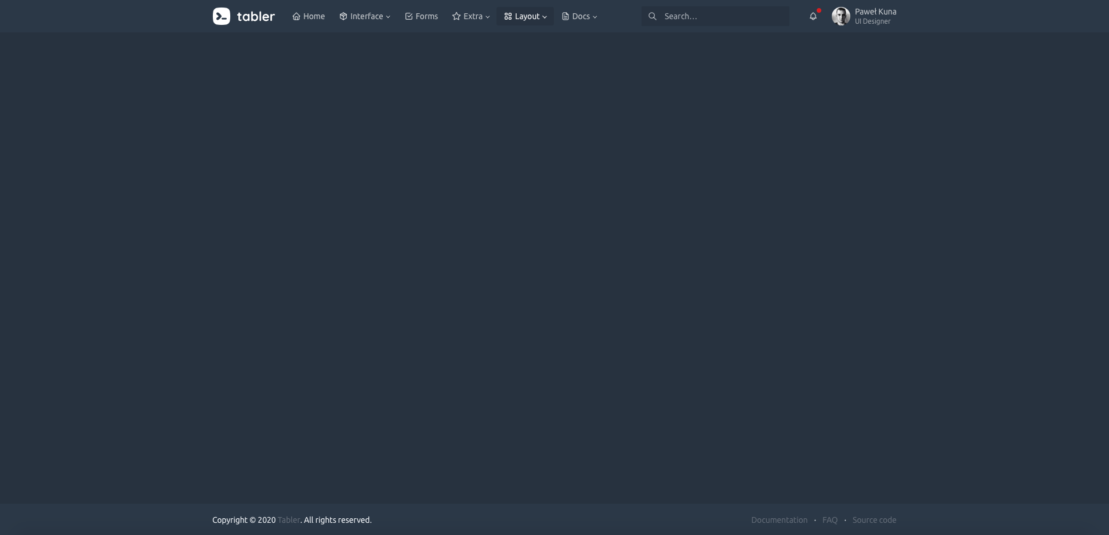
a(class = “nav-item”, href = “#home”)
div(role = “tabpanel”, id = “home”, …)
Body tab content wrapper

