Slide 1
RANDONEERING · PGFIRSTAID
Boise Code Camp · 2026
// OPEN SOURCE · POSTGRES HEALTH CHECKS
pgFirstAid
$ speaker · Justin Frye // randoneering, llc
01 / 16

Slide 2

RANDONEERING · PGFIRSTAID
02 · SCHEDULE
// AGENDA
Schedule.
08:30
Sessions
50-min sessions · 10-min breaks
09:30
Sessions
50 min
10:30
Session
50 min
11:30
Lunch
90 min · on your own
13:00
Session
14:00
Closing panel
02 / 16

Slide 3

RANDONEERING · PGFIRSTAID
03 · SECTION
03 / 16

Slide 4




RANDONEERING · PGFIRSTAID
04 · SPONSORS
// GRATITUDE
pgFirstAid sponsors.
04 / 16

Slide 5
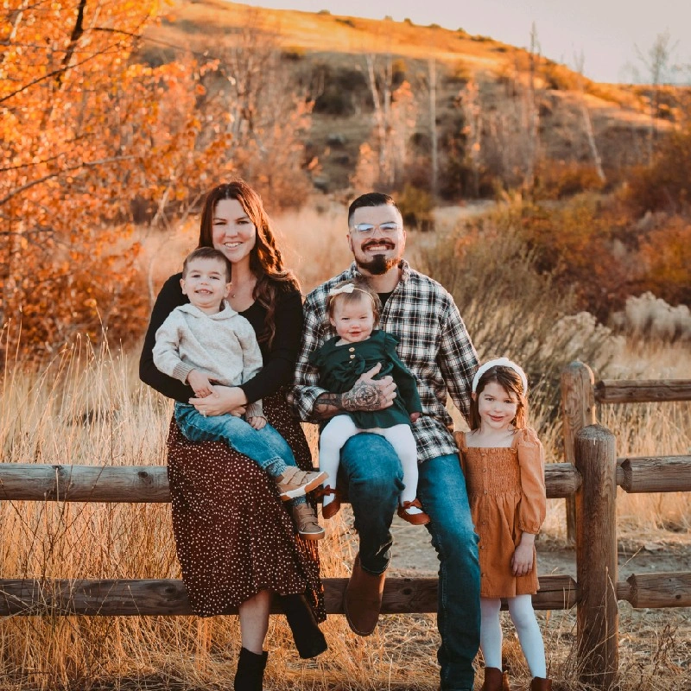
RANDONEERING · PGFIRSTAID
05 · INTRO
// ABOUT
Who is this guy?
Forever junk-drawer sysadmin
self-described, perpetually accurate
Data Engineer at RxBenefits, Inc.
Still trying to grasp pg_toast
Midwest native, living outside Boise, Idaho
Open source evangelist
05 / 16

Slide 6
RANDONEERING · PGFIRSTAID
06 · BACKGROUND
// BACKGROUND
The toolbox before this one.
SQL SERVER
POSTGRES / MYSQL / MARIADB
Brent Ozar
Extensions
FirstResponderKit
Monitoring tools
sp_whoisactive
But.....?
Adam Machanic
Nothing quite like the SQL Server kit.
Ola Hallengren
Maintenance Plan
CheckDB
Paul S. Randal
06 / 16

Slide 7
RANDONEERING · PGFIRSTAID
07 · FEATURES
// PGFIRSTAID · FEATURES
What it does.
Zero dependencies
Pure SQL — no extensions required to start
Actionable health checks
Each result tells you what to do next
Prioritized list by severity, out of the box
Views for on-prem and managed instances
Recommendations + documentation links inline
Optional: deeper checks with pg_stat_statements
07 / 16

Slide 8
RANDONEERING · PGFIRSTAID
08 · PRINCIPLES
// CORE PRINCIPLES
Built for everyone in the room.
Broad target audience
Zero dependencies
Developers
DBA / DBE
SREs
DevOps
ITOps
Operates on existing system tables and views
Lowers the barrier of entry
Hit the ground running on first execution
08 / 16

Slide 9
RANDONEERING · PGFIRSTAID
09 · HEALTH CHECKS
// HEALTH CHECKS · SEVERITY
Five severity levels.
CRITICAL
Tables without primary keys
HIGH
Tables larger than 100 GB
MEDIUM
Tables with more than 50 columns
LOW
Idle connections for > 1 hour
INFO
Server uptime, version, basic facts
09 / 16

Slide 10
RANDONEERING · PGFIRSTAID
10 · SCENARIO · DEV
// SCENARIO_01 · DEVELOPER
A guardrail in the dev lifecycle.
pgFirstAid integrates as a guardrail within the development lifecycle.
STEP 01
STEP 02
STEP 03
STEP 04
Schema definition
Analysis trigger
Inspection
Reporting
Developer defines schema using standard SQL / migrations.
Tool runs against the schema state — pre-commit hook or CI.
Queries system metadata for pattern violations: missing FKs, datatype misuse, indexing gaps.
Structured report detailing risks and the necessary fixes.
10 / 16

Slide 11
RANDONEERING · PGFIRSTAID
11 · SCENARIO · DEVOPS
// SCENARIO_02 · DEVOPS
A proactive check before deployment.
STEP 01
STEP 02
STEP 03
STEP 04
Testing Before Deploy
Instant Feedback
Post Deployment Check
Reporting
Catch missing indexes, slow queries, sleeping connections before prod
No more wasted cycles chasing red herrings
Filter results to check for expected outputs or unexpected behavior
Quantify what each release actually changed
11 / 16

Slide 12
RANDONEERING · PGFIRSTAID
12 · PLATFORMS
// SUPPORTED PLATFORMS
Where it runs.
PG 15 — 18
managed instances supported
AWS Aurora/RDS
GCP
Azure
Neon
Supabase
DigitalOcean
12 / 16

Slide 13
RANDONEERING · PGFIRSTAID
13 · LIMITATIONS
// LIMITATIONS · HONEST
What it doesn’t do.
No testing coverage for Azure and GCP
Call for action: community support welcome
No deep runtime logic
Can’t detect application logic bugs
pg_stat_statements is optional
Provides additional and more detailed stats
13 / 16

Slide 14




RANDONEERING · PGFIRSTAID
14 · LIVE DEMO
// DEMO
Live demo.
14 / 16

Slide 15
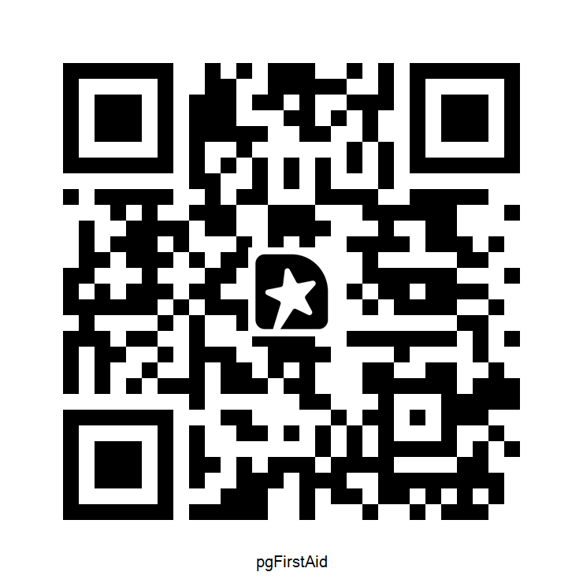
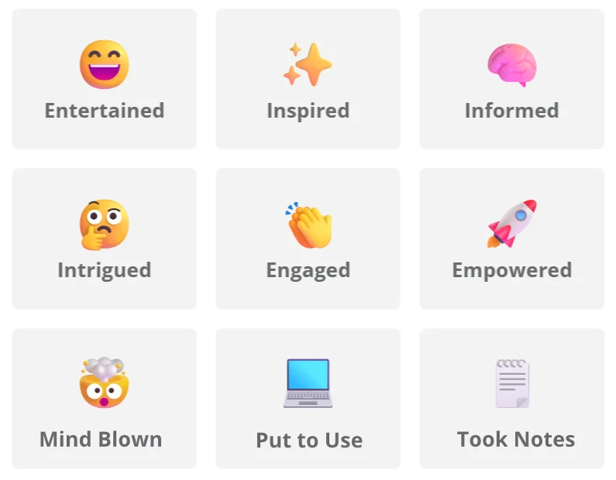
RANDONEERING · PGFIRSTAID
15 · FEEDBACK
// FEEDBACK · TWO MINUTES
Feedback.
Only takes a moment.
15 / 16

Slide 16

RANDONEERING · PGFIRSTAID
16 · END
// THANK YOU · PLEASE...
Star.
Contribute.
Share.
github → github.com/randoneering/pgfirstaid
web → randoneering.tech
16 / 16

