Slide 1

CHAPTER 1
THE PROBLEM
The Scripted Bot Era Is Over
Early AI sales agents were little more than glorified decision trees — rigid "if X, then Y" logic with no memory, no judgment, and zero context awareness. The result? Conversations that felt robotic, transactional, and painfully fragile. The moment a buyer deviated from the happy path, the whole experience shattered.

Slide 2

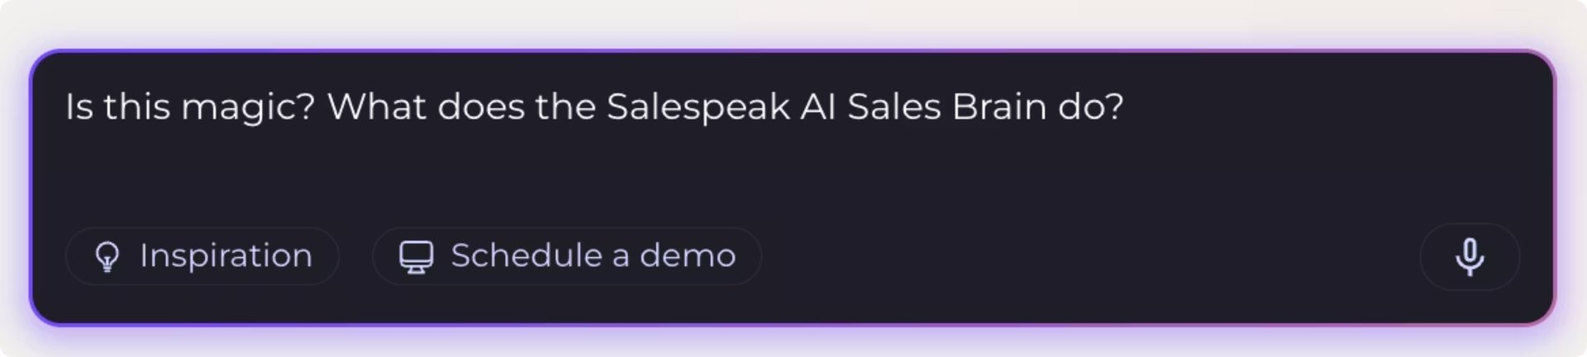
From Scripted to Smart: How to Systematically Humanize Your AI Sales Agent
Lior Mechlovich
CTO & Co-founder, Salespeak.ai
Spent most of my career building data platforms (ex-Amazon/AWS). Co-founded two bay area VC-backed startups
Building B2B enterprise AI products, Agents, Evals, and everything between

Slide 3

Why people hate chatbots?
While the promise of AI sales agents is compelling, many have experienced the stark reality of how current chatbots often fall short, leading to more frustration than help. Here are the all-too-common pain points:
Jarvis Expectations, "Have You Tried" Reality
We anticipate intelligent assistance, but too often encounter rigid scripts that derail at the slightest deviation.
The Infinite Doom Loop
Explaining your problem, only for the bot to ask the same question, forget context, and cycle endlessly.
"Just Let Me Talk to a Human" Rage
The universal outcry when a chatbot stubbornly refuses to escalate an issue to a real person, no matter how logical the request.
Confidently Wrong Energy
Bots providing irrelevant answers with unwavering certainty, like explaining store hours when you're asking about billing.

Slide 4
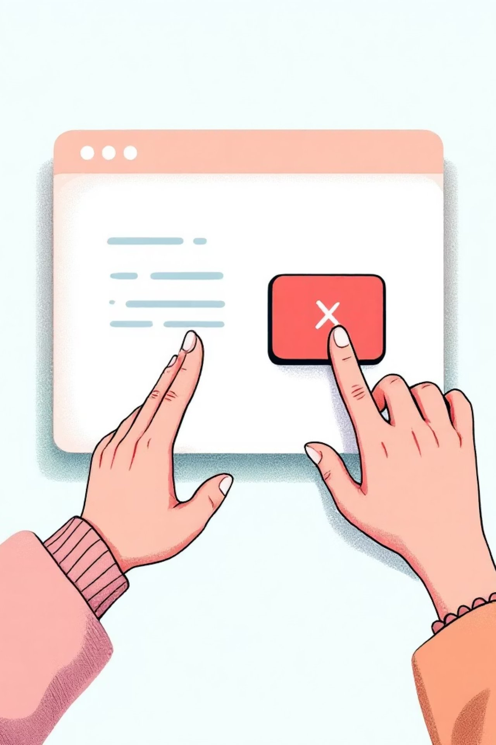
"Where's the 'X' button?"
That's the most common human response to a Chat box on the bottom right….
Can we change that?

Slide 5


What Buyers Actually Want
To Feel Understood
Not sold to — understood. Buyers want reps who grasp their world before pitching a solution.
To Feel Guided, Not Pushed
Smart follow-up questions and context-aware conversations that adapt in real time.
Continuity Across Touchpoints
Every conversation should build on the last — no starting from scratch, no repeating context.
Human ≠ random. Human = adaptive + context-driven.

Slide 6
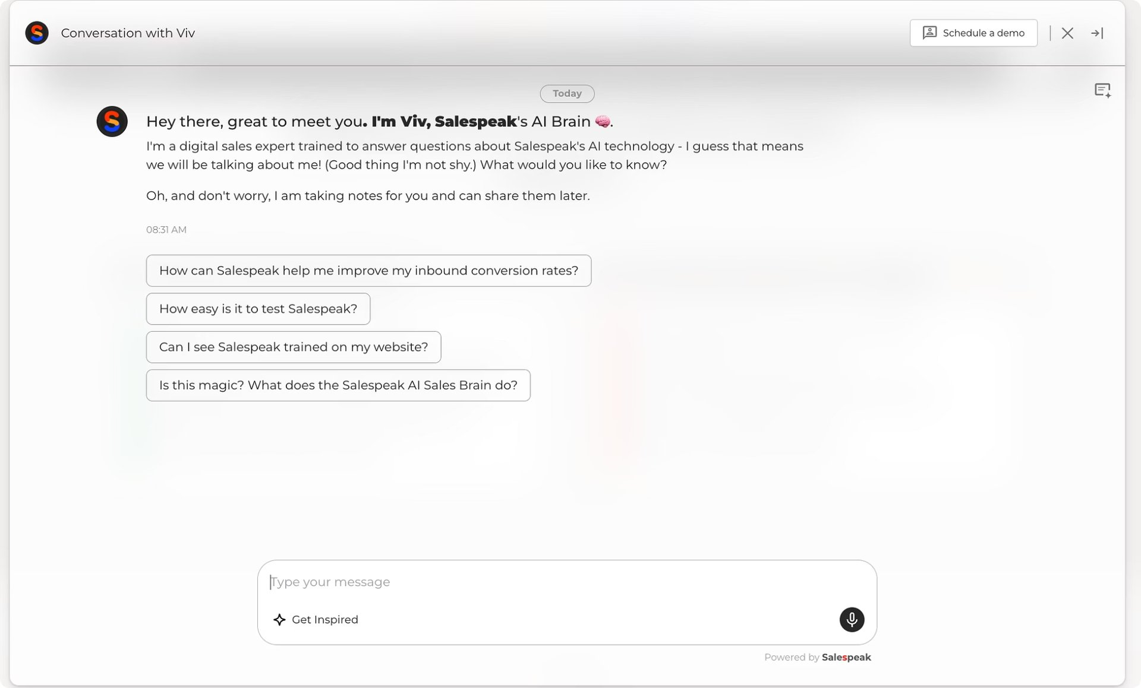
CHAPTER 2
INTRODUCING SALESPEAK
What Is Salespeak?
Salespeak is AI-native sales agent infrastructure — purpose-built for revenue conversations. We turn large language models into structured, goal-driven agents that sell the way your best reps do.
Multi-Turn Discovery
Objection Handling
Context-Aware Follow-Ups
CRM Personalization

Slide 7






Salespeak's Core Philosophy
AI agents should behave like trained reps, not chatbots. Every conversation is intent-aware, goal-oriented, state-driven, and memory-enabled. We replace brittle scripts with intelligent systems.
Intent-Aware
Understands what the buyer really needs
Goal-Oriented
Every turn drives toward an outcome
State-Driven
Tracks where the conversation stands
Memory-Enabled
Recalls context across sessions
We don't build chatbots. We build Intelligent conversational agents.

Slide 8

CHAPTER 3
HOW GREAT SALES AGENTS BEHAVE
How Human Sales Agents Actually Work
The best reps don't follow scripts — they operate on instinct sharpened by systems. They diagnose before prescribing, ask layered questions, and adjust based on real-time buyer signals. They manage conversation state intuitively and always know when to push — and when to pause.
Diagnose First
Read Signals
Manage State
Understand before you prescribe
Adjust approach based on buyer cues
Track deal context across every touchpoint

Slide 9



Behavioral Traits of High-Performing Reps
Curiosity-Driven Discovery
Structured Qualification
Emotional Calibration
Asking the questions that reveal what buyers won't volunteer
Implicit frameworks like MEDDIC guide every interaction
Objection reframing with adaptive pacing and goal clarity
If we want AI to behave human, we must model behavior — not just responses.

Slide 10
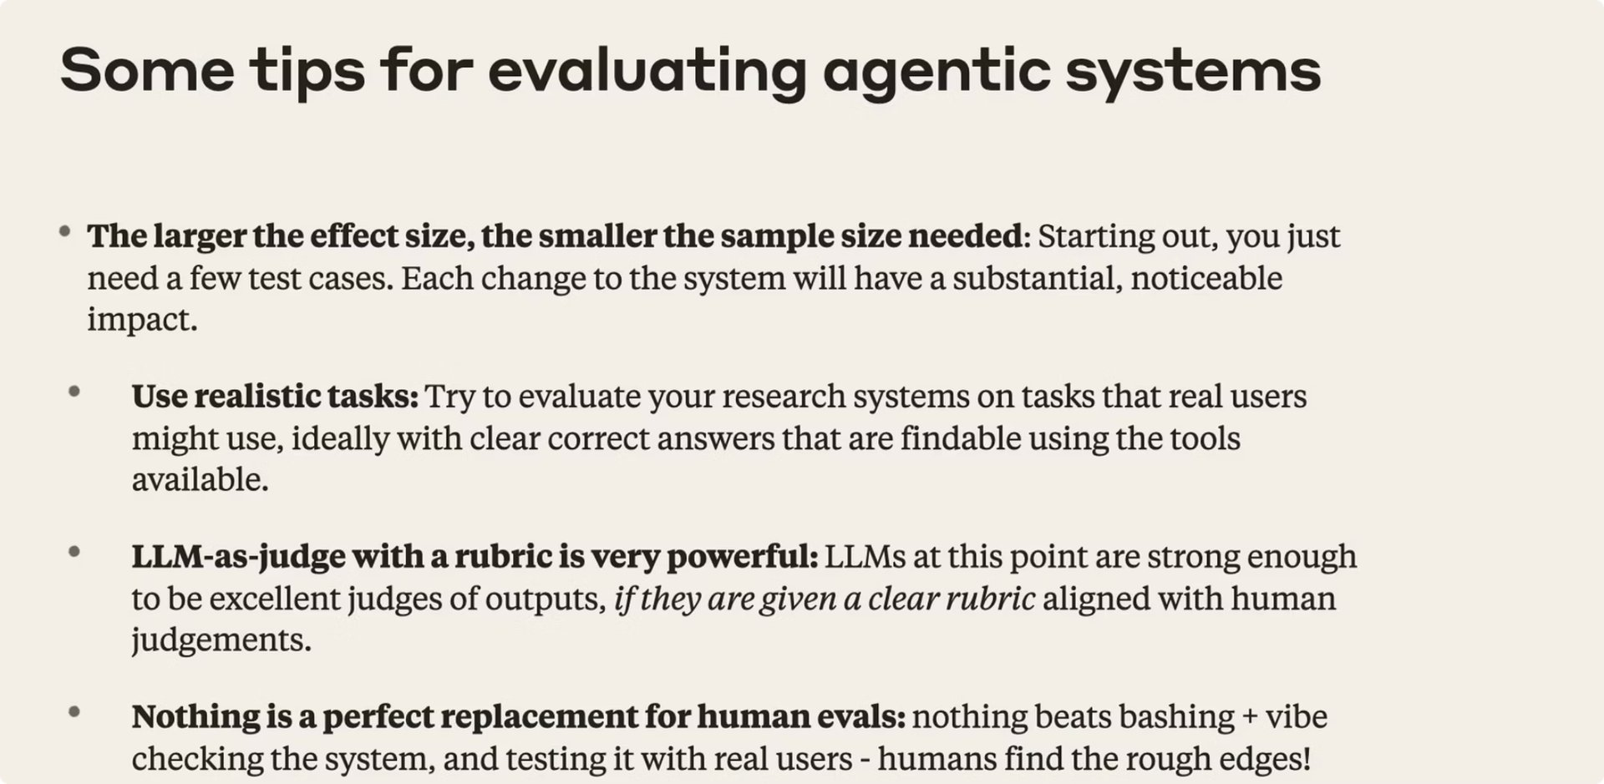
From Anthropic's Prompting for Agents | Code w/ Claude
How to start: Avoid the anti-pattern of attempting to build a massive, fully automated suite of hundreds of test cases immediately. Start with a small, simple eval, which can even be done manually, to get started and gain initial signal

Slide 11
CHAPTER 4
FROM SCRIPTED TO SYSTEMATIC
Scripts vs. Systems
❌ Scripted Agent
✅ Systematic Agent
Static flows with hardcoded branches
Breaks the moment buyers go off-script
No abstraction of intent
No reasoning layer whatsoever
Models intent and tracks conversation state
Has explicit goals per interaction
Makes real-time decisions with reasoning
Uses persistent memory across sessions

Slide 12
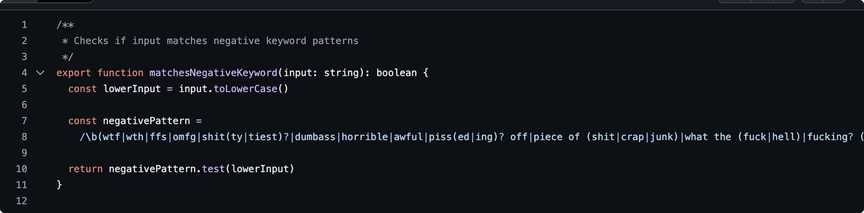
CHAPTER 4
FROM SCRIPTED TO SYSTEMATIC
Why User Feedback Can Be Misleading
Biased Sample: Rage & Insomnia
Noisy Signals: Emotion Over Insight
Only two types of people leave feedback: the furious, driven by negative experiences, and the bored, with time to spare. Everyone else got what they needed and disappeared into the void—so your "data" is primarily derived from extremes, representing rage or idleness rather than typical user sentiment.
Feedback often comes as emotional outbursts like "this sucks 😡" with no context, or complaints about external factors like slow WiFi. This means you're often measuring emotional weather and external frustrations, not actual AI quality or actionable insights for improvement.

Slide 13
CHAPTER 5
MODELING DISCOVERY
Discovery Is a System, Not a Question
Great discovery isn't a checklist — it's a structured system that unfolds based on what you learn. Each stage builds on the last, moving from problem identification to a clear definition of success.
Identify Problem
Quantify Impact
Understand Current Solution
Surface Constraints
Define Success

Slide 14

CHAPTER 5
MODELING DISCOVERY
What Is Discovery? (Sales 101)
Discovery is the process of diagnosing before prescribing. A great sales rep does not start with a pitch. They start with understanding.
Discovery answers:
What problem are they actually trying to solve?
How painful is it? (quantification of impact)
What happens if they do nothing? (cost of inaction)
How are they solving it today? (current state analysis)
Who is involved in the decision? (stakeholder mapping)
What does success look like? (desired future state)

Slide 15
How to Model Discovery in AI
Breaking discovery into composable layers gives the agent structured reasoning at every turn — from assessing what's known to choosing the right question strategy.
1
2
Conversation State
Hypothesis Layer
What do we know? What's missing? Map the gaps in real time.
What problem might they have? What signals suggest urgency?
3
4
Goal per Turn
Question Strategy
Clarify → Expand → Validate → Quantify. Each turn has a purpose.
Open-ended → Narrowing → Confirmatory. Guide without interrogating.

Slide 16
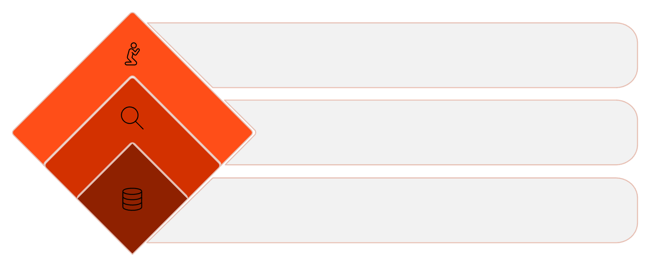
Discovery Architecture
The agent maintains structured memory objects — pain points, budget signals, timeline, authority, and use case — and selects its next move based on which fields are still missing.
By prioritizing relevance over completeness, the agent avoids the interrogation feel — every question earns its place in the conversation.
Select Next Move
Choose action that avoids interrogation tone
Assess Gaps
Identify and prioritize missing fields by relevance
Capture Context
Store pain points, budget, timeline, authority, use case
Pain Points
Budget Signals
Timeline
Authority
Use Case

Slide 17
From Agent Architecture to Production Intelligence
Building AI sales agents capable of dynamic, human-like discovery requires moving beyond theoretical architecture to a robust production system. This involves a continuous loop of building, observing, and improving, powered by specialized tooling.
Build (LangGraph)
Observe (LangSmith)
Evaluate & Improve (Production Loop)
Model the agent as a state machine
Nodes: LLM calls, tools, retrieval, validators
Edges: conditional routing, retries, escalation
Persistent state: memory, extracted fields, deal stage
Full execution traces (every step, every tool call)
Prompt + model version tracking
Latency, cost, error visibility
Side-by-side experiment comparison
Auto-score every conversation
Slack alerts for low scores
Human review on flagged chats
Prompt/model updates
Retry & compare before redeploy
→ No black boxes
→ Continuous improvement, not prompt guessing
→ Structured, predictable decision-making
Bottom Line:
LangGraph gives you control. LangSmith gives you visibility. Together → production-grade AI sales agents.

Slide 18
CHAPTER 5
MODELING DISCOVERY
Model Selection Tradeoffs
Choosing the right AI model for your discovery agent involves balancing several critical performance and resource factors.
Latency
Cost
Context Window
Tool Reliability
The speed at which the agent processes and responds.
Operational expenses associated with model usage.
The agent's ability to maintain and recall conversation history.
Accuracy in using external tools and functions.
Extraction Accuracy
Hallucination Rate
Precision in identifying and extracting key information.
Frequency of generating inaccurate or nonsensical information.
For discovery agents, reasoning quality consistently outweighs creative writing ability.

Slide 19
Latency vs. Thinking Depth
AI agents face a fundamental tradeoff: the more complex the reasoning, the higher the latency and cost. Understanding this spectrum is critical for optimizing agent performance in real-world scenarios.
1
2
Fast Agent
Deep Agent
Single LLM call
Minimal reasoning steps
Lower operational cost
Multi-step reasoning chains
Tool use & self-reflection
Higher quality outcomes
Where does quality justify latency?
In sales conversations, speed is paramount. While deep reasoning yields better outcomes, delays are detrimental. A 1-2 second response time is generally acceptable, but anything over 10 seconds will significantly degrade the buyer experience and kill the conversation flow.

Slide 20
CHAPTER 5
OBSERVABILITY & EVALS IN PRODUCTION
Why Observability Is Non-Negotiable
In production, AI agents fail in subtle ways — often silently and destructively:
Silent hallucinations
Partial extraction errors
Agents fabricating information without detection.
Key data points are missed or misidentified from conversations.
Goal drift mid-conversation
Context loss after 8+ turns
The agent deviates from its primary objective, losing focus.
Forgetting earlier conversation details, leading to repetition or irrelevant responses.
Latency spikes
Tool misuse
Slow response times, degrading the user experience.
Agents incorrectly calling external tools or misinterpreting their outputs.
Without robust observability into these nuanced behaviors, you're left in the dark:
You’re debugging vibes instead of data, leading to guesswork and frustration.
You can’t scale safely, as undetected issues multiply with increased agent usage.
You can’t improve systematically, hindering your ability to iterate and optimize agent performance effectively.

Slide 21
Observability's New Frontier
Is ensuring AI helpfulness still "classic" observability?
Does this responsibility extend to Site Reliability Engineering?
How do we define and measure "helpfulness" within an SRE framework?

Slide 22






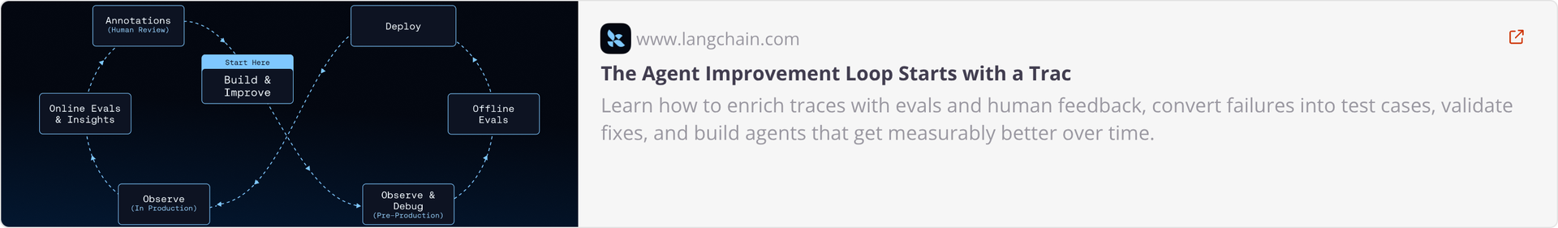
CHAPTER 5
CONTINUOUS IMPROVEMENT
The Continuous Improvement Loop
For AI agents in production, continuous improvement is critical. This systematic loop ensures agents evolve, learn from interactions, and consistently hit performance targets.
Collect Conversations
Label Failures
Monitor Metrics
Add to Eval Dataset
Deploy New Prompt Version
Run Regression Tests
This iterative cycle, run weekly, drives agent precision and effectiveness, adapting to new challenges and optimizing performance in real-time.

Slide 23

KEY TAKEAWAYS
The Continuous Improvement Loop
The improvement loop for AI agents is a systematic process leveraging traces to drive measurable enhancements and prevent regressions.
Layered Agent Systems
Iterative Refinement
AI agents are multi-layered systems (model weights, orchestration code, context). Traces reveal which layer needs optimization.
The loop involves enriching traces with evaluations and human feedback, identifying failure patterns, applying targeted changes, and validating fixes.
Universal Trace Sources
LangSmith's Role
Traces from any environment—development, staging, benchmarks, or production—feed the same critical improvement loop.
LangSmith integrates every step, from initial tracing to CI/CD gates, ensuring continuous, data-driven improvement and preventing regressions.
Improving an agent systematically requires a feedback loop. You collect traces of agent behavior, enrich them with evaluations and human feedback, identify what's failing and why, make targeted changes, and validate that those changes worked before shipping. Then you repeat from a higher baseline.
This loop is powered by traces. These traces can come from many places – from staging environments, benchmark runs, local development, and especially from production. What matters is collecting these traces, enriching them, and using that data to improve the system.

Slide 24
CHAPTER 5
DEFINING SUCCESS
What Does a "Good" Conversation Look Like?
Before optimizing, we must define what success means for an AI sales agent. It's not just about a smooth chat; it's about driving tangible business outcomes.
Direct Conversions
Information Capture
Successful demo requests, qualified meeting bookings, or self-service sign-ups.
Timely and accurate collection of essential contact details like email or phone numbers.
Progressive Nudges
Downstream Impact
Guiding users toward the next step in their buying journey, whether immediate or deferred.
Increased browsing activity, repeat visits, or subsequent self-serviced actions.
A truly "good" conversation efficiently moves the prospect closer to a desired business outcome, regardless of its length.

Slide 25
CHAPTER 5
DEFINING SUCCESS
Early Warning: Detecting User Complaints
A "successful" conversion might mask underlying issues. For example, a user giving their email because the agent couldn't provide the requested information isn't true success. It's crucial to identify these subtle failure signals, as they indicate a breakdown in the agent's ability to help.
"I need a human"
Repeated questions
Direct requests to speak with a human, indicating the AI couldn't resolve the query.
Users rephrasing or asking the same question multiple times, signaling agent misunderstanding.
Frustration keywords
Abrupt conversation end
Detection of words like "frustrated," "stuck," "not helping," indicating negative sentiment.
Users dropping off without a clear resolution or handover, suggesting disengagement.
Information avoidance
Users deflecting agent's discovery questions, possibly due to lack of trust or perceived irrelevance.
Identifying these "red flags" ensures we distinguish genuine success from forced outcomes, providing actionable insights for agent improvement.

Slide 26

Early Warning: Detecting User Complaints
Proactively identifying user frustration is an "easy win" for rapid feedback and incident detection in your AI sales agent production pipeline.
Pattern-Based Detection
Immediate Incident Gauge
Implement simple regular expressions to catch keywords and phrases indicating dissatisfaction or confusion.
Flags conversations where the agent might be misinterpreting context, hallucinating, or failing to retrieve relevant information.
Direct RAG Quality Signal
Fuel for Improvement
Provides an invaluable, real-time indicator of whether your Retrieval Augmented Generation (RAG) is delivering accurate and helpful responses.
Automatically routes flagged conversations for human review, directly feeding into your continuous improvement and evaluation datasets.
A simple regex applied across conversation transcripts, like those generated by a Claude model, can serve as a powerful first line of defense for detecting potential issues.

Slide 27
How Do We Verify RAG Quality?
RAG Quality ≠ “Did it answer?”
For a B2B sales AI, retrieval quality must ensure:
Completeness
Specificity
Retrieve all relevant pain points.
Persona-specific vs. generic responses.
Differentiation
Strategic Depth
Position against competitors effectively.
Adapt by role or segment dynamically.
Traditional metrics (ROUGE, embedding similarity) are insufficient.
We need structured business evaluation.

Slide 28
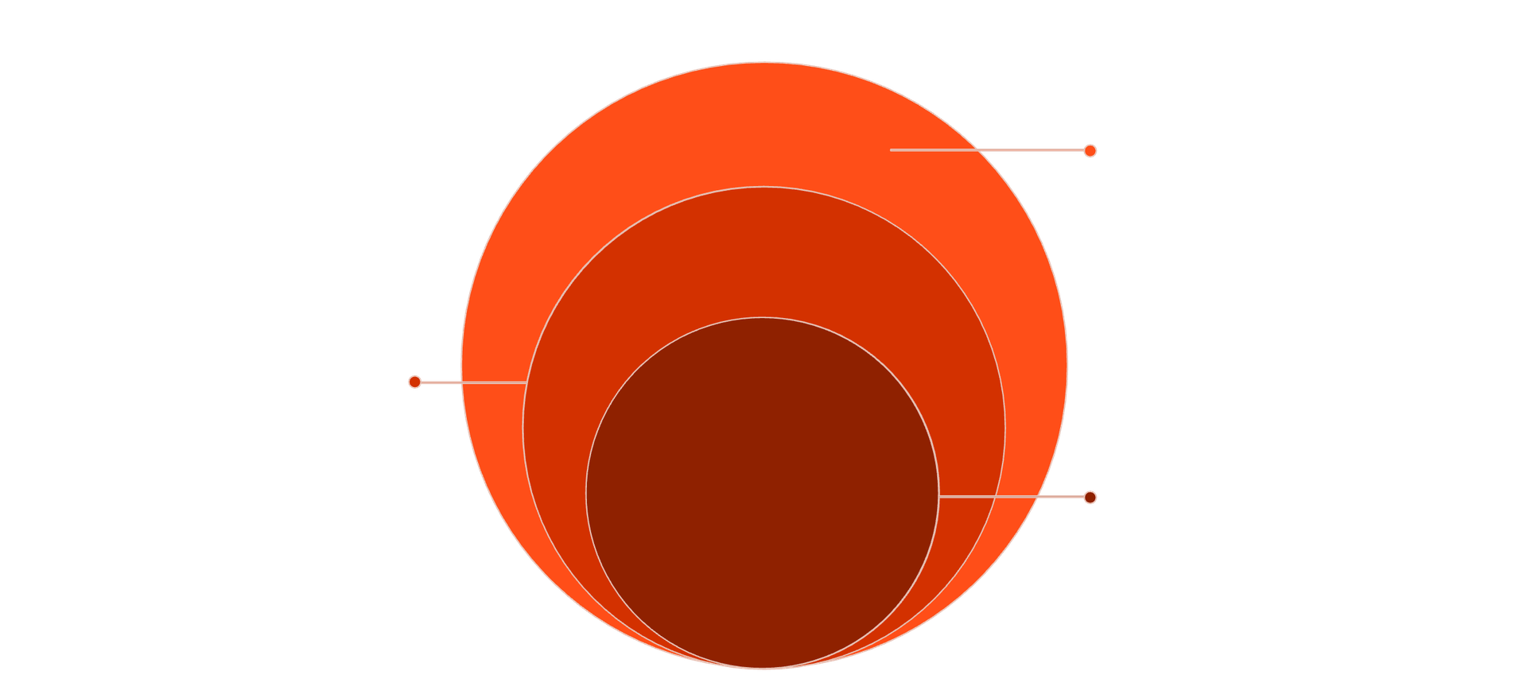

CHAPTER 5
RAG QUALITY
Verifying RAG Quality: The WKYT Framework
RAG Quality in a sales context is not merely about providing an answer; it’s about delivering actionable, persona-specific insights.
We adopt a WKYT (What, Know, Why, Think) or DIKW-style scoring system to measure the depth of the AI's understanding and response quality. Each level builds upon the last, contributing to a comprehensive intelligence score.
Specificity & Completeness
Detailed facts and full coverage (0-14)
Persona Depth
Persona-specific context and motivations (15-19)
Strategic Intelligence
Actionable, decision-ready insights (20-25)
This framework helps us evaluate how effectively the AI agent moves beyond raw data retrieval to truly grasp and apply knowledge, ensuring responses are not only accurate but also strategically aligned with buyer needs.
Goal: Continuously improve knowledge bank materials to measure and enhance the business intelligence quality of the RAG system, aiming for 100% per category.

Slide 29
CHAPTER 5
RAG QUALITY
Verifying RAG Quality: Pain Points by Persona
Ensuring Retrieval-Augmented Generation (RAG) effectively addresses pain points for different personas requires a multi-layered testing approach, moving beyond simple content retrieval to strategic understanding. A key action is to continuously improve knowledge bank materials.
01
02
Data: Completeness
Information: Solution Mapping
Are all core pain points retrieved accurately from the knowledge base? The initial step is to ensure the raw data is comprehensive and accessible.
Are the identified pain points consistently mapped to relevant solutions or product features? This layer checks the connectivity and utility of the retrieved information.
03
04
Knowledge: Persona Segmentation
Wisdom: Strategic Awareness
Are pain points segmented and addressed specifically for different personas or roles? Generic responses are ineffective for targeted sales conversations.
Does the RAG system demonstrate an understanding of strategic implications or roadmap awareness related to the pain points? This reflects a deeper, more valuable level of insight.
CMO: Visibility, brand positioning
RevOps: CRM accuracy, attribution
Founder: Differentiation, GTM fit
If RAG retrieves only generic content instead of persona-specific, strategically aligned information, the quality score of the agent will significantly drop, impacting its effectiveness.

Slide 30

CHAPTER 5
OBSERVABILITY & EVALS IN PRODUCTION
Context-Aware Evaluation (Why It’s Not Naïve GPT Scoring)
Our AI sales agent evaluation goes beyond basic scoring. The judge receives a rich configuration context, ensuring that performance is assessed against the specific operational environment and goals, not generic benchmarks.
The judge receives rich configuration context:
Inspiration Questions
Company Q&A Context
Knowledge Base Relevance
Campaign Instructions
Questions designed to prompt thoughtful responses, derived from Brain Knowledge Transfer.
Relevant company-specific knowledge for accurate responses, from Brain Knowledge Transfer.
Specific directives for the current sales campaign, from Brain Knowledge Transfer.
Context from the last 20 messages to ensure relevant use of the Knowledge Base.
Target Functions
Discovery Questions
Engagement Actions
Email Follow-up Flags
Pre-defined objectives and expected outcomes, from Brain Knowledge Transfer.
A library of questions to guide the discovery process, from Brain Knowledge Transfer.
Permitted and encouraged interaction types, from Brain Knowledge Transfer.
Indicators to prevent penalizing disabled behaviors like automated email sending, from Brain Knowledge Transfer.
Hallucination Guardrail
The judge can call a `kb_lookup` tool to validate claims and detects fabricated capability examples in real sessions (data from 2025-09-30-sessions).
Key Point
Our evaluation process is Configuration-aware, Campaign-aware, CRM-aware, and Knowledge-validated.
It judges performance in the customer’s configured environment, not in isolation.

Slide 31




CHAPTER 5
OBSERVABILITY & EVALS IN PRODUCTION
Hybrid Evaluation + Continuous Improvement Loop
Our robust evaluation process is designed to systematically identify agent performance, combining qualitative and quantitative metrics to drive continuous improvement.
Each evaluation returns:
General Review: Score (0-100)
AI Strengths
Identified Issues
An overall performance metric for the agent's interaction quality.
Detailed feedback on what the AI agent executed successfully.
Specific, structured problems requiring immediate attention and fixes.
Hybrid Assertions
To ensure comprehensive and unbiased assessment, our evaluation combines:
LLM Semantic Judgment
Deterministic Checks
Leveraging AI for nuanced, subjective assessment of conversation quality.
Rule-based assertions for objective validation of specific behaviors (e.g., data extraction).
This hybrid approach prevents over-reliance on purely subjective scoring, providing a balanced and actionable assessment.
The Improvement Loop
Issue Identified
Add Scenario & Judge Criteria
A problem is detected through evaluation.
The identified issue is formalized into a testable scenario with clear LLM judge criteria.
Regression Test
Deploy Fix
The updated agent undergoes rigorous testing against all known scenarios.
Once validated, the improved agent is deployed to production.

Slide 32
CHAPTER 5
MEMORY OPTIMIZATION
Structured Memory: Beyond Raw History
For AI agents, how memory is stored and accessed is critical to performance. Moving beyond raw chat logs to a structured memory model dramatically enhances consistency and reasoning.
❌ Passing Raw History
✅ Utilizing Structured Memory
40+ turns of chat history
Overwhelms context window
Forces agent to re-derive state
Leads to inconsistent behavior
Inefficient and slow
Extracted summary of conversation
Key fields (pain points, budget, timeline)
Current open questions & next steps
Assessed emotional state of buyer
Dramatically improves consistency & focus
By abstracting conversations into key data points, the agent operates with a clearer, more efficient understanding of the ongoing dialogue, ensuring every interaction is precise and relevant.

Slide 33

Human-in-the-Loop Is Not a Failure
It’s a strategic design choice, optimizing AI agent performance where human judgment, empathy, and nuanced understanding are critical.
High-Value Deals
Ambiguous Intent
Human review ensures tailored negotiation and risk checks.
Humans clarify unclear requests and guide responses.
Sensitive Objections
Escalation Scenarios
Empathy and judgment resolve delicate customer concerns.
Humans intervene for complex or critical outcomes.
By consciously integrating human oversight, Salespeak ensures agents operate within their optimal bounds, elevating critical interactions and building trust.

Slide 34
CHAPTER 5
QUALITY ASSURANCE
Human-in-the-Loop + Automated Quality Control
Smart agents don’t just respond. They evaluate themselves, learning and adapting through a rigorous quality assurance framework.
01
02
03
Automatic Chat Scoring
Slack Alerts for Low Scores
Human Review Layer
Every conversation gets a score based on:
If a conversation score falls below a predefined threshold:
Low-scoring conversations automatically enter a review queue. Reviewers see:
Discovery completeness
Goal progression
Relevance of questions
Context retention
Objection handling quality
Hallucination / fabrication detection
🚨 Slack notification sent to RevOps / AI owner
Summary of the conversation
Extracted state
Where the agent failed
Suggested improvement area
Full trace (similar to LangSmith)
Prompt version used
Tool calls + memory state
Evaluation breakdown
The human can then label the failure type, approve/override, suggest corrections, or mark as a training example, ensuring quality improves systematically.
Score output includes an overall quality score (0–100), sub-scores per dimension, and a confidence level.
This system turns failures into visible, actionable events for rapid intervention.
04
05
Auto Prompt Suggestions
Auto “Retry & Compare”
The system analyzes patterns from reviewed conversations (e.g., "Agent pitches too early," "Missing budget extraction," "Objection reframing weak") and generates:
For identified failed chats, the system can automatically re-run the conversation with:
An updated prompt
A different model
Adjusted reasoning depth
Suggested prompt adjustment
Revised instruction snippet
Structured diff vs. current prompt
This allows for direct comparison of the score delta and latency delta, providing quantitative insights into improvements.
Human approval leads to a versioned update, making prompts version-controlled assets, not guesswork.

Slide 35
The Context Window Tradeoff
Managing an AI agent's context window involves a critical balance between comprehensiveness and efficiency. Both "more" and "less" context come with distinct advantages and challenges.
More Context
Less Context
Better personalization: Agents can tailor responses more accurately with a richer understanding of past interactions.
Higher latency: Processing larger amounts of text takes more time, leading to slower response times.
More token cost: Increased context means higher API costs, impacting operational budgets.
More confusion risk: Irrelevant information can dilute focus, potentially leading to less accurate or more generic responses.
Faster: Reduced processing loads result in quicker response times, improving user experience.
Cheaper: Lower token usage directly translates to decreased operational costs.
More hallucination: Lack of sufficient information can cause agents to generate incorrect or fabricated details.
Less continuity: Agents may struggle to maintain a consistent understanding of the conversation over time.
Smart agents overcome this dilemma by optimizing memory management, extracting only the most critical information to maintain context without overloading the system.
Summarize Past Turns
Store Structured Memory
Condensing chat history into key takeaways, maintaining flow without all the raw text.
Extracting and organizing vital data points into predefined fields for efficient recall.

Slide 36
CHAPTER 5
CONTEXT ENGINEERING
Context, Context, Context
Most agents fail because: They don’t have the right context — or they have too much.
Context engineering is:
What to Include
What to Exclude
How to Structure It
When to Refresh It

Slide 37
CHAPTER 5
CONTEXT ENGINEERING
Understanding the Types of Context
Effective AI agents thrive on a rich, multi-dimensional understanding of their operating environment. We categorize context into four essential types:
Static Context
Dynamic Conversation Context
Product Information: Features, benefits, and specifications.
Pricing Structures: Details on costs, plans, and discounts.
Company Positioning: Brand messaging, values, and competitive differentiators.
Chat History: The ongoing dialogue between agent and buyer.
Extracted Fields: Key data points identified from the conversation (e.g., pain points, budget).
Current Stage: Where the buyer is in the sales journey.
External Context
Strategic Context
CRM Data: Customer relationship management records.
Account Metadata: Company size, industry, past interactions.
Industry Signals: Market trends and competitor insights.
Current Objective: The agent's immediate goal in the interaction.
Allowed Actions: Permitted behaviors and responses for the agent.
Guardrails: Ethical and operational boundaries for agent behavior.
Mastering the integration of these context types allows agents to deliver highly relevant, precise, and strategic interactions.

Slide 38
CONCLUSION
SUMMARY
Key Takeaways for Humanized AI Sales Agents
To truly humanize your AI sales agent and drive superior results, focus on these critical pillars:
Design for Human-Like Behavior
Embrace Continuous Improvement
Master Context Engineering
Move beyond rigid scripts by systematically modeling human sales behaviors, focusing on adaptive discovery and dynamic conversational flow.
Implement automated quality assurance, human-in-the-loop processes, and data-driven prompt optimization to constantly refine agent performance.
Strategically manage and integrate static, dynamic, external, and strategic context to enable intelligent, relevant, and personalized interactions.
By adopting these principles, you can transform your AI from a mere chatbot into a high-performing, human-like sales agent.

Slide 39
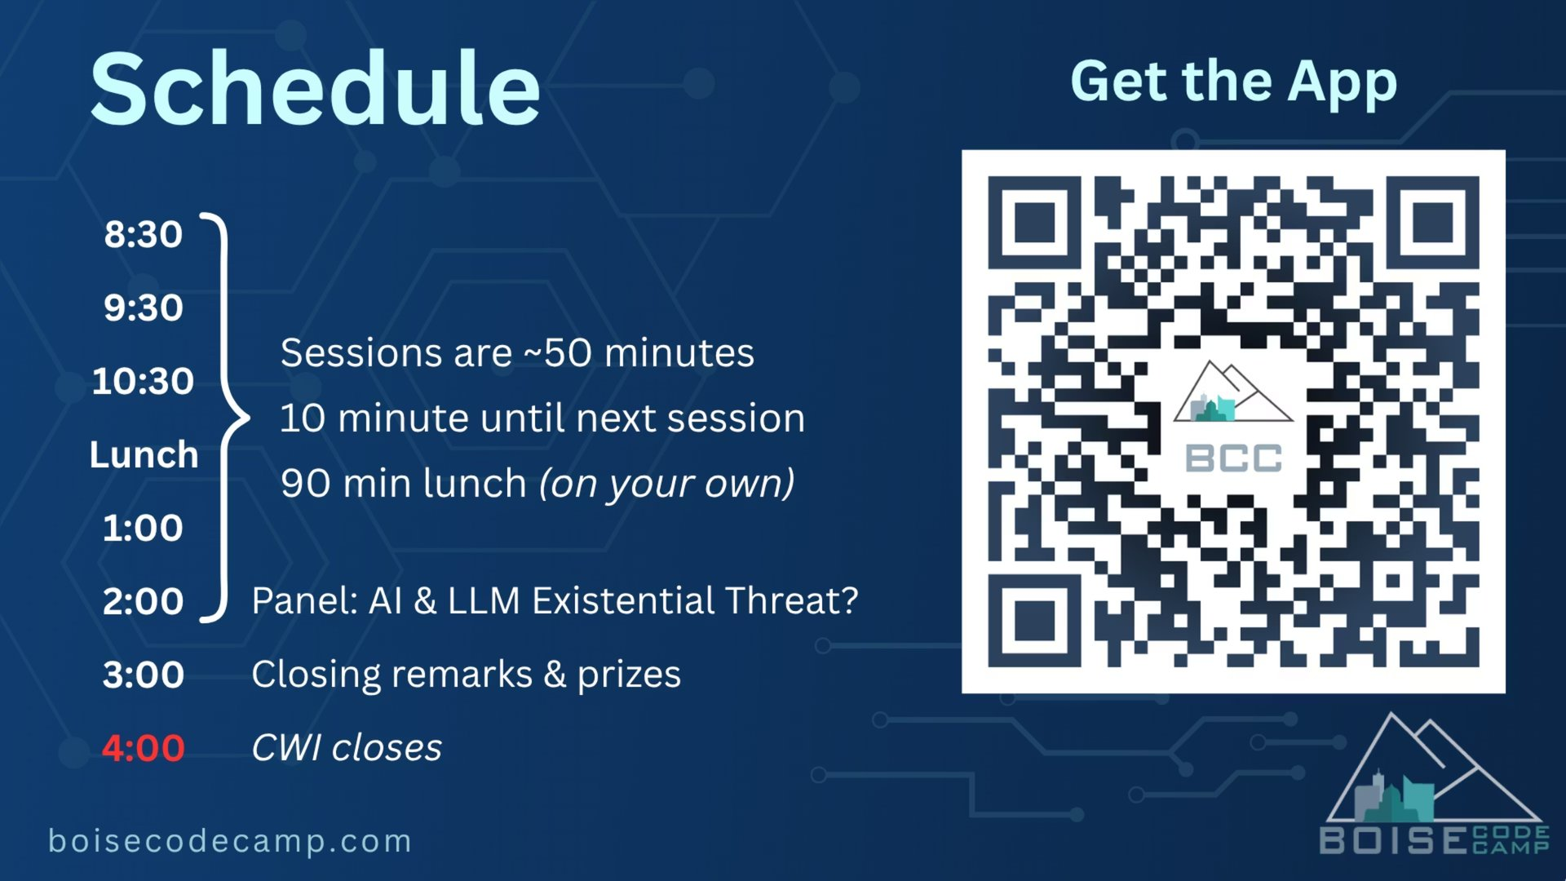

Slide 40


Slide 41
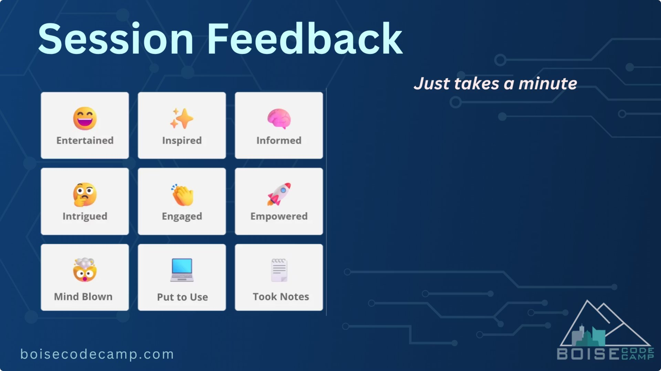

Slide 42
