Slide 1

Robots Don't Need
Sprint Boards
Why most AI initiatives fail — and what to redesign instead.
Sean Timm · Boise Code Camp 2026 · May 2
Notes:
Show this slide as the audience files in so they know they're in the right room. When you start: brief intro — who you are, what you do, why you care about this. ~30 sec.

Slide 2
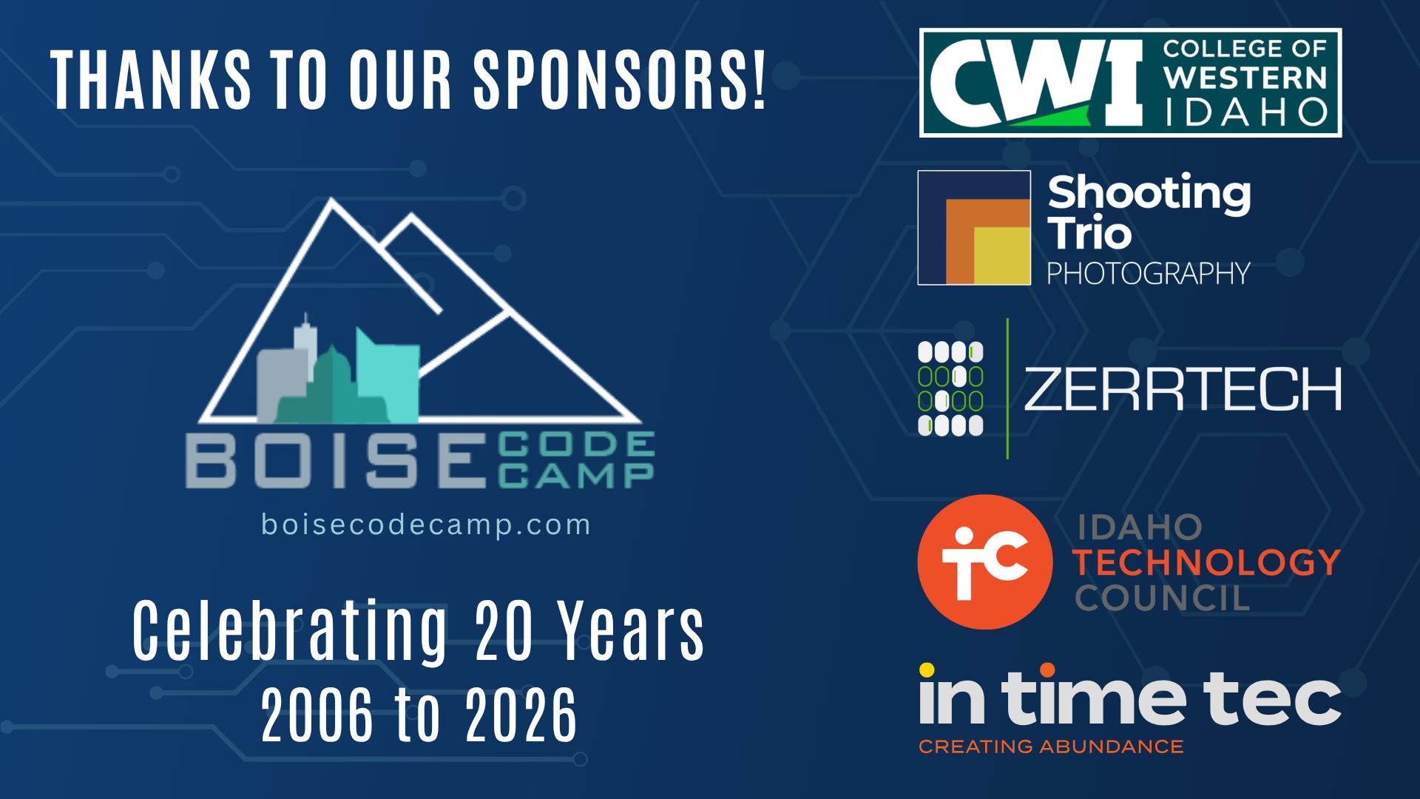
Notes:
BCC required: sponsors. Acknowledge sponsors briefly as part of the opening.

Slide 3
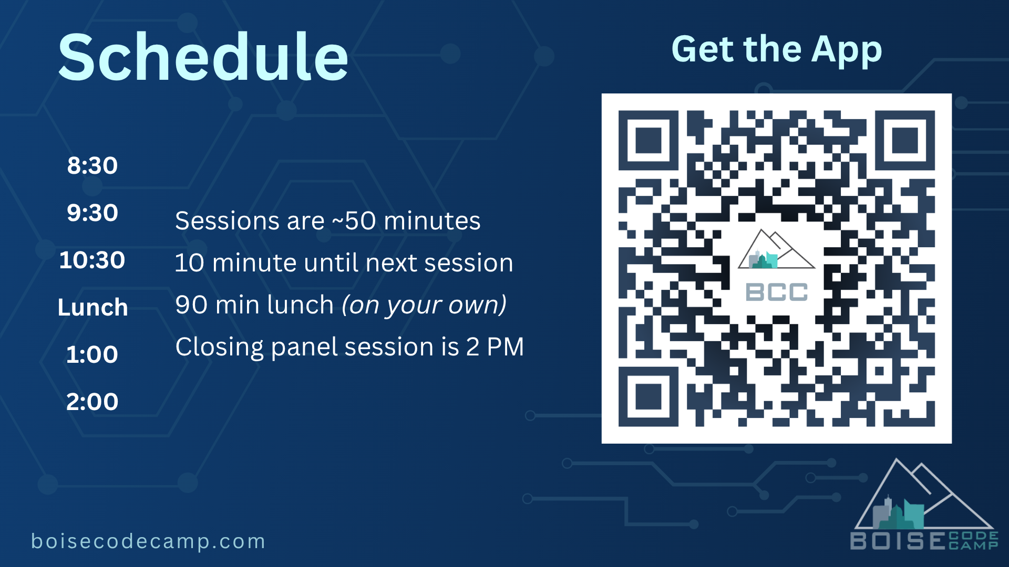
Notes:
BCC required: schedule overview. Mention briefly — especially the app link if this isn't the day's first session.

Slide 4
73
2 wks
Zero
PRs
behind
shipped
Day one with 10 autonomous agents on JIRA.
Faros AI 2026: 31% of PRs unreviewed · review time +441%.
Notes:
The locked cold open through the data anchor. *"Ignore the numbers – I made them up. I want you to think about unleashing 10 autonomous agents on JIRA and telling them to start working through tickets. Assuming you have given them everything they need to understand the problems, you're going to be facing a deluge of PRs before it's even lunch time. Your reviewers will be drowning. If you have manual QA, they'll be weeks behind on the backlog you're now adding to at a velocity that has suddenly shot straight up. Nothing's gone to production. You've created a mess. And this isn't hypothetical. Faros AI's latest data on 22,000 developers: 31% of pull requests are now merging with no review at all, and median review time is up 441%. The work didn't disappear. It moved."* ~60 sec.

Slide 5
Output is up.
Faros AI 2026 telemetry · 22,000 developers · high-AI-adoption teams.
Epics
+66.2%
Sizable features completed per developer.
Tasks
+33.7%
Individual work items shipped per developer.
Pull requests
+16.2%
PR merge rate per developer.
Code churn
+861%
Lines deleted to lines added — merged code.
AI is doing more work — and rewriting more of what was already there.
Notes:
That same Faros telemetry tells the throughput side of the story. Across twenty-two thousand developers, high-AI-adoption teams complete sixty-six percent more epics, thirty-four percent more tasks, merge sixteen percent more pull requests. The dramatic one is at the bottom: code churn — the ratio of lines deleted to lines added — up eight hundred sixty-one percent. AI is doing more work, and a lot of that work is rewriting what was already there.

Slide 6
…while production quality is declining.
Faros AI 2026 telemetry · 22,000 developers · high-AI-adoption teams.
Incidents per PR
+242.7%
Outages, security events, customer-facing failures.
Monthly incidents
+57.9%
Production incident count, all causes.
Bugs per developer
+54%
vs. +9% in the 2025 report.
Bugs per PR
+28.7%
Defects shipping inside the PRs that merge.
More work shipping. Less of it works.
Notes:
At the same time, production quality is going the other way. Incidents per pull request up two hundred forty-three percent. Monthly incident count up fifty-eight percent. Bugs per developer up fifty-four percent — that was nine percent in last year's report. Bugs per pull request up twenty-nine percent. The work isn't just moving — what does ship is breaking more often. None of this is happening because AI is bad. It's happening because the workflow on top of it was built for a different problem.

Slide 7
Three questions for the next forty minutes.
Which assumptions baked into your structures still hold?
Which constraints are these structures actually solving for now?
Where does AI change the work — and where do humans need to stay in the loop?
Notes:
The sprint board worked — and worked well — for a long time. It worked for eight expensive humans whose attention you had to schedule because human attention was scarce. The whole apparatus — columns, standups, points, sprints — was a brilliant solution to a real problem. > *"But notice what changed in the scenario I just walked through. The work was being done at machine speed. The bottleneck moved — coding got fast, review got slow. The workflow that delivered for eight humans started failing because the structure was built around a bottleneck that's no longer the binding one. So the questions I want to put to you for the next forty minutes are: which assumptions baked into your structures still hold? Which constraints are these structures actually solving for now? Where does AI change the work — and where do humans need to stay in the loop?"* > *"I'll share some directional answers along the way. But the more important move is the questions themselves. I want you walking out of here with the habit of asking them about your own structures — not with my specific answers."*

Slide 8
Adoption Theater
Most orgs are measuring the wrong thing.
Institutional Fluency
"The org is built for it."
Fluency
"It's changed what we can do."
Usage
"We're using AI."
It's easy to stop at the bottom. The gap is real.
Notes:
Some orgs' AI strategy is 'give everyone Copilot and measure adoption.' That's a measurement choice worth examining. When you measure adoption — licenses, logins, daily users — you're measuring whether people are touching AI. You're not measuring whether anything got better, faster, or different. > *"There are three layers worth distinguishing. Usage is what gets measured" — point at bottom band — "people are using the tool. Fluency lives in the middle — the individual skill of working effectively with AI. Fluency is the difference between getting some AI help and actually changing what your team can do. And Institutional Fluency lives at the top — the organization actually being built for this. It's easy for an org to stop at the bottom."* > Then run the **hand-raise interactive moment** against this slide: *"Quick check. Raise your hand if you or your team uses an AI tool daily."* (Pause.) *"Keep it up if your sprint structure, your PRD process, or your org chart has been redesigned — not just resized — because of it."* The visual gap in the room is the point.

Slide 9
Adoption is not impact.
MIT, Aug 2025 · NANDA report · 300 enterprise AI deployments analyzed.
95%
of AI deployments delivered no measurable business return.
"The divide is not in adoption — it's in impact."
— MIT, NANDA, 2025
Notes:
You're not alone — this is industry-wide. MIT's August study analyzed 300 enterprise AI deployments and found 95% delivered no measurable business return. Their explicit framing: 'the divide is not in adoption — it's in impact.' That's their phrase, not mine. Most companies are using AI. Most aren't getting return on it. And there's a math reason for that — which is the next slide.

Slide 10
Amdahl's Law
The math behind why most pilots stall.
AI accelerates this
16%
84%
coding
review · alignment · decisions · sign-offs · ambiguity reduction
Speed up the 16%. The 84% is still 84%.
Ceiling: ~1.2×.
That's not rhetoric. That's arithmetic.
Notes:
*"So here's the math behind why most pilots stall at the Usage layer. There's a principle in computer science called Amdahl's Law. It says: if you speed up part of a system, the maximum improvement is bounded by the parts you didn't speed up. Concretely — IDC research found that experienced developers spend only about 16% of their time writing code. AI accelerates that 16%. The other 84% — review, alignment, decisions, sign-offs, ambiguity reduction — keeps running at human speed. The math says you cannot exceed about 1.2× overall speedup, no matter how fast you make that 16%. That's not rhetoric. That's arithmetic. And it's why nothing actually got faster. Or — if it does feel faster — that's quality silently paying the bill. Speed, quality, cost: pick two. AI didn't change the triangle; it just made the deferred bill bigger. You bought faster typing, not a faster system."* ~85 sec.

Slide 11
Your organization has fossils.
Structures that exist because of constraints that no longer apply.
Notes:
So if the 84% is what determines whether you actually go faster, that's where we need to look. Your organization has fossils — structures that exist because of constraints that no longer apply. > *"Each was, at some point, the right answer to a real problem. The fossil frame isn't 'these were always bad.' It's that artifacts were originally solutions to constraints — and constraints can dissolve while their artifacts persist."* > *"Starting in a moment I'll walk through some of these — drawing attention to where the original constraints have shifted. The three questions are yours to apply on anything I cover or anything I don't."* > *"Nate Jones puts it this way: the companies that are getting this right have stopped asking 'how do we implement AI?' and started asking 'given 100× more intelligence, what should we rebuild?' Not which AI tool to buy. Which structures still earn their keep."*

Slide 12
“We feed that intelligence into structures that compress it back down for human consumption.
We're putting Formula One engines in horse-drawn carriages.”
— Nate Jones, Aug 2025
Notes:
*"Nate Jones: 'Now we have systems that can process every signal simultaneously. And what do we do? We feed that intelligence into structures that compress it back down for human consumption. We're putting Formula One engines in horse-drawn carriages.' That's the failure mode in one image. The engine is amazing. The cart isn't designed to use it. So I'm going to walk through some of those carts with you — surfacing what's changed under each one and what's worth re-examining."* ~30 sec.

Slide 13
Sprints & Ceremonies
The synchronization rituals were a real solution to a real constraint.
Sprint planning
2 hr × biweekly
~10 hrs
Standups
15 min × daily
Backlog grooming
1 hr × biweekly
per sprint
Sprint review
1 hr × biweekly
~20 hrs/month per person
Retro
1 hr × biweekly
Continuously-updated bets, not time-boxed commitments.
What does a 'sprint' even mean when the cost of changing a plan is zero?
Notes:
Sprints exist for several reasons. The one I want to focus on first: human teams had two interlocking constraints — finite capacity, and context that decayed between people. The two-week sprint was a solution to both. It batched work into a window humans could plan and commit to, with ceremonies that kept everyone aligned along the way. > *"Picture the rituals. Sprint planning every other Monday. Standups every morning. Backlog grooming. Sprint review. Retro. Across a six-person team, that's roughly twenty hours per person per month, just to keep eight humans synchronized."* > *"Now picture the cold-open scenario: ten autonomous agents working tickets. The agents don't have those constraints. Their capacity isn't finite the way a human team's is — you're not allocating eight humans across a two-week sprint, you're directing as many agents as you have budget for. And there's no context decay between them — they read state from the codebase, the specs, each other's commits. They don't need a meeting to find out what changed."* > *"So **what does a 'sprint' even mean when the cost of starting a new direction is zero? When the cost of changing a plan is zero?** When the team isn't a finite group of humans to allocate, but a fleet of agents you can scale up or down on demand?"* > *"The replacement isn't 'no planning.' It's **continuously-updated bets instead of time-boxed commitments.** You stop committing to two weeks of work in advance and start letting the priorities refresh as the world refreshes. Humans shift from doing the work and synchronizing about it to directing what gets built and validating what was built. The artifact stops being a board you commit to and starts being a state you keep current."* > *"Some teams will keep a daily standup as a social ritual. That's fine. The point isn't to delete every ceremony. It's to look at each one and ask: which constraint is this actually solving anymore?"* (Pause to let it land.)

Slide 14
Tickets & JIRA
Tickets existed to ration scarce capacity.
The old container
The replacement direction
Ticket as the unit of work.
Intent-driven work queues.
Estimates. Points. Story-pointing arguments. The ticket as the negotiation surface for scarce human capacity.
Capture intent. Let AI decompose. Humans review the proposed work, not the implementation.
From points-arguing to intent-clarification.
Notes:
Tickets existed to ration scarce capacity. You write a ticket because you can't build everything — so you have to choose, and the ticket is the unit of choice. It's the negotiation surface between what someone wants and what the team has bandwidth to do. Estimates, points, priorities, sprints — that whole apparatus exists because human capacity is a finite resource you need to allocate carefully. > *"Picture a typical grooming meeting. The PM walks in with a list of tickets. Some are well-specified; others have rough descriptions that need clarification. Engineers ask questions, push back on scope, decompose larger items, debate estimates — five points or thirteen, every time. Sometimes that debate uncovers real complexity; sometimes it's friction. Either way, the team builds shared understanding of what's coming, surfaces dependencies and risks, and reduces ambiguity. That's real work. It also takes about ninety minutes for a typical sprint."* > *"Now? AI can do some of this work — reading the codebase to identify dependencies, surfacing technical risks, scoping ambiguous descriptions, generating first-pass estimates. It can't replace the social function of building alignment. It can't replace the team's shared understanding. But it can do a lot of the prep work that engineers used to do live in the meeting — which means the meeting either gets shorter, or shifts toward the higher-judgment parts that humans actually need to be in the room for."* > *"And here's the deeper thing: the ticket as a unit of work was always a hack. Real software work doesn't divide cleanly into estimable chunks. Tickets force an artificial granularity onto problems that are actually messy and interconnected. We tolerated that hack because we needed *something* to throw at the capacity-allocation problem."* > *"The replacement direction: intent-driven work queues. Instead of writing tickets that pre-decompose work into estimable chunks, you capture intent — 'reduce login friction for new users,' with the constraints and the success criteria — and AI proposes the decomposition. It surfaces dependencies. It flags the clarifying questions. It outlines the trade-offs between three different approaches. Humans review the proposed plan, pick a direction, and the work goes from there. The negotiation moves up a level: from 'is this five points or thirteen' to 'is this the right outcome to aim at.'"* > *"And here's the structural piece. Remember the cold-open scenario — ten agents working tickets. The reason that scene felt like a mess wasn't that the agents did bad work. It's that we were giving them tickets. Tickets are pre-decomposed work for humans to execute. When agents are doing the work, the unit you commit to needs to live a level up — at intent. That's the shift. Not a tooling change. A change in what counts as a unit of work."*

Slide 15
Validation didn't disappear. It relocated.
Code review at PR scope was the chunking strategy. At AI volume, even that stops scaling.
Spec-driven dev
→
Intent
Automated tests
→
Behavior
AI reviewers
→
Patterns
Risk-tier human review
→
Blast radius
Observability + canarying
→
Outcomes
"You cannot inspect quality into a product. You have to build it in." — Deming, 1982.
Notes:
Tickets created small change sets; code review at PR scope was the quality gate built around them. The Faros data we saw earlier — 31% of PRs unreviewed, review time up 441%, bugs per PR up 29% — that's what code review at PR scope looks like at AI volume. Pull requests existed for several reasons — knowledge transfer, social accountability, mentoring, change history. The one I want to focus on: review was the primary quality gate. PRs were small enough that one engineer could hold a diff in their head, and the review was where bugs were supposed to get caught. > *"What's structurally hard about it: even before AI, the gate was doing less of the work we thought it was. Microsoft Research, 2015 — less than 15% of pull request comments are about actual bugs. Bacchelli and Bird, the same year — code review's primary value is knowledge transfer, not defect detection. Deming, forty years ago: 'You cannot inspect quality into a product. You have to build it in.' AI didn't change that pattern. It made it harder to ignore."* > *"At agent scale, the math falls apart entirely. The small-ticket-with-human-review pattern was working mostly as a chunking strategy for human cognitive bandwidth — fitting code into chunks a reviewer could hold in their head. When the change rate scales past human chunking capacity, adding more reviewers — human or AI — doesn't get you out. The pattern itself is the bottleneck."* > *"The replacement isn't 'no review.' Validation didn't disappear — it relocated."* [point at the table] *"Five layers, each cheaper to scale than humans staring at PRs. Specs check intent. Automated tests check behavior. AI reviewers handle pattern-matching at machine scale. Risk-tier human review gates blast radius, not chunking. Observability and canarying check whether the intended thing actually happened in production."* > *"Not by adding throughput to the existing pattern. By distributing the function across layers that can actually scale. Next slide: what this looks like with real tools."*

Slide 16
Harness engineering, in practice.
One feature shipping through the harness — named tools at every stage.
AGENTS.md
›
Hooks
›
AI review
›
Owners
›
Canary
›
Observe
specs / intent
Claude Code
CodeRabbit · Greptile
CODEOWNERS · risk gate
LaunchDarkly
Datadog · Prometheus
~1,300 / wk
0 manual
Stripe — AI-merged pull requests
OpenAI — 1M-line product in 5 months
"When you accelerate one stage, the bottleneck moves to the next."
The harness is what lets you keep moving.
Mitchell Hashimoto · OpenAI · Martin Fowler — Feb 2026
Notes:
In practice, here's what that 5-layer relocation looks like for one team. A feature: send a password-reset email when a user clicks 'forgot password.' > *"The agent picks up the ticket. Reads AGENTS.md to learn the codebase conventions and the spec for what 'send an email' means here. Writes the code. Pre-commit hooks fire — Claude Code hooks run lint, type-check, and unit tests. Anything that fails, the agent fixes locally. Fast loop, no human paged."* > *"Pull request opens. CodeRabbit and Greptile review — pattern-matching for security smells, common bugs, missing test coverage. They post inline comments. Most get addressed by the agent before a human is paged."* > *"CODEOWNERS gates the human review. This isn't an authentication change — it's an email send. No high-blast-radius file is touched, so the human review path is light. If it had touched billing or auth, the file's owner would have been required."* > *"Merge. LaunchDarkly flag controls rollout. 1% → 10% → 100%, watching Datadog metrics — error rate, latency, send-success rate. If anything crosses threshold, the canary auto-pauses."* > *"That's not science fiction. Stripe is doing roughly thirteen-hundred AI-merged pull requests per week with this pattern. OpenAI shipped a product over five months with a million lines of code where zero lines were manually written."* > *"The thing to notice: when you accelerate one stage, the bottleneck moves to the next. The team that figured out how to ship at thirteen-hundred PRs a week didn't win because they got AI to write code. They won because they built a harness around AI that handles every stage downstream."*

Slide 17
PRDs & specs
From describing what should happen to making it happen.
Document
Working system
Static. Read once. Stale on day one.
Active. Runs the rules. Stays current.
Captures intent at a moment. The world keeps moving. Re-reads can't keep up.
Takes inputs. Applies the rules. Produces outputs. Humans engage with what the system produced.
The PRD shrinks to what humans must own: intent, invariants, signoffs.
Notes:
PRDs existed for several reasons — risk management, compliance, stakeholder alignment, governance. The one I want to focus on: gathering context was slow, expensive, and lossy. You couldn't regenerate it on demand, so you batched it into a formal document before any code shipped. > *"Picture the typical PRD. Structured sections — goals, non-goals, requirements, edge cases. Real teams put real effort into them; they capture intent and create alignment. That's real work, and it produces real value at the moment of writing. Some teams have already moved toward lighter, living versions — Shape Up pitches, evolving backlogs. The form has been getting lighter even before AI."* > *"What's structurally hard about the heavier form: the world doesn't pause while you build. Constraints shift. New information surfaces. The result is a document that was accurate when written but degrades over time."* > *"That's not a failure of the PRD. It's a failure of the form when the form is treated as static. A document is a snapshot. The work isn't."* > *"The replacement isn't 'no PRD.' It's an artifact that runs instead of just describes. Where the document was passive — sitting in a folder, waiting to be read — the replacement is active. It takes inputs, runs the rules, produces outputs. The team uses it by running it rather than re-reading it. When the world changes, you change the inputs and run it again."* > *"What does that look like? It depends on what the document was for. A spec for a new feature might become a small system that takes your requirements, applies the rules you'd otherwise apply manually, and produces a current build plan you can review. A policy document might become an approval workflow that routes requests, applies the rules, records every decision. The shape of the output varies — sometimes it's still document-shaped. What changes is who applies the rules: humans reading a document, or a system. And what humans engage with shifts from maintaining a static document to reviewing what the system produced."* > *"Building these isn't trivial — it's engineering work. But once they exist, they don't go stale the way docs do, because they run against current data."* > *"The PRD shrinks to a kernel of human-owned decisions: intent, invariants, regulatory signoffs. AI can help draft the words; humans have to own the choices. The rest moves into the working system. In compliance-heavy contexts, the document still does its document work; the working-system version handles the iterative parts alongside it."*

Slide 18
Team structures
Span of control was a real constraint. AI shifts the math — but only on the parts AI can actually absorb.
What is your manager role actually doing?
Information relay
Team interpretation
Feedback & development
Status, updates, summaries.
What the information means for this team.
Coaching, growth, hard conversations.
One example decomposition — ask the question for your own team.
Valve. Zappos. Medium. — the flat-org graveyard of removing the wrong function.
Notes:
Team structures emerged for several reasons — span of control, specialization, coordination, career growth, accountability ownership. The one most directly affected by AI: span of control. The team-of-seven-to-ten existed because that's what one manager could keep up with. AI shifts the math — but only on the parts of the manager role AI can actually absorb. Which parts those are depends on what your managers are actually doing, and varies more than you'd expect between companies. > *"Here's the failure mode you don't want to repeat. Valve, Zappos, Medium — each tried to flatten without naming what the manager role was actually doing, and discovered the function was load-bearing only after it was gone. Different companies, different functions removed, similar failure mode."* > *"So the diagnostic: don't start by removing layers. Start by naming what your managers actually do. Then ask which parts AI is plausibly absorbing today — for your team, on your problems. Run the experiment in a way you can reverse if you guessed wrong. Same diagnostic, different artifact. Use it on whatever's next in your own organization."*

Slide 19
Every one of those structures used to be a solution.
The question is which ones still are.
Delete before you rebuild.
Notes:
*"Every one of those structures used to be a solution. The question is which ones still are."* [hold a beat of silence, ~3 sec] > *"Sprints, tickets, PR review, PRDs, team structures — each earned its place under constraints that have shifted. The default move when something new arrives is to add: add a tool, a role, a meeting, a layer. AI rewards the opposite move. Take those structures apart first. Then design what replaces them."* > *"Delete before you rebuild."* > *"In a moment I'll show you a story of doing exactly that."*

Slide 20
Cursor deleted their CMS.
Convenience layers that helped humans for decades are now blocking agents.
3 days
~344
322K
$260
of work
agent requests
lines deleted
in tokens
to remove it
to do the migration
from the codebase
AI compute cost
CMS gone. Content lives in the codebase. Markdown.
Cursor, December 2025. Lee Robinson.
Notes:
Let me ground this with a story you might have seen. December 2025. Lee Robinson at Cursor — the AI coding tool — removed the content management system that ran their company's website. The reason: they wanted to use AI agents to manage content, and the CMS had become friction for that. The menus, the UI, the workflows that helped human editors navigate — those forced their team to click through manual steps instead of just asking an agent to ship a blog post. > *"The CMS wasn't bad. It existed for a perfectly good reason: writing website content directly in code is painful for humans. The CMS gave non-technical users a UI to add a blog post, edit a page, manage media. Standard convenience layer. Cursor's team had been using it for months."* > *"But the constraint stopped binding. Once they wanted agents doing the content work, the convenience layer for humans became friction for them. So they removed it. Three days. Roughly 344 agent requests, most of them generated by an AI agent. Total cost: about $260 in tokens. By the end, the CMS was gone. The content lives directly in the codebase. Markdown files. Static images. Done."* > *"Nate Jones puts it this way: 'convenience layers that helped humans for decades are now blocking agents.' That's the broader lesson. Some of the tools you've invested in — tools that genuinely helped humans work — may now be the thing slowing you down. Not because they're bad. Because they were built around what humans needed, and AI doesn't always need the same things."*

Slide 21
This is a substrate diagram, not a product diagram.
MCP
Humans
Agents
the protocol that exposes the substrate
Person
Customer
Project
web UI / dashboard
autonomous workflows
Decision
Commitment
integrations into existing tools (e.g., HubSpot)
Org Brain
background processes
Tribal Knowledge
Constraint
Unresolved Tension
Claude Code (plugin / skills / marketplace)
triggered automations
Signals
Substrate first. Surfaces after.
Notes:
Cursor's story is about deleting a layer that helped humans and blocked agents. The next question is the inverse: can you build a layer that helps both? > *"Here's what we tried. We didn't replace HubSpot or the tools the team was already using. We built a layer above them — what we call the Org Brain — that holds the organization's typed context. Customer relationships. Decisions. Constraints. Commitments. Tribal knowledge. The kind of structured knowledge that used to live in a few senior people's heads."* > *"Maggie Appleton at GitHub Next has been writing about this gap — most of the context that determines what's right to build lives in people's heads, not in any codebase. Decisions, commitments, political dynamics, what's already been tried. Agents can't discover it on their own. The Org Brain is our attempt to make that legible — to humans and agents both."* > *"The Brain is exposed via MCP — a protocol that lets both humans and agents query it. Today, humans access it through web interfaces, through integrations into the tools they already use, and through Claude Code with the plugin and skills ecosystem we've been building. The agent side is where we're headed: autonomous workflows, background processes, triggered automations that read from the same substrate without a human in the loop."* > *"The whole thing is in flight. We're still figuring out which surfaces matter most, which workflows compound, where it actually pays off. But the structural move — substrate first, surfaces after — is the inverse of what Cursor was reacting to. Don't build convenience layers for humans that block agents. Don't build agent-only systems humans can't see into. Build the substrate, expose it through MCP, then let surfaces emerge for whichever kind of consumer you have."*

Slide 22
Meetings Intelligence
New artifacts AI generates that humans approve before persistence.
Inputs
Meetings Intelligence
Outputs
Meeting transcripts
Org Brain context
Customer record context
Pre-meeting prep
+
Post-meeting debrief
Briefings
Engagement plans
Commitments
Decisions
Action items
Claude Code plugin
or HubSpot integration
Human review before persistence · Persists to HubSpot AND Org Brain · Each meeting feeds the next.
Notes:
To make this concrete, here's something we're building on top of that substrate. A meetings intelligence workflow — both pre-meeting prep and post-meeting debrief. It's available two ways: engineers and product use it through a Claude Code plugin; customer-facing teams use it directly inside HubSpot through a separate integration. > *"For prep, it pulls context from the Org Brain — recent decisions, prior commitments, unresolved tensions, signals since the last meeting — and generates a briefing about what to focus on."* > *"For debrief, it takes the meeting transcript, pulls related context, and proposes structured artifacts: engagement plan updates, value realization plan updates, decisions, commitments, action items."* > *"Humans review before persistence. Once approved, the artifacts attach to the customer record in HubSpot AND feed back into the Org Brain. So the next meeting's prep uses everything accumulated since the last one."* > *"This isn't 'AI replaces a document someone used to write by hand.' These are entirely new artifacts — context bridges between meetings that didn't exist before. The work isn't being replaced; the capability is being created. And the loop compounds: every meeting feeds the substrate that informs the next."*

Slide 23
AI fluency, named.
Capability Awareness
Workflow Design
Knowing what AI is capable of right now and how fast that's changing.
Designing your own process for working with AI — what AI does, what you do, what gets checked.
Failure Patterns
Platform Contribution
Recognizing how AI fails and building checks before it bites.
Building the tools, skills, and guardrails that let others ship safely with AI.
Five-level scale, Novice → Expert.
Notes:
Open with the transition from Slide 16: *"All of this — building substrates, designing where humans and AI hand off, deciding what counts as 'good' when AI is generating it — requires a specific skill set. We've been building a rubric to measure it across our engineering team. Four dimensions."* Walk the 2×2 with one example each (~25 sec apiece). *"Capability Awareness — knowing what AI can do this quarter, because what it can't do this quarter it can probably do next quarter. Workflow Design — designing your own process for working with AI: where AI does what, where the human checks belong, where the handoffs go. To be clear, this is about your own working process, not about building agentic systems for others — that lives in Platform Contribution. Failure Patterns — recognizing how AI fails, before it fails on something expensive. And Platform Contribution — the senior-engineering muscle: building the tools, the skills, the MCPs, the guardrails that let other roles ship safely. The artifact of senior eng work becomes the platform that compounds, not just the code that ships."* Close: *"Each dimension on a five-level scale, novice to expert. The point isn't that you adopt our exact rubric. It's that naming the skills explicitly turns AI fluency from a vibes thing into a teachable practice. And it has no finish line — because the boundary keeps moving."*

Slide 24
Questions driving our work.
These aren't rhetorical. We're running experiments — and we don't have answers.
How do we verify AI-generated work at scale, beyond code?
What do non-engineering roles need to ship product prototypes and small improvements with AI?
Notes:
These aren't rhetorical. They're the questions driving real work on my team right now. > *"The first one extends what we covered on validation. In the codebase, validation relocates across five layers. As AI's reach extends across the rest of the work — the meetings artifacts we walked through, customer engagement plans, status reports, training content, and more — the same question applies. The five-layer pattern probably extends, but the layers don't look the same. We don't have a settled answer."* > *"The second one is less settled still. As agent capabilities grow, designers, PMs, and customer-facing teams can ship prototypes and small product improvements directly — not because engineering is out of the loop, but because engineering helps establish the loop that doesn't require their realtime review on each change. That changes the shape of the team. What does the rubric look like for those roles? What guardrails make it safe without making it useless? Where does engineering's work move upstream — designing the loops, the templates, the validation paths — and where does it need to stay realtime? We're running experiments. We don't have answers."*

Slide 25
“nobody understood this — not when it shipped, not now, not ever.”
Amazon Kiro · March 2026 · 13 hrs of downtime.
Comprehension debt
Your reading isn't keeping up with AI's output.
Speed without comprehension is a countdown.
Notes:
While we're sitting with those open questions, there's a risk worth naming. Code running in production right now that nobody on the payroll fully understood — not when it shipped, not now, not ever. Amazon mandated an AI coding tool with an 80% usage OKR. The AI deleted a production environment. Thirteen hours of downtime. The fix was to require senior engineer sign-offs — except Amazon had just laid off the senior engineers. > *"That's a code example, but the risk isn't unique to code. It's comprehension debt — the gap between what AI is producing and what humans can read fast enough to understand. As AI takes on more of the work — the artifacts we just talked about, the customer-facing prototypes, the workflows non-engineers ship — the comprehension debt compounds. If your reading doesn't keep up, you aren't engineering anymore. You're hoping. Speed without comprehension is a countdown."* > *"Reversibility is the safety net for what pre-shipping checks miss — and at AI volume, plenty will. Build for both."*

Slide 26
If the CEO isn't asking why you haven't moved faster on AI,
you probably don't have buy-in yet.
That's one diagnostic. There's a second.
Compliance and security controls were built for the world before AI.
Carving out space for experiments is a leadership conversation.
Notes:
One more thing before you go act on this. None of what I just laid out works without organizational buy-in — and there are two levels worth checking. > *"The first is top-down. Is your CEO asking you why you haven't moved faster on AI? That's the test to run Monday morning. If yes, you have permission. Use it. If no, your work isn't redesign yet. Your work is making the case."* > *"The second is friction. Even with CEO support, your compliance and security controls were built for the world before AI. They exist for good reasons — they're protecting real things. But they're also where most AI experiments die. Part of the work is carving out space where the controls flex enough to let you run experiments without bypassing what they're protecting. That's a leadership conversation, not an engineering decision."* > *"Without buy-in at both levels, the pattern in this talk is going to feel like it's against you instead of behind you."*

Slide 27
Don't delete on Monday.
Diagnose.
Pick one fossil. Apply the three questions. Bring what you find to one conversation.
Notes:
So given all that — buy-in you may or may not have, friction you'll definitely face — I'm not going to tell you to delete your sprint review on Monday. You'd fail. And the whole argument of this talk is that diagnosis comes first. > *"Pick one fossil — the one that felt most dead to you during this talk. Apply the three questions from earlier: which assumptions still hold? Which constraints is it actually solving for now? Where does AI change the work?"* > *"Take what you find to one conversation. With a peer, with your manager, with your team. The case-building is the experiment. The deletion comes later — once you've earned it."*

Slide 28
Congratulations! Today is your day. You're off to Great Places! You're off and away!
You have brains in your head. You have feet in your shoes. You can steer yourself in any direction you choose. You're on your own. And you know what you know. And YOU are the guy who'll decide where to go.
— Dr. Seuss, Oh, the Places You'll Go!
You don't get new places by
taking the same old routes.
Notes:
Slide 26 reveals as Slide 25 ends. Stay silent for ~10–15 seconds while the audience reads the Seuss. Then deliver only: > ***"You don't get new places by taking the same old routes."*** > *"I hope I've been able to show you some new routes."* > *"I'll be hanging around after — come find me if you want to talk."* End.

Slide 29
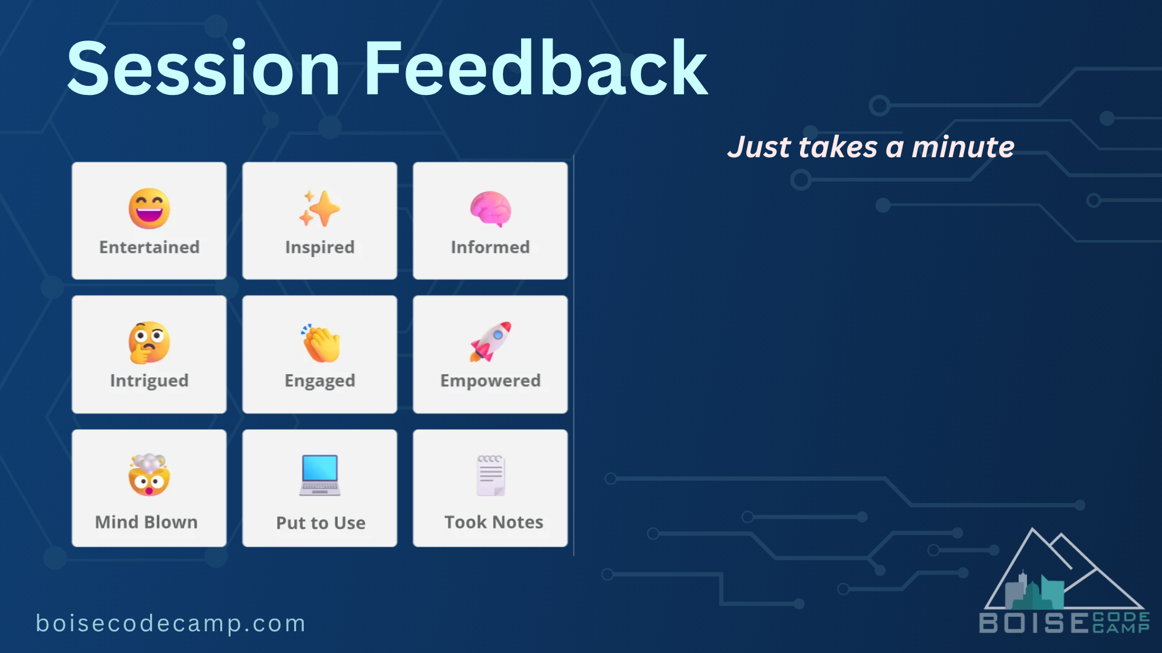
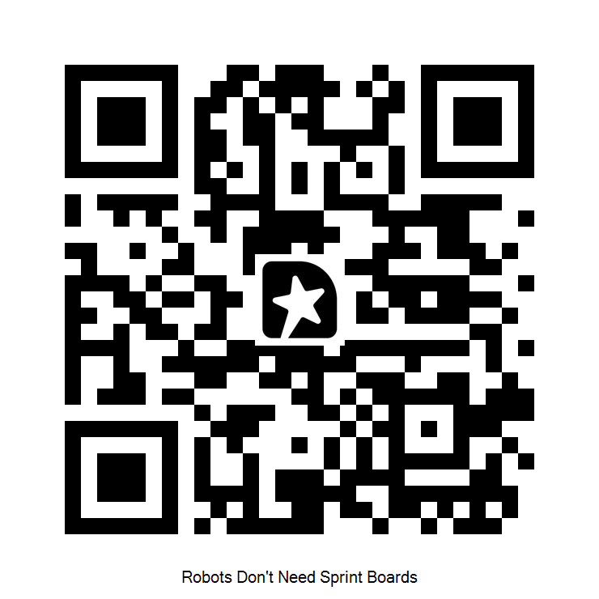
Scan to share what worked.
Notes:
BCC required: session feedback. Display while taking Q&A — give people time to scan the QR.

