Slide 1



C Without a Build System
Or: How I Killed the Linker

Slide 2



Samuel Lieberman
https://github.com/samuellieberman
Recreational Programmer
samuellieberman1@gmail.com

Slide 3
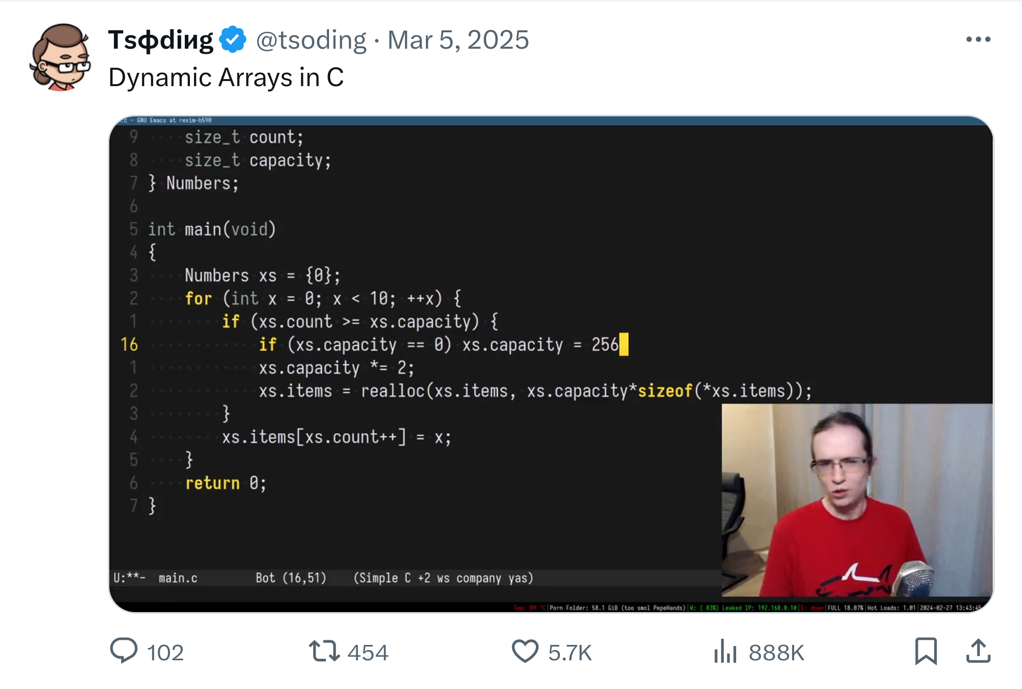
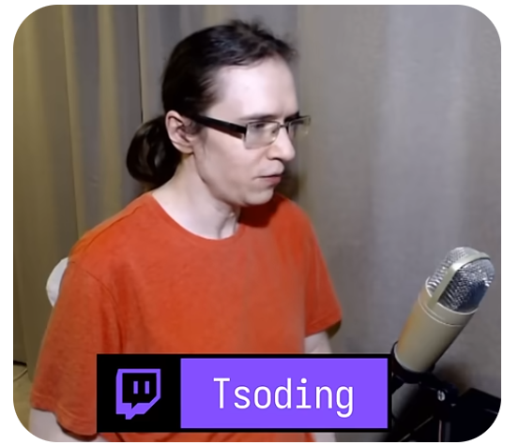
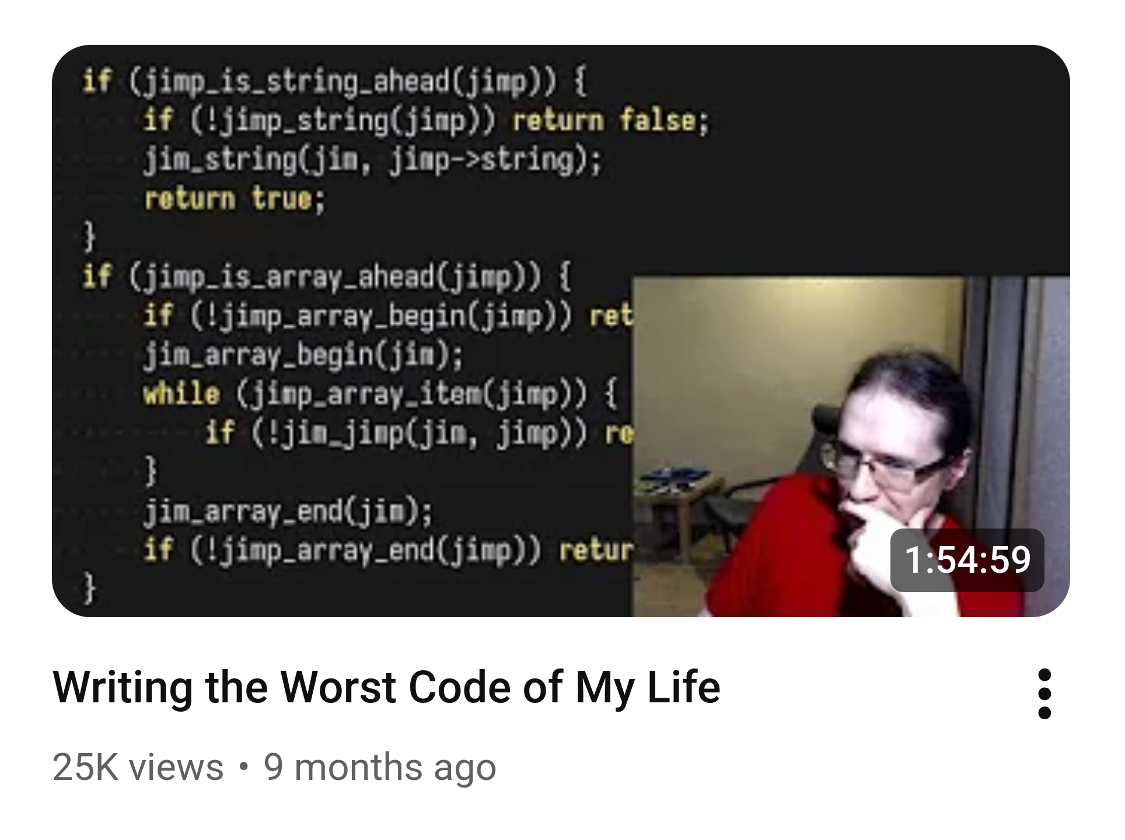

Slide 4
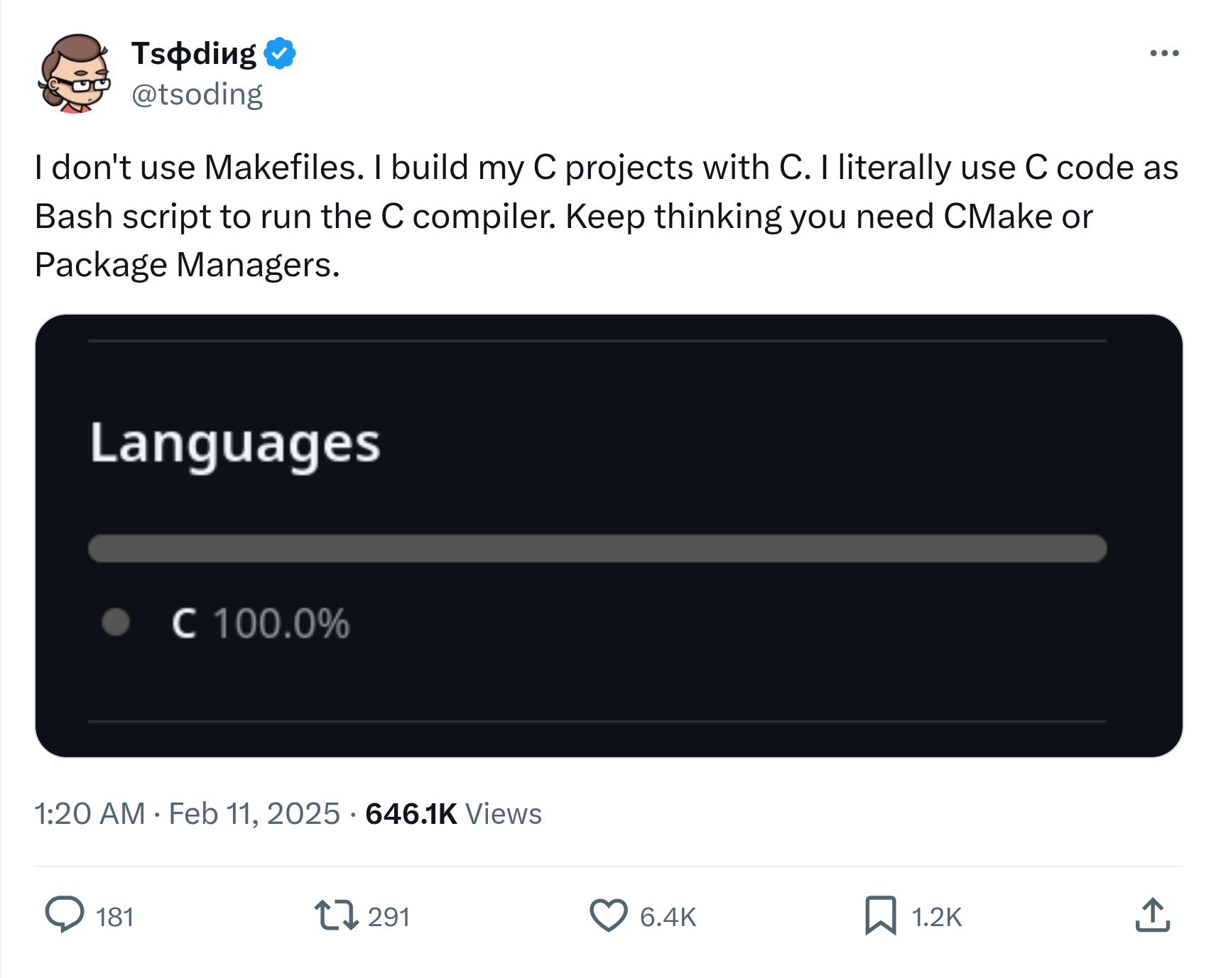

Slide 5

↓↓This guy↓↓

Slide 6








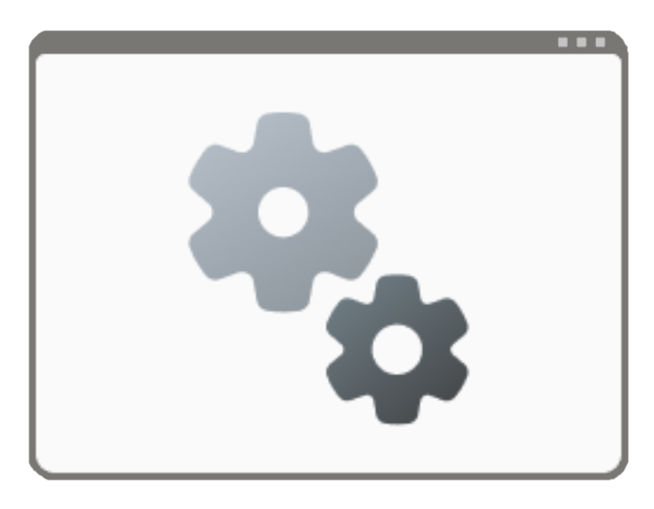


Linux
CMake
Python
Power Shell
Make
Ninja
Batch

Slide 7
But where is the C???
WE ❤️

Slide 8

Macro System
+
Higher Level Language
Assembly
+
Macro system
Python
Vibe Coding
Assembly

Slide 9
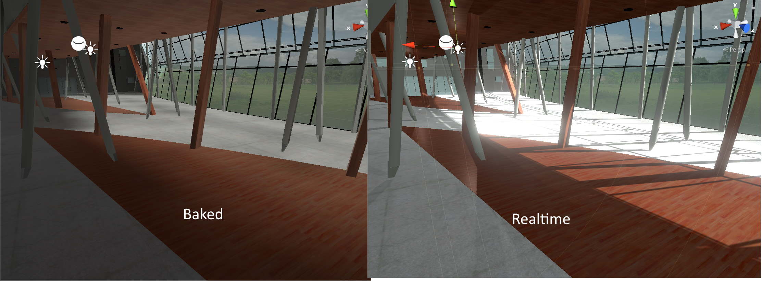
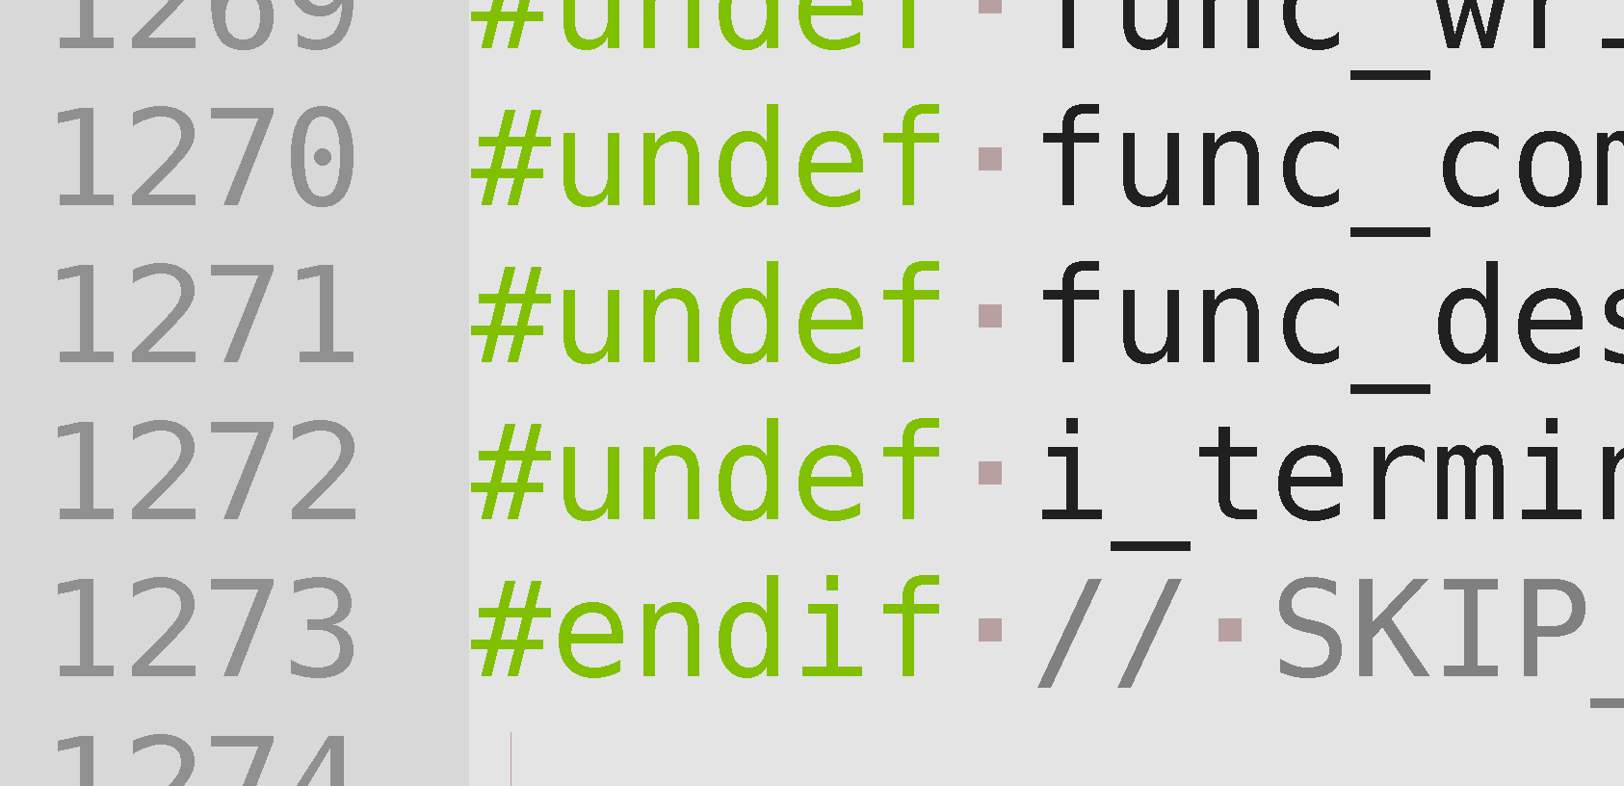
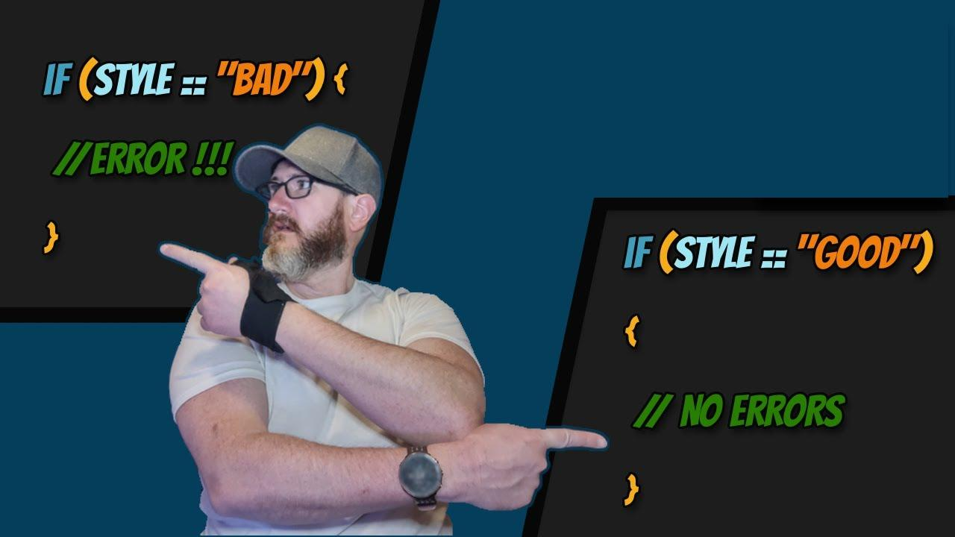
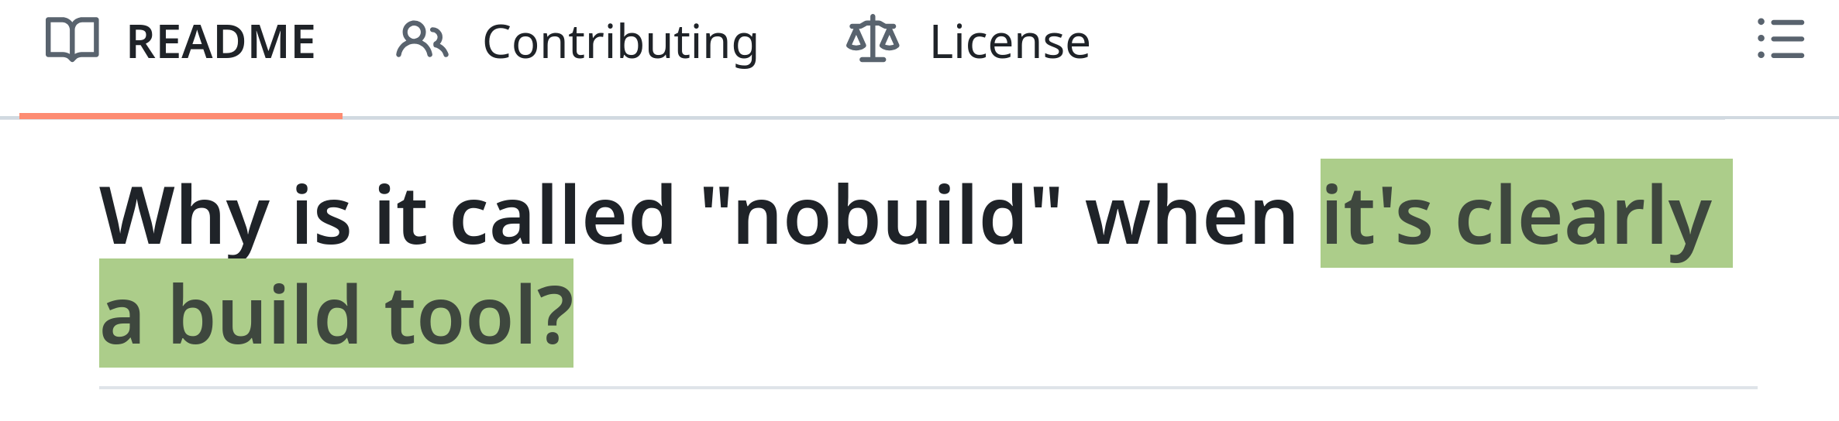
Wait… Do we like having a build system?

Slide 10
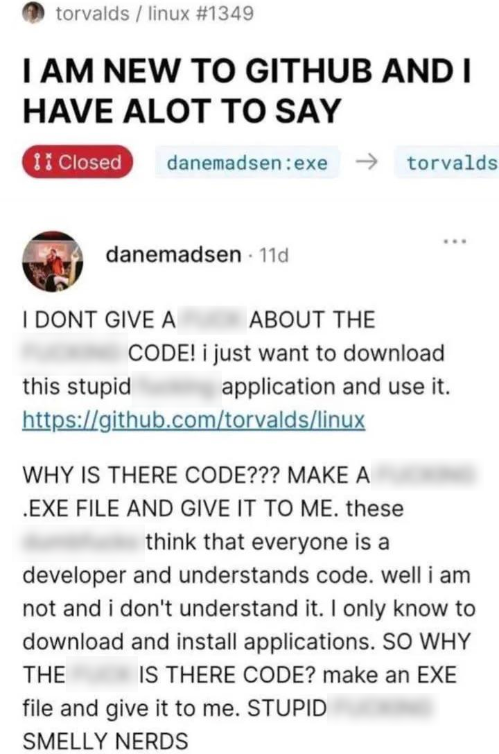
Wait… Do we like having a build system?

Slide 11
MISSION COMPLETE!

Slide 12
MISSION COMPLETE?

Slide 13
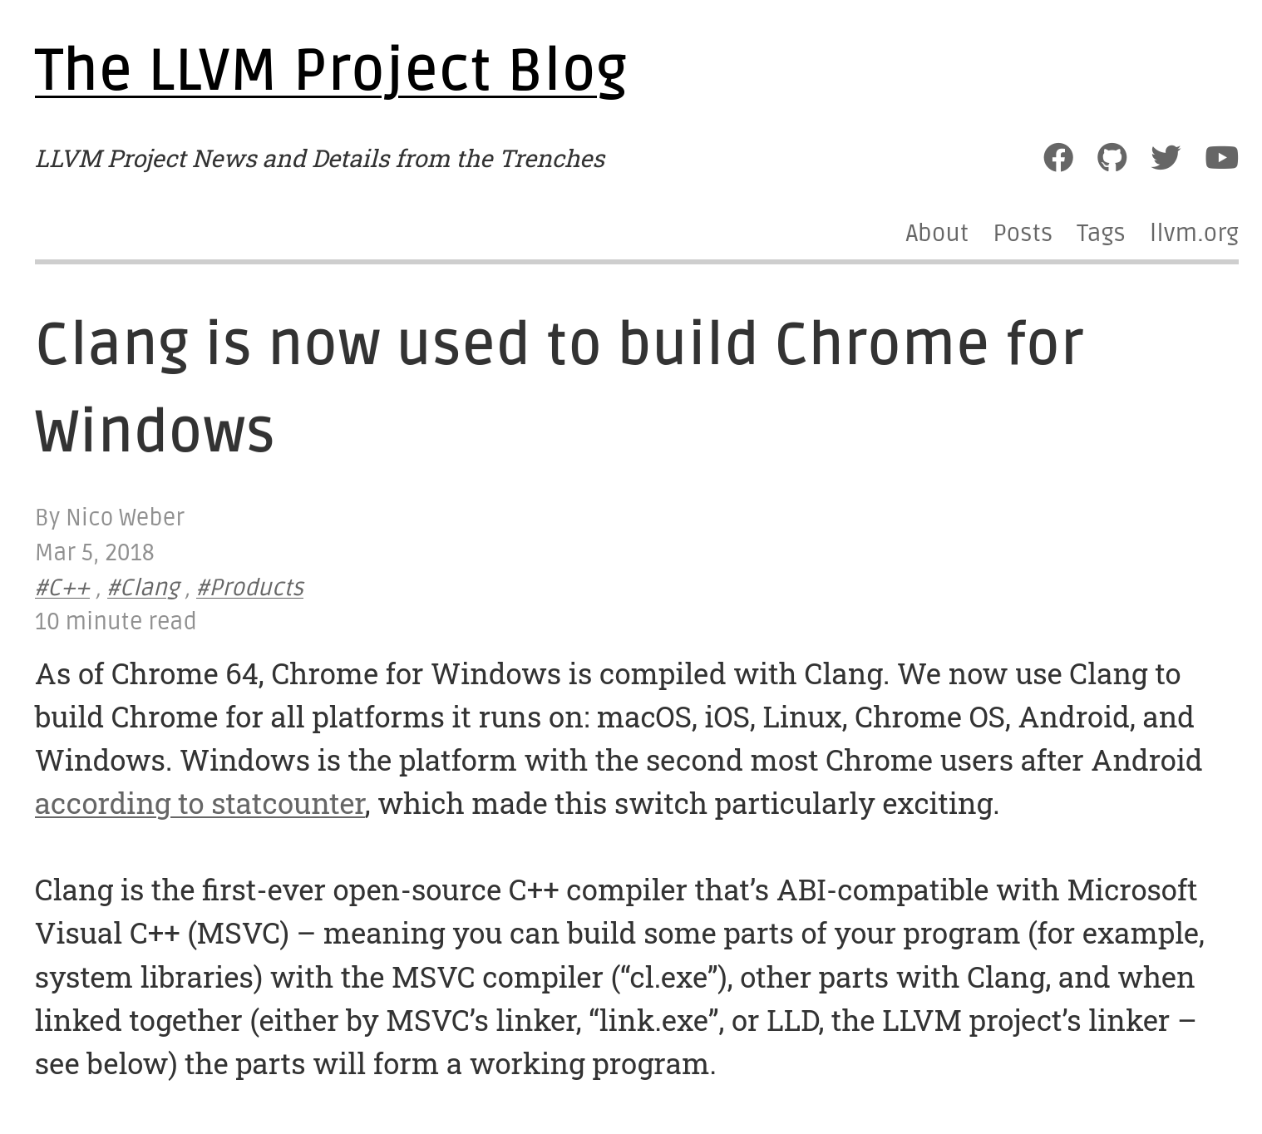

Slide 14


Open source Windows headers?

Slide 15

Open source Windows headers?

Slide 16

The Linker is officially dead!
Now I can make my application!

Slide 17
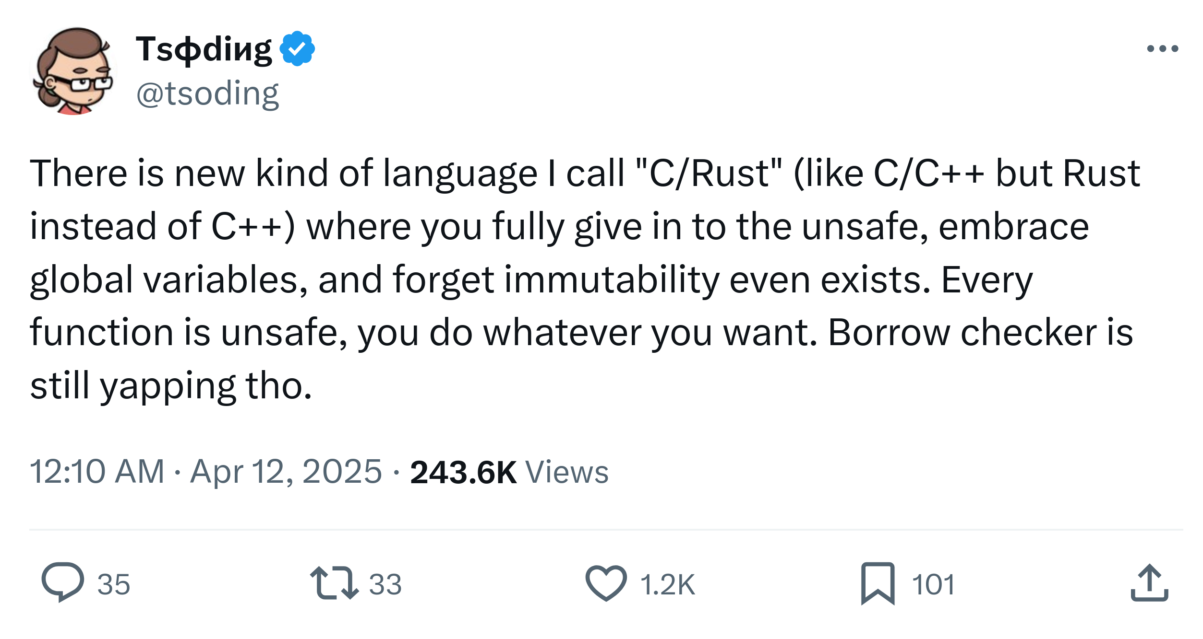

Slide 18


Slide 19

Questions and Feedback
Scan this fancy custom QR code they gave me to give me feedback
https://github.com/samuellieberman
Samuel Lieberman
samuellieberman1@gmail.com

