Slide 1
School-to-Work Transitions in the Philippines
WF Philippines
Angela Chen-Delantar
July, 2024

Slide 2
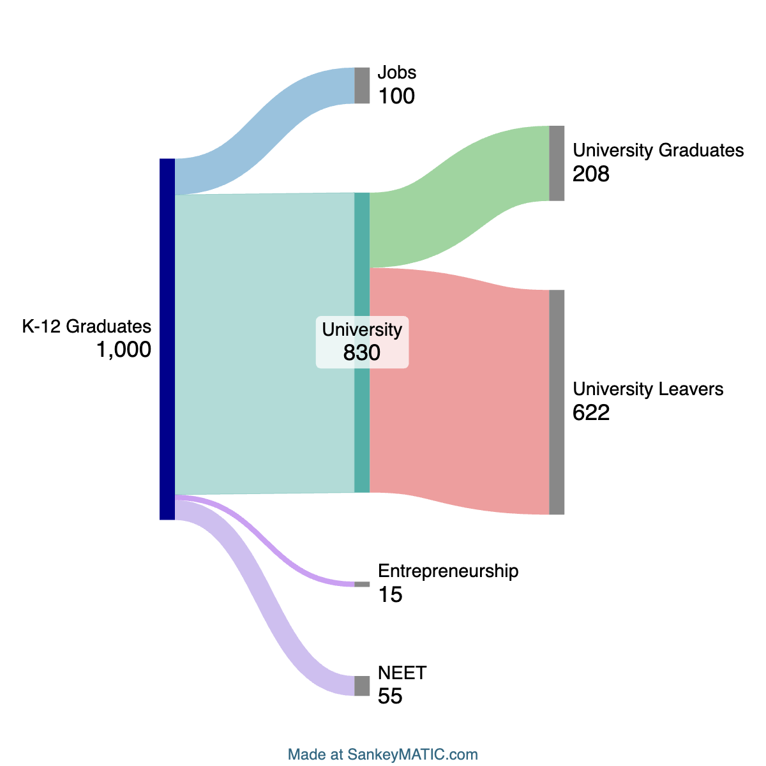
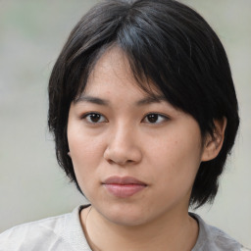


A Snapshot of the School-to-Work Systems in the Philippines
Illustrative School-to-Work Journey of 1,000 youths
1.2mn senior high school (SHS) graduated in 2023, how did they enter the workplace?
To illustrate their journey, let’s start with 1,000 of these Senior High School (K-12) graduates and see where do they go?
10% enter the job market
83% attend university with only 25% of these enrollee graduating from HEIs; it is assumed the leavers (75%) enter the job market
1.5% enter entrepreneurship and 5.5% considered NEETs*
Using this framework and our 3 personas, we can track the predicted school to work journeys of these illustrative 1,000 learners and understand their current employment outcomes.
Source: 2023 Department of Education's Basic Education Report from its 2019 and 2020 National Senior High School Tracer Study; HEI Completion rate PBEd State of Philippine Education Report 2023. SHS Graduates from PSA: 2023 Stats Yearbook. https://www.psa.gov.ph/system/files/psy/2023-Philippine-Statistical-Yearbook.pdf.
Those who entered entrepreneurship or are NEETs are not considered in this analysis.

Slide 3
If 1,000 students graduate from senior high school in 🇵🇭, what happens next?
Group 1
Group 2
Group 3
Beth
Carla
Alex
K-12
K-12
HEI
K-12
HEI
Beth’s cohort has 100 of the 1,000 senior high school graduates. Entering the job market immediately, Beth and her friends are most likely working at MSMEs in service oriented jobs or in large companies in manufacturing.
Carla complete her university degree with 200+ of the original 830 cohort who enrolled in college. She’s likely to have studied Business Administration or Teaching and now seeking work as a professional in a major city.
Alex enrolled in university but along with 600+ others left college without finishing his degree citing high cost of education and a desire to seek for employment sooner. Alex is likely to have found a job that does not require a diploma but 2 or more years of university.
Please note that 70 out of the 1000 youths are pursuing entrepreneurship or are considered NEETs. NEETs are out of school youth not in education, employment or training.

Slide 4
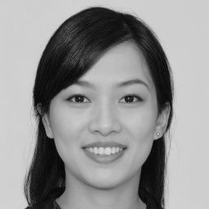

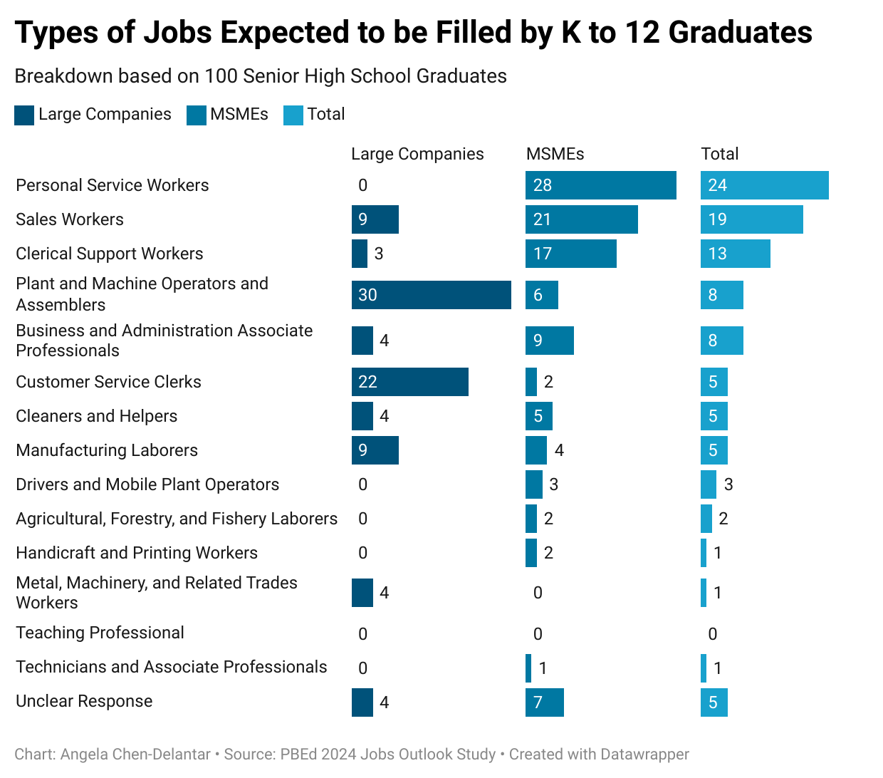
100 of the 1,000 K-12 grads heads into the workforce
In 2023, ~120,000 grads of senior high school (SHS) joined the workforce
The SHS grads who head into the job market are projected to have the following prospects:
24% personal service work e.g., F&B staff, building and housekeeping workers, hairdressers, beauticians, etc.
19% sales
13% clerical support work
Differences of Large Companies (>500 employees) vs MSMEs:
Large companies are fulfilling jobs in manufacturing, and customer service
MSMEs focus on personal service and sales
This is likely to result in a gendered split between these opportunities with more men working in large companies*
Note: 120,000 is based on the 10% of SHS grads estimated provided by DepEd
Source: PBEd 2024 Job Outlook Study. Table 7. Percentages transposed to 100 Learners. International Labour Organization’s International Standard Classification of Occupations
*Based on trends from PIDS Policy Note - Do men and women in the Philippines have equal economic opportunities? (PIDS, 2017)

Slide 5
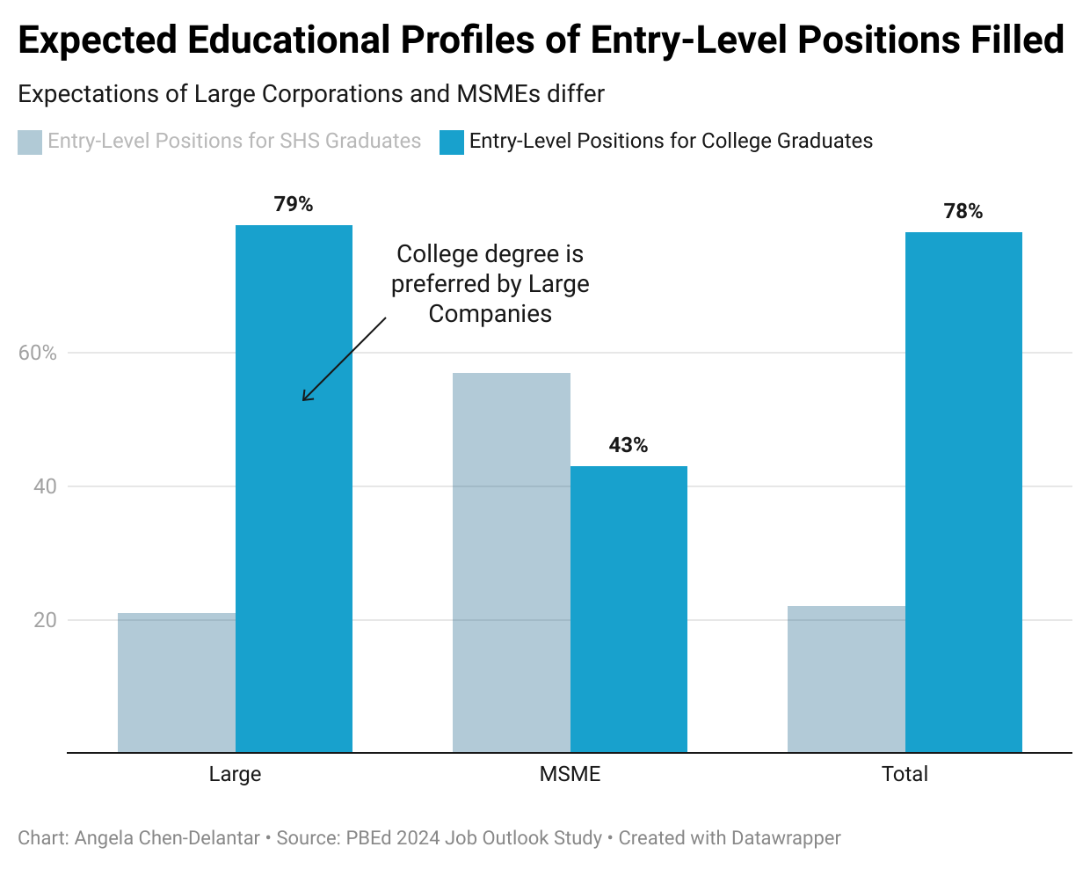
SHS grads faces challenges from hiring practices
SHS grads are disadvantaged in the job market
While ~50% of companies declared they had opportunities for K-12 grads, in reality, their expectation of who will get into entry-level roles tell another story:
79% of entry-level roles at large corps are expected to be filled by college graduates
MSMEs seem to be more open to accepting K to 12 graduates to fill in their entry-level positions with 67% of roles expected for SHS grads
The industry survey indicates that 22% of the total entry-level positions in 2024 will be accessible to K to 12 graduates, with majority of these positions available at large companies.
Source: PBEd 2024 Job Outlook Study. Figure 9 and 10. ~300 companies were surveyed on their entry-level openings and preferred educational requirements.
The PBEd study covered a total of 299 respondents, including 258 (86.3%) micro, small, and medium enterprises (MSMEs) and 41 (13.7%) large companies across the country. Businesses projected a total of 17,273 entry-level job openings in 2024.
This dataset is confirmed by Department of Labor and Employment’s (DOLE) report (Barcelo, 2023) and Employers Confederation of the Philippines (ECOP) news interview (Cordero, 2023).

Slide 6
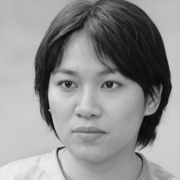
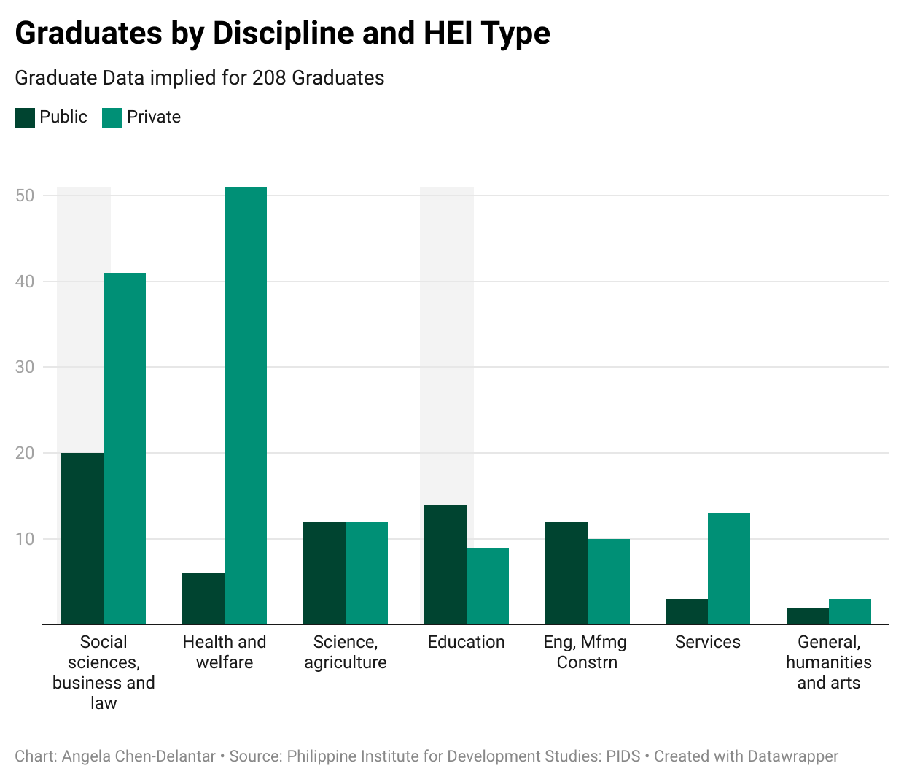
208 of the 1,000 K-12 grads enrol and complete a HEI degree
Only 25% of enrolled student graduate from college
34% of all graduates come from public HEIs
50% of public HEI graduates studied either business admin, or education.
There are difference in disciplines chosen by graduates at private and public HEIs:
Health and Welfare: 37% of private HEI graduates, mostly in Nursing, compared to 9% in public HEIs.
Education: Over 20% of public HEI graduates completed education courses, versus only 7% in private HEIs.
Social Sciences and Business: Popular across both sectors, with 28% of public and 30% of private HEI graduates.
Source: The 4th Philippine Graduate Tracer Study: Examining Higher Education as a Pathway to Employment, Citizenship, and Life Satisfaction from the Learner’s Perspective. Research Paper Series No. 2021-05 (PIDS. 2021). Data collection ran from July 2014 to June 2015. A total of 11,547 face-to-face interviews were completed.

Slide 7
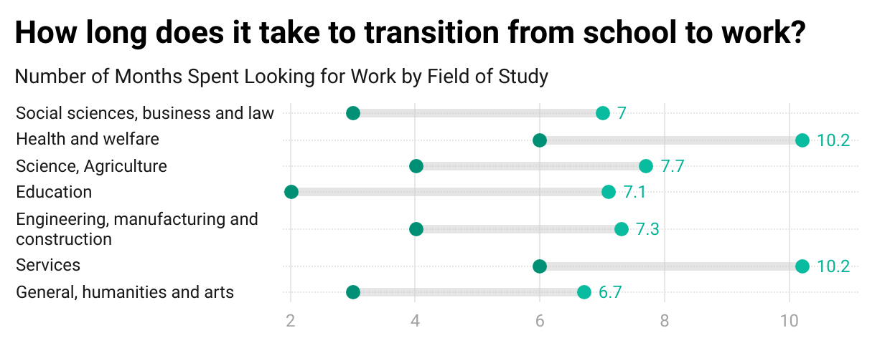
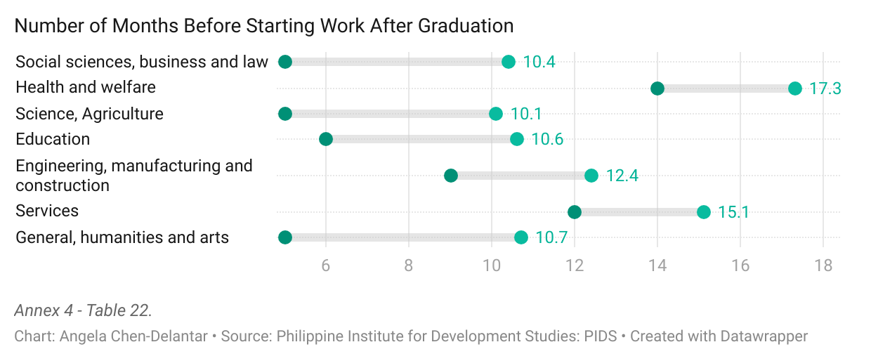
HEI grads don’t start their job search right away
Time to placement varies based on the discipline of the graduate and if exams are required
Graduates started looking for work on avg 4.6 months after graduation; public HEI grads started sooner at 3.3 months due to the PRC licensure exam requirement.
It took graduates 8.2 months on avg to land a job, with public HEI grads finding jobs 1.5 months sooner.
For PRC license-requiring programs, the job start time is 11 months, compared to 5 months for non-PRC programs.
Graduates of education and social sciences/business and law have the shortest job search, with a median of 2-3 months.
Median
Mean
The difference between the number of months spent looking for work and the number of months before starting work is explained by months spent before starting job search.
Main Reasons for Not Searching right away: The primary reasons for not looking for work immediately were to review for licensure exams (41%) and to rest (33%). Personal Circumstances: Around 12% delayed their job search due to getting married, getting pregnant, or family/household duties.

Slide 8
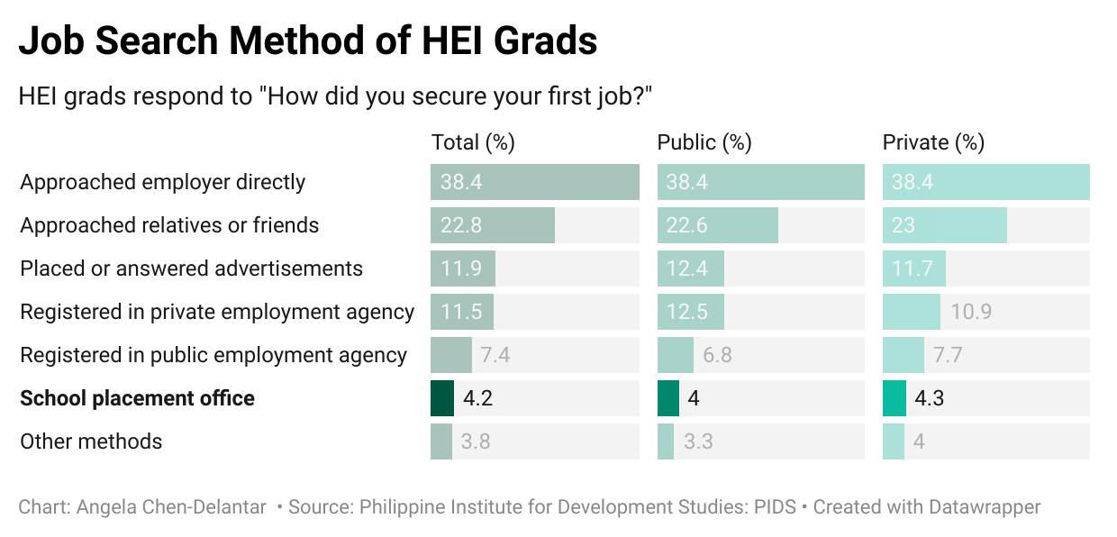
~80% HEI grads find placement, but not through school
Across studies, 70-90% are cited as the placement rate of HEIs
In the PIDS study involving 11k HEI grads, 85% of the grads have had their first job after graduation by time of study.
A placement rate of of 74%. This is significantly higher than the university's strategic target of 67%
6 other tracers studies conducted at HEI-level or discipline-level were reviewed with similar results
Tracer Studies of HEI Graduate Employment:
Roman, A. G., & Villanueva, R. U. (Year). Graduate employment rate of one state university of the Calabarzon region in Philippines: A retrospection. *International Journal of Evaluation and Research in Education*, *Volume*(Issue), Page numbers. Laguna State Polytechnic University, Siniloan, Philippines.
Hipona, J. B., Cuevas, J. E. T., & Martin, J. A. (2021). A Tracer Study of the Bachelor of Science in Nursing Program of La Consolacion University Philippines Graduates: A Reflection on Institutional goals. Cosmos An International Journal of Art & Higher Education, 10(1), 16–26. doi: 10.46360/cosmos.ahe.520211004.
Mina, J. C., Reyes, E. J. G., & Salas, R. F. (2020). A Tracer Study of Bachelor of Science in Information Technology (BSIT) Graduates of Nueva Ecija University of Science and Technology (NEUST), San Isidro Campus. International Journal of English Literature and Social Sciences, 5(4), 1337–1344. doi: 10.22161/ijels.54.77.
Malahay, R. S., & Saing, P. M. (2018). A tracer study of Bachelor of Science in Computer Science Graduates of Negros Oriental State University-Guihulngan City Campus, Philippines. International Journal of Applied Research, 4(12), 44–46.
Caingcoy, M. (2020). Cross-Sectional Inquiry on Employability and Employment Status of Bachelor of Secondary Education Graduates (2016-2018): A Tracer Study. SSRN Electronic Journal. doi: 10.2139/ssrn.3632058.
Corpuz, E. R. P. (2020). Tracer Study of Nueva Ecija University of Science and Technology Graduates (Atate Campus). International Journal of English Literature and Social Sciences, 5(2), 434–440. doi: 10.22161/ijels.52.17.
Calpa, M. J. B., Esquierdo, I. E., & Unay, O. D. (2021). Tracer Study of Bs in Mathematics Graduates (2001 – 2015) of the College of Science, University of Eastern Philippines. Asian Research Journal of Mathematics, 17(1), 38–44. doi: 10.9734/arjom/2021/v17i130263.

Slide 9
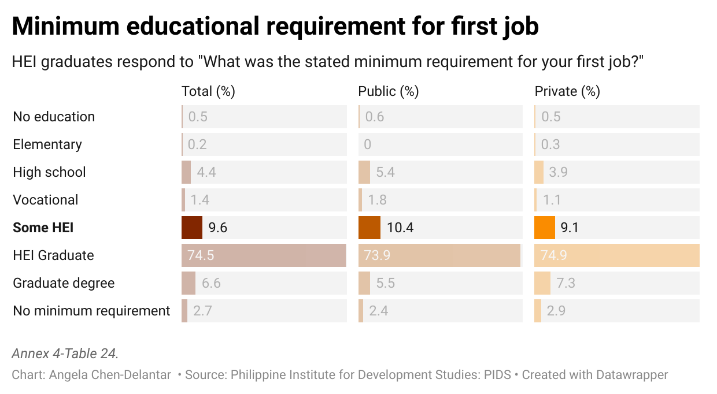
622 of the 1,000 K-12 grads say “No Diploma, No Problem”
75% of HEI enrolled don’t complete, but very limited visibility on this segment
HEIs had a 15.90% attrition rate in SY (SY ‘20-21, which jumped to 37.79% (SY ’21-’22) and 41% in (SY ‘22-’23).
The primary reason for dropping out was a lack of financial resources with many students were already working while attending college, suggesting that the need to earn an income was a critical factor in their decision to drop out.
~10% of jobs state that only some HEI is needed, however the number may be higher
Based on qualitative feedback and discussion with HR from the BPO industry, “second-year college completers” is a common standard for call centre positions.
Source: The 4th Philippine Graduate Tracer Study: Examining Higher Education as a Pathway to Employment, Citizenship, and Life Satisfaction from the Learner’s Perspective. Research Paper Series No. 2021-05 (PIDS. 2021). Data collection ran from July 2014 to June 2015. A total of 11,547 face-to-face interviews were completed.
Senator Sherwin Gatchalian Speech. 2023 Accessed July 2024.
Orion, H. C., Jr., Forosuelo, E. J. D., & Cavalida, J. M. (Year). Factors affecting students’ decision to drop out of school. Cor Jesu College.
Source for BPO HR Feedback: Mercer HR Conference. Manila June 2024.

Slide 10
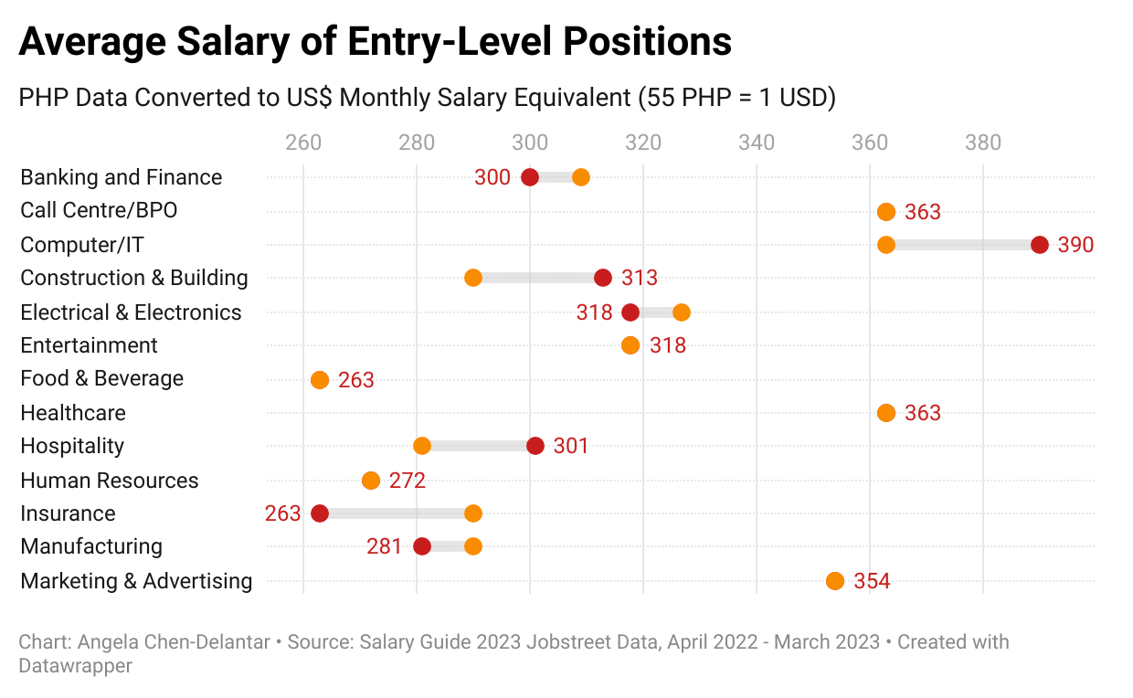
In 2023, entry-level jobs pay $315 per month
JobStreet’s 2023 salary guide provide ideas on how graduate can increase their compensation
Industries like Call/Centre BPOs, Computer/IT, and Healthcare are the highest salary for entry-level positions
Depending on the industry, working at a large corporate would offer a small salary premium of 5-7%
While K-12 graduate are unlikely to be able to apply for these higher paying jobs, it is unclear if there is a salary difference between those who are HEI grads and those who have completed 2 years of HEI studies
SME
Large Corp
Source: JobStreet. Salary Guide 2023: Employment Trends in the Philippines

Slide 11
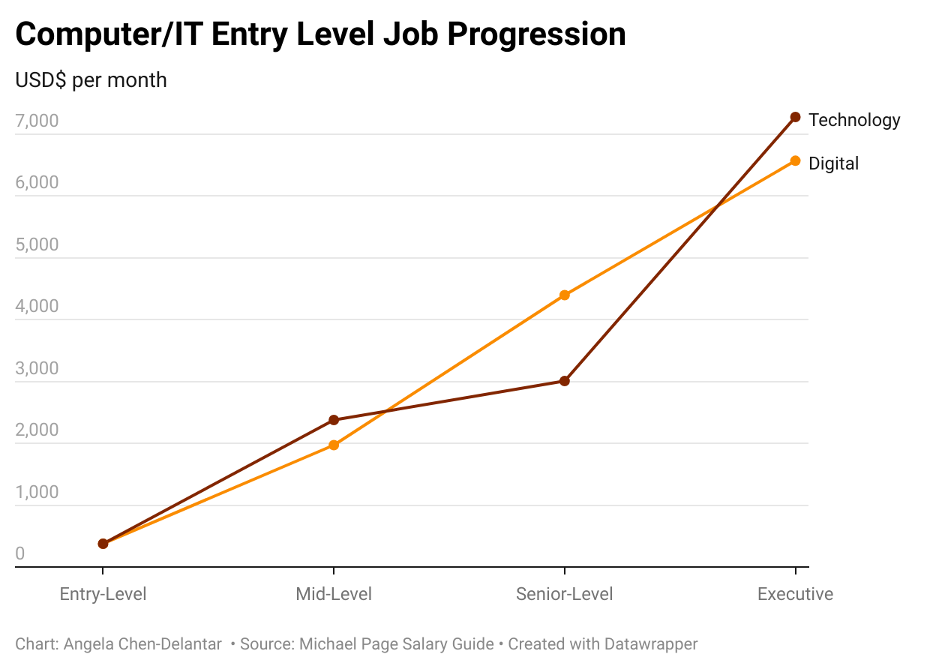
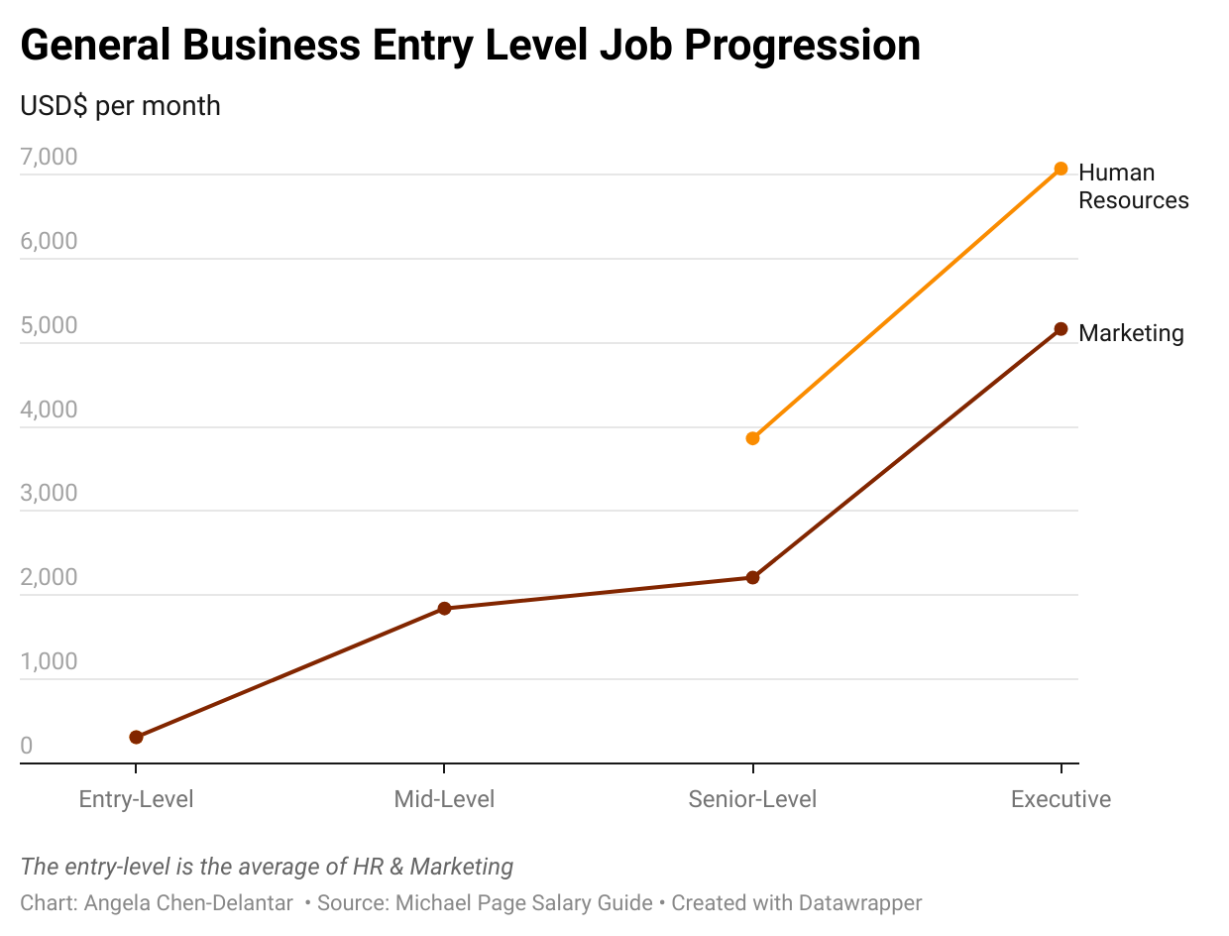
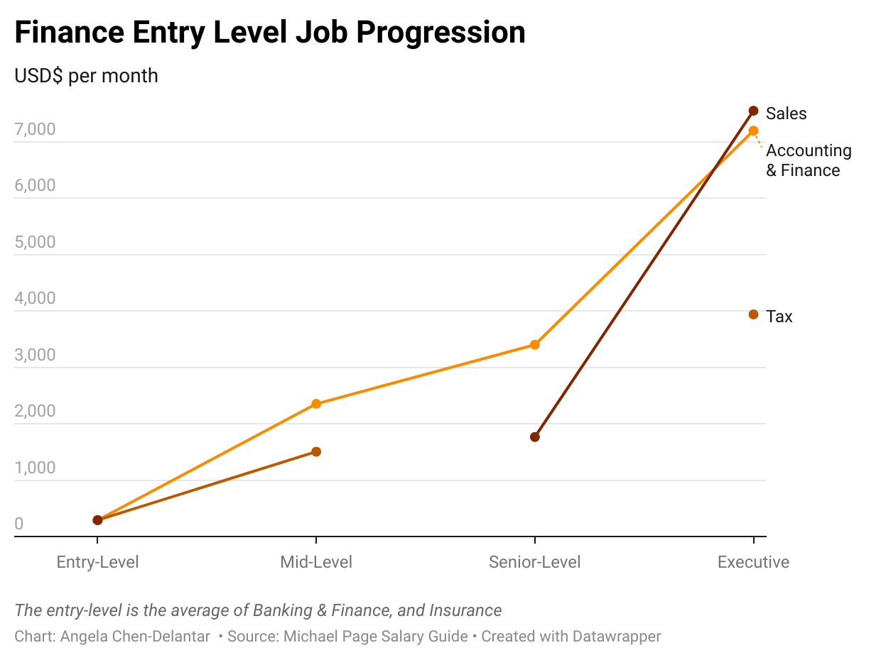
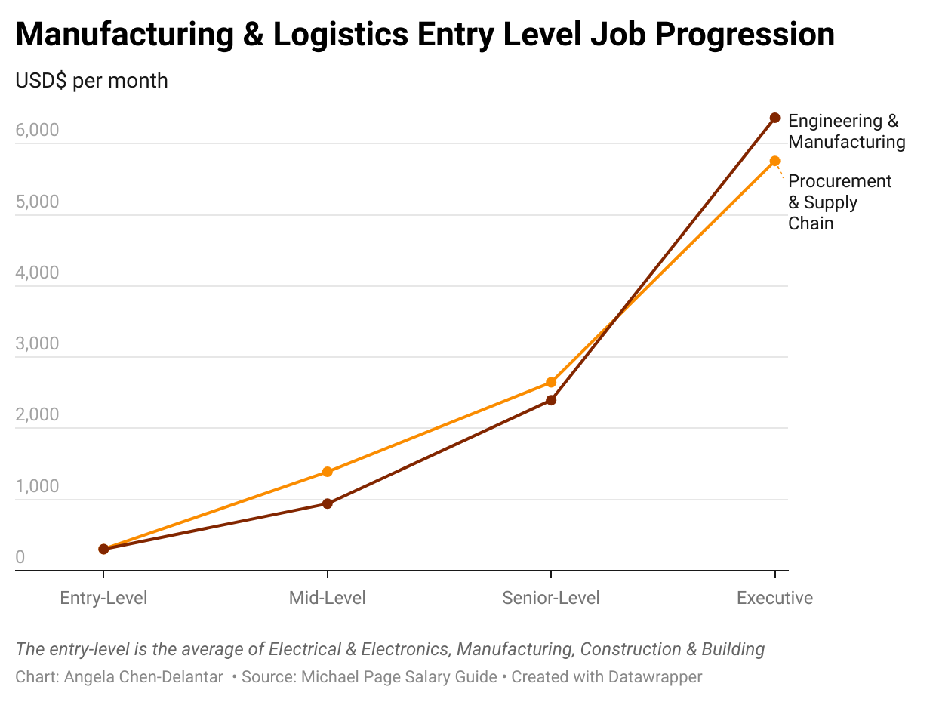
Jobs for college graduates offer decent salary growth at senior levels
in industry
We can identify industries and job roles in professional settings and in manufacturing that offer good career progression with $1756 as mid-level monthly salary which is 5.5x of the entry-level salary of $315 over 5-8 years.

Slide 12
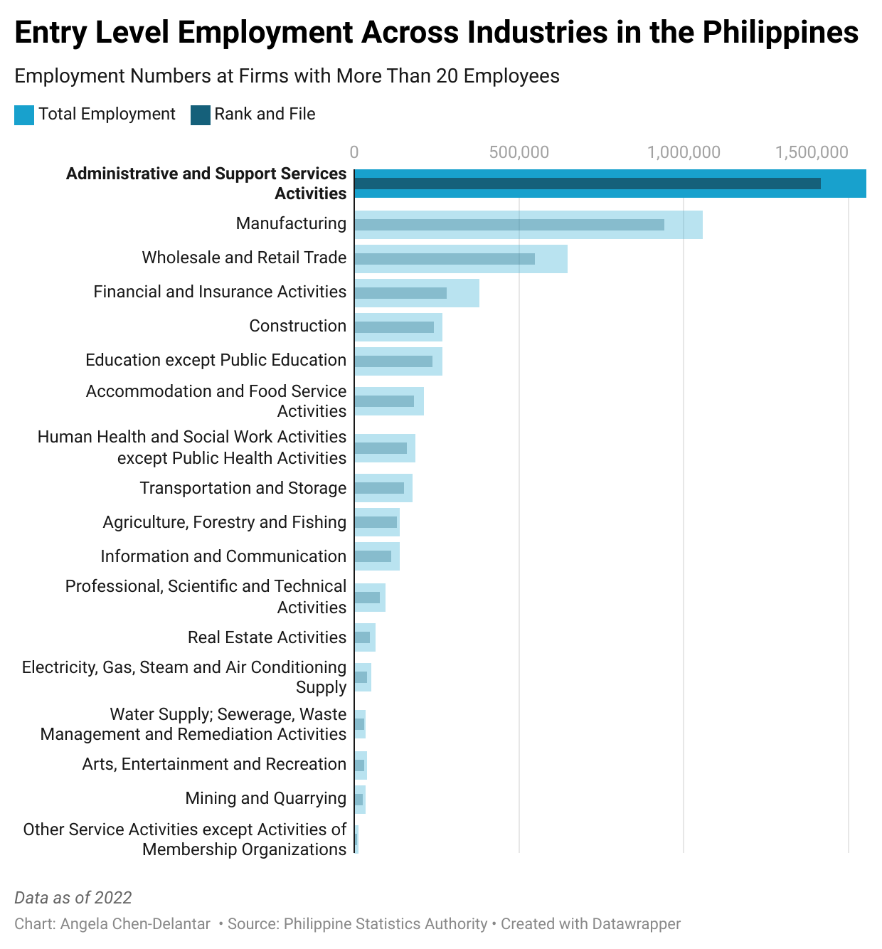
However, the bulk of jobs are still in low to mid level skills
Most of all employees registered through government agencies in the Philippines are working in low to mid-level skills.
For instance, 30% of 1.6 million included in Admin and Support Services, of which 1.3 million is reported by the BPO Industry Association (IBPAP) as being in BPOs
A closer look at the Industries which are in the top 8 demonstrate that the supply-demand dynamics keep the going salary and the salary progression low as compared to professional job opportunities. (see next slide)

Slide 13
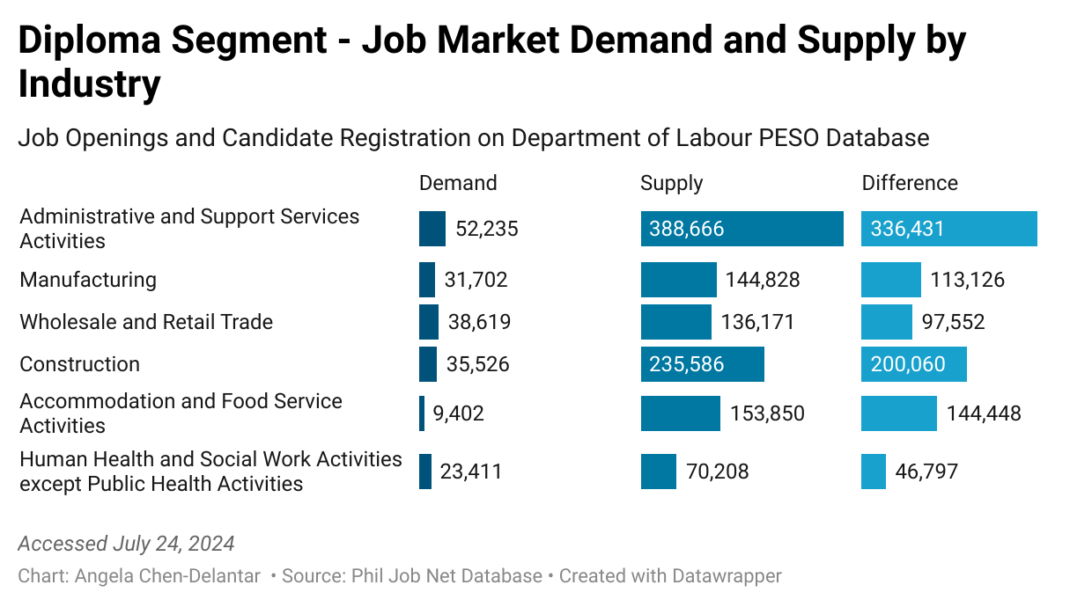
Healthcare jobs have a more balanced supply-demand dynamic compared to other industries
6 out of the top 8 industries by employment volume have oversupply of candidates*
In the healthcare sector, the demand-to-supply ratio is notably tight compared to the overall job market. For every job opening in healthcare, there are approximately 3 candidates, compared to an average of 7 candidates per job opening across all sectors.
Mid to high-skills, such as those in the technology and finance sectors, most likely exhibit a lower candidate-to-job ratio. However, this dataset is provided by the government jobsite which focuses on accessible, non-degree jobs.
* Data for the other 2 of the top 8 (Finance and Insurance, Education Except Public Education) is not available.

Slide 14
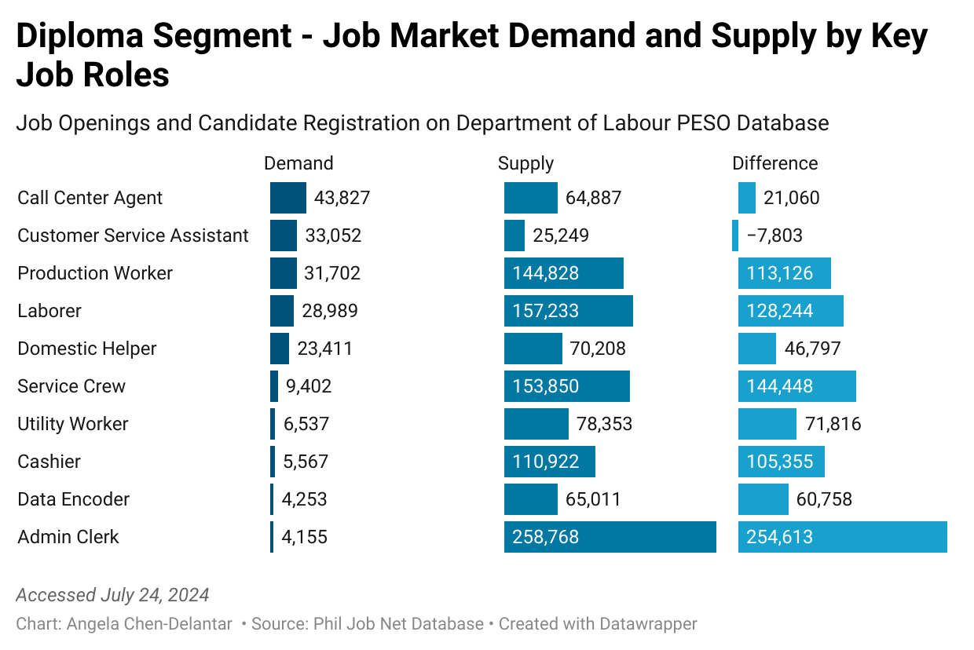
Call Center and Customer Service Agents are still in higher demand than others
Further evidence is needed to confirm the job market dynamics for roles:
Opportunities for domestic helpers to work as overseas workers (OFWs) can be investigated
Compared to Call Center Agents, Admin Clerk and Data Encoder jobs have less favorable supply-demand dynamics for candidates, however, many remote jobs are posted in alternative platforms and need to reviewed holistically
The future growth of these roles also need to reviewed
Notes:
Notes
Action 1: Forecast of Jobs and Labour Market Forecast; until 2025;
Action 2: Regional Summits where key sectors + LMI ;
Action 3: generic email link;
Government interns are available to help with placement -> JPO linked to the PESO ; there is an annual event to incentivize the best JPOs (Batangas – BatSU; LPU); based on the LGU categories if highly urbanized; they are under the LGUs but deliver the programs from the DOLE; there are new laws that are there to strengthen the DOLE.
How about the ones that are not performing well right now -> not having financial support from the LGU, benchmarking across;
How to identify the PESO office from the sector first;
Career Development Support; CDSB; consortium with other agencies; provide youth with information on labor market information; Guidance counsellor
Major National job fairs; June 12th hired on the spot data; and near-hires;
Private manpower agencies; DOLE doesn’t have access to the workers but only to the agencies; <200 are accredited and only ¼ have licenses that last for 3 years; they got the licenses 2 years ago and now they are not so many;

Slide 15
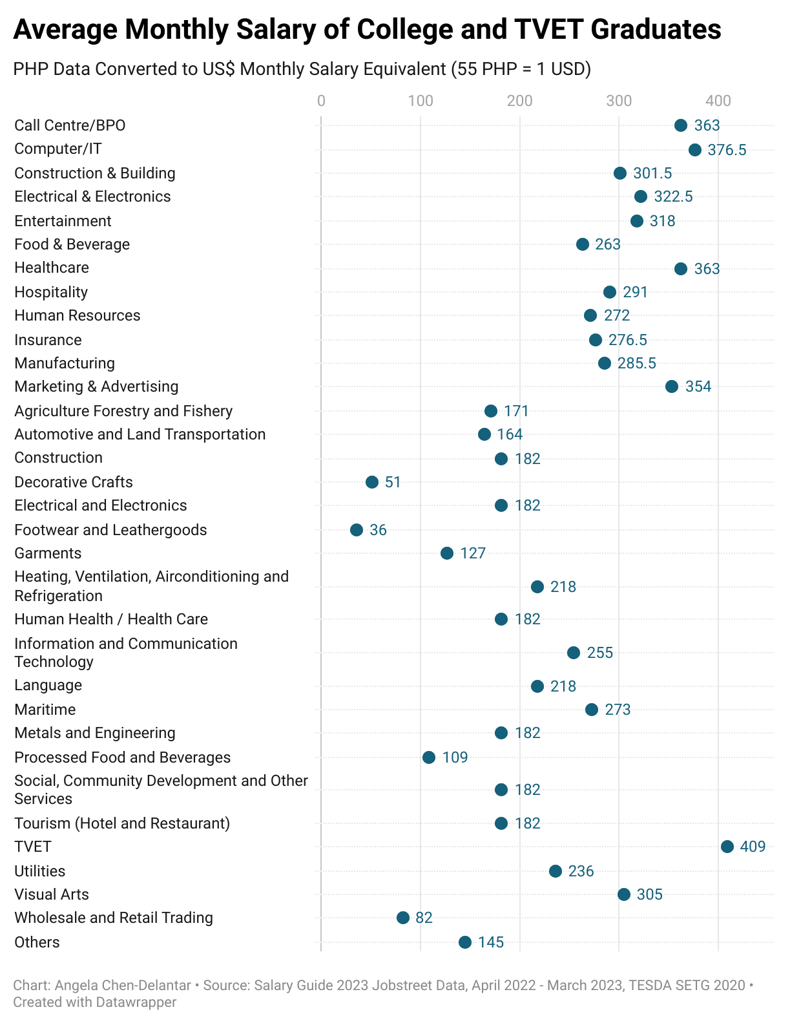
Clear Salary differences of Univ VS TVET graduates
Univ Grad
There is a clear wage difference between the salary reported by Univ grads and TVET grads
Average weighted salary for TESDA graduates is $180 per month, which is $133 less than the average University graduate salary of $313
6 sectors can be identified as having salary data for both univ and TVET grads
Further qualitative interviews with HR needed to verify if hiring process allows for TVET grads to compete with University grads
TVET Graduate

Slide 16
How can the foundation help each of these learners?
Group 1
Group 2
Group 3
Beth
Carla
Alex
K-12
K-12
HEI
K-12
HEI
Beth and her cohort are disadvantaged in workforce and are competing with prior cohorts who have completed at least 2 years of HEI studies. The foundation can work with public or private placement agencies, or approach large corporate directly.
HEI graduates like Carla are most likely to succeed in higher paying entry-level positioners. The foundation can focus on working with Public HEIs where more grads studied disciplines with longer time to placement, and lower salary, and thus can improve their outcomes with the foundation’s courses.
Alex will likely try to secure a BPO job where current hiring practices accept his dropout status. The foundation can work with BPO industry association and companies directly to facilitate the transition. Schools may not be the right partner for those like Alex who leave the system.
Please note that 70 out of the 1000 youths are pursuing entrepreneurship or are considered NEETs. NEETs are out of school youth not in education, employment or training.

Slide 17
Maximize Impact Potential with Targeted Partnerships
Illustrative School-to-Work Journey of 1,000 youths
Additionality of impact can be achieved where no one else is serving those learners left behind
The foundation currently work almost exclusively with learners like Carla, who only represents ~20% of the 1,000 learners who are the most prepared to enter the workforce. Additional analysis will provide the exact split.
To match our GTM direction to maximize the impact of the foundation and achieve its 1 million Filipinos upskilled by 2030 goal:
Focus more on those who are not HEI graduates
Target job roles with tight supply-demand ratios
Additional benchmark data on existing placement rates, average salary and time to place for University Leavers
Source: 2023 Department of Education's Basic Education Report from its 2019 and 2020 National Senior High School Tracer Study; HEI Completion rate PBEd State of Philippine Education Report 2023. SHS Graduates from PSA: 2023 Stats Yearbook. https://www.psa.gov.ph/system/files/psy/2023-Philippine-Statistical-Yearbook.pdf.
Those who entered entrepreneurship or are NEETs are not considered in this analysis.

