Slide 1
ADAPTER PATTERN
Notes:
1

Slide 2
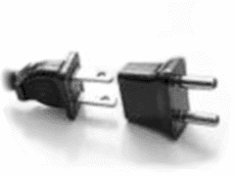
Intent
Converts the interface of a class into another interface that a client requires.
Adapter acts as an intermediary and lets classes work together that couldn't otherwise because of incompatible interfaces.
Wrap an existing class with a new interface.
Also Known As
-> Wrapper
Notes:
2

Slide 3
slide 3
Motivation
Sometimes a toolkit or class library cannot be used because its interface is incompatible with the interface required by an application
We cannot change the library interface, since we may not have its source code
Even if we did have the source code, we probably should not change the library for each domain-specific application
Notes:
3

Slide 4
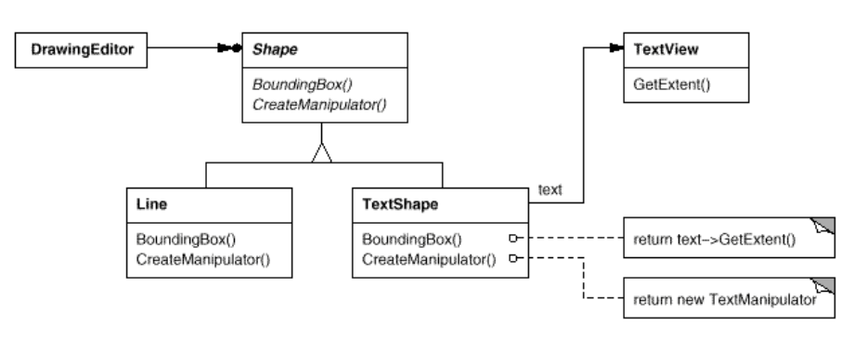
slide 4
Motivation
Example:
Notes:
4

Slide 5
slide 5
Participants
Target (shape)
defines the domain-specific interface that Client uses.
Adapter (TextShape)
adapts the interface Adaptee to the Target interface.
Adaptee (TextView)
defines an existing interface that needs adapting.
Client (DrawingEditor)
collaborates with objects conforming to the Target interface.
Notes:
5

Slide 6
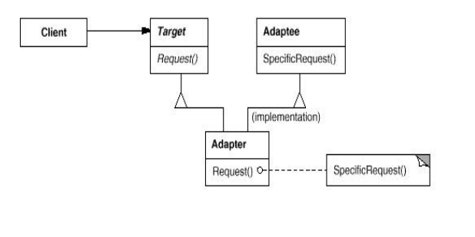
slide 6
Structure
A class adapter uses multiple inheritance to adapt one interface to another:
Notes:
6

Slide 7
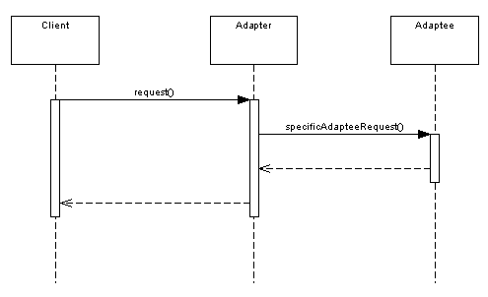
slide 7
Collaboration
Notes:
7

Slide 8
slide 8
Applicability
Use the Adapter pattern when
You want to use an existing class, and its interface does not match the one you need
You want to create a reusable class that cooperates with unrelated classes with incompatible interfaces
Notes:
8

Slide 9
9
Example 1
The classic round pegs and square pegs!
Here's the SquarePeg class:
/**
* The SquarePeg class.
* This is the Target class.
*/
public class SquarePeg {
public void insert(String str) {
System.out.println("SquarePeg insert(): " + str);
}
}
Notes:
9

Slide 10
10
Example 1 (continued)
And the RoundPeg class:
/**
* The RoundPeg class.
* This is the Adaptee class.
*/
public class RoundPeg {
public void insertIntoHole(String msg) {
System.out.println("RoundPeg insertIntoHole(): " + msg);
}
}
If a client only understands the SquarePeg interface for inserting
pegs using the insert() method, how can it insert round pegs? A
peg adapter!
Notes:
10

Slide 11
11
Example 1 (continued)
Here is the PegAdapter class:
/**
* The PegAdapter class.
* This is the Adapter class.
* It adapts a RoundPeg to a SquarePeg.
* Its interface is that of a SquarePeg.
*/
public class PegAdapter extends SquarePeg {
private RoundPeg roundPeg;
public PegAdapter(RoundPeg peg) {this.roundPeg = peg;}
public void insert(String str) {roundPeg.insertIntoHole(str);}
}
Notes:
11

Slide 12
12
Example 1 (continued)
Typical client program:
// Test program for Pegs.
public class TestPegs {
public static void main(String args[]) {
// Create some pegs.
RoundPeg roundPeg = new RoundPeg();
SquarePeg squarePeg = new SquarePeg();
// Do an insert using the square peg.
squarePeg.insert("Inserting square peg...");
Notes:
12

Slide 13
13
Example 1 (continued)
// Now we'd like to do an insert using the round peg.
// But this client only understands the insert()
// method of pegs, not a insertIntoHole() method.
// The solution: create an adapter that adapts
// a square peg to a round peg!
PegAdapter adapter = new PegAdapter(roundPeg);
adapter.insert("Inserting round peg...");
}
}
Client program output:
SquarePeg insert(): Inserting square peg...
RoundPeg insertIntoHole(): Inserting round peg...
Notes:
13

Slide 14
slide 14
Related Patterns
The Bridge pattern shares structure with object adapter, but diverges on intent. Bridge is concerned with separating an object's interface from its implementation while adapter changes the interface of an existing object
The Decorator pattern does not change an object's interface, but it does support recursive composition which adapter does not. In this way, Decorator is more flexible than adapter for dealing with functionality additions
Notes:
14

Slide 15
BRIDGE PATTERN
Notes:
15

Slide 16
Intent
Decouple the functional abstraction from its implementation so that the two can be changed and can vary independently
Also known as:
Handle/Body
Notes:
16

Slide 17
Motivation
Problem: For some classes, we want to adapt (reuse) either their abstractions, their implementations or both.
How can we structure a class so that abstractions and/or implementations can easily be modified?
Inheritance binds an implementation to the abstraction permanently, which makes it difficult to modify, extend, and reuse abstraction and implementations independently.
Notes:
17

Slide 18
Motivation
Consider the implementation of a portable Window abstraction in a user interface toolkit. X Window System and IBM's Presentation Manager (PM), for example. We could use inheritance but this approach has two drawbacks:
It's inconvenient to extend the Window abstraction to cover different kinds of windows or new platforms.
Imagine an IconWindow subclass of Window
It makes client code, platform-dependent. Clients should be able to create a window without committing to a concrete implementation.
Notes:
18

Slide 19
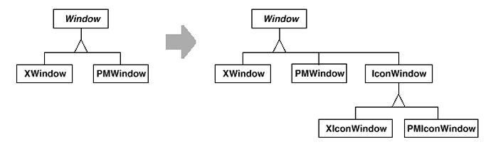
Motivation
Notes:
19

Slide 20
Applicable scenarios
When you need to avoid a permanent binding between a functional abstraction and its implementation.
When both the functional abstractions and implementations need to be extended using subclasses.
When implementation changes should not impact clients (not even recompile).
When the implementation should be completely hidden from the client.
When you have a proliferation of classes.
When, unknown to the client, implementations are shared among objects
Notes:
20

Slide 21
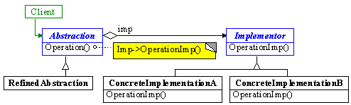
Structure
Notes:
21

Slide 22
Participants & Collaborations
Abstraction
- defines the functional abstraction's interface
- maintains a reference to the Implementor
- forwards requests to the Implementor (collaboration)
RefinedAbstraction
- extends abstraction interface
Implementor
- defines interface for implementations
ConcreteImplementor
- implements Implementor interface, i.e. defines an implementation
Notes:
22

Slide 23
Consequences
Decouples interface and implementation
Decoupling Abstraction and Implementor also eliminates compile-time dependencies on implementation. Changing implementation class does not require recompile of abstraction classes.
Improves extensibility
Both abstraction and implementations can be extended independently
Hides implementation details from clients
More of a design-time pattern
Notes:
23

Slide 24
Example1
Suppose I have been given the task of writing a program that will draw rectangles with either of two drawing programs. I have been told that when I instantiate a rectangle, I will know whether I should use drawing program 1 (DP1) or drawing program 2 (DP2).
The rectangles are defined as two pairs of points, as represented in the following figures and the differences between the drawing programs are summarized in the following table.
Notes:
24

Slide 25
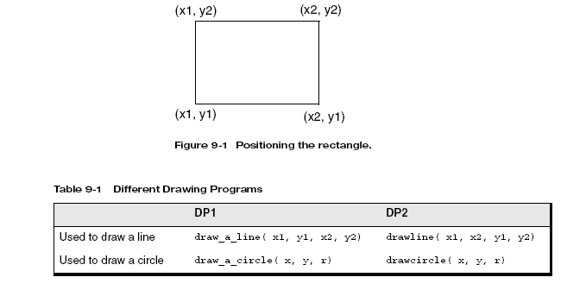
Example1
Notes:
25

Slide 26
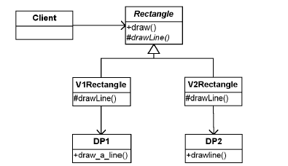
Example 1
My customer told me that the clients of the rectangles do not want to worry about what type of drawing program it should use. It occurs to me that since the rectangles are told what drawing program to use when instantiated, I can have two different kinds of rectangle objects: one that uses DP1 and one that uses DP2. Each would have a draw method but would implement it differently.
Notes:
26

Slide 27
Example1
By having an abstract class Rectangle, I take advantage of the fact that the only difference between the different types of Rectangle are how they implement the drawLine method. The V1Rectangle is implemented by having a reference to a DP1 object and using that object’s draw_a_line method. The V2Rectangle is implemented by having a reference to a DP2 object and using that object’s drawline method. However, by instantiating the right type of Rectangle, I no longer have to worry about this difference.
Notes:
27

Slide 28
Example 1
Now, suppose that after completing this code, one of the inevitable three (death, taxes, and changing requirements) comes my way. I am asked to support another kind of shape—this time, a circle. However, I am also given the mandate that the collection object does not want to know the difference between Rectangles and Circles.
It occurs to me that I can simply extend the approach I’ve already started by adding another level to my class hierarchy. I only need to add a new class, called Shape, from which I will derive the Rectangle and Circle classes. This way, the Client object can just refer to Shape objects without worrying about what kind of Shape it has been given.
As a beginning object-oriented analyst, it might seem natural to implement these requirements using only inheritance. For example, I could start out with something like the following figure and then, for each kind of Shape, implement the shape with each drawing program, deriving a version of DP1 and a version of DP2 for Rectangle and deriving a version of DP1 and a version of DP2 one for Circle.
Notes:
28

Slide 29
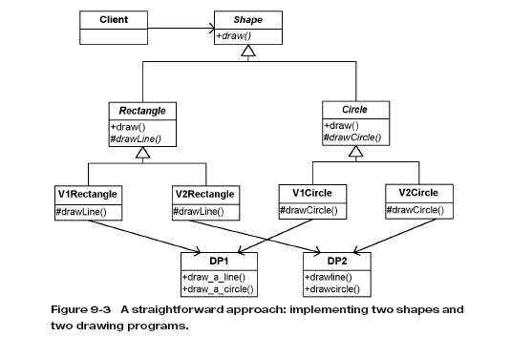
Example1
Notes:
29

Slide 30
Example1
The combinatorial problem
Look at the previous class diagram and pay attention to the third row of classes. Consider the following:
- The classes in this row represent the four specific types of Shapes that I have. What happens if I get another drawing program, that is, another variation in implementation? I will have six different kinds of Shapes (two Shape concepts times three drawing programs).
- Imagine what happens if I then get another type of Shape, another variation in concept. I will have nine different types of Shapes (three Shape concepts times three drawing programs).
Notes:
30

Slide 31
Example1
The class explosion problem arises because in this solution, the coupling abstraction (the kinds of Shapes) and the implementation (the drawing programs) are tightly coupled.
Each type of shape must know what type of drawing program it is using. I need a way to separate the variations in abstraction from the variations in implementation so that the number of classes only grows linearly
Notes:
31

Slide 32
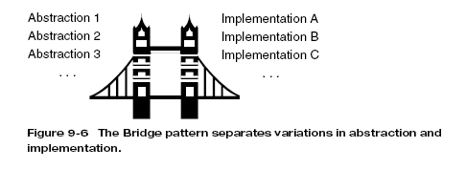
Example1
This is exactly the intent of the Bridge pattern: [to] de-couple an abstraction from its implementation so that the two can vary independently.2
Notes:
32

Slide 33
Example 1
Question: What else is poor about this design?
Does there appear to be redundancy?
Would you say classes have high cohesion or low cohesion?
Are classes tightly or loosely coupled?
Would you want to have to maintain this code?
Notes:
33

Slide 34

Example1
The characteristics of the problem fit this nicely. I know that I ought to be using the Bridge pattern even though I do not know yet how to implement it.
Notes:
34

Slide 35
Example1
You have to do two things first.
1- Commonality analysis
2-Variablity analysis
The common concepts will be represented by abstract classes , variations will be implemented by concrete classes.
Notes:
35

Slide 36
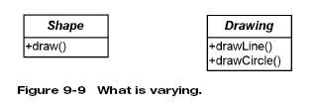
Example1
In this case we have different types of shapes and different type of drawing programs. So common concepts are shape and Drawing. So we encapsulate them
Notes:
36

Slide 37
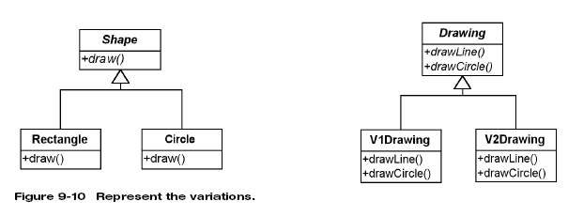
The next step is to represent the specific variations that are present. For Shape, rectangles and circles. For drawing programs,DP1 and DP2 respectively.
Notes:
37

Slide 38
Example1
Lets see if we can relate these classes by having one use the other. Two possibilities: either Shape uses the Drawing programs or the Drawing programs use Shape.
If drawing programs could draw shapes directly, then they would have to know some things about shapes in general: what they are, what they look like. But this violates a fundamental principle of objects: an object should only be responsible for itself.
It also violates encapsulation. Drawing objects would have to know specific information about the Shapes (that is, the kind of Shape) in order to draw them.
Notes:
38

Slide 39
Example1
Now, consider the first case. Shapes use Drawing objects to draw themselves. Shapes wouldn’t need to know what type of Drawing object it used since I could have Shapes refer to the Drawing class.
Notes:
39

Slide 40
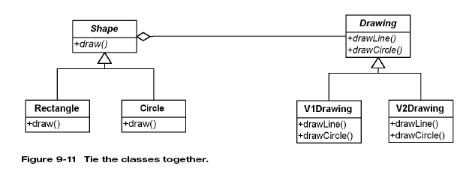
Example1
Notes:
40

Slide 41
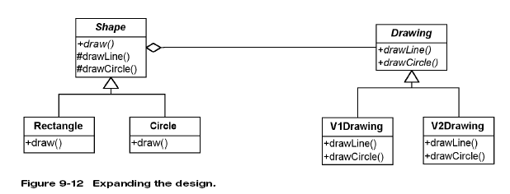
Example1
Added protected methods in shape that call methods in Drawing
Notes:
41

Slide 42
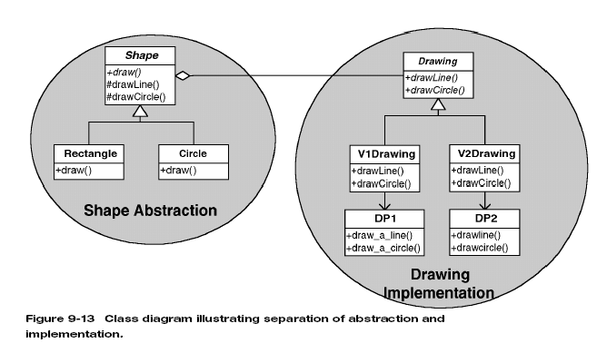
.
Notes:
42

Slide 43
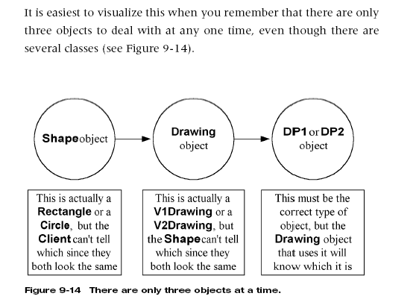
Notes:
43

