Slide 1
Wells Expert Committee (WEC) and IADC overview
Well Control and BOP discussion
IRF meeting 4th and 5th October 2011, Stavanger
Steve Cromar (WEC)
Steve Kropla (IADC)

Slide 2
Well engineering design and well operations management GIRG recommendations
A 3 tier-review process
Recommend to industry and regulators that they insist upon a “two (independent and physical) barrier” policy during the life of the well
The promotion of human competence management systems to ensure individual staff and management teams always have the skills they need
The promotion of a culture that fosters adherence to standards and procedures
Recognition of existing agreed standards – both international and national – as a baseline for industry improvements
New and improved technical and operational practices for the overall governance of well construction – under OGP direction

Slide 3
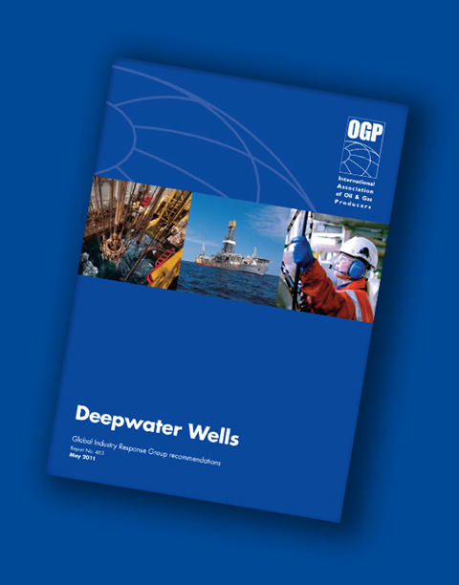
Progress – Wells Expert Committee
The WEC is an OGP standing committee and now consists of 30 experts from the oil & gas industry and service companies, who can call on each OGP member’s specific expertise if needed
Four task forces are working on:
Database of well incidents
BOP reliability and technology development
Human factors – training, competence and behaviours
International standards

Slide 4
Timeline – Wells Expert Committee
JUNE 2011: WEC founded following publication of the GIRG Deepwater Wells report
AUGUST 2011: WEC holds its third committee meeting and formalises the setup of four taskforces to deal with specific areas
OCTOBER 2011: WEC issues surveys and questionnaires to the industry to gather data and progress recommendations on training programmes
Q2 2012: WEC expects to report on progress

Slide 5
Progress – well control incident database
Objective:
To improve the sharing of lessons learned amongst OGP members relating to well control events
Well control events are considered to be:
  Uncontrolled flow of well fluids to the environment including flow to subsurface formations
  A closure of an element of BOP equipment due to loss of primary well control
  An incident or near-miss related to well control where the lessons learned could be of interest to other OGP members
  Or equivalent incidents

Slide 6
Progress – well control incident database
Deliverables:
  A process for collecting well control incident data from member companies
  The sharing of significant lessons learned in the form of a well incident alert
  A well control incident database which will be able to show trends
The schedule of the Task Force is to start sharing well incident events by end Q1 2012 and to have the database operational by end 2012

Slide 7
Progress – Human Factors Task Force – training, competence & behaviours
Objective:
Step change in competence & behaviours of Operations teams in well control for the global oil & gas industry
A clear challenge is how to influence our global industry
We are currently exploring the possibility of using the existing vehicle of well control training, examination & certification which influences worldwide wells teams from assistant driller upwards

Slide 8
Progress – Human Factors Task Force – training, competence & behaviours
Proposed strategy:
Implement behavioural change – e.g. crew resource management (MID 2013)
Competence assessment & assurance (MID 2013)
Maximum use of existing industry enhancements – e.g. OGP Sub-Com, WLCPF & IADC
Must be driven by operators, critical OGP role as the ‘voice of the industry’

Slide 9
Progress – international standards
Terms of Reference prepared
List of relevant API, ISO, NORSOK etc. standards drafted
WEC prioritisation of key standards offered to ISO/TC67
Propose OGP budget funding to support ISO standards work
OGP input to EU Commission workshop on standards
OGP input to IRF prioritised topic on standards and best practices

Slide 10
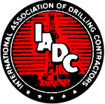
Progress – BOP reliability
Task team formed with members from manufacturers, drilling contractors and operators to identify BOP reliability and efficiency improvement opportunities
Opportunity to work closer with regulatory bodies to develop clear definitions and expectations regarding BOP reliability
Initial assignment: respond to IRF request to OGP and IADC to look into possibility of BOP evaluation to address reliability, integrity and vulnerability

Slide 11
Progress – BOP reliability
Two separate (but similar) surveys developed to lead effort on BOPs:
Operators – distributed/collected by OGP
Rig contractors – distributed/collected by IADC
As requested by IRF, these surveys will focus on:
Functionality (design review, testing procedures, modifications)
Integrity (secondary control systems testing, function and pressure testing, maintenance and repair)
Vulnerability (verification of function/activation, ability to maintain barrier)

Slide 12
Progress – BOP reliability
Intent of surveys is to establish benchmark of current “state of industry” regarding BOPs, gauge efforts undertaken in response to recent events
Information collected through the surveys will serve as starting point to determine pathway forward for refinement and improvement to BOP systems and further WEC BOP Reliability Task Force activities and recommendations

Slide 13
Progress – Wells Expert Committee
A further general survey for promoting the work of the WEC and the GIRG Deepwater Wells report is currently undergoing final review/approval process
Assistance in forming the questionnaires by leading academics

Slide 14
Key conclusions
Action on prevention will yield the most effective outcomes
Implementation of GIRG recommendations by OGP member companies and associate members will improve industry prevention and intervention capabilities – and OGP will encourage their wider adoption.
An on-going commitment from the industry is required to work together for continuous improvement in skills development, competence and a culture of compliance.
Active co-ordination and collaboration with NOIAs, the MWCC Project, other private contractors and various international entities is essential.

