Slide 1
2011 International Regulators Offshore Safety Summit Conference Global perspective: International Association of Oil & Gas Producers (OGP) Joep Coppes, Vice Chairman OGP 4th October 2011
Notes:
Good morning, ladies and gentlemen. It is my pleasure to be here today and I would like to thank the organisers for the opportunity to speak at this very important conference.
My name is Joep Coppes and I am vice-Chair of the International Association of Oil & Gas Producers, OGP. I have been working in the industry for 25 years and am an engineer by background. My day job is VP of European Production for Shell.
Today, we will hear how industry, safety regulators and international organisations have been working to improve offshore safety in response to accidents such as Macondo and Montara.
What I would like to do over the next 20 minutes is to update you on what the global industry has been doing in this area since the findings of OGP’s Global Industry Response Group (GIRG) were published in May of this year.
In particular, I want to demonstrate how the industry has improved in three areas:
Prevention
Capping & containment
Oil spill response
I’ll be happy to take any questions at the end.

Slide 2
OGP background
More than 70 members around the world
Integrated oil & gas explorers/producers
Small independent oil & gas companies
National oil companies
Service sector companies (associate members)
15 national and other associations
Including APPEA, API, IADC, IPIECA, OLF, NOGEPA, IBP, O&G UK
Based in London with an EU office in Brussels
Notes:
Although known to most of you, let me briefly provide some background on the Association and the Global Industry Response Group – or GIRG.
OGP is an upstream organisation with members from oil & gas producing companies, service sector companies and national and other associations – including IADC, Oil & Gas UK, OLF, NOGEPA and APPEA. All are represented here today.

Slide 3
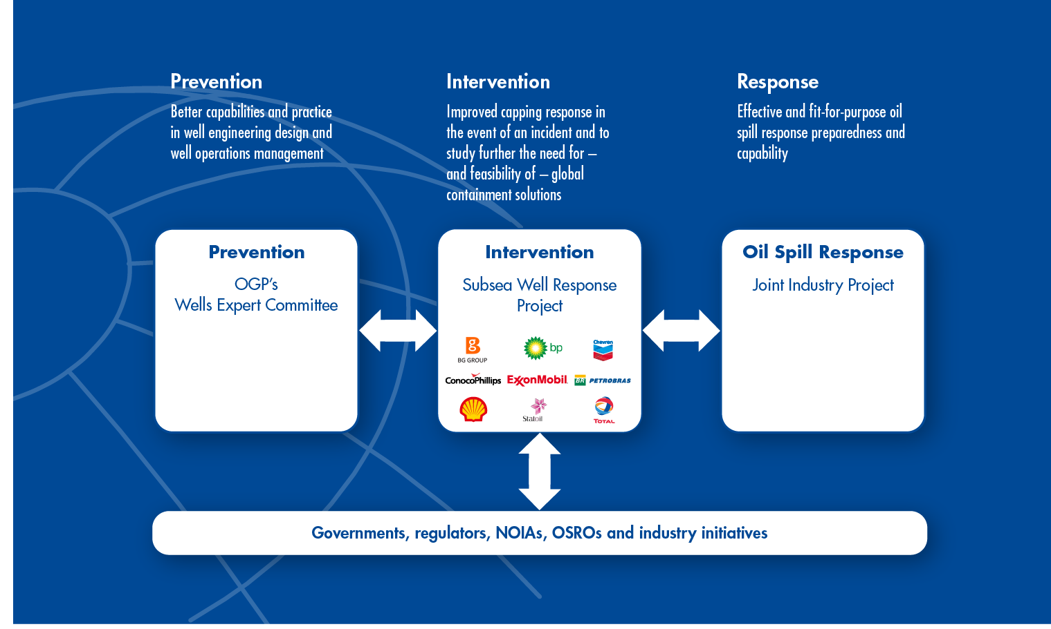
Recommendations Global Industry Response Group (GIRG)
Notes:
In May 2011, the GIRG’s three technical work groups published their findings on well incident prevention, intervention and response.
The first team made recommendations for better capabilities and practice in well engineering design and operations management. This included a 3-tier review process of well design (drilling, independent, regulator) and a 2-barrier policy. To work out these recommendations on well incident prevention the Wells Expert Committee (WEC) was formed by OGP.
The second team made recommendations in the areas of capping, subsea dispersant hardware and further study into containment solutions. As a follow up the Subsea Well Response Project (SWRP) – a non-profit consortium of nine leading oil and gas companies was formed in Feb 2011. Its remit is to improve capping response and study the need for and feasibility of containment solutions.
And in the area of oil spill response, a specialist team recommended reinforcing the effectiveness and value of dispersants and enhancing existing recommended practices for in situ burning. This third post-GIRG entity is the Oil Spill Response Joint Industry Project. This will advance the GIRG recommendations on oil spill response preparedness and response capability.
What I will focus on today is how these recommendations are being taken forward and by whom.

Slide 4
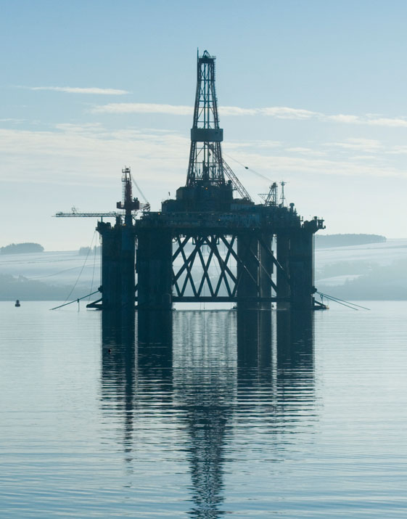
Wells Expert Committee (WEC)
Four task forces are working on:
Database of well incidents
BOP reliability and technology development
Human factors – training, competence and behaviours
International standards
On-going liaison with relevant bodies such as API, IADC, ISO, OSPRAG and WLCPF Competence Task Forces
Notes:
Let me first touch on OGP’s new Wells Expert Committee (WEC). We formed this to advance the GIRG’s recommendations on well incident prevention.
As you will hear a full summary tomorrow of the WEC’s activities from Steve Cromar, OGP’s WEC Chairman, with your permission, I’ll just outline the four key areas which the Committee is working on….
Database of well incidents
BOP reliability and technology development
Human factors – Training, competence and behaviours
International standards
The WEC will of course also promote the recommendations in the GIRG Deepwater Wells report.

Slide 5
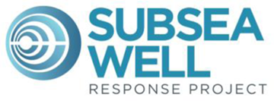
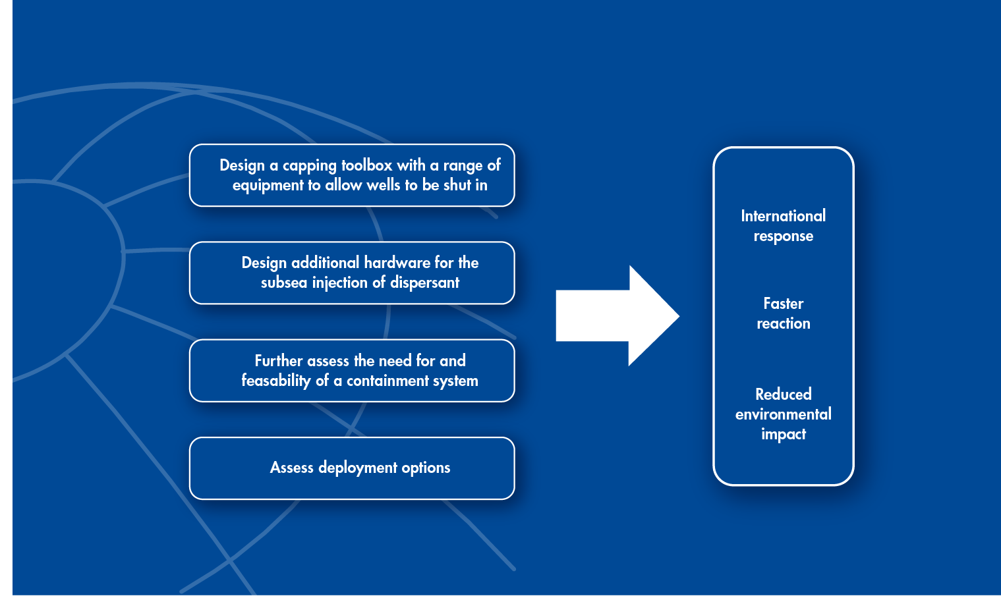
Subsea Well Response Project
Notes:
Now, let’s focus on the Subsea Well Response Project (SWRP).
The Macondo and Montara incidents demonstrated to a wider public the length of time required to effectively control a flowing well. Understandably, the expectation now is that the industry works together to ensure any future incident should be controlled faster and more effectively.
So, to improve the industry’s capping response readiness – in a range of diverse regions around the world – nine leading oil and gas companies formed the SWRP.
Participants are: BG Group, BP, Chevron, ConocoPhillips, ExxonMobil, Petrobras, Statoil, Total with Shell as the Operator. The team is located in Stavanger.
In achieving its objectives, the SWRP is guided by four important principles, all of which encompass today’s theme: working together to improve offshore safety. These are:
To recognise that prevention is paramount
To work together with the wider offshore industry and regulators
To enhance industry’s response capabilities
To be able to respond rapidly on an international scale
The project team has been working on all these areas. Let’s see where we are on each.

Slide 6
SWRP progress to date
Capping requirement
Able to seal on surface of the well & stop the flow of hydrocarbons from the well
Allows well kill operations when set up with a spool equipped with side outlets to kill, choke and/or divert
To be designed to be transportable by air
Dispersant requirement
Subsea dispersant application is a key part of subsea well response
Provides for safe working environment for responders on the surface
Reduces shoreline impacts
SWRP to pursue design of subsea components of a dispersant injection system
Notes:
In this phase of this project we are focussing on existing capabilities and designing new equipment. Based on the requirements you see here, work is on-going to develop a flexible capping toolbox with dispersant application. This will enhance international response capabilities.
Meanwhile, SWRP is also assessing various deployment options for the maintenance and operation of the equipment that it will develop/purchase/include. I am not sure yet what this deployment organisation will look like, but it could be for example a new organisation, or bringing activities under an existing commercial organisation or under a not-for-profit organisation.
SWRP has also made progress with suppliers on the design of the capping and dispersant hardware toolbox . SWRP is planning to decide on possible next phases towards the end of this year.

Slide 7

Oil Spill Response Joint Industry Project
Nineteen work streams identified in original GIRG process
Legal structure of ‘OSR – JIP’ defined
Fourteen companies have joined the JIP, others likely to follow
Interfaces with SWRP and API established
Work started on:
Developing industry “best practice” OSR series
Dispersant logistics & supply chains for subsea
Understanding how OSR model differs for offshore vs. shipping
Notes:
And the third group out of GIRG is looking into the recommendations on the oil spill response side. This is executed through a Joint Industry Project.
The founding principle of the OSR-JIP is to improve co-ordination among:
Key stakeholders such as oil spill response organisations (OSROs)
Governments; and
Operating oil and gas companies
We want to be inclusive in this, taking in all representative bodies around the world.
To date, 14 OGP and IPIECA members have joined the project. We expect more will follow and work has already begun on working the recommendations made by GIRG.
Key to ensuring the global relevance of this work will be collaboration with groups such as the SWRP project in Stavanger and API in Washington.

Slide 8

OSR-JIP progress to date
Dispersant logistics & supply chain
Joint SWRP /OSR – JIP co-operation
Define target well population
Develop an integrated, generic, and common response model
Develop a proposal for optimised stock volumes & locations and a re-supply plan/model(s)
Modelling offshore response capability
Significant differences in regulatory approach, with varying focus – and understanding – on risk vs. hazard
A better understanding of how response preparedness requirements for the offshore (static risk/variable & potentially large volume) differ from the existing shipping model (mobile risk & finite volume) is needed
Notes:
Key areas of work are to:
Define the target well population that would be protected by subsea dispersant application
Develop an integrated, generic, and common response model identifying activities across the well response-oil spill response spectrum
Develop a proposal for optimised stock volumes & locations; and
Develop re-supply plan/model(s) for the stocking plan above
And to tackle the wide variations in offshore response capability globally, work is also underway on modelling offshore response capability.

Slide 9
Key conclusions
Action on prevention will yield the most effective outcomes
Implementation of these recommendations by OGP member companies and associate members will improve industry prevention and intervention capabilities
An on-going commitment from the industry is required to work together for continuous improvement
Active international co-ordination and collaboration is crucial, as is a seamless approach to prevention by operating and drilling companies alike
Notes:
So, let me conclude by returning to today’s theme: working together to improve offshore safety.
In developing the GIRG’s recommendations, OGP actively sought the input of industry regulators and trade bodies. That was to ensure the recommendations were fully compatible internationally and harnessed existing good practices. So we are already on the right track.
And the WEC, SWRP and OSR-JIP will continue – as they are now – to work closely with regulators, national oil industry associations and other stakeholders to further develop these initiatives.
Examples include the 3-tier review process recommended by the WEC and the principles on dispersant use and facilitating regulatory licensing to permit such implementation.
But in closing, I’d like to make a plea:
It is my firm belief that all of us in the room have a responsibility to ensure the safety and integrity of our operations across the globe. And so it is up to all of us to continue to work together to enhance our ability to prevent incidents – and respond effectively, in the unlikely event that an incident does occur.
If we assume these responsibilities collectively, share the primary objective of prevention, then we will demonstrate that all of us have learned the lessons of earlier incidents.
Many thanks for your attention.

Slide 10
Acronyms
API – American Petroleum Institute
APPEA – Australian Petroleum Production & Exploration Association
IADC – International Association of Drilling Contractors
IBP – Brazilian Petroleum Institute
IPIECA – The global oil and gas industry association for environmental and social issues
ISO – International Organization for Standardization
MWC Project – Marine Well Containment Project
NOGEPA – Netherlands Oil and Gas Exploration and Production Association
O&G UK – Oil & Gas UK
OLF – Norwegian Oil Industry Association
OSPRAG – Oil Spill Prevention and Response Advisory Group
WLCPF – Well Life Cycle Practices Forum

Slide 11
Thank you
www.ogp.org.uk

