Slide 1
OSPAR's Activities on the Prevention of Significant Acute Oil Pollution from Offshore Drilling Activities and Associated International Developments

Slide 2
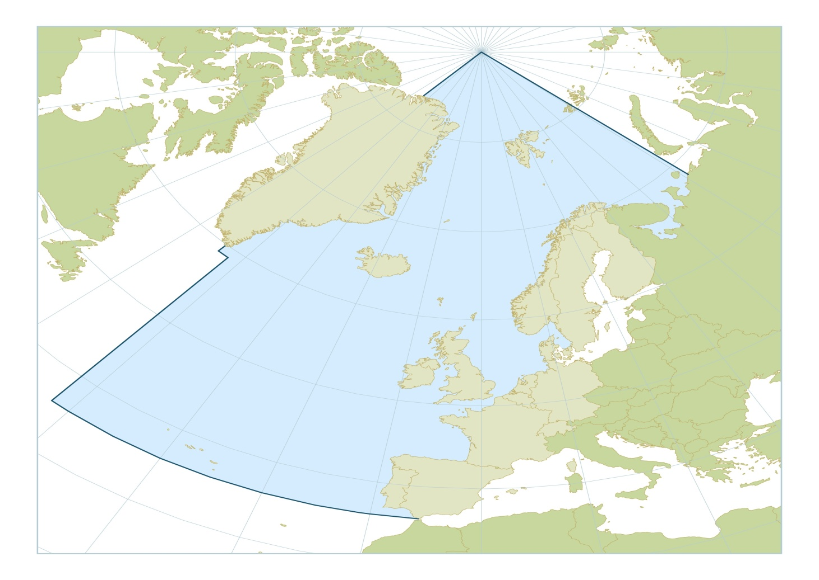
OSPAR Convention Area (in blue)

Slide 3
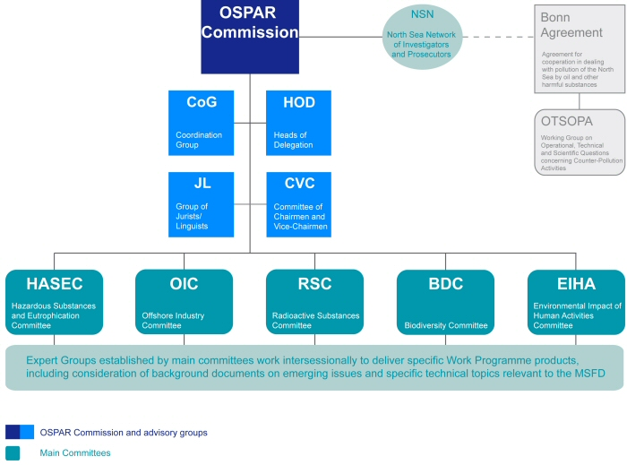
OSPAR Structure

Slide 4
Who are the Contracting Parties?
Belgium, Denmark, Finland, France, Germany, Iceland, Ireland, Luxembourg, The Netherlands, Norway, Portugal, Spain, Sweden, Switzerland and United Kingdom, together with the European Community.

Slide 5
What is the purpose of the Convention?
“The Contracting Parties shall, in accordance with the provisions of the Convention, take all possible steps to prevent and eliminate pollution and shall take the necessary measures to protect the maritime area against the adverse effects of human activities so as to safeguard human health and to conserve marine ecosystems and, when practicable, restore marine areas which have been adversely affected.“

Slide 6
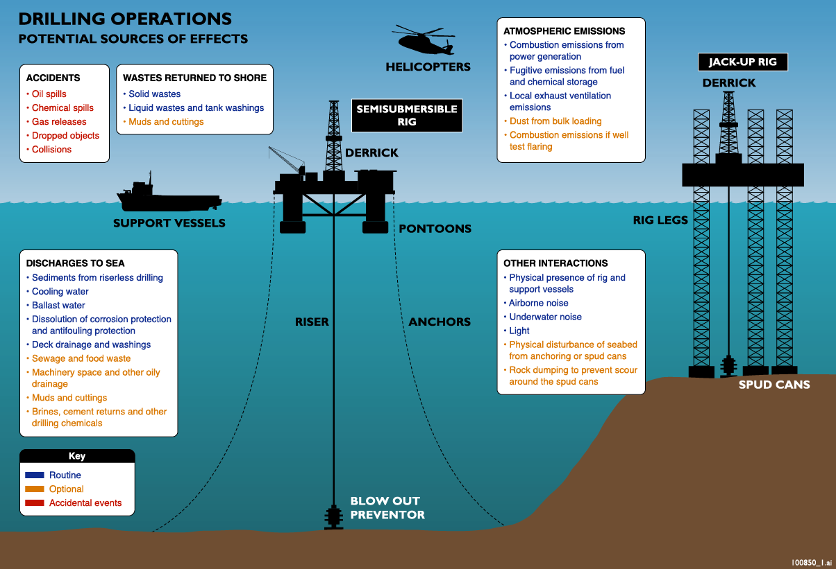
Notes:
Secondly drilling operations
Currently about 30 mobile rigs operating on the UKCS
Activity levels are high with about 60 exploration and 240 development or production wells drilled each year
90% of this activity is in the more mature areas of the North Sea
Major environmental issues are the physical presence of the rigs and drilling discharges

Slide 7
The incident
The Deepwater Horizon Drilling rig suffered a catastrophic blowout on the 20th of April 2010.
11 men lost their lives and an estimated 4.9 million barrels of oil were spilled.

Slide 8
The investigations / reviews
Several processes were initiated internationally to both check the current fitness of offshore regimes and, where appropriate, to initiate improvements with the objective of avoiding a reoccurrence of such a tragic event both in the United States and elsewhere

Slide 9
The investigations / reviews
The American Presidential Commission.
The US Joint Investigation Team of the Departments of the Interior and Homeland Security (USCG/BOEMRE).
The North Sea Offshore Authorities Forum (NSOAF).
The International Regulators Forum (IRF).
The European Union
G20

Slide 10
European Union
EC issued Communication “Facing the challenge of the safety of offshore oil and gas activities” in October 2010.
Specific Commission proposals expected later this year.
European Parliament debated, and rejected, calls for a moratorium on deep drilling in October 2010.
Council of Ministers published conclusions of the safety of offshore oil and gas activities – December 2010
European Parliament held a hearing on safety of offshore oil and gas in March 2011.
Report (Motion) prepared by Energy / Environment committees of EP and voted through on 13th September 2011.

Slide 11
OSPAR process
September of 2010 meeting of the OSPAR Commission and an OSPAR Ministerial meeting in Bergen, Norway.
Meeting discussed possible moratoria but there was no general support for such a move. Ministers agreed on an OSPAR Recommendation 2010/18 “On the prevention of significant acute oil pollution from offshore drilling activities“.
This Recommendation called for reviews by contracting parties and established a process for assessing the relevance of the Deepwater Horizon incident for the existing OSPAR framework for the offshore industry, both nationally and internationally.

Slide 12
Relationship between OSPAR and other processes
At the OIC meeting in March 2011 Contracting Parties agreed that:
There was a need to avoid duplication of work carried out in the EU or in forums such as NSOAF and the G20 and that OSPAR should concentrate on possible gaps.
While the activities of other forums would be relevant to OSPAR, they should not pre-judge any decision to be taken by OSPAR.
There was a need to work closely with authorities responsible for emergency prevention, preparedness and response (e.g. the Bonn Agreement) taking into account environmental risks and the sensitivity of marine ecosystems to oil pollution.

Slide 13
What is expected?
An Intersessional Correspondence Group – ICG DRILLEX is to assess the results of investigations of drilling in extreme conditions and their relevance to potential environmental impacts
The terms of reference for this group are to present to OSPAR 2012:
a report based on Contracting Parties national reviews following the Deepwater Horizon accident;
a report based on external reviews including the North Sea Offshore Authorities Forum (NSOAF), European Commission, the International Regulators Forum (IRF) and the USA Presidential investigation; and
based on a and b, an assessment of their relevance to OSPAR with a view to taking additional action if needed.

Slide 14
OSPAR process
OSPAR’s Offshore Industry Committee (OIC) 2011 concluded in early March that further work would be needed in order to take on board any findings from other investigative processes. Considered but did not reach agreement on the idea of OSPAR Guidelines.
Preliminary report “Investigations of Drilling in Extreme Conditions and their Relevance to Potential Environmental Impacts” prepared. This report was presented to OSPAR 2011 in June.

Slide 15
OSPAR process
DRILLEX examined CPs procedures / regulations for:
Rig assessment
Well design and control
Incident prevention
Contingency planning – scenarios / environmental risks / preparedness
Incident response – training / equipment / personnel
Defining “extreme conditions” or “high risk”

Slide 16
OSPAR process
DRILLEX preliminary report indicated and documented that a substantial amount of work had been undertaken by CPs in their own national review process but that more time would be needed to consider the outputs of some of the ongoing national and international processes.
OSPAR Commission agreed that DRILLEX continue its work and will hold a meeting to assist this process on 11th October 2011.
Objective of the work is to:
“evaluate the need for, and suggest a way forward regarding possible new OSPAR recommendations, guidelines or other types of actions/measures.”

Slide 17
OSPAR – future work and challenges
As indicated, contracting parties will meet next week to continue the work of DRILLEX.
Challenges will include:
How to add value without duplicating other processes
To what extent OSPAR, which is a convention for the protection of the environment, should involve itself in safety issues.
How it is possible to protect the environment without involving itself in safety issues to some extent!
If a measure is proposed resulting from the process, what form should it take – voluntary Agreement or Recommendation or binding Decision.

Slide 18
OSPAR and global approaches
OSPAR is one of several regional conventions. For example the Helsinki and Barcelona conventions cover the Baltic and Mediterranean seas respectively.
The 2011 OIC meeting involved representatives from the Mediterranean and provided an opportunity to exchange information and experience on offshore oil and gas activities in both Regional Seas Conventions.
However, one reason that separate Conventions exist is that different regions may have different environmental sensitivities, cultural and regulatory backgrounds. Oil spilled in the Arctic provides different challenges to oil spilled in the warmer waters of more southerly latitudes.
Any global initiative should recognise the competence and experience of the regional conventions in its consideration of potential measures.

Slide 19
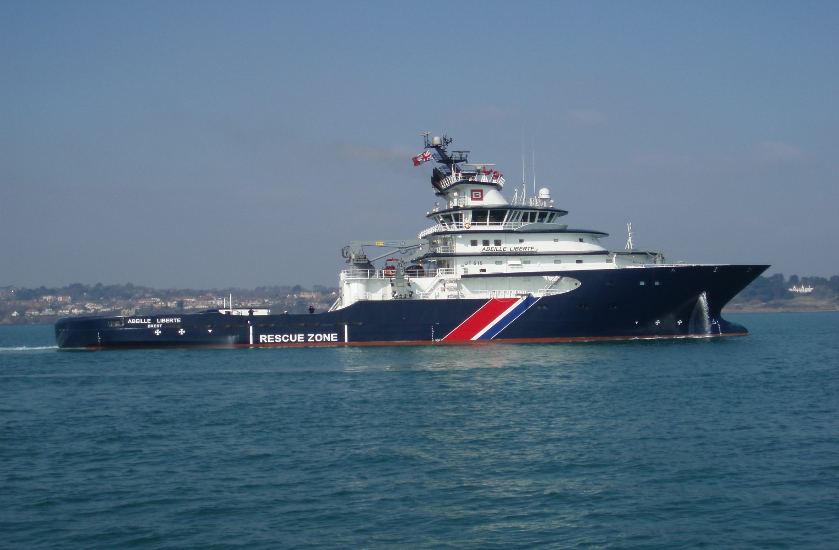
International Co-operation
Bonn Agreement – North Sea States
intergovernmental co-operation dealing with
pollution and in particular aerial surveillance
co-ordination
Mancheplan - France and UK
provides for a joint response to SAR and
counter pollution activities
NORBRIT – Norway and UK
Joint response, is more focused on counter
pollution.

