Slide 1
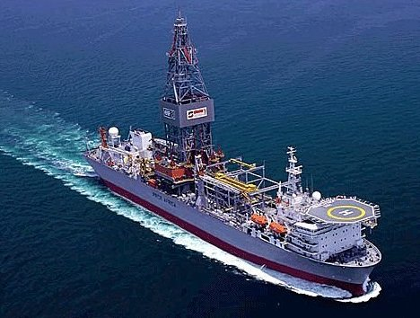

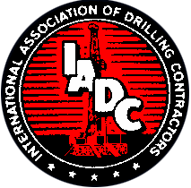
IADC Global Perspective
IRF Offshore Safety Summmit Conference
Stavanger, 4th October 2011
Steve Kropla, Group Vice President – Operations & Accreditation
International Association of Drilling Contractors

Slide 2
Worldwide Membership
Founded in 1940, today IADC represents drilling contractors, oil and gas producing companies and manufacturing and service companies worldwide and is truly a multinational organization.
  Drilling & Well Servicing Contractors - 420
  Producers (including National Oil Companies) - 62
  Oilfield Service & Supply Firms - 996

Slide 3
IRF Invitation
What has IADC, on behalf of the drilling industry, done so far?
What will IADC be doing in the coming year or so?
What are the five most important topics for improvement for the drilling industry, and what are the obstacles?
What do you expect from IRF/regulators and other stakeholders?
What do they think of differences in the safety/environmental approaches between the drilling and operating industries, and what should they learn from them?

Slide 4
What has IADC done?
  Participation in Producer Initiatives
      API Joint Industry Task Force
      OGP Wells Expert Committee
    Participation in Governmental/other activities
      US Congressional inquiries
      Chemical Safety Board inquiry
      National Academy of Engineering
      National Commission on BP Deepwater Horizon Oil Spill and Deepwater Drilling
      G20 Global Marine Environmental Protection Group

Slide 5
What has IADC done?
IADC HSE Case Guidelines updated December 2010 to address enhancements with respect to:
  Bridging arrangements
  Particular risks of deepwater wells
  Evaluation of routes used to access TSRs (if provided) and evacuation systems

Slide 6
What has IADC done?
Revised IADC WellCAP Supervisory Curriculum
  Increased simulator use to minimum 30% course time
  Increased focus on warning signs
  Reformatted to include learning objectives and key points/comments for individual topics

Slide 7
What has IADC done?
Other WellCAP refinements/activities
  SWAT audits in 2010 of all US training providers; expanded on global basis
  Tighter Instructor qualifications for initial approval
  New requirements for instructor requalification
  Clarification of testing requirements
  Elimination of “grace period”

Slide 8
What has IADC done?
Initiated dialog with Cuba regulators & industry
  Goal is to share industry best practices on well control, spill prevention & cleanup
  Cubans participated in panel at IADC Environmental Drilling Conference
  Two IADC delegation visits thus far

Slide 9
What has IADC done?
API/IADC Bulletin 97 -- Well Construction Interface Document (WCID)
  Traditional HSE-MS bridging arrangement plus:
    Well basis of design
    Well execution plan
    Critical well activity risk assessments
Balloting closed 3rd Oct; issued by year-end?

Slide 10
What will IADC be doing?
Further updates to HSE Case Guidelines
  Evacuation & escape routes
  Reference drawings & schematics
  Design & commissioning of new facilities
  Additional guidance on management of change
  Explicit consideration of regulatory requirements as part of the audit process
  Consideration of audit results and records retention
  Selection of contractors

Slide 11
What will IADC be doing?
Additional WellCAP Curriculum Revisions
  Fundamental Drilling course
  Workover Supervisor (will include Fracking)
  Workover Fundamental
  Wireline
  Coiled Tubing Simulation standards
  Consideration of annual retraining requirements

Slide 12
What will IADC be doing?
International Alliance for Well Control (IAWC)
  Revival of joint effort with IWCF
  Terms of Reference agreed
  Work on Operating Agreement proceeding
  Targeted pilot to begin Norway Jan. 2012

Slide 13
What will IADC be doing?
Revision of IADC KSAs
  Guidance document on knowledge, skills and ability
  Update for more specific competency assessment
  New focus on specialized positions (i.e., Subsea Engineers)

Slide 14
What will IADC be doing?
International Maritime Organisation (IMO)
  Amendments to the 2009 MODU Code
  Revision of resolution A.891 on Training of MOU personnel

Slide 15
What will IADC be doing?
Focused dissemination of information on regulatory and standards-setting initiatives and relevant joint industry projects
General dissemination of information through website and conferences

Slide 16
“Top 5” topics and obstacles
Organizational Learning
Transparency and Information Sharing
Integration of HSE Management Systems
Competence and Training
Effect of New-Builds

Slide 17
“Top 5” topics and obstacles
Organizational Learning
    Despite the broad dissemination of information made possible by the internet, there remain many barriers to spread and uptake of information (horizontally) and to its penetration (vertically).
    Companies are challenged by information overload to effectively apply lessons learned.

Slide 18
“Top 5” topics and obstacles
Transparency and Information Sharing
  It remains to be seen whether companies are making information on incidents more readily available, or if governments are improving their dissemination of information (this is not to say that some aren’t already doing an excellent job).

Slide 19
“Top 5” topics and obstacles
Integration of HSE Management Systems
API/IADC Bulletin 97 provides excellent guidance on risk-communication and integration of HSEMS; however, the guidance is focused on deepwater activities regarding U.S. regulatory objectives.
Similar guidance, with global perspective, should be developed in order to facilitate development of appropriate national guidance for countries other than the United States.

Slide 20
“Top 5” topics and obstacles
Competence and Training
  Post-Macondo expectation that organizations must have in place the tools to assure the competence of their personnel.
  However, the effort to develop industry-agreed standards for competence and competence assessment is having difficulty gaining traction.
  Possible reasons: “The big crew change”, an historic focus on training and competence at a business unit, national, level, and differing philosophies prioritizing efforts amongst organizations and regulatory bodies.

Slide 21
“Top 5” topics and obstacles
Effect of New-Builds
Number of new rigs under construction, many with advanced technological capabilities, will further challenge companies to train and maintain skilled crews.
This may reach critical levels for certain highly-specialized rig positions (i.e., Subsea Engineers).

Slide 22
Expectations from IRF/stakeholders
If IRF members should ensure that the initiatives they pursue have a global focus.
IRF members, and other national regulatory bodies, need to become/remain engaged in the international standards-setting efforts. In doing so, they should clearly articulate their views (preferably shared views) regarding the prioritization of standards-setting efforts.
If perceived legal impediments to industry’s sharing of incident information cannot be overcome, IRF members and other regulatory bodies should work aggressively to investigate incidents and place their learning from incidents in the public domain.

Slide 23
Approaches between drilling/operating
In general, safety is approached (both by operators and drilling contractors) with broad goals of ‘keeping people safe’ while environmental approaches are very compliance oriented.
There is little incentive for an operator to assure that contracting organizations truly understand the risks to which they are being exposed under a contract. Some may seek to transfer their exposure to the risk and seek indemnification of any residual liabilities through contract terms and/or insurance.

Slide 24
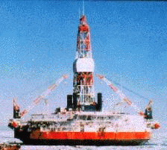

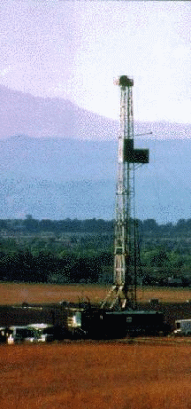
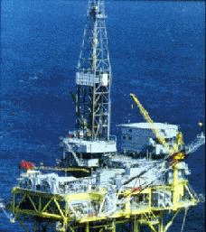
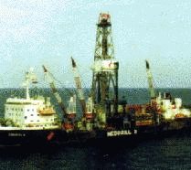
Global Leadership for the Drilling Industry
http://iadc.org

