Slide 1
North Sea Safety Regulators responses to Macondo/Montara
IRF Summit Conference, October 2011
Steve Walker
Head of Offshore Division
UK Health & Safety Executive (HSE)

Slide 2
North Sea Regulators responses to Macondo & Montara incidents
Introduction
Summarise what regulators have done so far:
    Political responses
    Working with industry
    Regulatory/supervision actions
    Capturing lessons from GoM investigations
Response of North Sea Offshore Authorities Forum (NSOAF)
Regulatory authority priorities for the future
Way forward

Slide 3
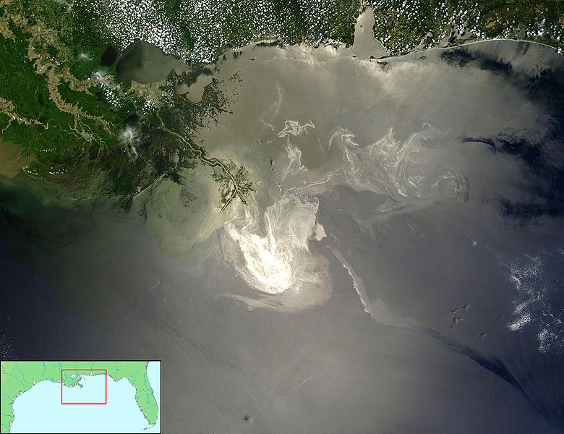
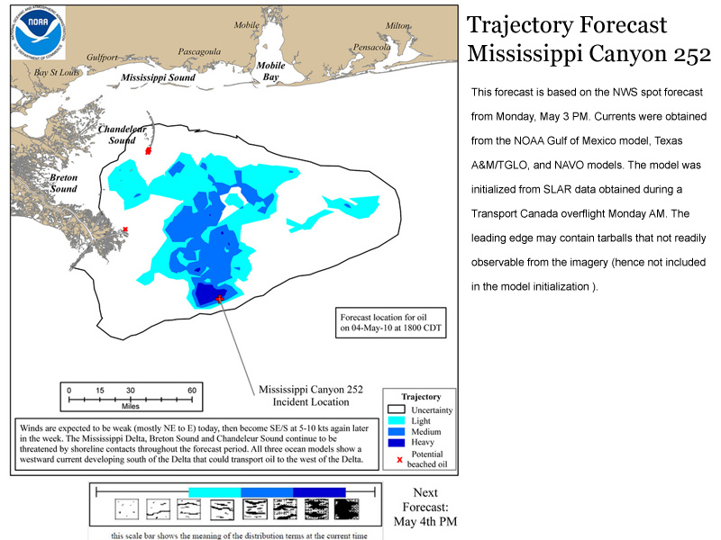

Slide 4
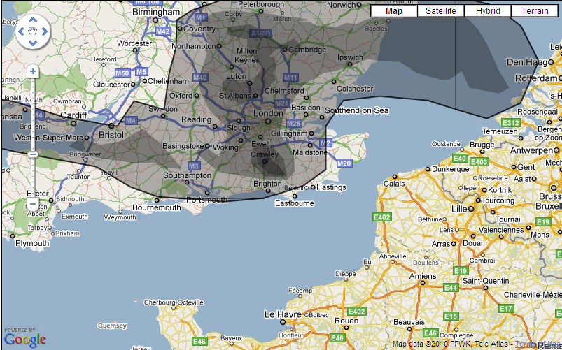
Release of 4.9 million barrels of oil
(170 million gallons)
Notes:
One barrel of oil = 159 litres = 35 gallons

Slide 5
Initial political reaction in North Sea
Montara – little notice apart from specialist press
Macondo - first few days, interest was relatively narrow, BUT…..
Media and political attention quickly developed:
  Waking up of European public awareness of environmental oil spill consequences within the “enclosed” North Sea
  Public/press realisation of deep water drilling by Norway and UK in the North Sea
  In UK, focus on BP as a “British” company in USA
  Growing sophistication of media stories, Greenpeace activities etc
  Appreciation of financial and economic aspects - > moved to the financial pages!
  Wide political interest aroused

Slide 6
Regulatory response
General high demand for regulatory reassurance by Ministers/politicians
In UK:
    high level of questions raised in Parliament and by Ministers
    a special “Select Committee” of MPs created to assess need for moratorium of deepwater drilling in UK
    a formal independent review of UK’s offshore regulatory regime
In NL & N
    Similarly high interest from their Parliaments/Ministers/Media, but no political initiatives
In DK
    Political discussion, and Ministerial interest in DEA Review, but no call on specific action
    n. DK initiatives: Minister was informed about authority’s result of review and assessment.

Slide 7
Regulatory response
In general, North Sea national regulators had to rapidly reassess whether their existing regimes in the North Sea were robust
Compared and contrasted North Sea –v- Gulf of Mexico:
    Mature, goal setting safety regime, built on lessons from Alexander Kielland, Piper Alpha etc
    Established Safety Case or equivalent regime within European offshore legislation
    Safety culture/work force involvement in North Sea
Notes:
Alexander Kielland, 1980: 123fatalities
Piper Alpha 1988: 167 fatalities
Ekofisk 1977: first blowout, up to bbls

Slide 8
Examples of initial responses by regulators
Subsequently, measured approaches by North Sea regulators. For example:-
NL wrote to all operators, and initiated a self assessment of drilling operations by operators against the initial Salazar Recommendations from U.S.
N engaged with industry to get industry action on improvement measures.
  PSA in-house project on industry causes and areas of improvement, with an interim report in June 2011.
  Seminar arranged 23 September 2011 where all stakeholders participated.
UK reinforced existing approach, plus:
  Increased well control assessment during MODU offshore inspections
  Increased “peer review” of well integrity decisions, particularly deepwater wells (>300 metres)
  Increased liaison and joint inspections with offshore environmental regulator
  Fully involved in OSPRAG
  Feedback to UK tri-partite Oil Industry Advisory Committee (OIAC)
DK undertook inspection campaign on BOPs, particularly 3rd party maintenance
  Also discussion in DK tri-partite forum (Trade Unions, Industry and Authorities).

Slide 9
Regulators response (continued)
North Sea regulators also worked closely with industry – previous presentation highlighted NOGEPA, OLF and OSPRAG initiatives, all fully supported by their national regulators
    …but expected that developed guidelines and actions etc would be implemented!
    …and will be monitoring outputs!
Established mechanisms to analyse reports arising from the U.S. (and Montara) to learn lessons – e.g. UK Deepwater Horizon Internal Review Group, Norway PSA Project Team, Denmark DEA review of reports and subsequent assessment of regulations and enforcement.

Slide 10
Safety regulator coordination with environmental regulators
Macondo stimulated improved coordination between safety and environmental regulators – few North Sea countries have joint regulators or regulatory systems
    UK increased liaison and improved Memorandum of Understanding between HSE & DECC
    NL initiated a steering committee for improving the emergency response (by both industry and government) - SSM/Maritime Authorities/Industry
    DK: Close cooperation between safety authorities (DEA), environment authorities (DEPA) and maritime authorities has been in place long before Macondo. Follow-up on Macondo a joint initiative.

Slide 11

North Sea Offshore Authorities Forum (NSOAF)

Slide 12
NSOAF AIMS AND OBJECTIVES
Founded in 1989, NSOAF members are :-
Denmark
Faroe Islands
Germany
Ireland
Netherlands
Norway
Sweden
United Kingdom
Exchange information, examples of best practice and lessons learnt from incidents
Develop common positions and joint initiatives
Reduce the difficulties due to differences in regulatory regimes and requirements

Slide 13
NSOAF
Regional forum for sharing responses to Macondo
Used Wells Working Group to take forward issues:-
    Cross checked NOIA/ regulator initiatives against failures identified in U.S. reports
    Identified issues which lacked or needed more attention
    Concluded regulatory regimes are fundamentally sound
    Main outstanding concerns:
      Human Barriers (values/beliefs/competency)
      Organisational Barriers (safety culture/ supervision/competency assurance)
    Proposed multinational audit in North Sea on blowout prevention focussing on Human and Organisational factors

Slide 14
NSOAF and the European Commission
Deepwater Horizon initiated significant ramping up of European Commission interest in offshore matters
Key areas being
    Relative comfort in North Sea regulation, but concern about Mediterranean and Black Sea
    Liability issues
    Adequacy of cross-Europe oil spill response
    Transparency /openness issues
European Commission communication in October 2010 set out their views on way forward
NSOAF working with the European Commission as it develops proposals for strengthening offshore oil & gas regulatory regimes set out in European law – more later from Jan Panek.

Slide 15
What are the North Sea regulators priorities for the future?
Things are now different! More challenging environment (for regulators and industry alike), especially deep water
Real need to learn from Macondo/ Montara – still awaiting CSB report (key for “why” rather than “how”)
Ensuring industry continue to take forward and implement improvements
Human and organisational factors in drilling
Improving coordination of safety and environmental issues
Improved consistency of regulation within the North Sea by continuing regional cooperation between regulators
Respond to drives for greater transparency

Slide 16
North Sea “pillars” for acceptable regulation of offshore safety standards
1. The legislative and standards framework
    Those who create the risk must manage them
2. Strong and competent regulator
    Constructively, and robustly challenges the risk creators
    Targeted, proportionate, consistent and transparent approach
3. A committed industry
    Understands and buys into the regulatory framework
    Delivers obligations effectively and consistent
    Creates a safety culture
    Engages with those exposed to risk – the workforce

Slide 17
Way forward
We must all learn the lessons from Macondo and Montara
Multiple barriers breached = change any feelings of invulnerability -> “chronic unease”
“Most of the mistakes and oversights at Macondo can be traced back to a single overarching failure – a failure of management.”
Concentrate on all three “pillars” together:
    Framework of legislation and standards
    Strong, competent, effective regulators
    Commitment of industry and its workforce.
Notes:
Lessons for operators, contractors and regulators
Multiple barriers broached – any one of which could have prevented the blowout

