Slide 1
String Project
От Борис Милев, Желязко Иванов, Стойчо Димитров и Мартин Бакалов

Slide 2
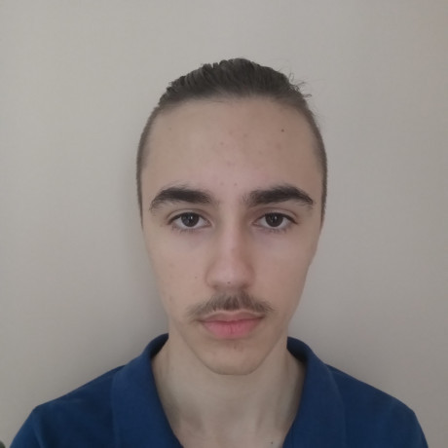
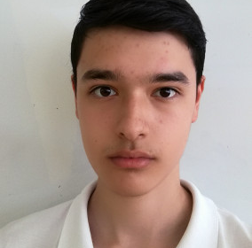

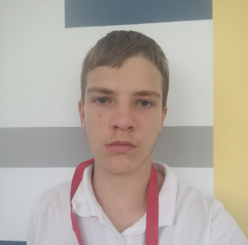
Our team
Scrum trainer – Boris Milev
Developer back end – Zhelyazko Ivanov
Developer front end – Stoicho Dimitrov
Code checker – Martin Bakalov

Slide 3


Used technologies
C++
Visual studio

Slide 4
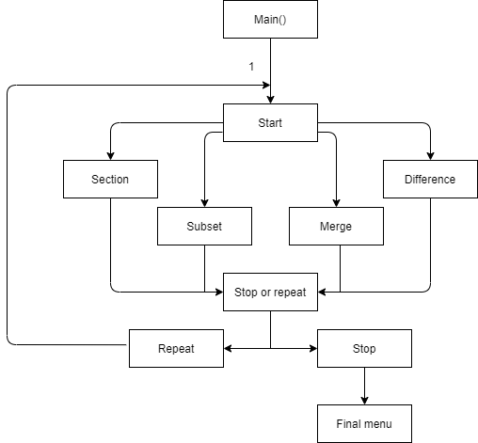
How it all works

Slide 5
Future plans
To add interface
More functionality
Expand the team

Slide 6

Thanks for your attention

