Slide 1
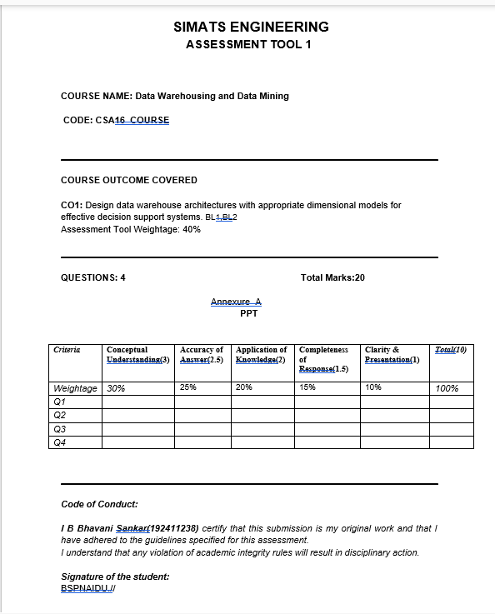

Slide 2
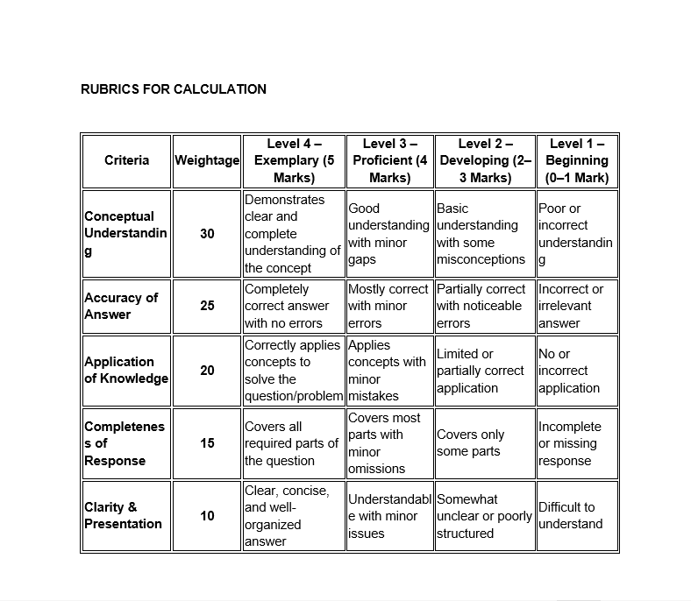

Slide 3
From Raw Data to Business Intelligence
Presented By
Bhavani Shanker Bhale
CSA1603

Slide 4

What is a Data Warehouse?
Central repository that stores business data.
Collects data from multiple sources.
Organizes data for easy analysis.
Supports reporting and decision-making.
Improves business performance and planning.

Slide 5
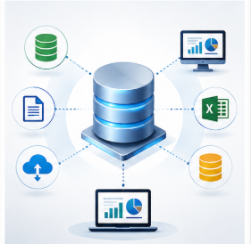
How Data Warehouse Works
Working Process (ETL)
Extract – Collect data from different sources.
Transform – Clean and organize the data.
Load – Store data in the warehouse.
Generate reports and dashboards.
Help managers make smart decisions.

Slide 6
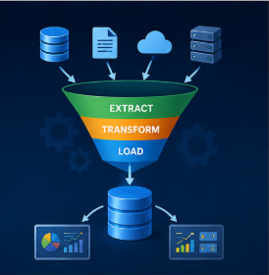
Characteristics
Characteristics of Data Warehouse
Subject-Oriented – Organized by business topics.
Integrated – Combines data from many systems.
Time-Variant – Stores historical information.
Non-Volatile – Data remains stable after loading.
Provides accurate and consistent information.

Slide 7

Real World Applications
Amazon recommends products to customers.
Banks detect fraud and analyse transactions.
Hospitals maintain patient history.
Universities monitor student performance.
Businesses predict future sales trends.

Slide 8
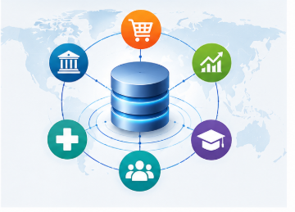
Conclusion
Stores large volumes of organized data.
Uses ETL to prepare quality data.
Supports Business Intelligence (BI).
Enables faster and smarter decisions.
"Data + Analysis = Business Success."

