Slide 1
RACE ORGANIZER
Group 8

Slide 2
Index
Purpose of the Application and its Architecture
Brief description of the process using SCRUM
Description of the use of YouTrack for Scrum and the integration with GitHub
Description of the use of Maven
Unit, Coverage and Performance Testing
Continuous Integration
Use of Doxygen and SLF4j
Use of Swagger
Events and Difficulties
<number>

Slide 3
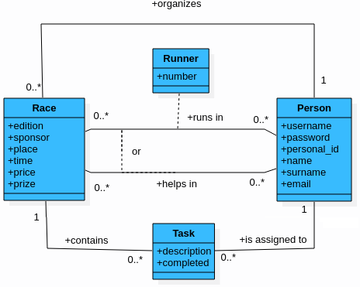
Purpose of the Application and its Architecture
Sign up into a race
Manage Race information
Manage tasks
REST client-server architecture
Server on Django
Client written in Java
MariaDB
<number>

Slide 4
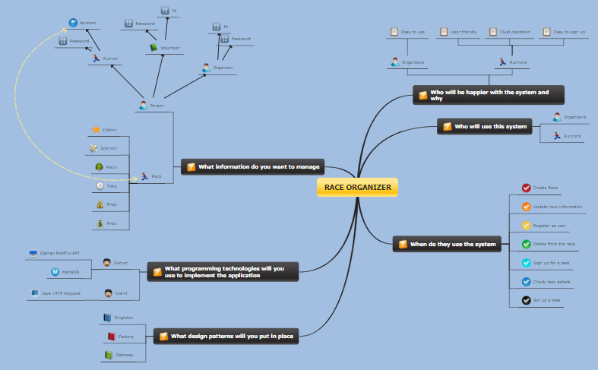
Brief description of the process using SCRUM
Product owner
Scrum master
Product backlog
Architecture
Mindmap
3 sprints of 2 weeks - Meetings
Planning
Review
Retrospective
<number>

Slide 5
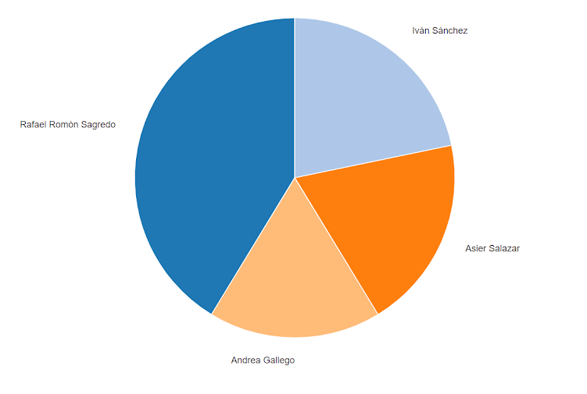
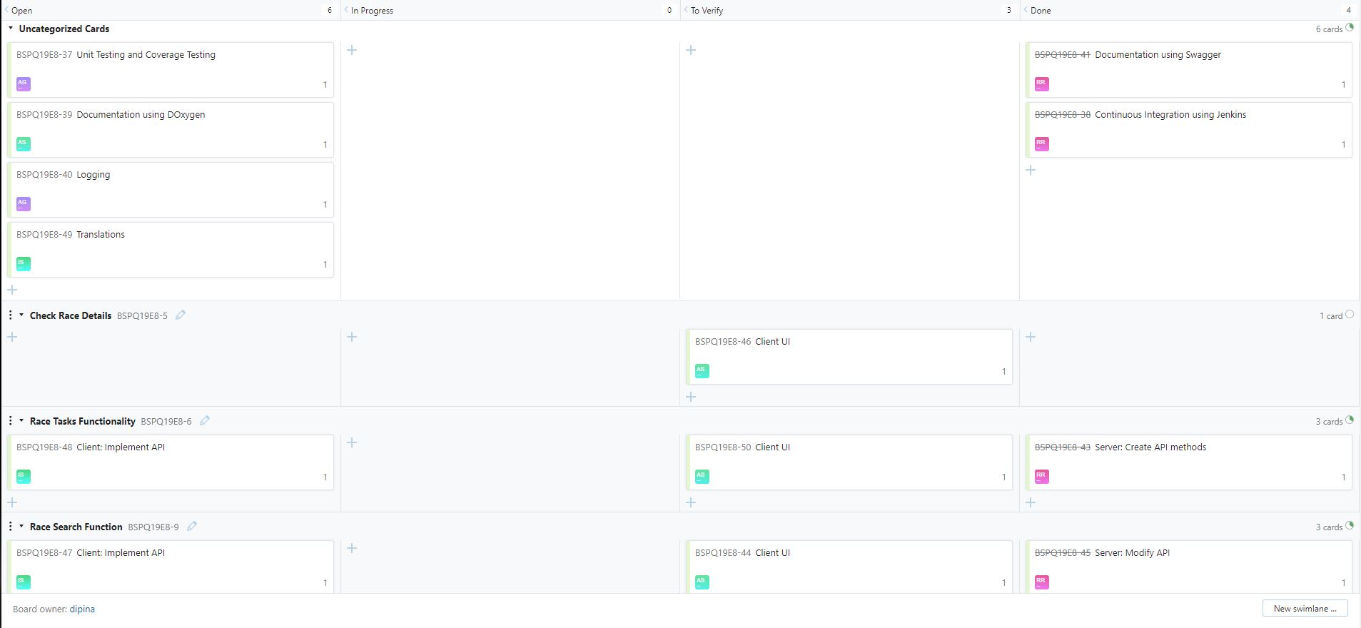
Description of the use of YouTrack for Scrum and the integration with GitHub
<number>

Slide 6
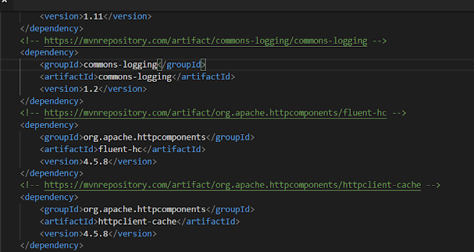
Description of the use of Maven
Run Client
Run Tests
Dependencies/Plugins
HttpComponents
commons-logging
JUnit
<number>

Slide 7
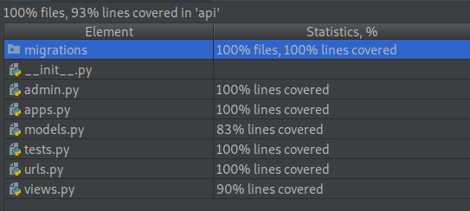
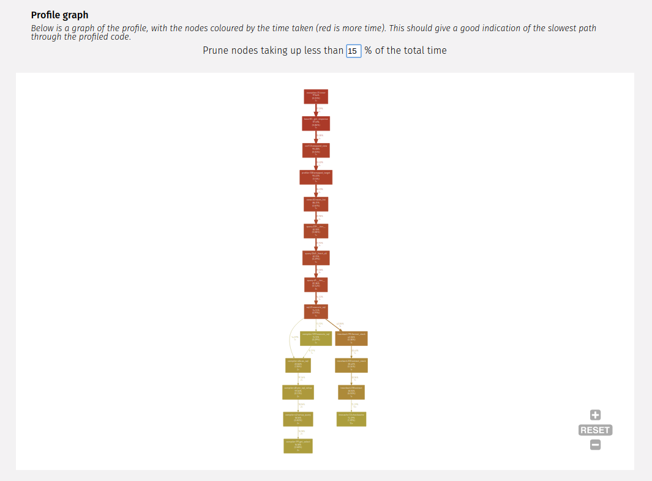
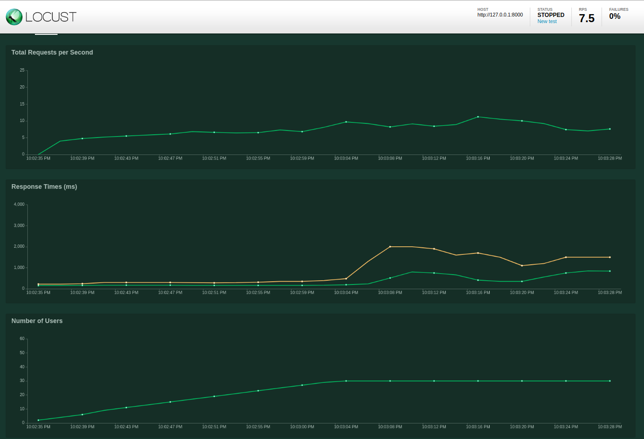
Unit, Coverage and Performance Testing
Server Test → 93% Coverage
Performance Testing using Locust
Profiling silk
<number>

Slide 8

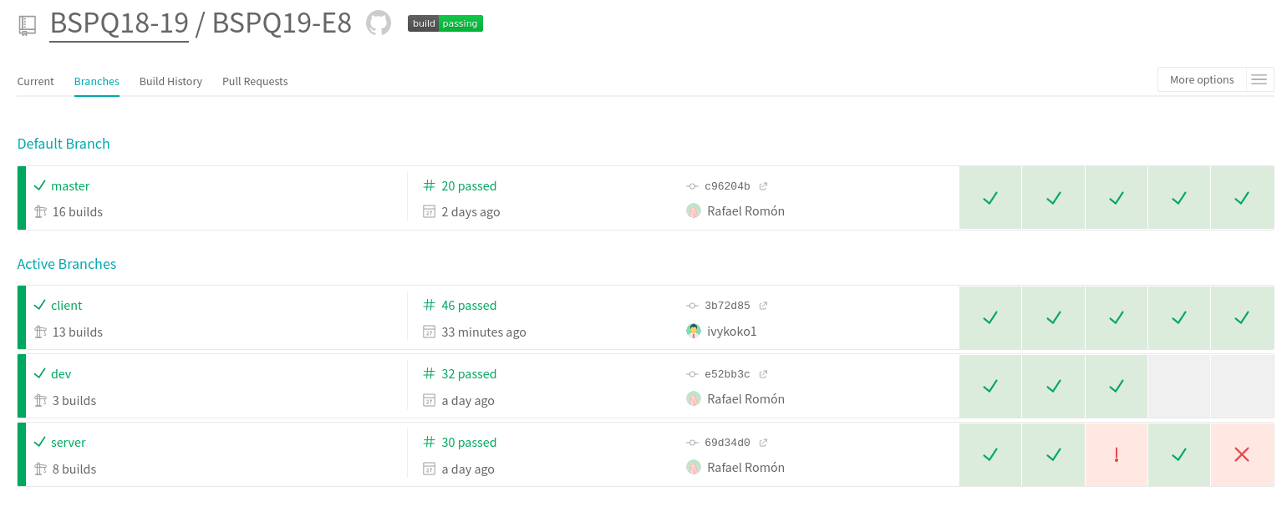
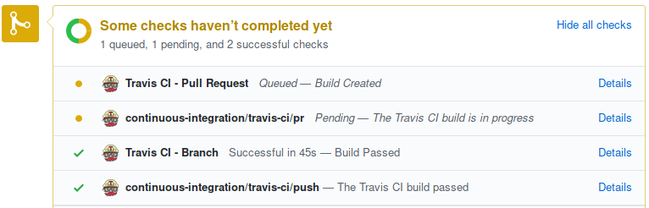
Continuous Integration
<number>

Slide 9

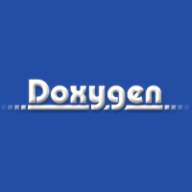
Use of Doxygen and SLF4j
Doxygen is an automated multi-language doc generator.
It allows to export docs to PDF, LaTeX or HTML.
Simple Logging Facade for Java (SLF4J) serves as a simple facade or abstraction for various logging frameworks such as Log4j, which we have used.
<number>

Slide 10
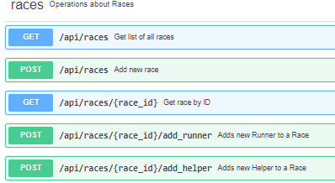
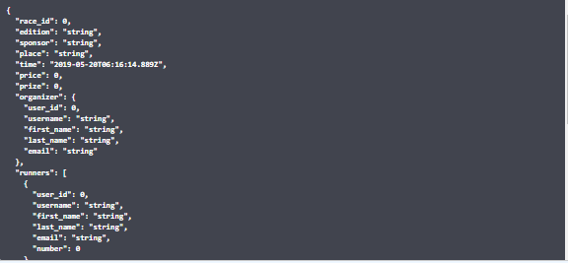
Use of Swagger
Swagger makes it easy to visualize RESTful APIs and their responses.
Documentation for the API follows the OpenAPI standard
<number>

Slide 11
Events and Difficulties
Main difficulty: integration and learning new technologies.
Lack of communication makes integration between two different platforms more difficult.
Server DB creation difficulties using MySQL instead of MariaDB.
Adapting to use a project management tool, like YouTrack.
Time management.
<number>

Slide 12
Demo
<number>

