Slide 1

Campus Pay:
Smart Card Café System
Cloud-based RFID POS Solution deployed on AWS
Group Members:
Mustansar Tanwir (BSSE23027)
M. Hasham (BSSE23053)
M. Abdullah (BSSE23087)

Slide 2
Executive Summary
Smart POS system for university cafés
RFID-based student authentication
Mobile ordering with wallet payments
Scalable backend deployed on AWS

Slide 3
Problem Statement
Manual café queues cause delays
Cash handling is inefficient
No centralized café management
Lack of real-time order confirmation

Slide 4
Proposed Solution
Centralized POS platform
Student mobile app for ordering
RFID-based order confirmation
Secure wallet-based payments

Slide 5
System Architecture
Web portal for cafés
Mobile app for students
RFID POS device
AWS-hosted backend services

Slide 6
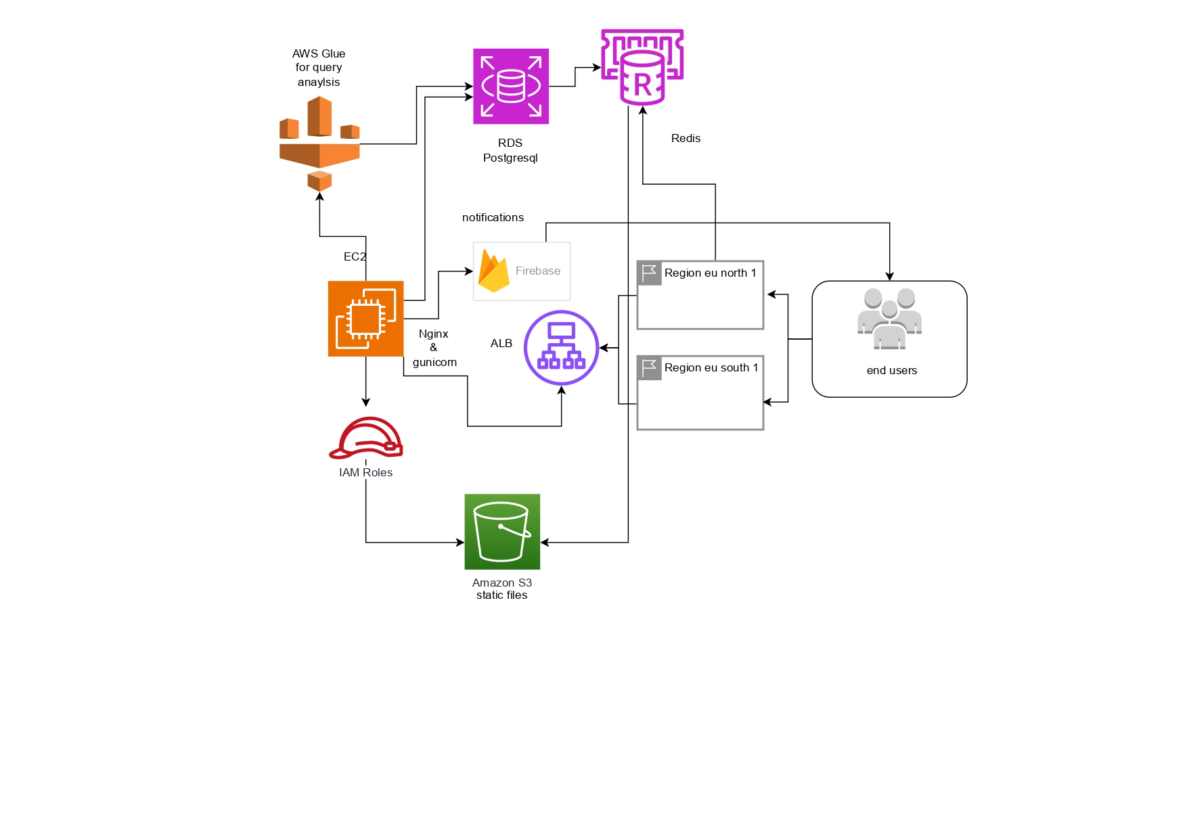
AWS Architecture Diagram

Slide 7
Implementation – Backend
Django backend on EC2
Nginx as reverse proxy
Gunicorn as WSGI server
Application Load Balancer for routing

Slide 8
Implementation – Data Layer
Amazon RDS (PostgreSQL)
Redis for caching & sessions
Amazon S3 for static files

Slide 9
RFID & Notification Flow
RFID scan triggers backend API
Student identified from database
Firebase sends push notification
Student confirms order

Slide 10
Payment & Security
Wallet balance verification
Atomic database transactions
IAM roles & security groups
No direct DB public access

Slide 11
AWS Deployment Steps
IAM configuration
EC2 & ALB setup
RDS & Redis configuration
Backend deployment

Slide 12
Results
Reduced waiting time
Cashless transactions
Scalable architecture
Improved operational efficiency

Slide 13
Conclusion
End-to-end cloud POS solution
Secure and scalable backend
Designed for university-scale usage

