Slide 1


Serverless Stock
Portfolio Tracker
Cloud-Native Real-Time Investment Management
Group Members
Muhammad Daniyal Hammad
Mohsin Raza
Eashal Yasin

Slide 2
EXECUTIVE SUMMARY
The Serverless Real-Time Stock Portfolio Tracker is an AWS-based web application that allows users to manage and monitor stock portfolios in real time without managing servers. It uses S3 and CloudFront for a fast and secure frontend, API Gateway and AWS Lambda for backend logic, and DynamoDB for scalable data storage. Live stock prices are fetched from external APIs, while Secrets Manager and IAM ensure security. The serverless design provides automatic scalability, low cost through pay-as-you-go pricing, and reliable performance with built-in monitoring via CloudWatch.
100%
Serverless Architecture

Slide 3

INTRODUCTION & MARKET CONTEXT
The growth of digital investing has enabled more individuals, especially students and small investors, to participate in stock markets. However, many still rely on manual or fragmented tools for portfolio tracking, which often results in delayed data, errors, and limited insight into real-time performance.
The Serverless Real-Time Stock Portfolio Tracker solves this problem using a modern AWS serverless architecture. By leveraging services such as Lambda, API Gateway, and DynamoDB, it provides a scalable, secure, and cost-efficient platform that delivers real-time portfolio insights while eliminating the need for server management.

Slide 4
THE PROBLEM DEFINITION
Fragmentation: Investors often use multiple trading platforms, resulting in scattered data and no single, unified view of portfolio performance.
Manual Calculations: Reliance on spreadsheets or manual records makes portfolio management time-consuming and susceptible to human errors.
Latency: In stock tracking systems, high latency causes delayed price updates, reducing accuracy and timely decision-making.
Security: Insufficient security controls in basic tools expose sensitive financial data to potential breaches.

Slide 5



AIMS & OBJECTIVES
Main Aim
Cloud Logic
Data Integrity
To develop a serverless, cloud-based stock portfolio tracking system on AWS that allows real-time monitoring of investments, combining ease of use with scalability and cost efficiency.
Leverage AWS serverless services such as Lambda, API Gateway, and DynamoDB to handle all backend operations automatically, ensuring seamless execution of business logic without managing servers.
Ensure accurate, consistent, and secure portfolio data through DynamoDB storage, secure API communication, and strict access controls using IAM, maintaining reliability and trustworthiness of financial information.

Slide 6
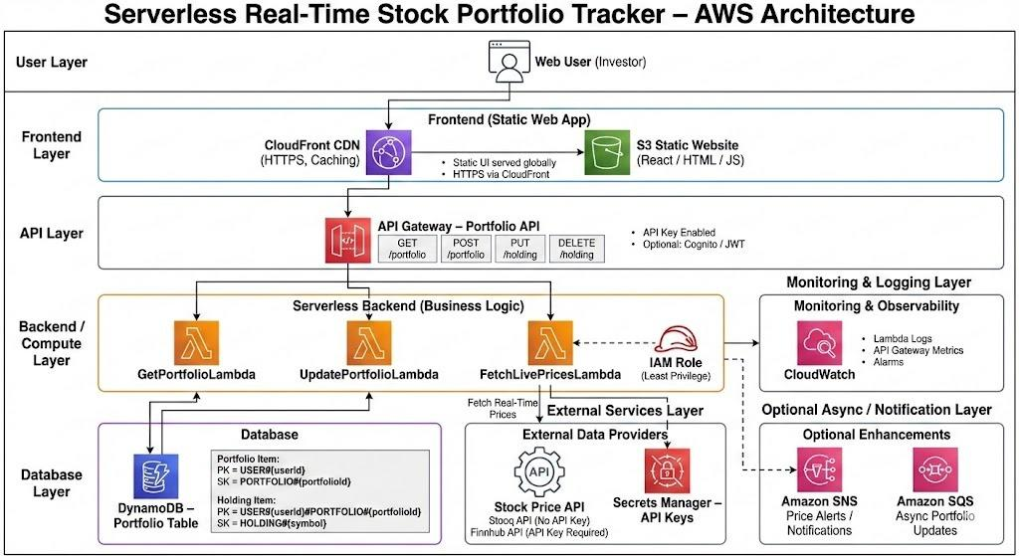
COMPLETE ARCHITECTURE FLOW
Unified Workflow
1. User Interaction: S3-hosted Static Frontend.
2. Entry Point: API Gateway secure HTTPS request.
3. Business Logic: Lambda processing and P/L math.
4. Data Fetch: External Finnhub API Integration.
5. Persistence: DynamoDB NoSQL storage.

Slide 7
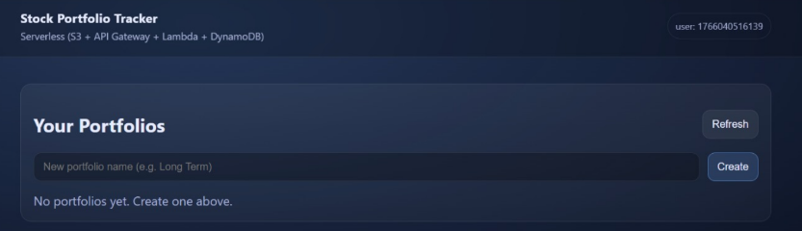
FRONTEND: AMAZON S3 HOSTING
Static Web Hosting
The frontend is a React SPA hosted on Amazon S3 using Static Website Hosting, providing a serverless, durable, and cost-effective solution. In production, content is served securely via CloudFront, which reduces latency, enforces HTTPS, and lowers S3 costs through global caching. The frontend runs entirely in the browser and communicates with the backend through API Gateway to fetch real-time data. This setup ensures zero server management, automatic scalability, high durability, and efficient content delivery worldwide.

Slide 8
API LAYER: AMAZON API GATEWAY
Secure REST Endpoints:Amazon API Gateway acts as the managed "front door" for all frontend requests, exposing RESTful APIs that allow users to view and manage their portfolio or fetch live stock prices. It abstracts the backend complexity while providing a consistent and secure interface for the client.
CORS & Throttling: API Gateway handles cross-origin requests from the frontend, ensuring browser security, and implements throttling and rate limiting to protect backend services from traffic spikes or abuse, maintaining system stability and cost efficiency.
Trigger Mechanism: It seamlessly routes incoming requests to the appropriate AWS Lambda functions (e.g., Add Stock, Update Portfolio, View Holdings) and returns the processed results to the client, enabling real-time interaction between the frontend and the serverless backend.

Slide 9

BACKEND LOGIC: AWS LAMBDA
Zero Management Compute
AWS Lambda runs backend code in response to events, requiring no server provisioning or maintenance. It operates on a pay-per-use basis, costing nothing when idle.
Key Logic & Financial Algorithms: Lambda handles core calculations, including market value, real-time profit/loss, and portfolio aggregation to provide accurate, up-to-date investment insights.
CRUD Operations & External Integration: Functions manage portfolio operations (Add, View, Update, Delete) and fetch live stock prices from external APIs like Finnhub, feeding real-time data into calculations.
Key Logic:
• Add stock to holding
• Calculate Market Value
• Compute Real-time P/L

Slide 10

DATA LAYER: AMAZON DYNAMODB
High-Speed Persistence
DynamoDB provides fast, single-digit millisecond data access, ensuring portfolio information is retrieved and updated instantly.
Fully Managed NoSQL: As a serverless key-value store, it handles replication, durability, and schema flexibility without manual maintenance.
Investor Data Storage: The database stores user holdings with User ID as the partition key and Stock Symbol as the sort key, along with attributes like quantity, average buy price, and timestamp.
Scalability & Performance: DynamoDB auto-scales to handle traffic spikes and maintains consistent low-latency performance, ensuring a responsive user experience.

Slide 11


REAL-TIME DATA INTEGRATION
Finnhub API
Mock Provider
Acts as a fallback during development, demos, or when API limits are reached, generating realistic price data to keep the application functional.
Connects to live market APIs to fetch current stock prices ($P_c$) instantly, ensuring accurate portfolio valuation and real-time P/L calculations.

Slide 12

MATHEMATICAL CALCULATION MODEL
1. Market Value Calculation
2. Unrealized Profit / Loss

Slide 13

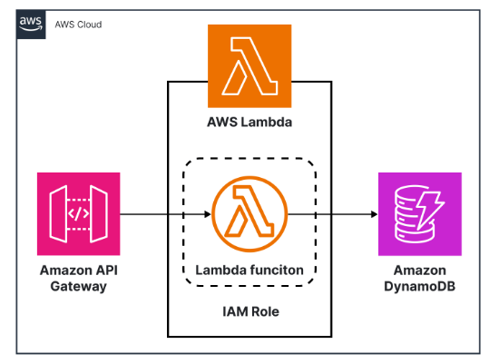
MONITORING & OBSERVABILITY
Amazon CloudWatch
Amazon CloudWatch provides centralized monitoring for the serverless architecture, allowing real-time visibility into the health of Lambda, API Gateway, and DynamoDB without needing direct server access.
Usage:
• Debugging Lambda executions.
• Monitoring API latency spikes.
• Tracking cold start performance.

Slide 14
KEY PROJECT BENEFITS
Scalability: Automatically handles bursts of traffic during market open/close.
Cost Efficiency: No idle server costs; only pay for what you compute.
Speed: Real-time price fetching ensures up-to-the-minute P/L accuracy.
Security: IAM roles ensure strict data access policies (Least Privilege).

Slide 15
Thank You
Serverless Real-Time Stock Portfolio Tracker
Any Questions?

