Slide 1

AWS Full-Stack Deployment of CineVerse
A Cloud-Based Web Application
Presented By:
M. Umair
Hazim
University:
Information Technology University (ITU), Lahore
IEEE Software Engineering & Cloud Architecture Standards

Slide 2

Project Overview
Frontend: React.js (Amazon S3)
Backend: NestJS (Amazon EC2)
Database: PostgreSQL
Objective:
Deploy a scalable full-stack application using AWS

Slide 3
AWS Architecture Overview
Amazon S3 – Frontend Hosting
Amazon EC2 – Backend API
Elastic IP – Public Access
Security Groups – Network Firewall
Design Principles:
Modularity, Scalability, Separation of Concerns

Slide 4
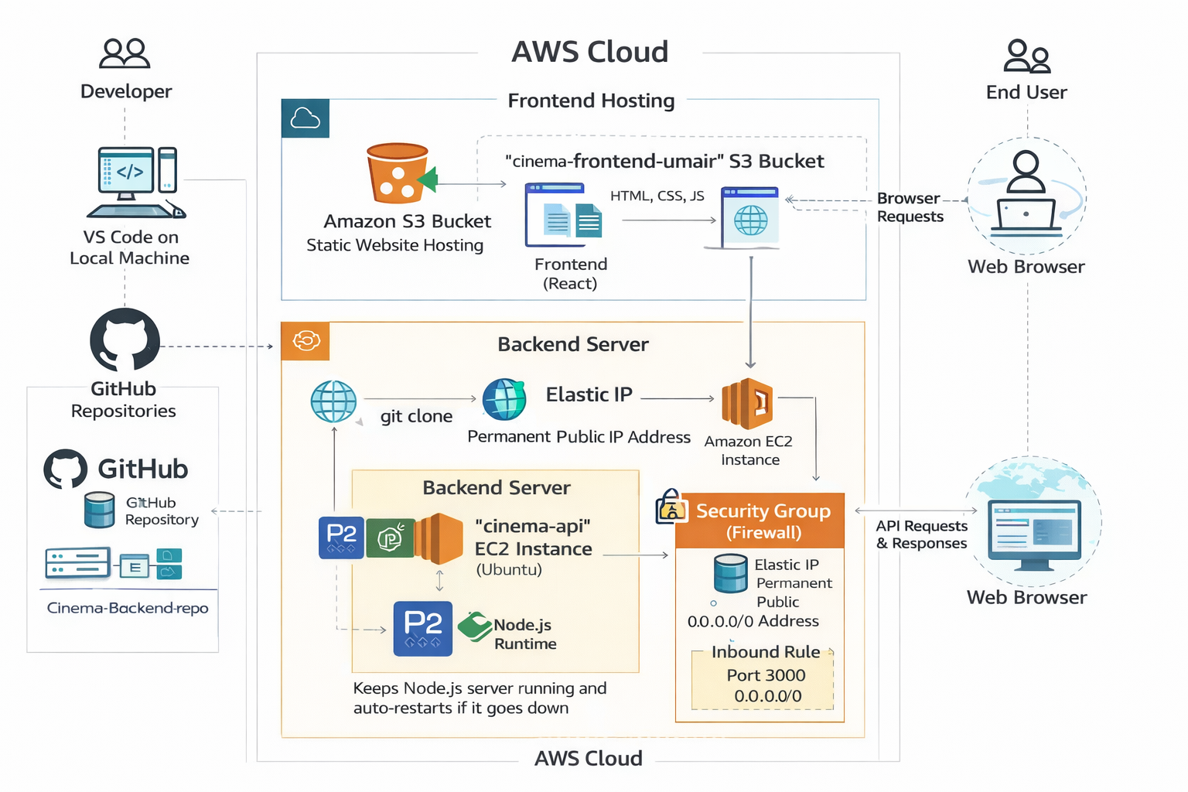

Slide 5
Frontend Deployment
React Build using npm
Static files hosted on Amazon S3
Public access enabled
Benefits:
Low Cost, High Availability, Fast Access

Slide 6
Backend Deployment
NestJS on Ubuntu EC2
PM2 for process management
Elastic IP for stable access
Security Groups allow API traffic

Slide 7
Conclusion & IEEE Compliance
Successful AWS Deployment
Reliable Cloud Architecture
IEEE Design Principles Followed
Future Work:
HTTPS, CI/CD, Amazon RDS

Slide 8

Thank you

